Slide 1
Building New Support
Building Welcome / Welcome Back Strategies

Slide 3
Big Idea
The time and effort you put into
loving new donors
and retaining them as friends
is worth it.

Slide 4
Hearts and Minds
Attitude of Gratitude
Warmth and appreciation
Community and Connection
Jewish Identity
Honest information and sharing
Attention, responsiveness, timeliness
Personalized, “You”
CULTURE OF PHILANTHROPY

Slide 5
Structures
This workshop will cover such things as . . . .
Life-time value of new donors
New sources of support
Donor Life Cycle
Donor Journey Maps
New Donor Welcome Packets
CULTURE OF PHILANTHROPY

Slide 6
Behaviors
What happens after this workshop?
How to prioritize and implement new ideas and learning?
Whose job is it?
How skilled are you in the use of your Donor Database?
Will it stick with the staff?
CULTURE OF PHILANTHROPY

Slide 7
Sad Story of Donor Retention
Fundraising Effectiveness Project (FEP) comparing the first six months of 2018 with those of 2017:
Total donors are down 6.6%
New donors are down 9.2%
For the past decade overall donor retention rates have been below 50% and continue to decline. (The overall rate now stands at 45.5%.)
New Donor Retention now stands at 23%
Repeat or Multi-year Donor Retention at 60%.

Slide 8
One Jewish Camp
The Average 5-year Lifetime Value of a Donor: $2,238
After removing tribute donors that have no relationship to our Camp to generate this figure,
The New Donor Retention Rate in 2017: 41.7% vs. 23%
Overall Donor Retention Rate in 2017: 60.57% vs. 45.5%

Slide 9
First Gift
Major or Stretch Giving
Legacy
Second Gift
Active: Second year in a row or monthly giving
Deborah Polivy:
Donor Lifecycle Map
Multi-Year Active

Slide 10
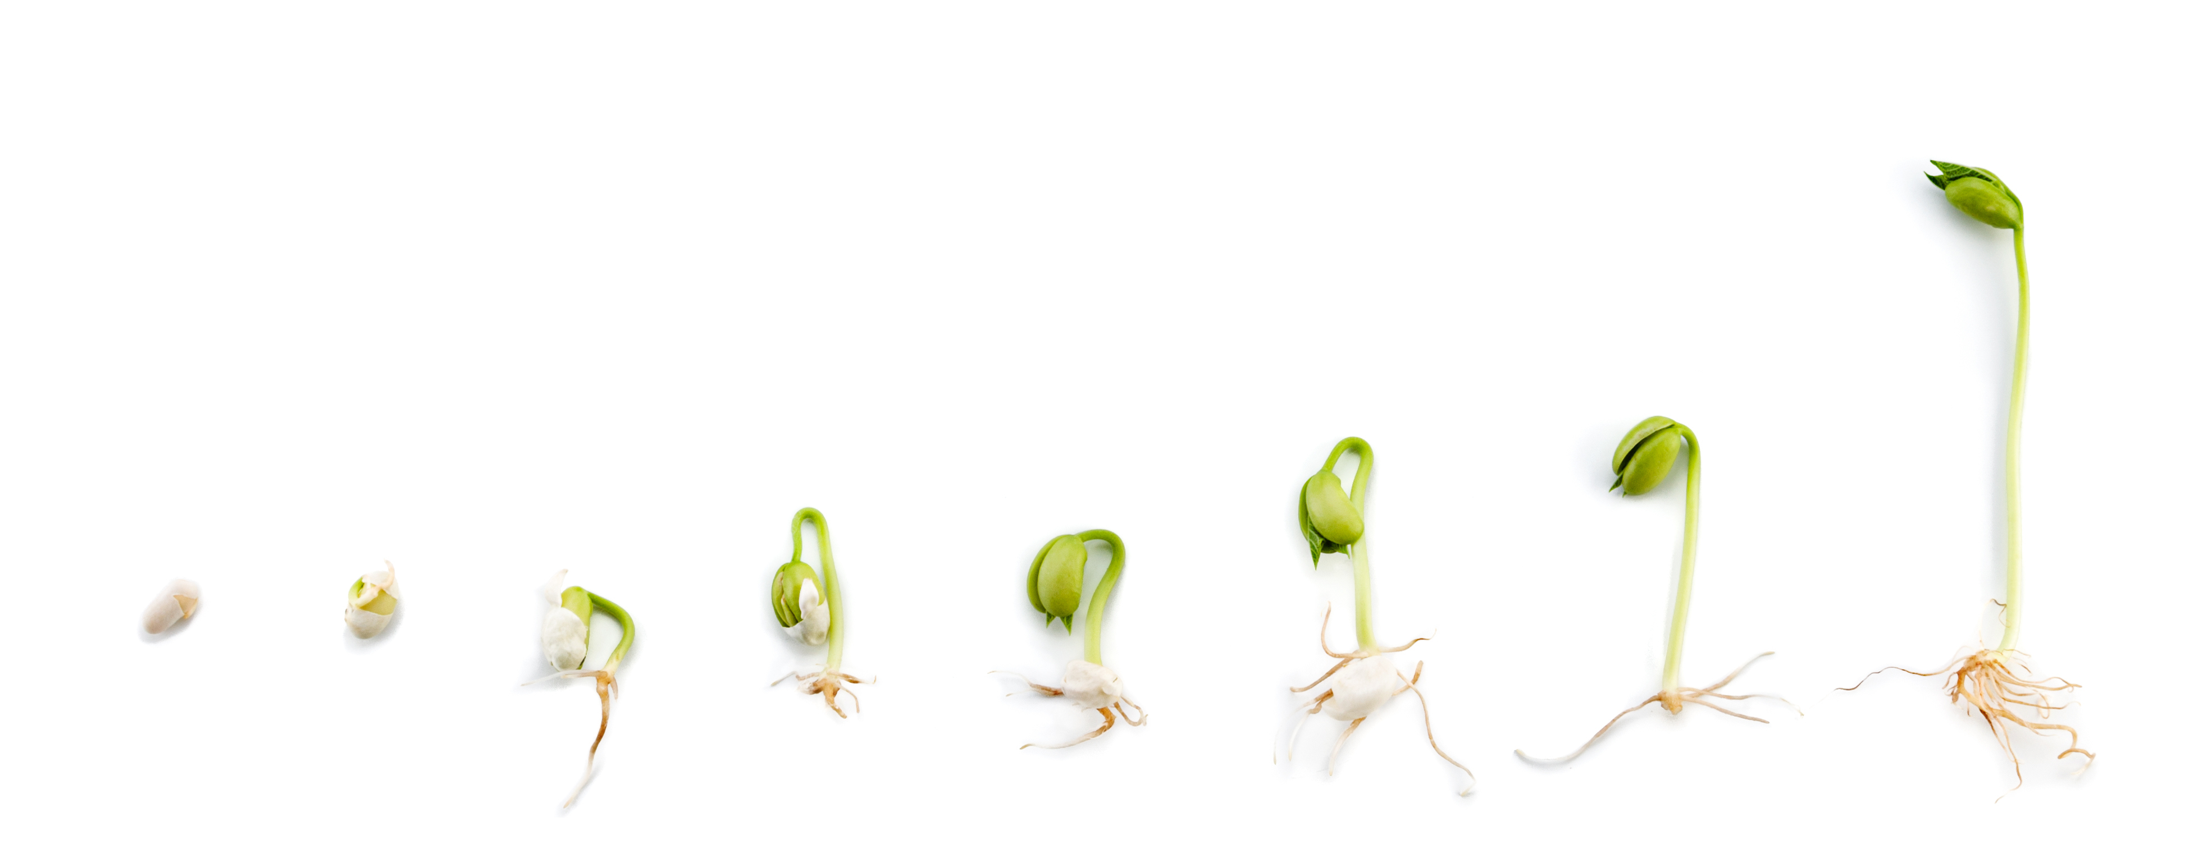
Average bequest $35,000 to $70,000

Slide 11
Legacy: $50,000+
First Gift: $180
Major or Stretch Giving: $10,000
Second Gift
Active: Second year in a row or monthly giving
Deborah Polivy:
Donor Lifecycle Map
Multi-Year Active: 5 yr average $2,000

Slide 12
Who are your new sources of support?
Current Parents
Grateful Past Parents
Current Grandparents
Current Staff
Alumni – older
Alumni – younger
Past Staff (not Alumni?)
Friends of the above / Friends of Honorees

Slide 13
Who are your new sources of support?
Current Parents
Grateful Past Parents
Current Grandparents
Current Staff
Alumni – older
Alumni – younger
Past Staff (non Alumni?)
Friends of the above / Friends of Honorees

Slide 14
Why Give?
Why should I give?

Slide 15
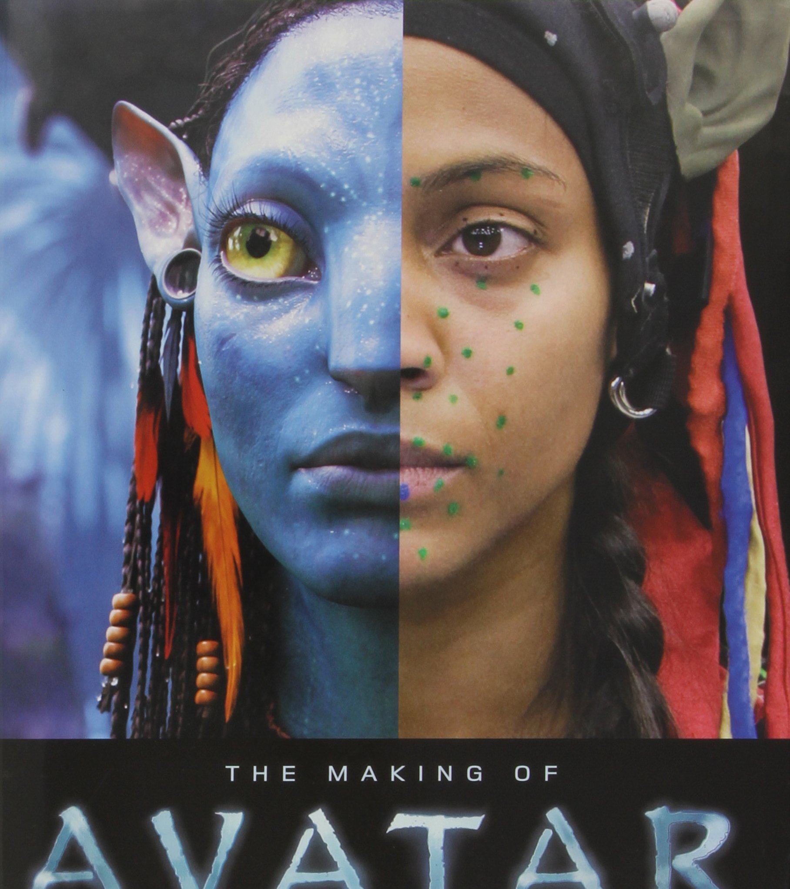
Avatars
Who is she?
Why does she care about your Camp?
Where does she live?
What is her/ her family’s Jewish identity?
What other types of organization does she donate to?
How busy is she these days?

Slide 16
List 10 reasons why she DOES NOT donate to your Camp.

Slide 17
Talk to me!
Give her explicate answers to her specific reasons why she does not give

Slide 18
Donor Journey Map

Slide 20
Ask Join Thank Commitment Thank Steward
Donor Journey Map

Slide 21
Journey Map
ASK
Easy to give
Quick Thank You
WELCOME Packet
REPORT
Celebrate
ASK Again

Slide 22
Journey Map
Appeal Letter?
Visitors Day?
On-line?
Where does the request for support show up?
Welcome first? Then Ask?
ASK
Easy to give
Quick Thank You
WELCOME Packet
REPORT
Celebrate
ASK Again

Slide 23
Journey Map
Mail
Paper
Online
Camper
Registration
ASK
Easy to give
Quick Thank You
WELCOME Packet
REPORT
Celebrate
ASK Again

Slide 24
Journey Map
Formal
And Personal
(Text Msg
Written card
Or Email)
ASK
Easy to give
Quick Thank You
WELCOME Packet
REPORT
Celebrate
ASK Again

Slide 25
Journey Map
1st time donor
Wow me,
What to expect
Survey ME!
-Jewish ID
-Why love Camp?
-What would you like?
ASK
Easy to give
Quick Thank You
WELCOME Packet
REPORT
Celebrate
ASK Again

Slide 26
Journey Map
Impact of my gift
What difference does it make?
ASK
Easy to give
Quick Thank You
WELCOME Packet
REPORT
Celebrate
ASK Again
Stories of Impact.
Donor is the hero of the story, not Camp.
Because of YOU!

Slide 27
Journey Map
Birthday cards
Or anniversary of donation card
Camper thank you card
Personal Invitations
ASK
Easy to give
Quick Thank You
WELCOME Packet
REPORT
Celebrate
ASK Again

Slide 28
Journey Map
ASK
Easy to give
Quick Thank You
WELCOME Packet
REPORT
Celebrate
ASK Again

Slide 29
Welcome Back Letter – No ask for donations

Slide 30
Donor Journey Map for your Avatar
ASK
Easy to give
Quick Thank You
WELCOME Packet
REPORT
Celebrate
ASK Again

Slide 31
Longing for belonging

Slide 32
Belonging,
Identity,
And
Purpose
Notes:
A feeling of Belonging – a connection to something that you long to remember

Slide 33
Big Idea
The time and effort you put into
loving new donors
and retaining them as friends
is worth it.

