Slide 1
Camp Daisy and Harry Stein 2015-2020 Strategic Plan February 25, 2015

Slide 2
Agenda
1.
Introduction
2.
Vision and Mission
3.
Five Year Plan
2

Slide 3
2015-2020 Strategic Plan The Process
Objective: Prepare a 5 year plan to guide Camp Stein‘s growth and development
Planning process started in May, 2014
Partnered with JCamp180 and hired experienced consultant, Royster Hedgepeth, to lead the process
Held two workshops over five month period, with group feedback opportunities along the way
Engaged Camp Committee, CBI Board members, Clergy, and friends of camp: ~40 people
Final plan completed in January, 2015
There is a robust and inspiring plan to drive Camp Stein’s future
3

Slide 4
2015-2020 Strategic Plan Camp Stein Today: Current State
Highest enrollment in past 2 years, waiting lists in some bunks / sessions
Highly engaged Staff and Camp Committee
Successful first phase capital campaign
Investment in new programming i.e. Tennis!
Growing off-season revenue
Area of growing population
Reaching capacity in some areas
Aging facility needing investment / maintenance
Investment cannot be supported by camper fees alone
Limited engagement and awareness from other Congregations and Jewish communities in the Southwest
4

Slide 5
2015-2020 Strategic Plan Aspirations for the Future
Powerful, transformative effect Jewish summer camp has on campers and families
The role Jewish summer camp plays in developing new generations of Jewish leaders
The desire to strengthen Camp Stein’s capacity to provide a quality summer camp experience, serve more campers, and enhance its capacity for year-round service
Perception of Camp Stein’s potential for growth and its ability to serve the Reform communities in the Southwest
5

Slide 6
Agenda
1.
Introduction
2.
Vision and Mission
3.
Five Year Plan
6

Slide 7
2015-2020 Strategic Plan Vision and Mission
Vision
Be the leading Jewish outdoor camping experience in the Southwest, and to be the first choice of campers, staff, and community participants
Mission
To create sacred communities of living Judaism that endow children, youth, and adults with a positive Jewish identity, personal growth and self-esteem, and life-long friendships and role models
29K camper age Jewish kids
11K in AZ alone
~ 3K attend camp
~400 attend Camp Stein
7

Slide 8
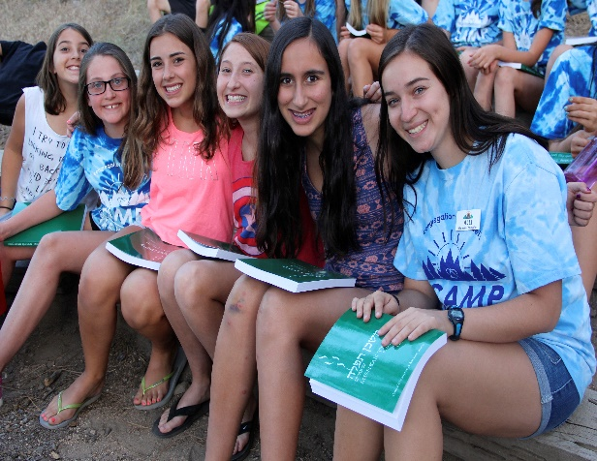
2015-2020 Strategic Plan Vision and Mission
Superior Camp Experience
Develop strong, confident Jewish identity
Form positive, supportive life-long relationships
Cultivate and enhance self-confidence and independance
Gain leadership skills as idividuals and as community leaders
Year-round Center for Youth Engagement
Deepen and enrich the summer camp experience
Expand opportunities for educating Jewish youth and forming future Jewish leaders
Serve as an eduction and resource center for the greater Southwest communities
8

Slide 9
2015-2020 Strategic Plan Core Values
Kehillah
Community – the sense of belonging to something bigger than the self inspires kavod (respect) and chesed (kindness), and forms a safe space for learning and growing
In the Image of God – Staff members and campers model the importance of appreciating differences, honoring their own bodies and minds, and taking care of each other
B‘Tzelem Elohim
Hachnasat Orchim
Welcoming Guests – a sense of belonging brings people back each summer, but also for newcomers to be warmly welcome
Core Values
Kavanah
Clal Yisrael
Unity of the Jewish People – sense of belonging rooted in the camp community and a love for the land and people of Israel
Spirituality - Camp is where Judiasm comes to life through hidur mitzvah (creativity), simcha (celebration), and ruach (spirit)
Tikkun Olam
Repairing the World – the physical space of camp becomes the learning place for teva (nature)
9

Slide 10
Agenda
1.
Introduction
2.
Vision and Mission
3.
Five Year Plan
10

Slide 11
2015-2020 Strategic Plan Strategic Objectives
Leading Jewish Outdoor Camp Experience
Competitive and contemporary Jewish outdoor camping experience
Financially Healthy
Financially healthy and sustainable
Southwest Presence
Strong presence and capacity for service throughout the southwestern United States
Strong Governance
Goverened by a strong, performance-based Camp Committee and related Sub-committees
11

Slide 12
2015-2020 Strategic Plan Strategic Goals
Leading Jewish Outdoor Camp Experience
Financially Healthy and Sustainable
Southwest Presence
Strong Governance
Ensure that the camps programs are leading, contemporary, and competitive
Focus on staff training, leadership development, and continuity
Provide modern, updated and expanded facilities based on the plan for program, staff, and enrollment growth
Achieve full capacity during the summer sessions
Create year-round income from the Camp
Develop a vibrant progam of private support
Develop a highly engaged Professional Advisory Committee
Expand recruitment efforts throughout Southwest
Develop a first-class Center for Youth Engagement, Education, and Leadership development
Develop a strong performance-based Camp Committee
Establish effective Sub-committees to focus on:
Planning and Development
Marketing/PR
Alumni Development
Finance and Scholorship
Facilities
Professional Advisory Committee
12

Slide 13
2015-2020 Strategic Plan Action Plans
 |  |  | 2015 |  |  |  | 2016 |  |  |  | 2017 | 2018 | 2019
Strategic Objective | Goals | Actions | q1 | q2 | q3 | q4 | q1 | q2 | q3 | q4
Leading Jewish Outdoor Camp Experience | Ensure camps programs are leading, contemporary, and competitive | Create a Planning and Development Sub-committee Develop a Program Master Plan
 | Focus on staff training, leadership development, and continuity | Provide year-round training for Staff Expand Ozrim program Implement a Leadership Certificate Program for Staff Implement a Staff satisfaction assessment process
 | Provide modern, updated, and expanded facilities based on the plan for program, staff, and growth | Create a Facilities Sub-committee Create a multi-year Facilities Master Plan Create a multi-year Fundraising Plan
13

Slide 14
2015-2020 Strategic Plan Action Plans
 |  |  | 2015 |  |  |  | 2016 |  |  |  | 2017 | 2018 | 2019
Strategic Objective | Goals | Actions | q1 | q2 | q3 | q4 | q1 | q2 | q3 | q4
Financially healthy and sustainable | Achieve full capacity during the summer sessions | Create marketing and PR program Develop Ambassador program Expand opportunities for financial assistance
 | Generate year-round income from the camp | Create marketing program Incorporate requirements for year-round use into Facilities Master plan Develop other camp programs outside of camp i.e travel camp, day camp, adult camp, etc.
 | Develop a vibrant program of private support | Develop a comprehensive fundraising plan Develop alumni relations program Explore adding professional Development Director to staff
14

Slide 15
2015-2020 Strategic Plan Action Plans
 |  |  | 2015 |  |  |  | 2016 |  |  |  | 2017 | 2018 | 2019
Strategic Objective | Goals | Actions | q1 | q2 | q3 | q4 | q1 | q2 | q3 | q4
Southwest Presence | Develop an engaged Professional Advisory Committee | Initiate conversation and engagement with other Congregations, lay leaders, and prospective donors Develop a PR plan to engage and inform other Congregations and communities of interest
 | Expand recruiting activities throughout the Southwest | Expand greater Phoenix and other Arizona recruiting activities Focus recruitment on key states of Nevada, New Mexico, Colorado, and Utah
 | Develop a first-class Center for Youth Engagement, Education, and Leadership | Define vision for Center Develop programming to support year-round youth engagement Explore adding full-time Event Manager resource to staff
15

Slide 16
2015-2020 Strategic Plan Action Plans
 |  |  | 2015 |  |  |  | 2016 |  |  |  | 2017 | 2018 | 2019
Strategic Objective | Goals | Actions | q1 | q2 | q3 | q4 | q1 | q2 | q3 | q4
Strong Governance | Develop a strong, performance-based Camp Committee | Implement Sub-committee structure to support the strategic plan Implement an Executive Committee to provide oversight and governance, represent camp to the CBI BOD
 | Establish effective operating Sub-committees | Implement the Sub-committee structure to support the implementation of the strategic plan Develop time-phased implementation plans for each Sub-committee that prioritizes activities and actions
16

Slide 17
2015-2020 Strategic Plan Camper Growth Projection
Requires growth in cabins and dining facility
Camper Growth Projections
Opportunity for growth of at least 25%
Most growth from Arizona
Need to achieve fair share of Southwest
Potential for 600+ campers by 2020
29K camper age Jewish kids
11K in AZ alone
~ 3K attend camp
~400 attend Camp Stein
17

Slide 18
2015-2020 Strategic Plan Building Blocks
The Progam Master Plan is the basis for all other Plans
Phase 2 Funding will support the mid-term investments in programming and facilities - $1-2MM
The Phase 3 Fundraising Plan will support the development of the Center - $2-3MM
Program Master Plan
Facilities Master Plan
Phase 2 Funding Raising Plan
Center for Youth Engagement Plan
Phase 3 Fundraising Plan
Staffing and Resource Plan
The Facilities Master Plan will detail the long-term phased plan to support the Program Master Plan
The Center for Youth Engagement Plan will detail the long-term phased plan to develop a world-class Center
The Staffing and Resource Plan will support the developement of the Programming, Facilities, and Center
18

Slide 19
2015-2020 Strategic Plan Summary
Vision is to be the leading Jewish outdoor camping experience in the Southwest
We can create a leading Center for youth engagement and leadership development
Based on a strong Progam and Facilities Master Plans
The potential for growth is real
60+% more kids will go to camp
and the BEST team!
$3-5MM+ This will require significant capital funding
19

Slide 20
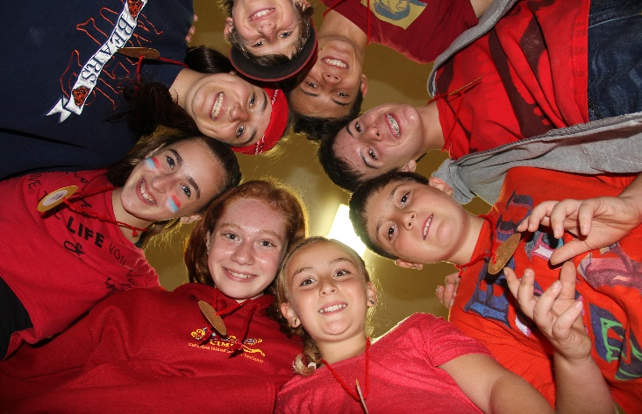
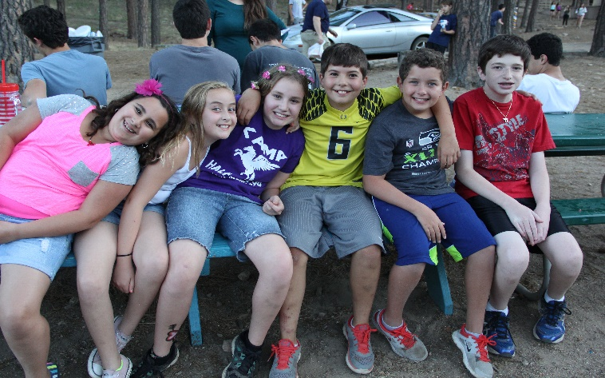
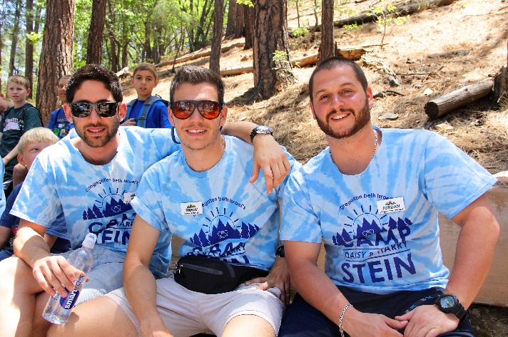
Thank you!

