Slide 1

Financial Visibility
A Template to Track Finances and Keep
Your Board Informed
Mark Gold
(mark@hgf.org)
October, 2019

Slide 2
Workshop Take-aways
Best practices in budgeting and budget presentation
  Suggestions will focus on camp budgeting
Samples of best practices in action
Template you can use

Slide 3
Parent Organization
Applies to larger organization (Synagogue, JCC) or even a camp that has non-camp activities supported by income and expenses:
  Year around programming
  Retreat Center

Slide 4
Parent Organization
Best Practices
Program components must equal overall budget
There is probably a central administration cost that has minimal associated revenue
Allocate the excess central administration costs to the operating departments that have revenue
For camps with other activities, separate camp operations from non-camp operations

Slide 5
Budget Overview
The budget should be built from the bottom up
  Revenue assumptions (enrollment)
  Fundraising history
Separate operating budget from capital budget
Don’t use aspirational fundraising revenue to plug a poor budget
Expenses should be based on available revenue, and not on historical operations.

Slide 6
Budget Overview
Best Practices
Show multiple years
  Minimum of two prior years (eliminates the one-year outlier)
  Show current year budget, year-to-date, and forecast
  Show next year plan
Include sufficient detail to show operations
  Account for summer spending surge in communications
Monthly summary and review by finance committee
Minimum of quarterly reviews by full board

Slide 7
Budget Overview
Best Practices
Non-Camp Revenue
  If non-camp revenue has associated expenses, it should be tracked with a separate budget (e.g. retreat center or year-round programming) and only NET revenue allocated to the camp operations.

Slide 8
Budget Revenue
Tuition revenue should be calculated from enrollment assumptions
Budget a scholarship amount
Show all revenues that are relative to camp operations
Grants and Support:
  Allocations from Federations (annual support)
  Specialized or targeted grant support

Slide 9
Budget Revenue
Scholarships are an adjustment to revenue (not an expense):
  If scholarship demands exceeds available funds, RAISE MORE before you give it out.
  Manage scholarships to the available funds
  Camps have gone bankrupt based on “pay what you can afford”.

Slide 10
Budget Revenue
Capital campaign revenues are not operating funds
  If you include capital revenues, you need a separate line for capital expenses
  It’s OK to include capital income and expenses as long as the amount is small relative to the overall camp budget; Don’t do it when on a capital building spree.
Gifts to your endowment fund are not operating funds
TRACK THESE REVENUES SEPARATE FROM YOUR OPERATING BUDGET LEAST THEY GIVE YOU A FALSE SENSE OF SECURITY

Slide 11
Budget Revenue
Best Practices
Enrollment Assumptions:
  Build assumptions each year: session by session
  Include tuition and enrollment numbers
Capital Income and Expenses:
  Have a separate budget and spreadsheet
Camp Tuition
  List full tuition with no discounts
    Calculation based on campers, weeks, rate

Slide 12
Budget Revenue
Best Practices
Fundraising:
  Separate individual from institutional gifts
  Separate scholarship revenue, annual campaign revenue, endowment income

Slide 13
Budget Revenue
Best Practices
Tuition Discounts
  Set a budget line for each discount plan
    Makes impact of discount offerings visible
    Shows the impact of each discount
    Helps develop future discount offerings
  Adjust actuals based on response
Show scholarships as a discount to revenue:
  Separate need-based scholarship amount for accountability

Slide 14
Budget Expenses
Utilize expense categories that are consistent with industry-wide standards:
  Personnel - Operations - Occupancy
  Program - Office Expenses - Security
  Transportation - Bank Charges - Technology
  Travel - Laundry - Fundraising
  Medical - Utilities - Laundry
  Food - Pool / Water - Legal / Accounting
  Maintenance - Recruitment - Insurance

Slide 15
Budget Expenses
Use back-up worksheets as necessary to detail expense budgets

Slide 16
Budget Expenses
Require that adherence to budgets be managed by whoever is closed to the operations (particularly true for program expenses)
Put in place accountability and traceability standards
  Approvals in advance of expenditures
  Multiple levels of approval

Slide 17
Budget Expenses
Best Practices
Personnel
  The more detail the better: Particularly for seasonal staff
  Includes both direct and indirect costs
    Salaries and wages
    Benefits (taxes other than payroll deductions)
    Benefits (others)

Slide 18
Budget Expenses
Best Practices
Program Expenses
  Provide the program budget details to the program area director and make her/him responsible for adherence to the budget
  Break down program expenses to the lowest meaningful level of control
  Share the accounting ledger structure and insist that summer spending be allocated at the time money is spent (particularly important for credit card expenses)
  Track, track, track – especially during the summer

Slide 19
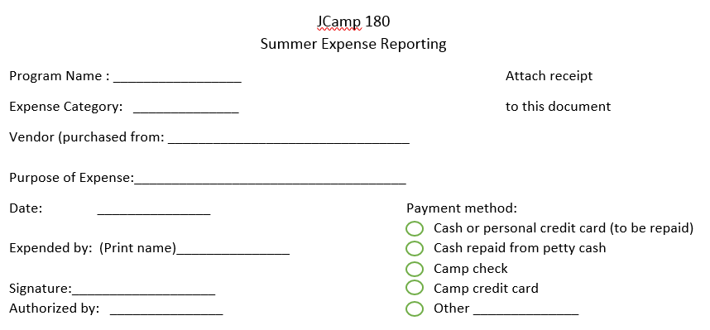

Slide 20
Cash Flow
Cash flow projections are NOT a budget; the budget must come first.
It is a tool to help manage financial operations
  Used to track cash on hand
  Addresses tendency to use next year’s revenue to pay this year’s expenses
Most useful to organizations with seasonal revenue or expenses
Tracks cash available to pay bills
Must be updated monthly (by bookkeeper) to remain useful

