Slide 1


Title

Slide 2

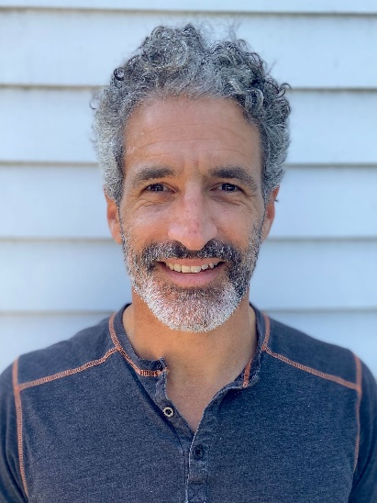
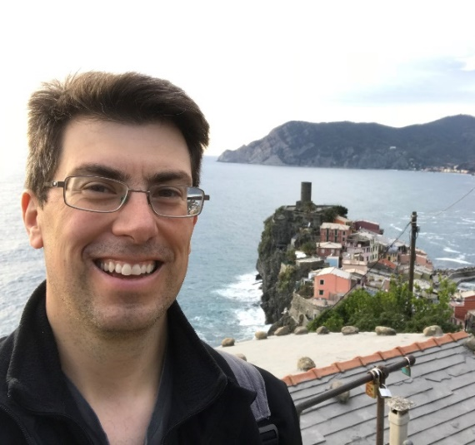

Enrollment 2021 Drop-in: Opening Enrollment
August 20, 2020
Aron Goldman Kevin Martone Herschel Singer
Mentor, Enrollment Program Director Technology Program Manager Analytics Manager
JCamp 180 JCamp 180 JCamp 180

Slide 3
Title Box
Your goals
What are you hoping to get out of today’s session?
Write down
Use chat window to share

Slide 4
Agenda
Title Box
Welcome, introductions, goals
Drop-in recap
2021 enrollment testimonial (Camp Livingston)
Guided discussion
What’s next…

Slide 5

Title

Slide 6
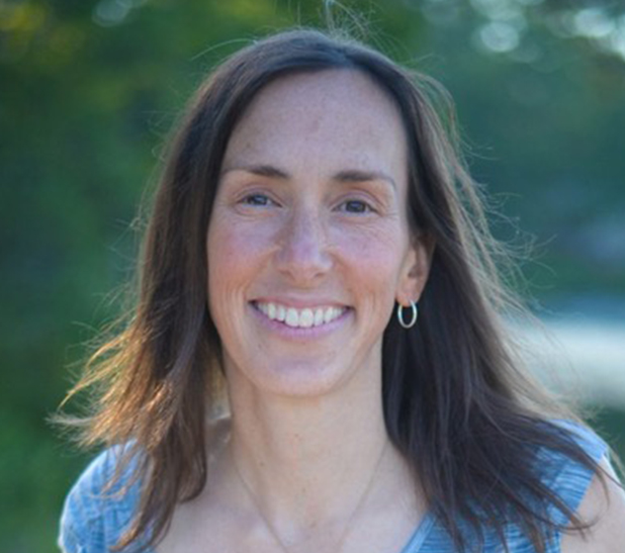

2021 Enrollment Testimonials
2021 Enrollment Testimonial
Sarah Atkins, Executive Director
Camp Kadimah
Halifax, Canada
Max Yamson, Executive Director
Camp Livingston
Bennington, Indiana

Slide 7
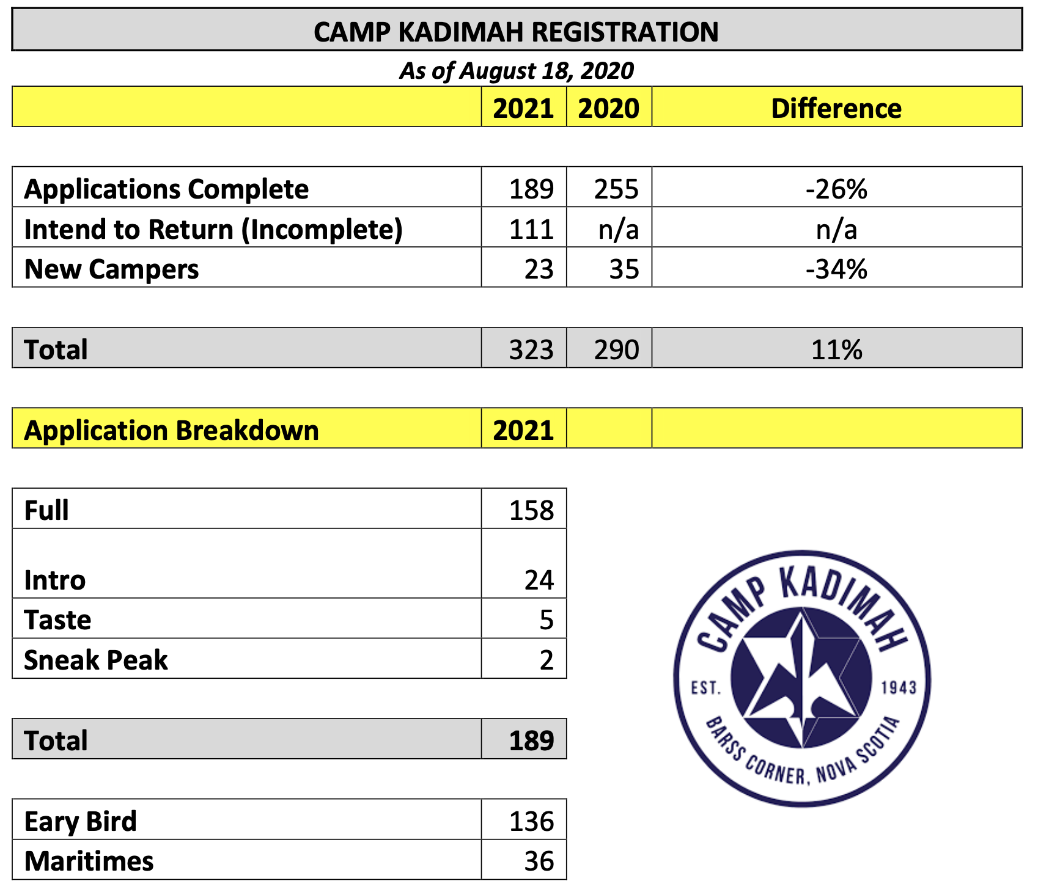
Discussion
Title Box

Slide 8
Discussion
Title Box

Slide 9
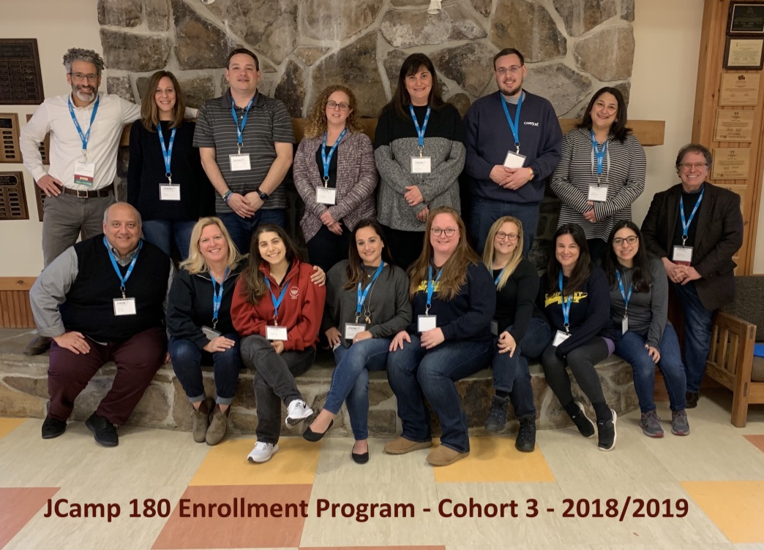
Drop-in Sessions
What’s next
Title Box
Title Box
JCamp 180 Enrollment Program kickoff: September 15
More info: www.jcamp180.org/enrollment
What we learned from drop-ins
JCamp 180 Annual Conference: Oct 19-20

Slide 10
Drop-in Sessions
Title Box
So what are your next steps?

