Slide 1


Title

Slide 2
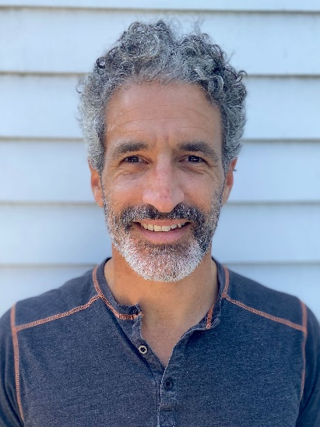


Tackling Your Biggest Enrollment Issues
A Taste of the Revised Enrollment Program
July 23, 2020
Aron Goldman Kevin Martone Herschel Singer
Mentor, Enrollment Program Director Technology Program Manager Analytics Manager
JCamp 180 JCamp 180 JCamp 180

Slide 3

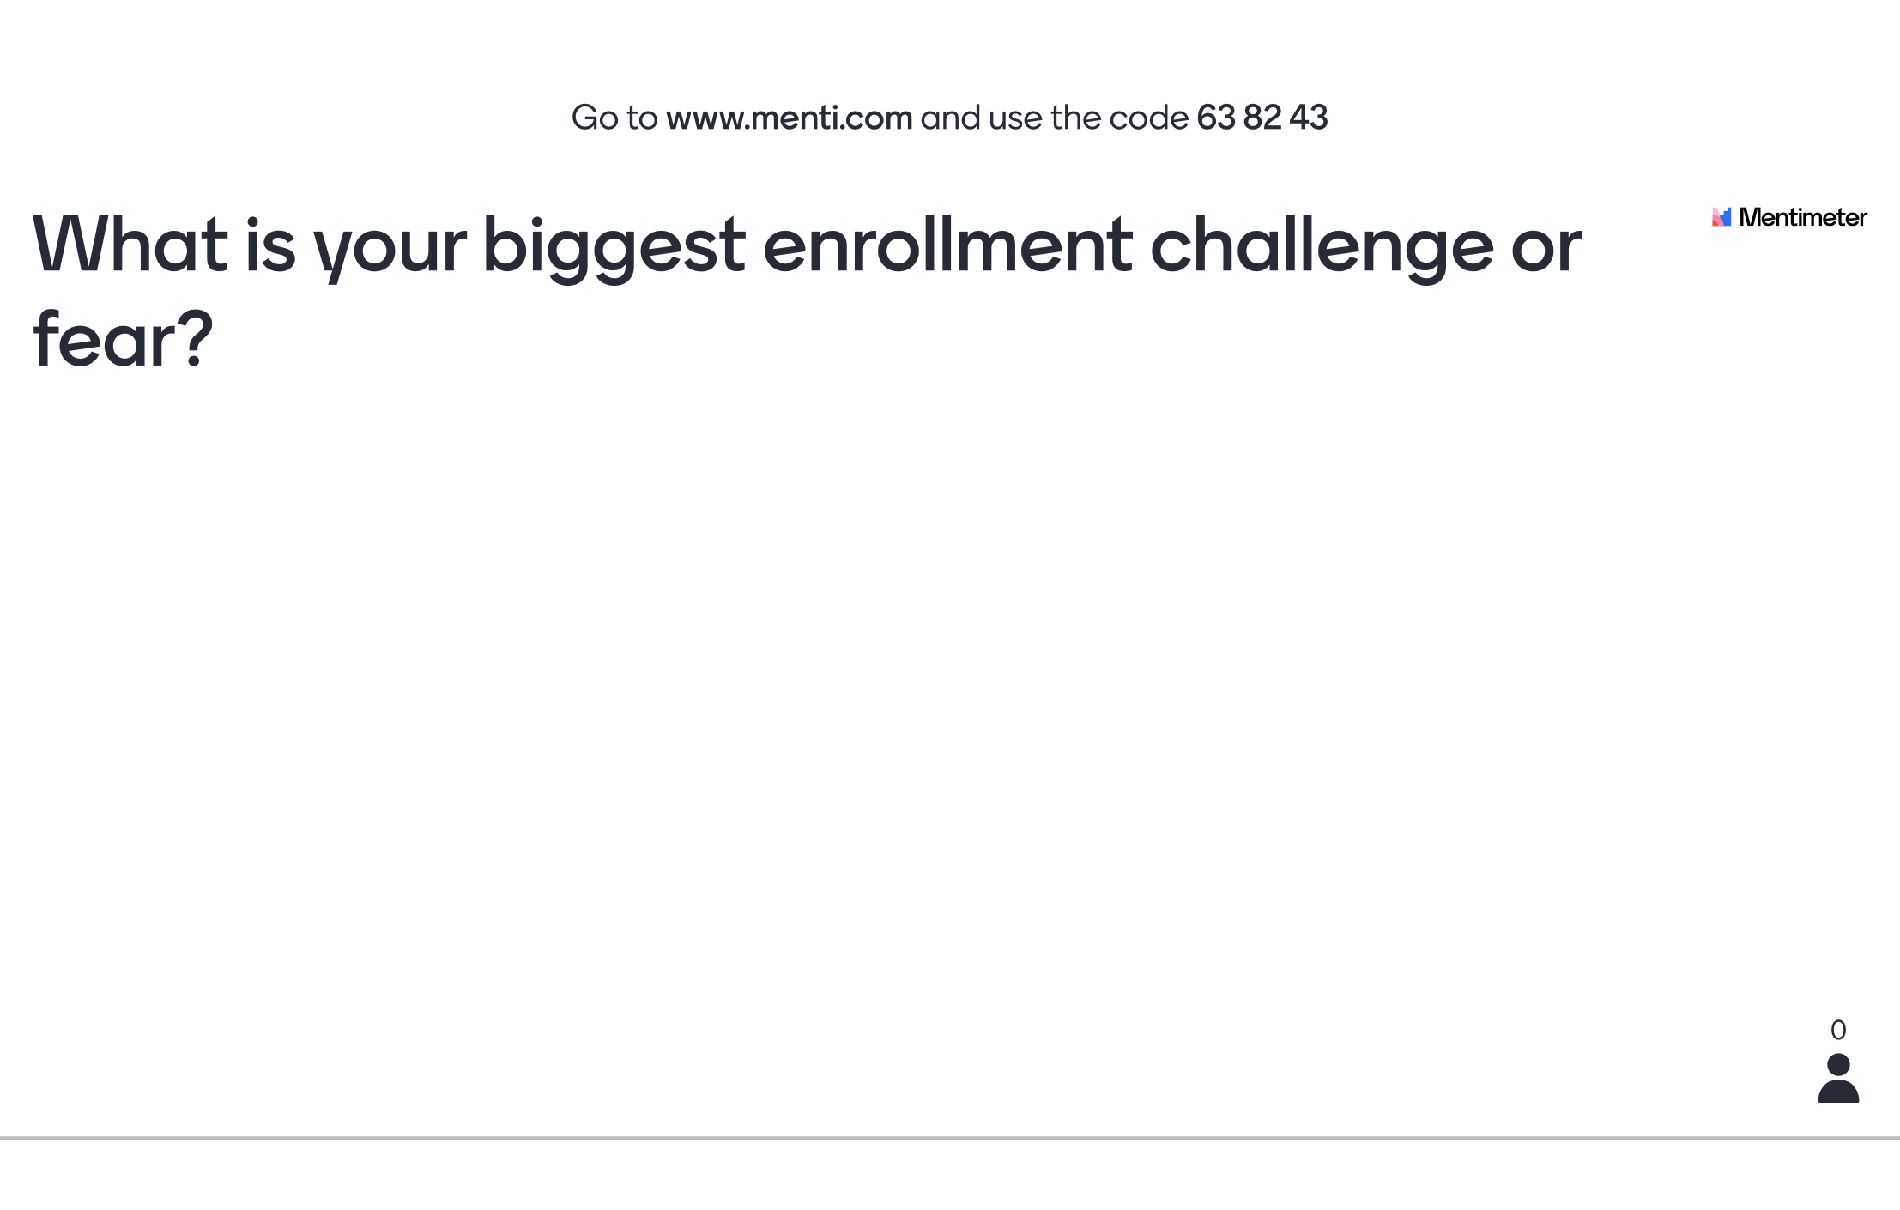
A question:
What is your biggest enrollment challenge or fear? Be specific.
When you’re ready, input your answer here:
[link?]

Slide 4
Agenda
Title Box
Welcome, Introductions
Breakouts – Tackling Your Biggest Enrollment Challenge
Enrollment Program Info/Testimonial
Enrollment challenges/Enrollment Drop-ins

Slide 5
Tackling Your Biggest Enrollment Challenge
Breakouts – 3 people
10 minutes on YOUR biggest challenge:
  2 minutes - “client” describes their challenge
  1-2 minutes - 2 “consultants” ask clarifying questions
  5 minutes - “client” mutes themselves/turns off video. Just listen as “consultants” discuss the challenge and potential solutions
  1 minute - “client” video/mic back on; thank you/follow up
Repeat for each person in the breakout room

Slide 6


Aaron Hadley
Director, Camp Ben Frankel

Slide 7
Title Box
Program Curriculum
Ch. 1: Program structure and special considerations
Ch. 2: ROI analysis tool
Ch. 3: Enrollment dashboards and analytics
Ch. 4: Marketing
Ch. 5: Retention
Ch. 6: Customer satisfaction
Ch. 7: Budgeting, Pricing, and incentives
Ch. 9: Staffing and governance
Ch. 10: Comprehensive plan development

Slide 8
Title Box
Program structure / format
Nine-month program (Sept 2020 – April 2021)
Each month:
Full cohort module presentation, including limited participant interaction and a guest presenter (typically) - 90 mins
Small group peer-driven “community of practice” working session - 60 mins
One-on-one check-in with program staff and JCamp Mentor - 45 mins
Additional communication (Zoom, phone, email, etc.) as needed

Slide 9
Get on board!
Title Box
Register here: www.jcamp180.org/enrollment
Deadline: Mid-August

Slide 10
Final question!
Title Box
What enrollment challenges do you want to tackle in the coming weeks? (Pick up to 3)
Thank you!

Slide 11
Drop-in Sessions
Title Box
When?
  August 6
  August 13
  August 20
More information and link to join: www.jcamp180.org/adapt

