Slide 1
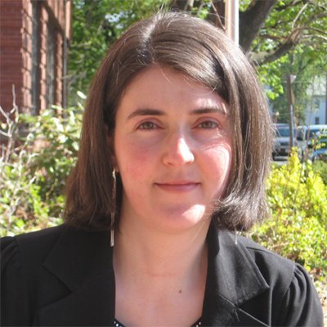
10 Common Fundraising Mistakes... and How to Avoid Them
2011 Grinspoon Webinar Series
Natasha Dresner
Consultant/Mentor, GIJP
natasha@hgf.org
February 22nd, 2011

Slide 2
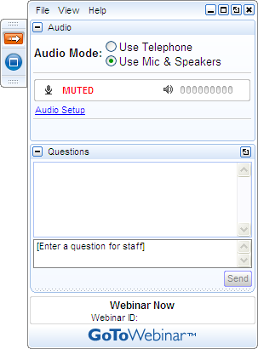
Get Involved
A) Grab Tab – Click red arrow to open/close Control Panel. Click square to toggle Viewer Window between full screen/window mode. Click mic icon to mute/unmute your audio.
B) Audio Pane – Select audio format. Click Audio Setup to verify Speakers & Microphone.
C) Questions Pane – Attendees can submit questions and review answers.
D) Type your question and click Send to submit it to the organizer.
A →
B →
C →
D →

Slide 3
10 Common Fundraising Mistakes
I was here yesterday and you wouldn’t wait on me.
You work on commission, right?
Big mistake!
Huge!
Hi, do you remember me?
No, I’m sorry.
Yes…
Scene from “Pretty Woman”

Slide 4
Mistake? Or a Learning Opportunity?
“If a mistake is not a stepping stone,
it is a mistake.”
Eli Siegel

Slide 5
Your Experiences: Are You Learning from Your Mistakes?

Slide 6
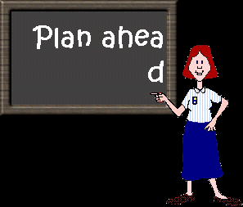
1) Failing to have a clear agreed upon fundraising plan and deadlines

Slide 7
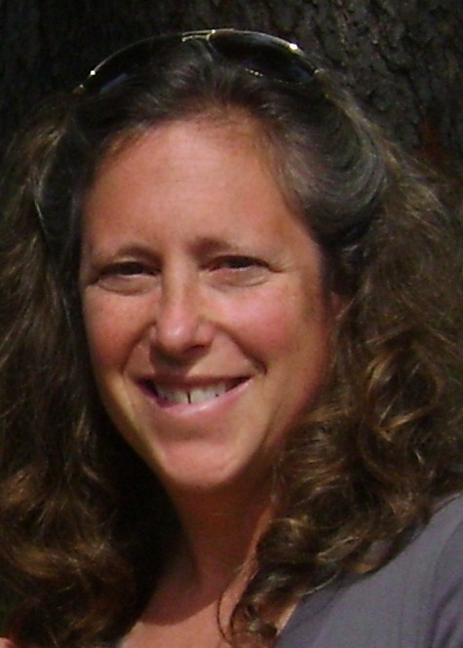
1) Failing to have a clear agreed upon fundraising plan and deadlines
Ruth Ann Ornstein
Executive Director
Camp Laurelwood
Madison, CT

Slide 8
Always Fighting Fires

Slide 9
Look Into The Future

Slide 10
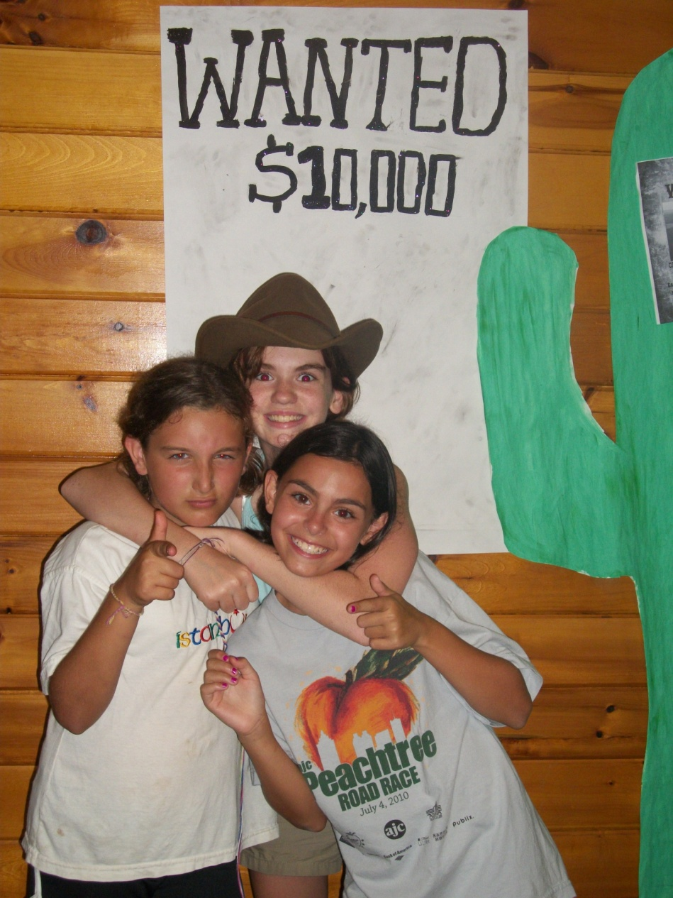
Clear Message

Slide 11
#2 Failing to give yourself, and thinking that others can raise the money for you

Slide 12
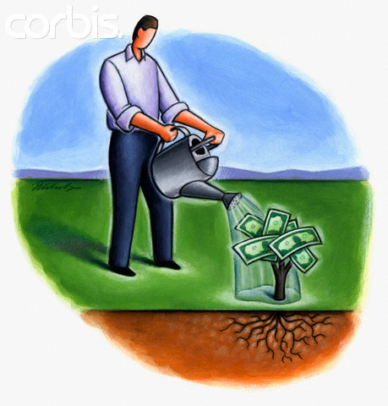
#3 Failing to cultivate prospects Asking them too soon

Slide 13
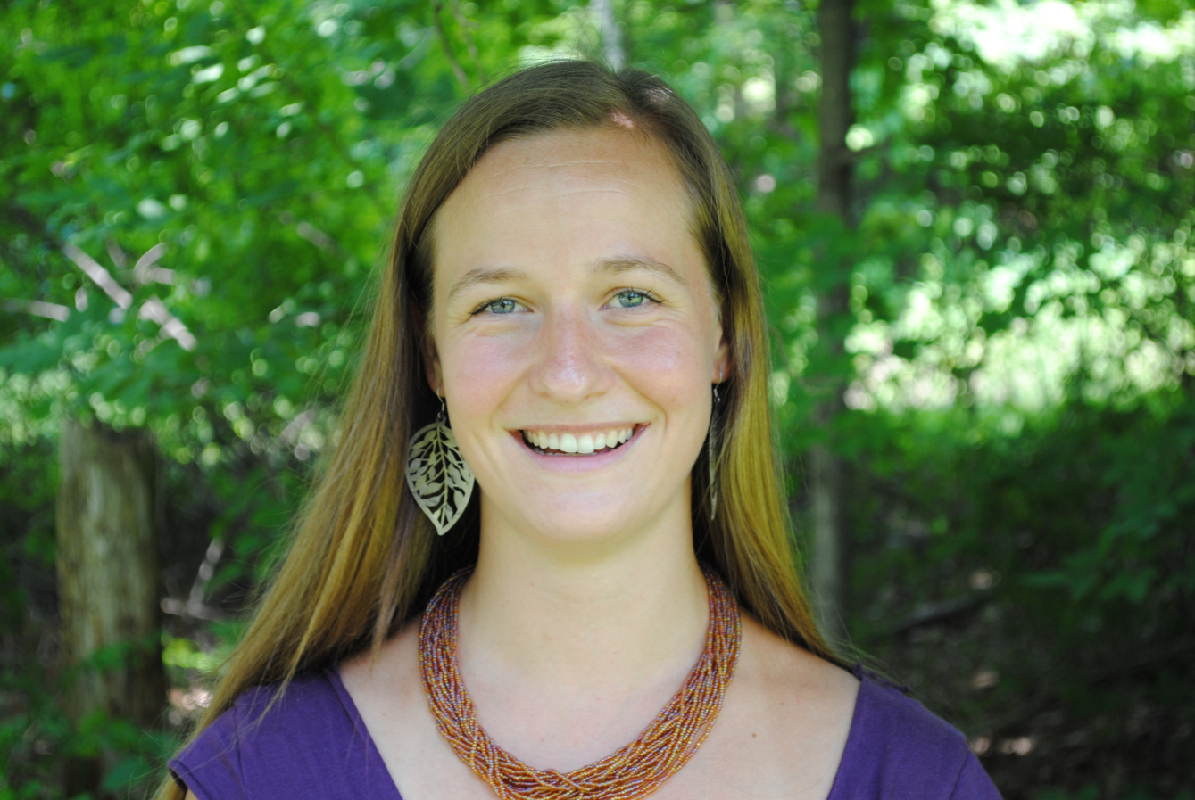
3) Failing to cultivate prospects/ Asking them too soon
Megan Jensen, Development Associate
Isabella Freedman Jewish Retreat Center
Falls Village, CT

Slide 14
4) Failing to ask and/or failing to ask for a specific (large enough) gift

Slide 15
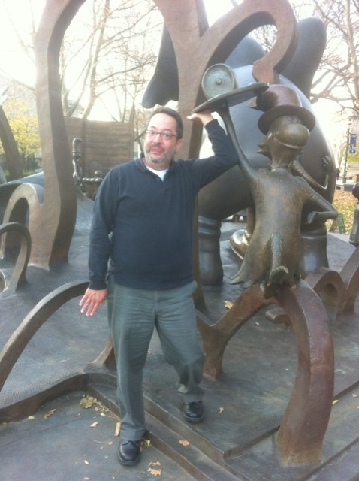
4) Failing to ask and/or failing to ask for a specific (large enough) gift
Jonathan "J.C." Cohen
Director
URJ Henry S. Jacobs Camp
Utica, Mississippi

Slide 16
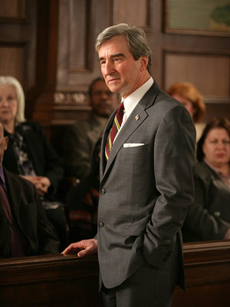
#5
Believing that just because your organization is for a good cause, you don’t need to make a strong case to raise money

Slide 17
6) Failing to close the solicitation once it has been made

Slide 18
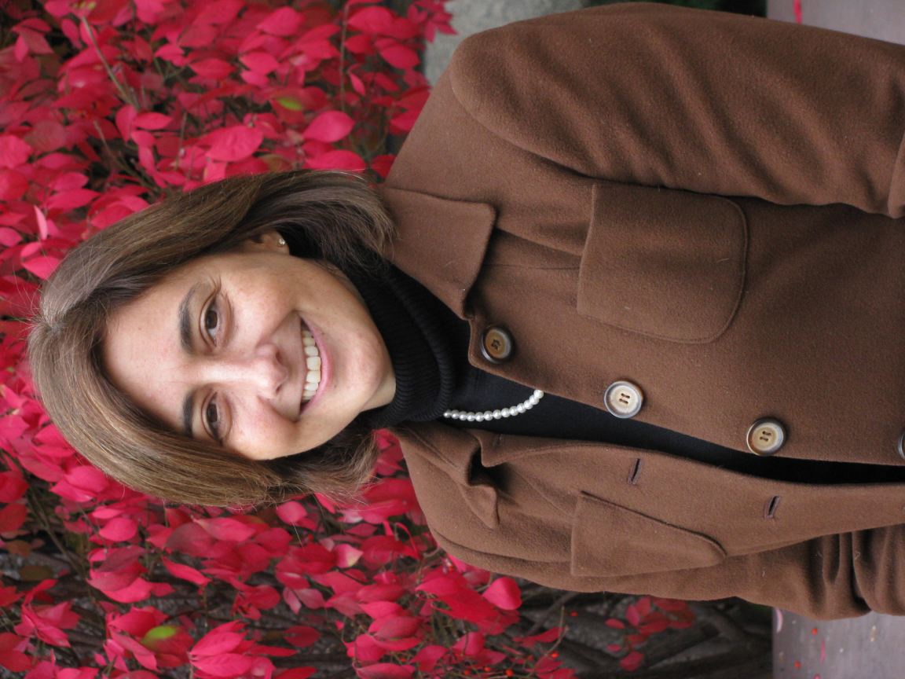
6) Failing to close the solicitation once it has been made
Tamara Cohen, CFRE
Associate Executive Director
JCC of Greater Rochester Camp Seneca Lake
Rochester, NY

Slide 19
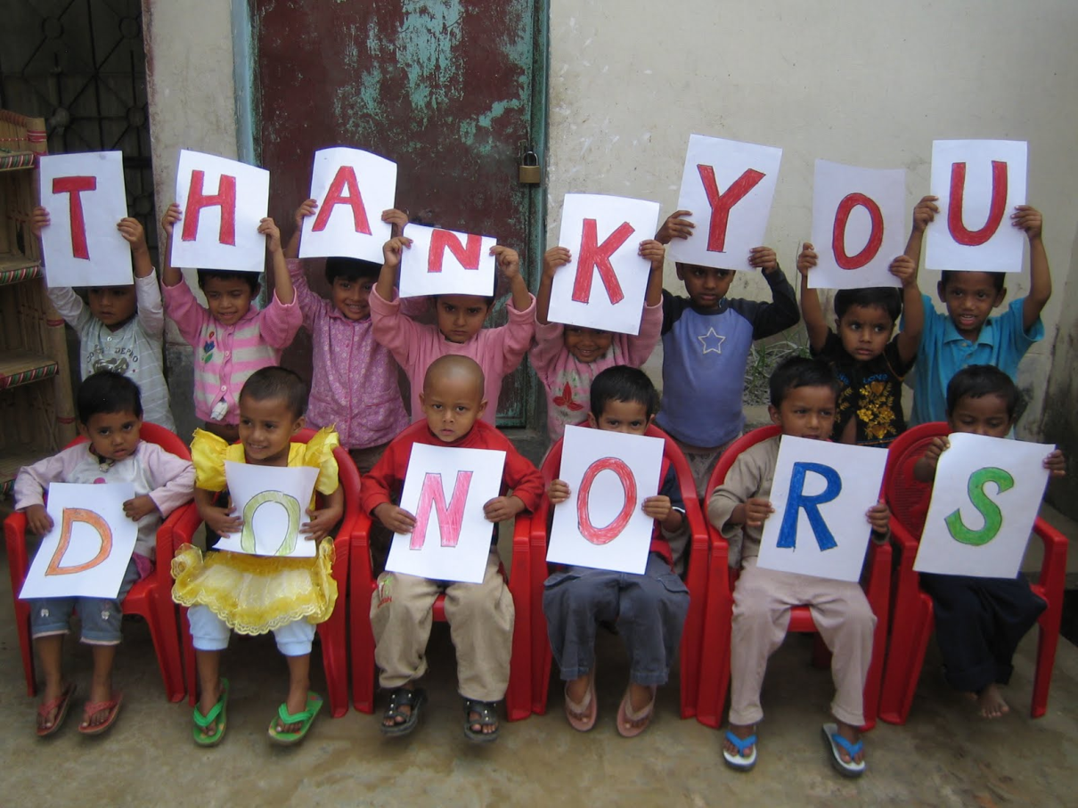
7) Failing to thank and steward your donors

Slide 20
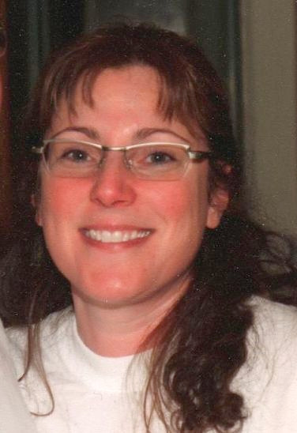
7) Failing to thank and steward your donors
Dena Kaufman
Development Director
URJ Camp Newman
Santa Rosa, CA

Slide 21
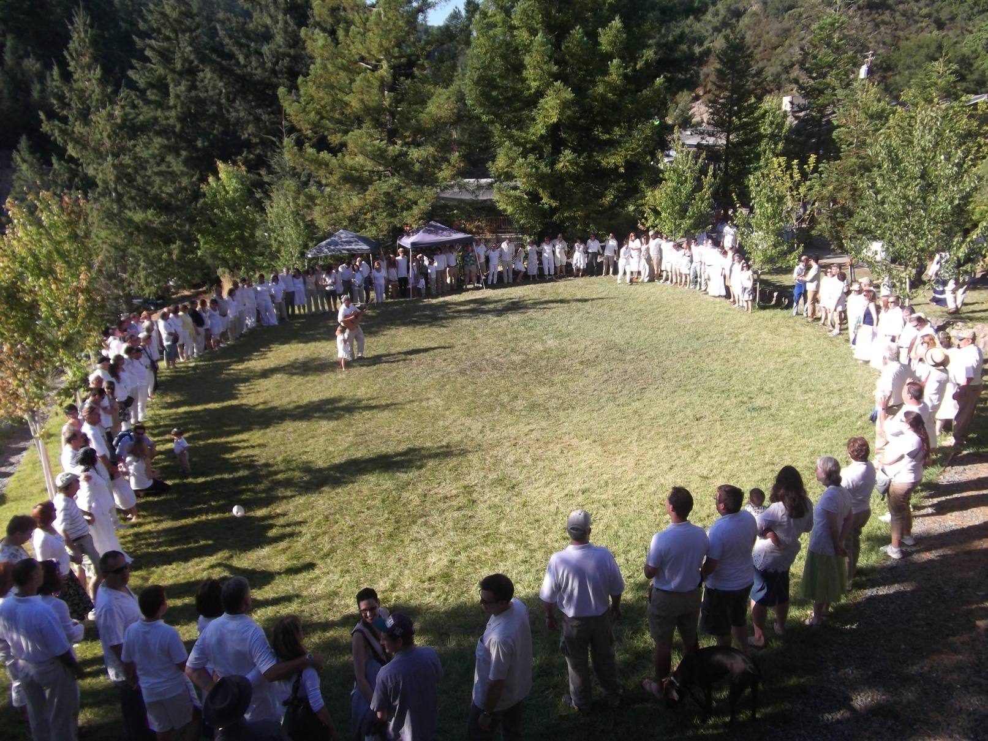
URJ Camp Newman Santa Rosa, California Represent 8 Western States

Slide 22
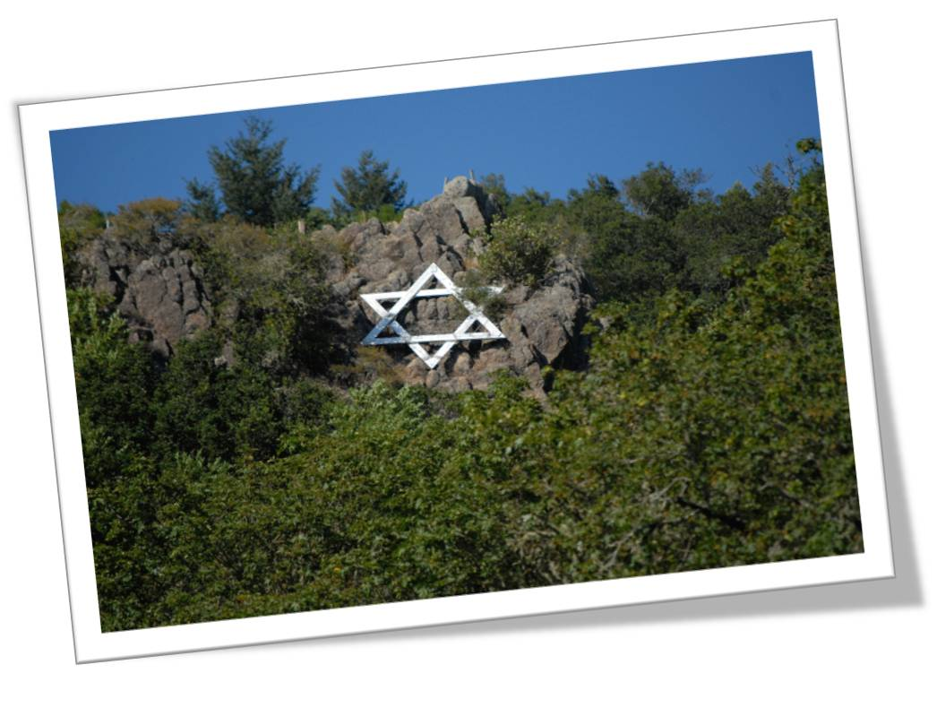
Original Campaign for Purchase and Start-up 1996
$12 Million

Slide 23
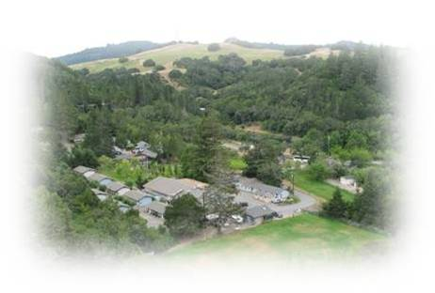
Of Those Original Donors, We only have computer records for 66 Donors equaling 1,100,000

Slide 24
KEEP 11 Donors = $270,000
Of 11 Donors, 4 Have Given Again = $686,000
66 Donors $1.1 Million
LOST 55 Donors = $830,000
What IF ???

Slide 25
$107,640
$130,000
10 Donors $5,000-$10,000 CONVERT to Annual Donors of $1,000 for 13 years
$257,400
11 Donors $10,000-$20,000 CONVERT to Annual Donors of $1,800 for 13 years
$1,144,000
11 Donors $20,000-$163,000 CONVERT to Annual Donors of $8,000 for 13 years
TOTAL
$1,639,040 TOTAL
23 Donors $1,000-$4,000 CONVERT to Annual Donors of $360 for 13 years

Slide 26
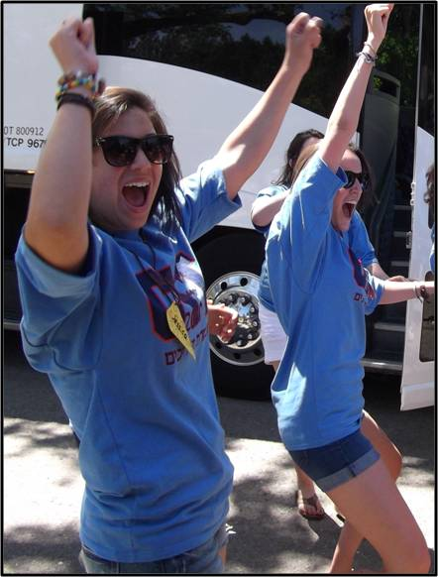
In Words That We Understand
1,365 FREE weeks of camp
OR
170 FREE full summer campers OR
An Endowment with $1,639,040
which gives you 5% per year
which is $81,952 per year

Slide 27
Donor Care
Summer Shabbat Visit
Donor Annual Report & Recognition
Personal Visit
Positive Points of Contact

Slide 28
Insert for Thank You notes and Pledge Reminders

Slide 29
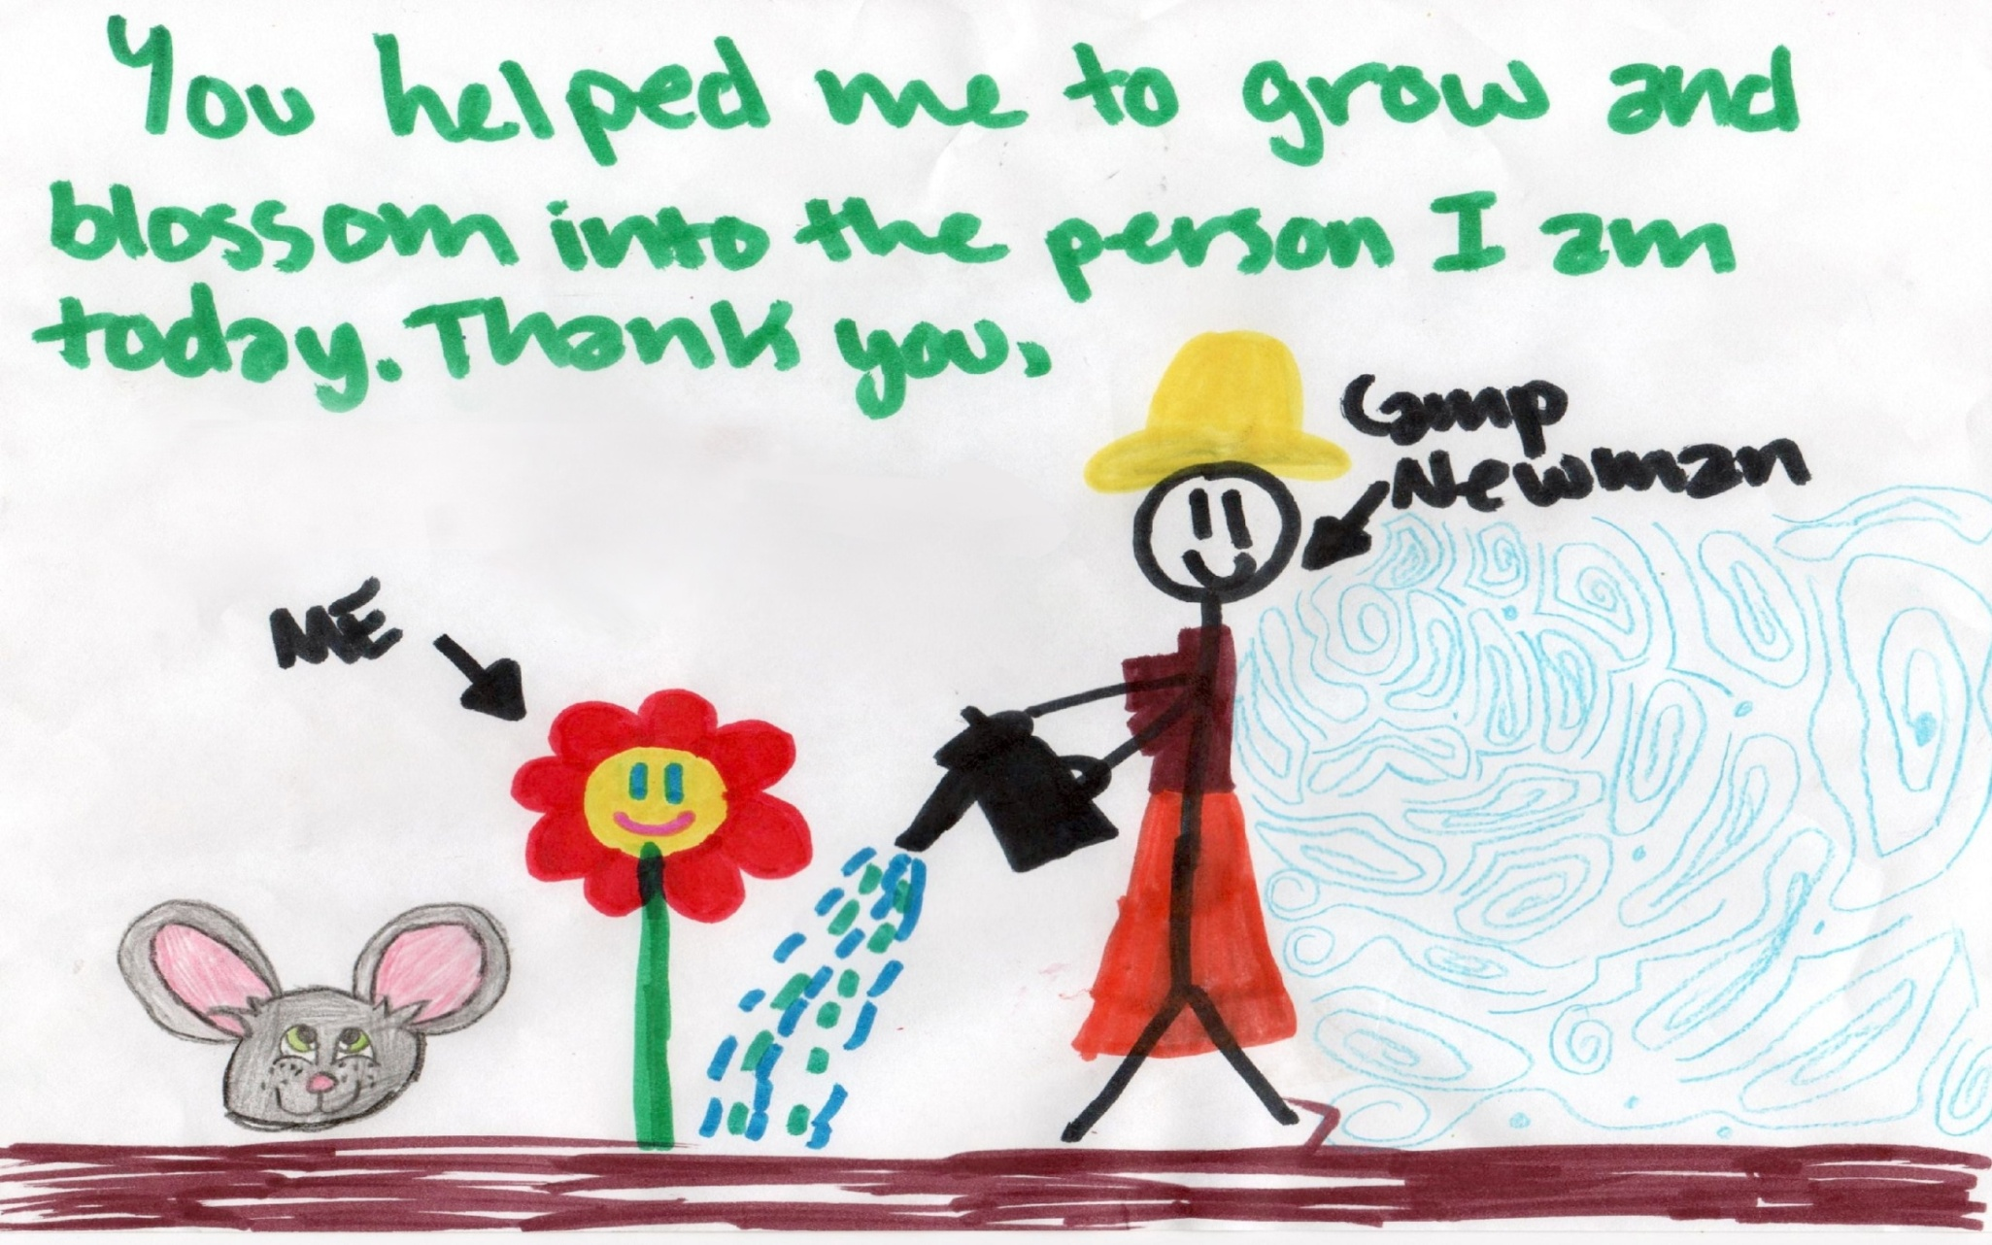
Shabbat Shalom !

Slide 30
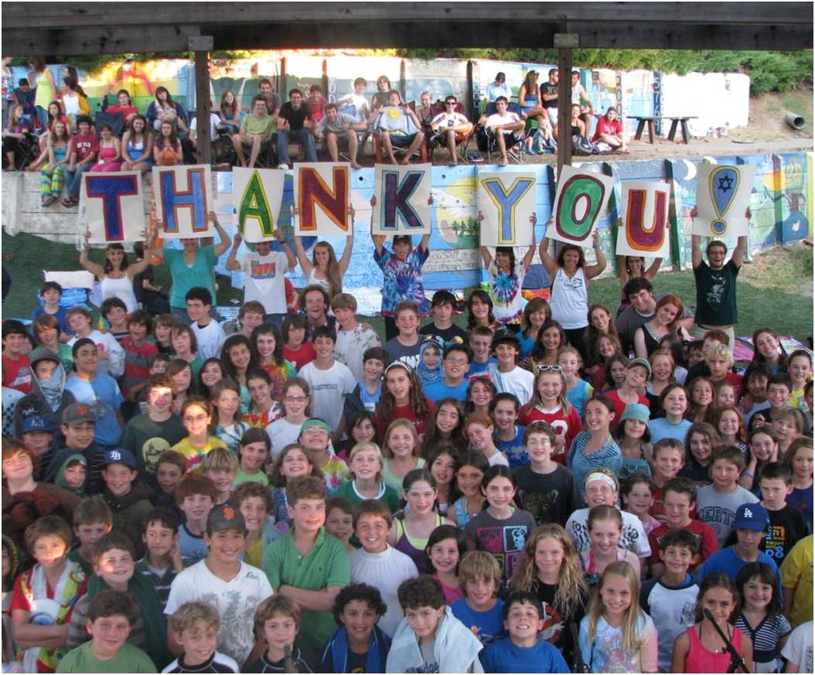

Slide 31
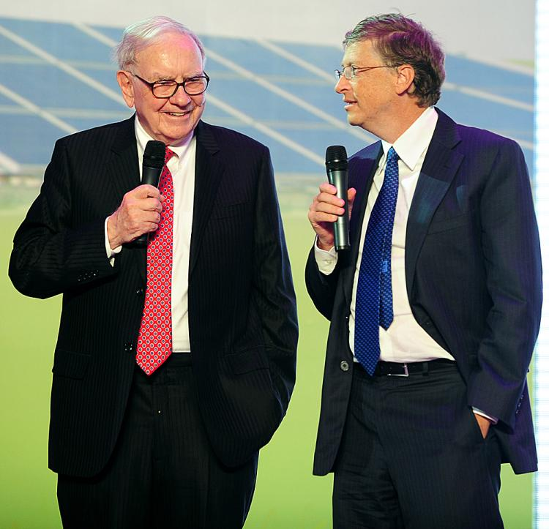
#8 Believing that just because someone is wealthy, they will give
Why are they asking us?! Do we look like Harold Grinspoon?
Warren Buffet and Bill Gates

Slide 32
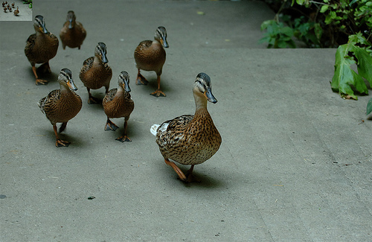
9) Having weak camp leadership – Board/Staff/Fundraising Committee
Get your ducks in a row

Slide 33
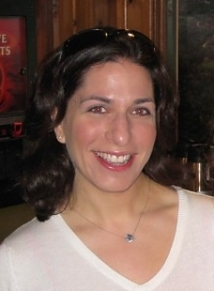
9) Having weak camp leadership – Board/Staff/Fundraising Committee
Amy Glazer
Development Director
Camp Ramah in the Berkshires
Wingdale, NY

Slide 34
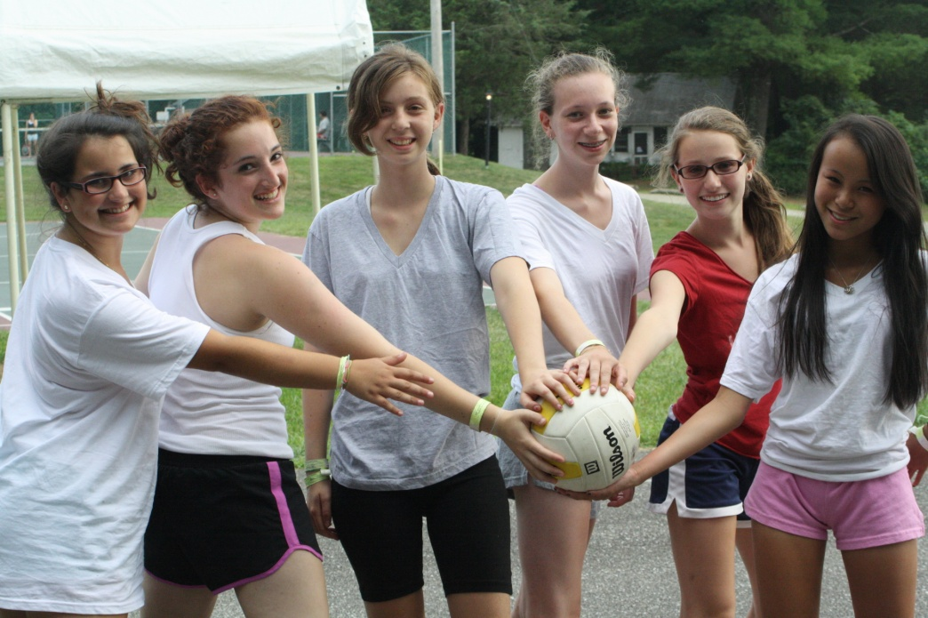
An Active Board = A Strong Team
Large Board historically interested in program/ day-to-day administration
Small and inactive Development Committee
Minimal involvement in development programs
Result – A Weak Team!

Slide 35
Challenge – a few people doing all of the work
Legacy – one person doing majority of asks
Prospecting – difficult to open doors to new donors
Development Director doing work typically reserved for volunteers

Slide 36
Solution
Board Development
One-on-one prospecting
Gradual engagement of volunteers
Development Committee building

Slide 37
10) Believing you can raise $1M by getting 1,000 people to give $1,000 each

Slide 38
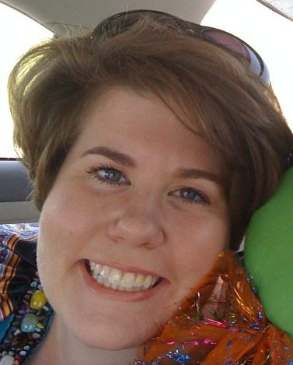
10) Believing you can raise $1M by getting 1,000 people to give $1,000 each
Ellen Alexander
Development Director
URJ Henry S. Jacobs Camp
Utica, MS

Slide 39
10) Believing you can raise $1M by getting 1,000 people to give $1,000 each

Slide 40
Conventional Capital Campaign of $1,000,000

Slide 41
Bonus Lessons

Slide 42
Bonus Lessons
Believing that you need to downsize the amount of your asks in a bad economy
Failing to utilize Technology
Believing that Fundraising is a static process that doesn’t require adjustment of strategies
Believing that mismanagement (of funds and operation) has no fundraising impact

Slide 43
How Can We Avoid Making These Mistakes?
Learn from your mistakes
Educate yourself
Share and learn from others
Institute a learning culture
And, remember, some mistakes are too important to avoid

Slide 44
Resources
This Presentation and Audio Recording of this Webinar:
http://www.gijp.org/knowledge-center/webinars.aspx
18 Common Fundraising Mistakes Article: http://www.gijp.org/knowledge-center/fundraising/fundraising-background/18-common-fundraising-mistakes.aspx
Grinspoon Institute Knowledge Center:
http://www.gijp.org/Knowledge-Center.aspx

Slide 45
10 Common Fundraising Mistakes... and How to Avoid Them
2011 Grinspoon Webinar Series
Natasha Dresner
Consultant/Mentor, GIJP
natasha@hgf.org
February 22nd, 2011

