Slide 1

Asking for Camp
Now
Welcome!

Slide 2
Purpose & Intended Results
For Participants to:
Understand the flow of a donor enrollment conversation
Feel ready to have an enrollment conversation
See how these conversations can strengthen donor relations
Begin to develop a strategy for some of your top donors
Learn how you might enroll someone in your community to be a lead donor (and perhaps provide a match)

Slide 3
Agenda
Welcome
Why ask now?
Who should you ask?
Who should do it?
What is the request?
Following Up
Announcements

Slide 4

Who’s in the
room?

Slide 5

NOW!!!
When is the right time to ask?

Slide 6
A survey of non-profits*
93.5% believe that donors will be less able to give
A survey of donors
52.5% say they expect to give about the same as before the virus hit
30% plan on giving more
24.5% say they will look for ways to help the unemployed directly
(*BBBWise Giving Alliance through its website Give.org conducted first week of April)

Slide 7
5 Reasons To Ask Now
If you are not asking, people will assume that you’re okay.
Others ARE asking, if you don’t, resources will go elsewhere.
People want to make a difference right now. It’s a mitzvah to ask!
When people give, they become partners who could help in countless ways (beyond money…and both now and in the future).
It’s smart to give now: Some people have expendable income because they are spending less. People who make larger gifts can deduct up to 100% of the adjusted gross income for charitable contributions in 2020. People who make smaller gifts can deduct them up to $300.

Slide 8

The Cycle of Fundraising
Fundraising Planning – setting clear goals and a course to get there
Identifying Prospective Donors –recognizing the individuals who share your commitment throughout your surrounding communities
Cultivating and Engaging – building relationships and engaging individuals in your successes and challenges
Enrolling– inviting people to invest their resources to advance your vision
Stewarding – appreciating people for their contributions and maintaining a connection between them and the work of your organization
Notes:
EP

Slide 9
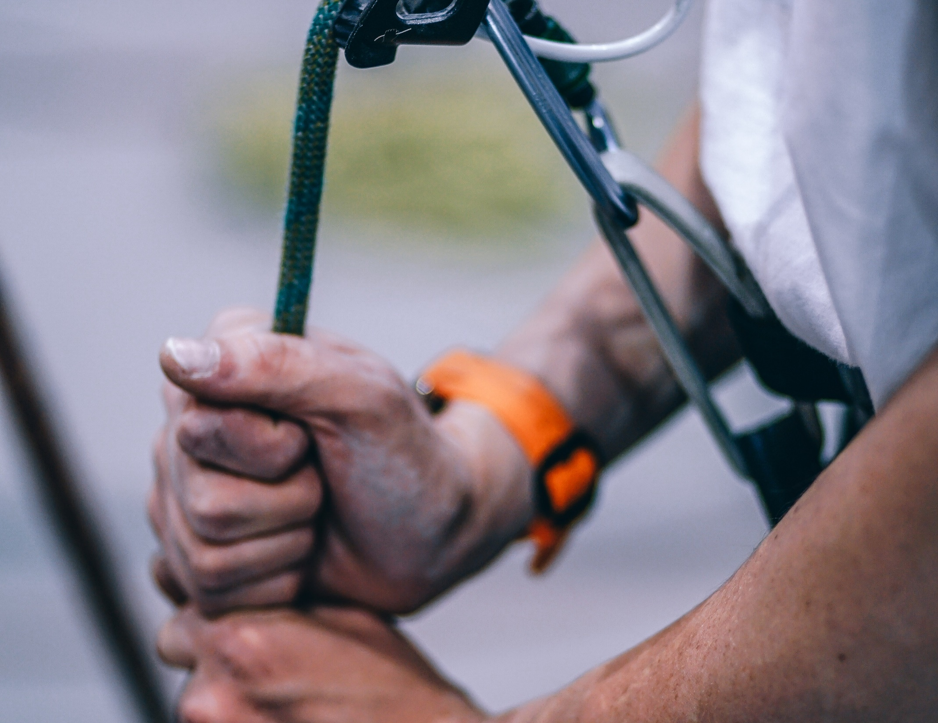
Photo by Igor Ovsyannkov

Slide 10

Photo by Jackson Hendry

Slide 11
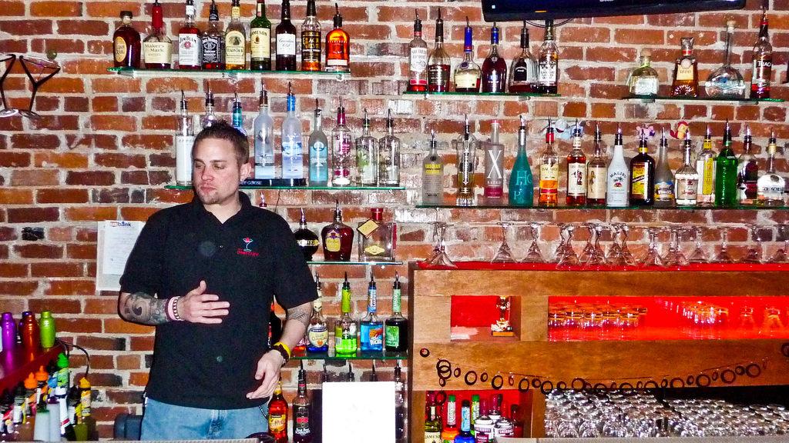
Who is enrolling whom?

Slide 12
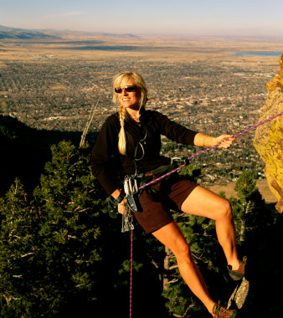
Enrolling
Asking questions
Trusting the wisdom
and expertise of your
donor
Direct and clear
Sharing an authentic story
Selling
Talking
Being the Expert
Manipulation
Pitching

Slide 13

“Enrollment is the art and practice of generating
a spark of possibility
for others to share.”
Benjamin and
Rosamond Stone Zander

Slide 14
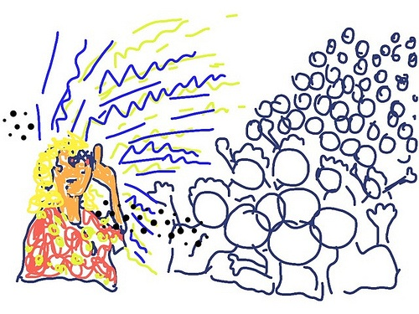
Be Strategic in Your Approach
How can you turn tuition into a gift and have parents become new donors?
How can you engage alumni giving in this pandemic?
How can you encourage larger donors to step up?
What populations could be an ongoing revenue stream for your camp?
Who
should you enroll?
What would be the approach with parents?
What are the best communication methods with alumni?
How would you get major donors to give larger gifts?
How could parents, alumni and major donors each play a part in your strategy?
Are there major donors who could provide a matching gift?
Everyone!

Slide 15
Who
should be part of the team making calls?
Board members, development staff, executive directors, any volunteer leaders…

Slide 17
“Enrollment is the art and practice of generating
a spark of possibility
for others to share.”
Benjamin and
Rosamond Stone Zander

Slide 18
f you are not asking, people will assume that you’
re okay
Others ARE asking, if you don’t, resources will go elsewhere.
People want to make a difference right now. It’s a mitzvah to ask!
When people give, tp to
What are you enrolling people in?
Your camp’s VALUES and VISION

Slide 19
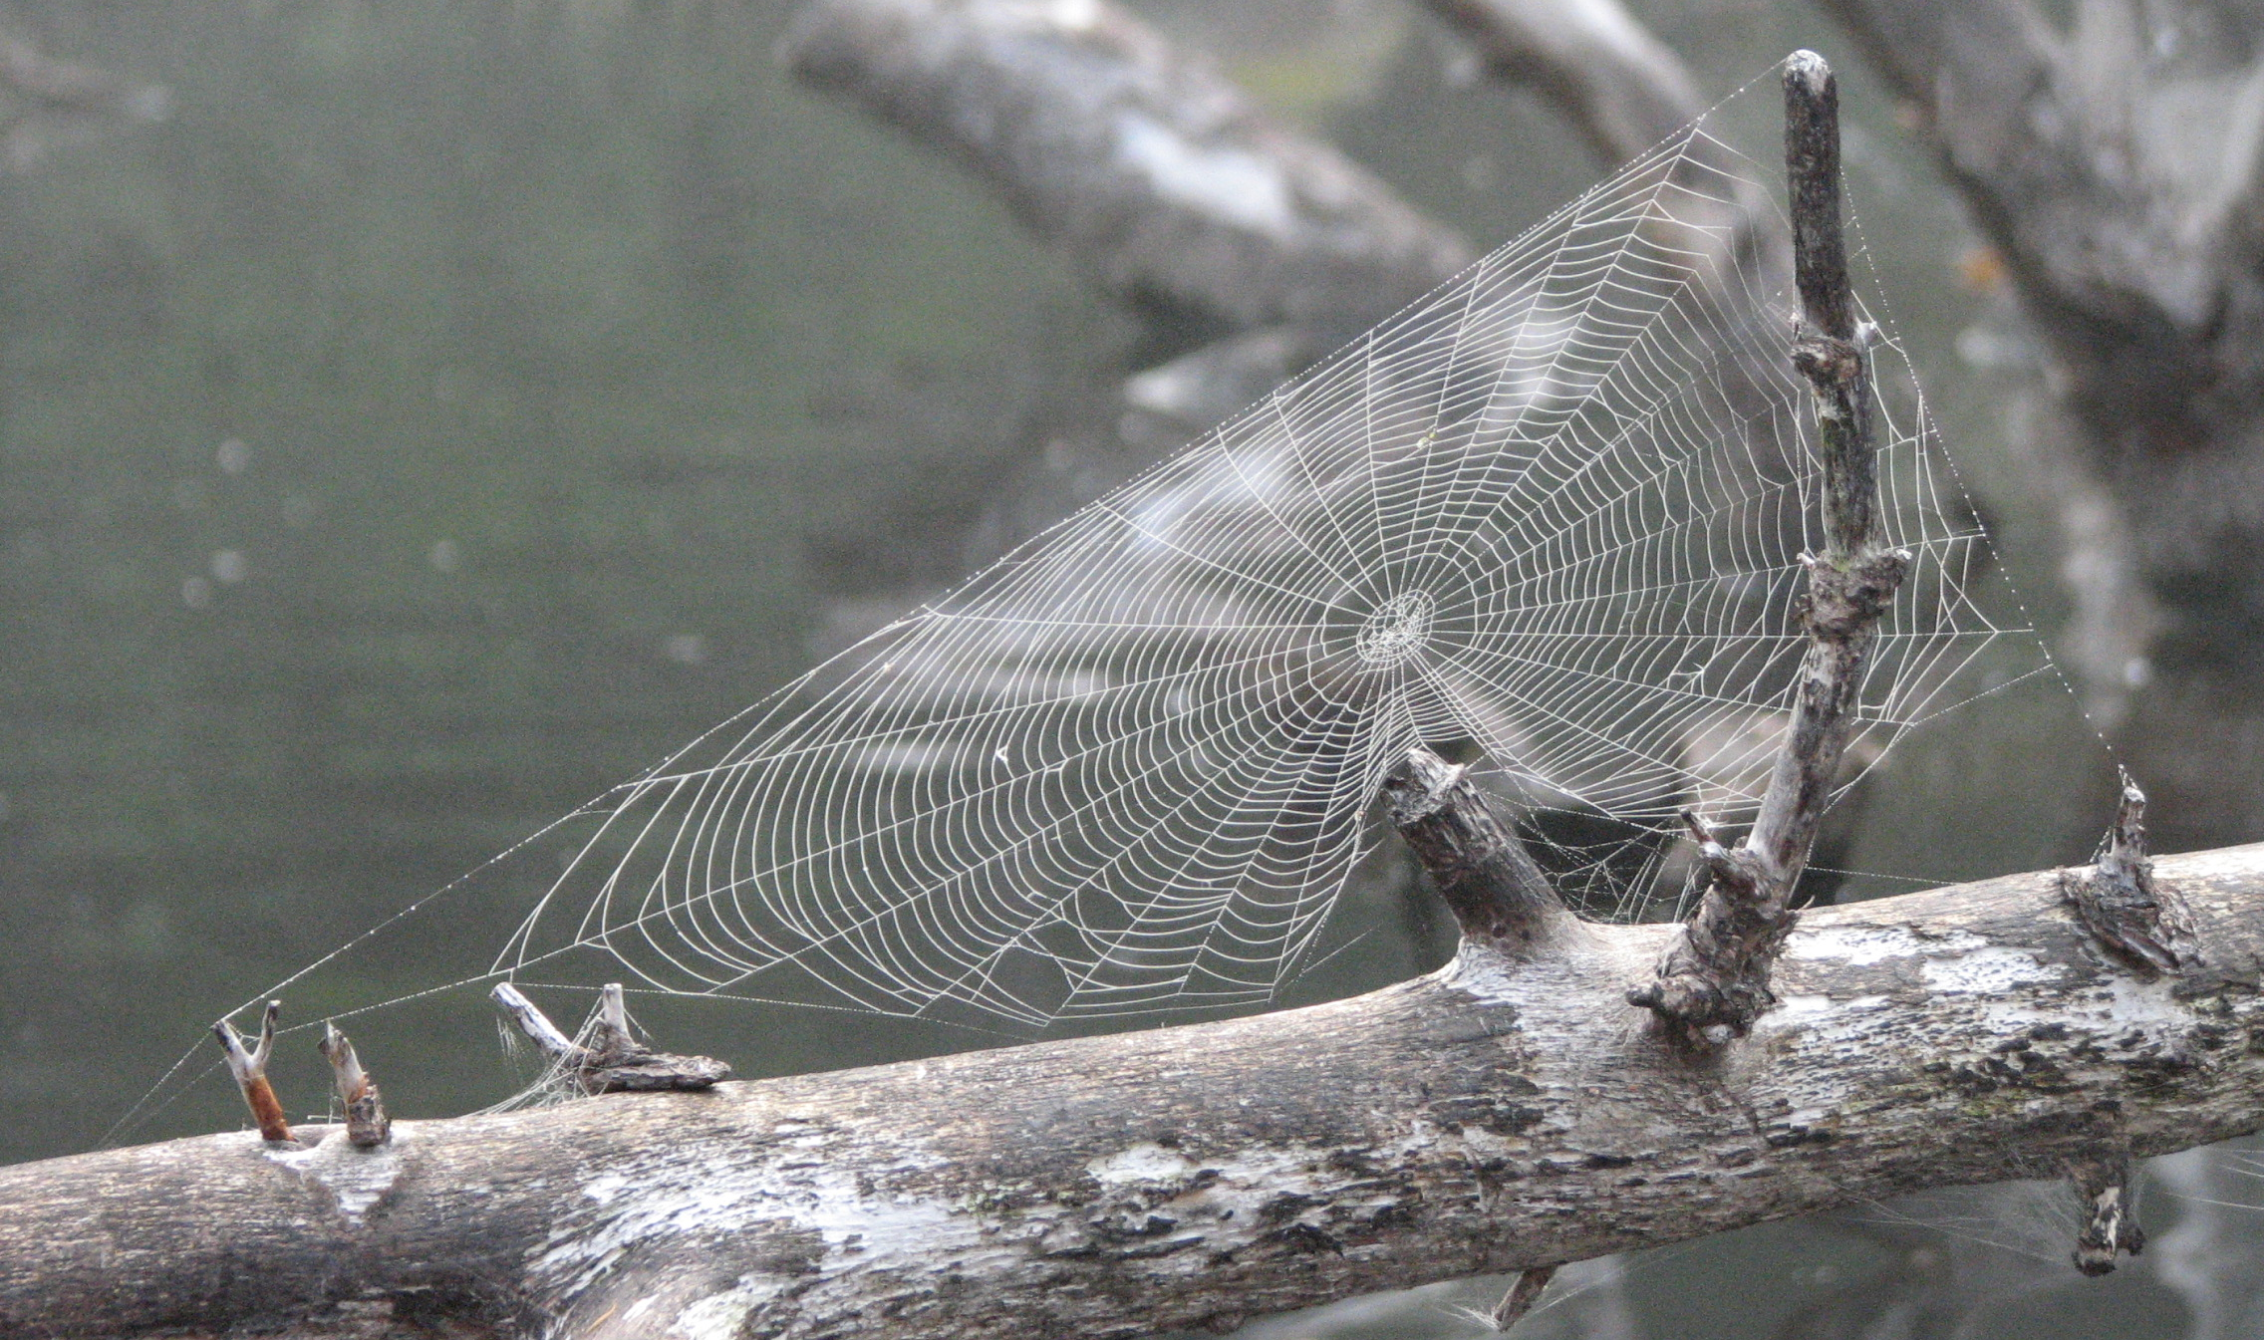
What you appreciate, appreciates.
Lynne Twist

Slide 20

Key Questions You Need to Answer Before You Begin
What is my plan? Who am I reaching out to? Parents? Alumni? Existing Donors? Regional stakeholders?
What is my goal – and strategy for that goal?
  Specific dollar goal overall - from which subgroup of your stakeholders
  More donors?
  Strengthen donor relations?
How will I ask?
  1:1 calls?
  Direct mail?
  Social Media Plan?
What is my request – and why is it important?
  Do I want to ask for a specific amount? What are our needs?
  Am I asking a parent to turn their child’s tuition into a gift? Why?
  Am I seeking a donor to initiate a match for other donors to follow?

Slide 21

Getting (Mentally) Prepared for Your Calls
Who is the donor – and strategy for that donor?
  How recently, & what have they given previously (donor hist. report)
  What are their passions at camp? How have they been involved?
  How does this call fit into the bigger plans that you might have, or they might have together, for your camp?
Who are they as humans? (Fall in love with them)
  Get in touch with this person’s values and commitment
  What do you like most about this person?
  How are you alike? Why do you like to give to camp? Would they feel similar?
  What is their relationship to your camp? Why would they want to give?
What questions would be good to ask them to learn more about them?
  Come up with 3 to 4 questions
  Am I seeking a donor to initiate a match for other donors to follow?
Practice how this call could go. Find someone to do a mock with you.
  Imagine the donor as a friend, in front of you as speak to them.
  Imagine a yes, a no or a maybe. Can you give space for all three?

Slide 22

Outline of an Enrollment Conversation*
Do they have time to talk?
How are they doing? How is their family? Listen!
Get related and acknowledge who they are/what they’ve done for your camp
Your intentions to update them on camp and share some of the things that are going on right now.
Ask questions and listen (take notes on what they say)
REALLY listen!
Speak the vision
Enrollment Request : Invitation to partner in shared vision
Listen (Resist the urge to talk here).
Yes, No or Maybe
Thank you, and plan for follow up (A CLEAR FOLLOW UP PLAN)
* Constantly mentally check in…who is enrolling whom?

Slide 23
What if I Get a Machine??
Hi, this is __________ from Camp _________
How are you? We are reaching out to our supporters to see how they are doing. I hope that you and your family are doing well and that you are all healthy.
I was hoping that we could catch up so that I can hear how you’re doing, and to share with you what our plan is for camp this year.
While there have been some real disappointments due to Covid, We’ve also had some amazing opportunities for camp that I’d love to share with you.
I hope that you’ll consider giving me a call back.
I can be reached at: (413) 000-0000. Or by email at …

Slide 24
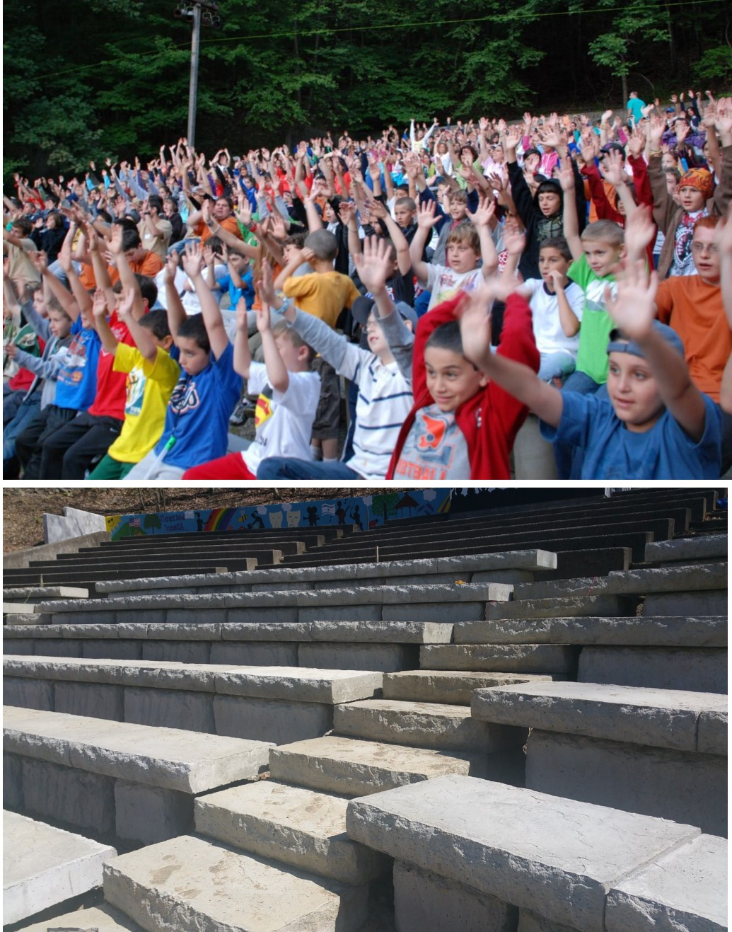
Do
Be Relevant: How does your camp matter now?
The staff are heroes
Build trust
Be about WE
Focus on your core values
Be authentic about what you know and do not know: challenges are okay to share.
Don’t
Share how you are suffering
Exaggerate or inauthentically emphasize the impact of pandemic
Photo Credit:
Surprise Lake Camp

Slide 25
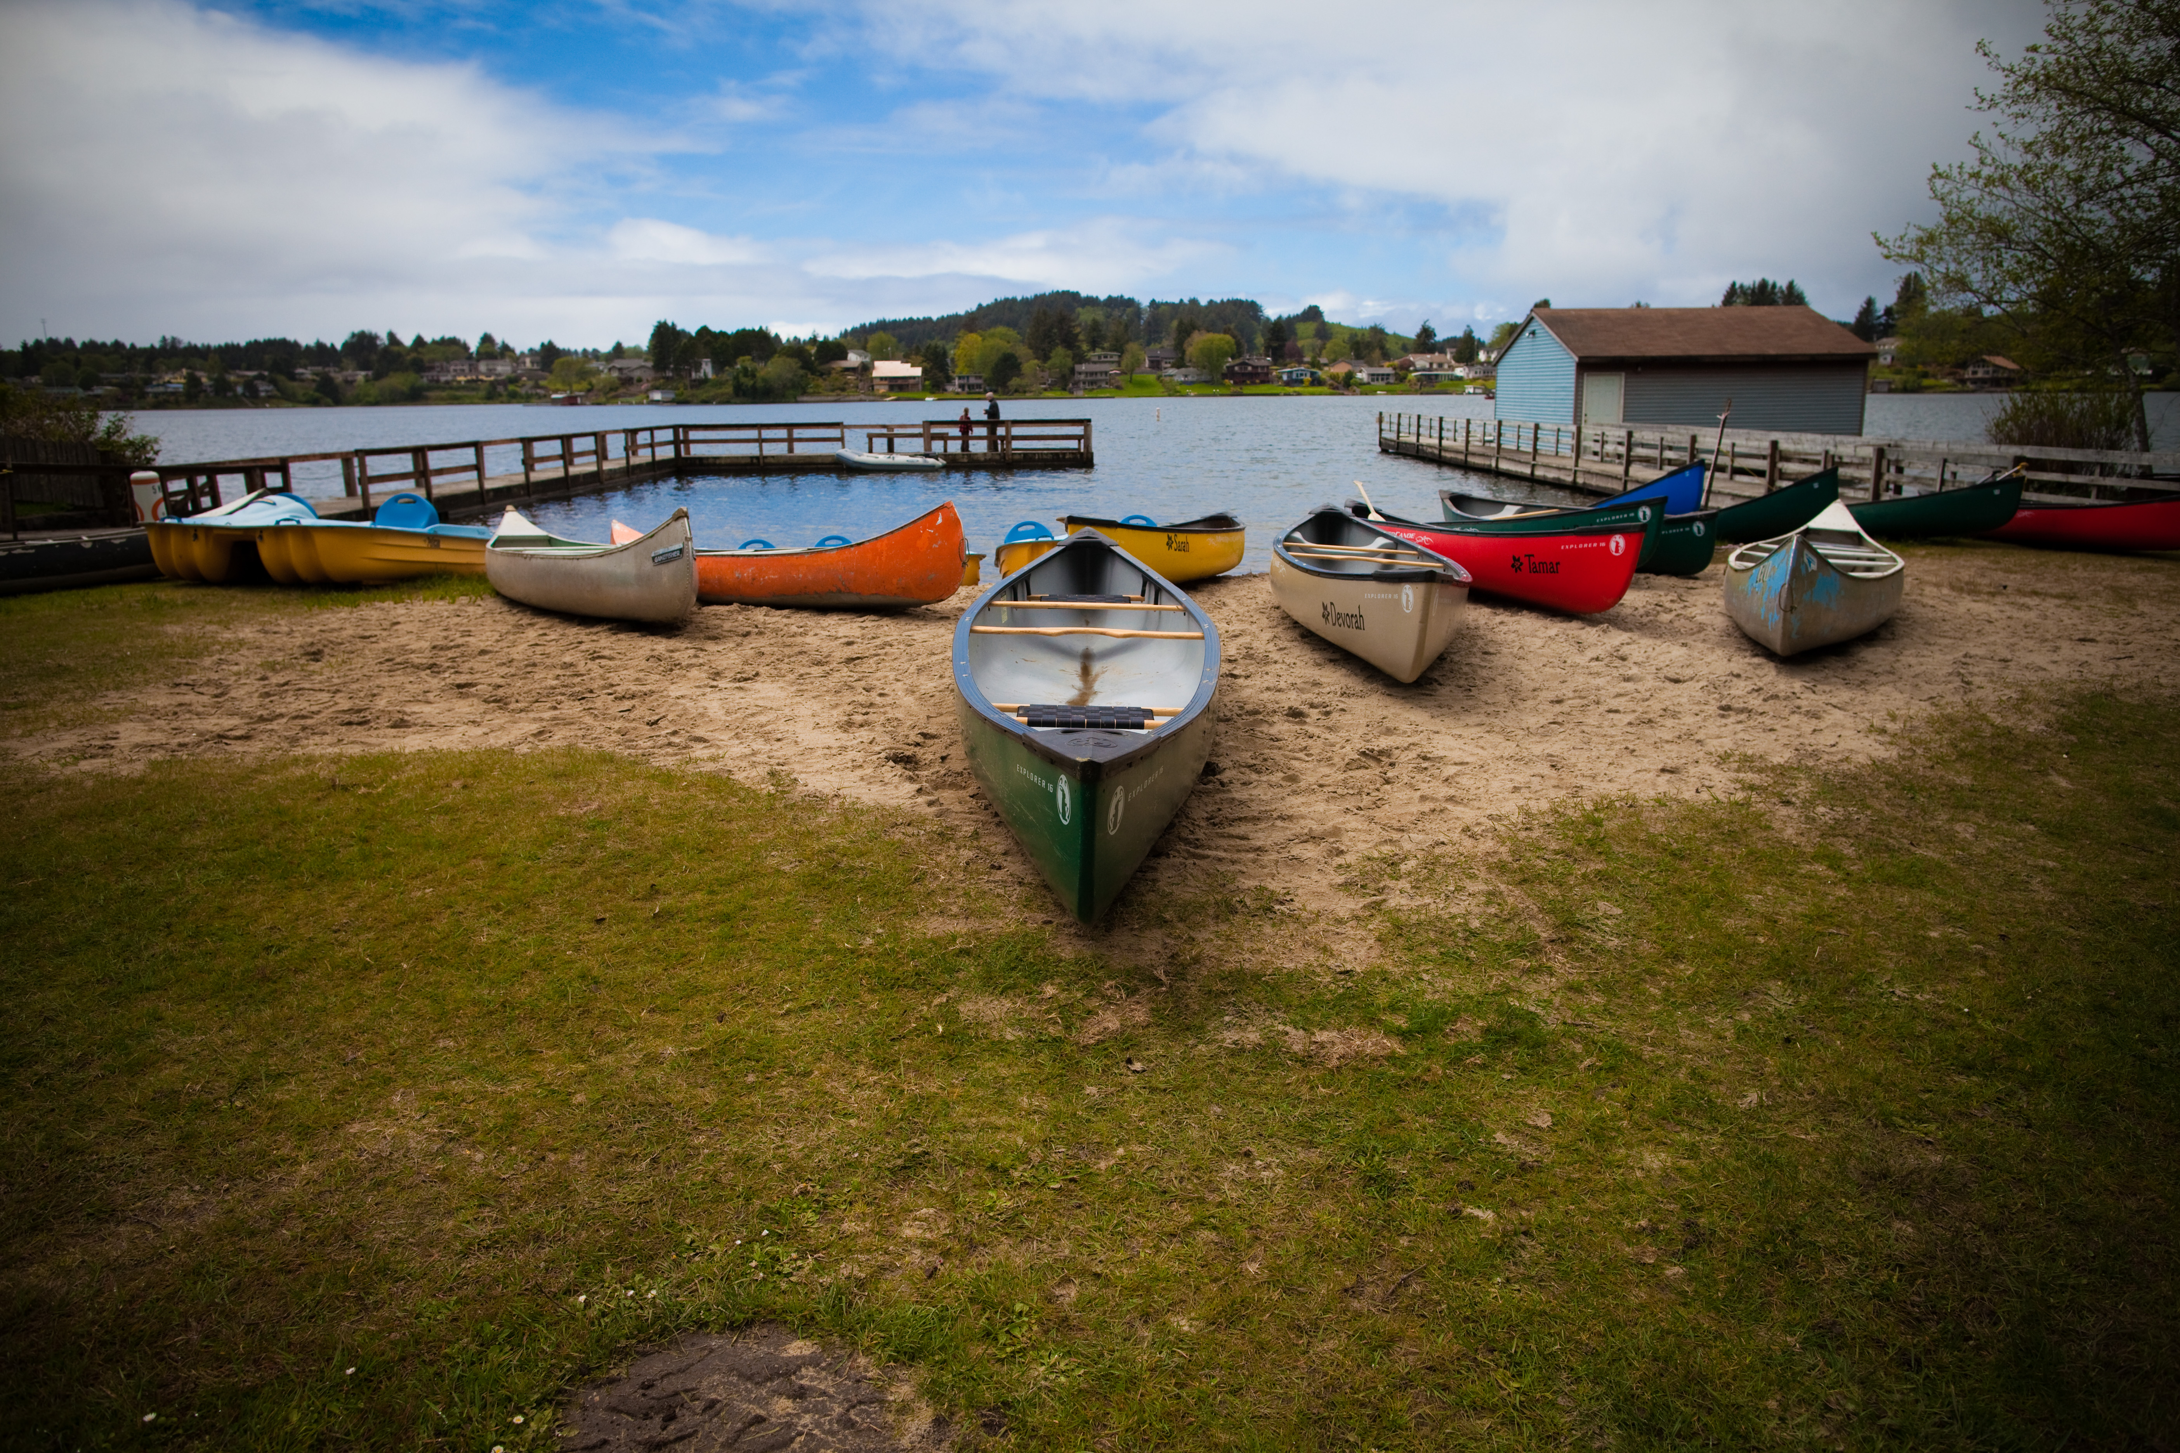

What are you passionate about?
The things that matter the most to me are….
Opening up the space for impacting the future is a powerful tool for enrollment.

Slide 26
Announcements
A cohort call/community of practice for Camp Development Professionals – Day and Overnight – is being run by both FJC and JCamp 180. The next one is 2 PM on Monday, May 11 (next Monday). Keep an eye out for the link.
JFN for donors to learn about how they can help with All Together Now: Thursday May 7, at noon.
Drop-in Discussion for All Together Now participants – to help anyone from those camps – staff or board members – make the most of the All Together Now matching grant. 2 PM Tuesday, May 12 (next Tuesday). New link will be sent out soon.
Facebook Frame for All Together Now matching grant. You can find this in the All Together Now Toolkit (Jcamp180.org/toolkit), including instructions for how to add it to your profile picture.

Slide 27



Slide 28
Asking for Camp
Now

