Slide 1
The Donor Lifecycle Map: Strategies for Obtaining, Retaining, and Upgrading Gifts
Deborah Kaplan Polivy, Ph.D.
October 24, 2017

Slide 2
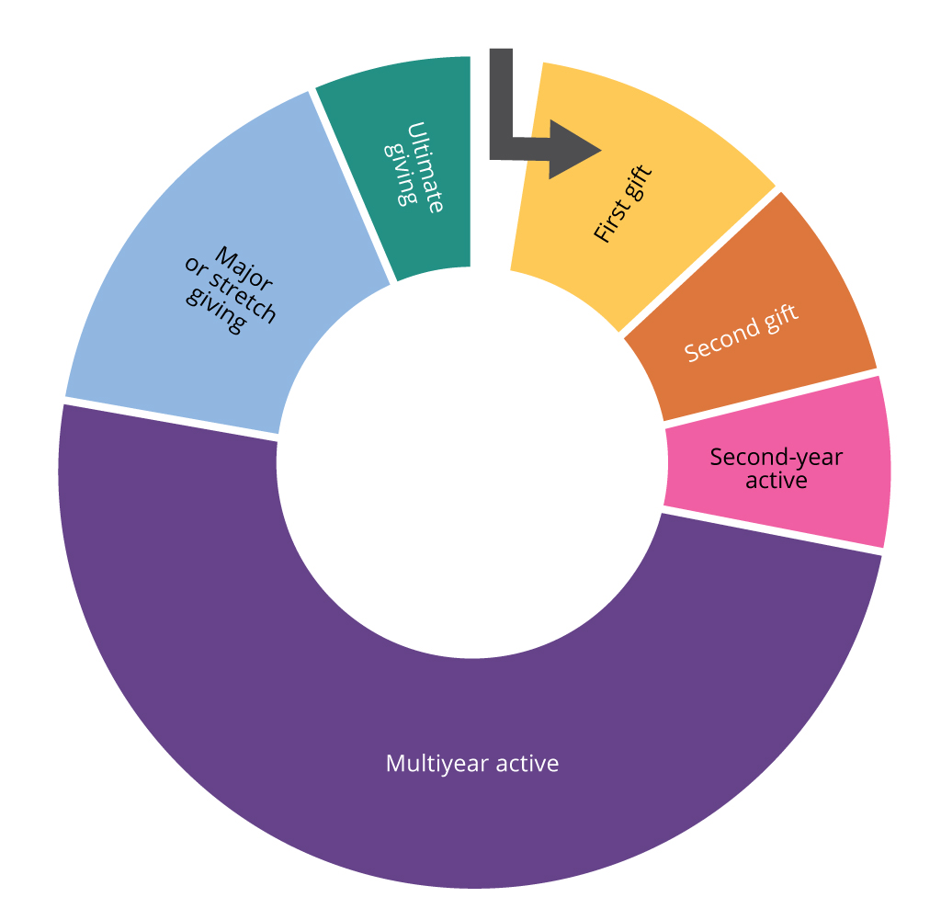
The Donor Lifecycle Map*
* "Donor Lifecycle Map" was published prior on 101fundraising.org by Sarah Clifton.

Slide 3
Why did the donor lifecycle map make so much sense to me?
Notes:
Why did the donor lifecycle map make so much sense to me?

Slide 4
What is cultivation?
“To foster the growth of”
(According to Webster)
© 2013 Deborah Kaplan Polivy

Slide 5
Of what are we trying to foster growth?
Money
Donors
Opportunities
© 2013 Deborah Kaplan Polivy

Slide 6
The Donor Lifecycle Map

Slide 7
What Questions Can We Ask?
What tools do we have to move donors from one section of the Donor Lifecycle Map to the next?
How well are we maintaining donors from one segment to the next?
How do we measure success?

Slide 8
What tools do we have?

Slide 9
The Donor Lifecycle Map
What tools can we use to move donors along the Donor Lifecycle Map?
Newsletters
Face to face meetings for major, new donors
Social media
Phonathon to say thank you
Annual report on the internet
Personal letter

Slide 10
The Donor Lifecycle Map
Thank you call or letter
Face to face meeting
Invitation to an event
Newsletters
Personalized direct mail
Face to face invitation to second year active
Telephone call
Print annual report
Opportunities for involvement

Slide 11
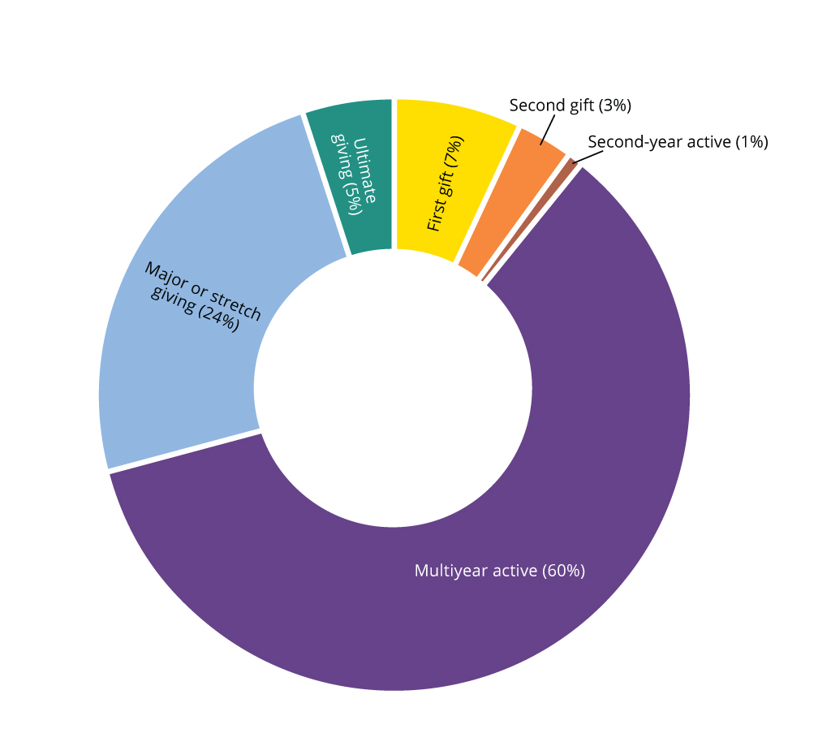
How well are we maintaining our donors?

Slide 12
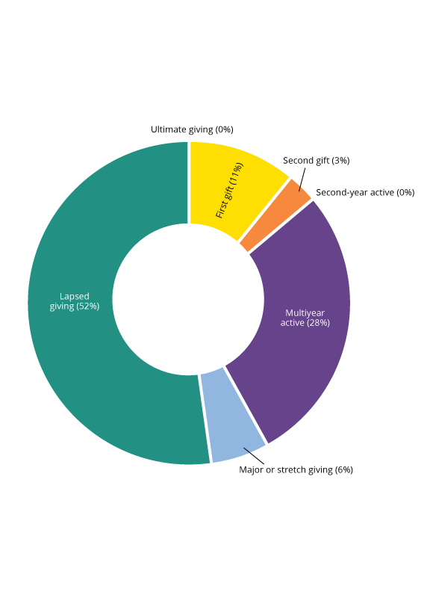
Lapsed Donors

Slide 13
Measures of success using the Donor Lifecycle Map
Goal – move 90% of first year contributors to second year.
Goal – shift 15% of second year donors to second year active.
Goal – move 15% of multi-year active donors to major donors.
Goal - Convene 6 face to face meetings every month with multi-year active donors.
Goal – Design an ultimate gift program, including create a Legacy Society.

Slide 14
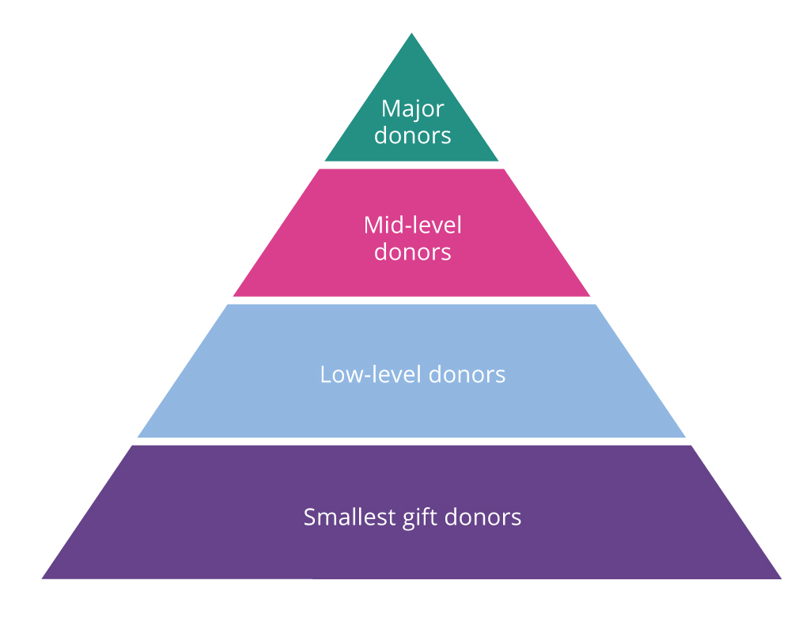
How does the Donor Lifecycle Map compare to the Donor Pyramid?

Slide 15
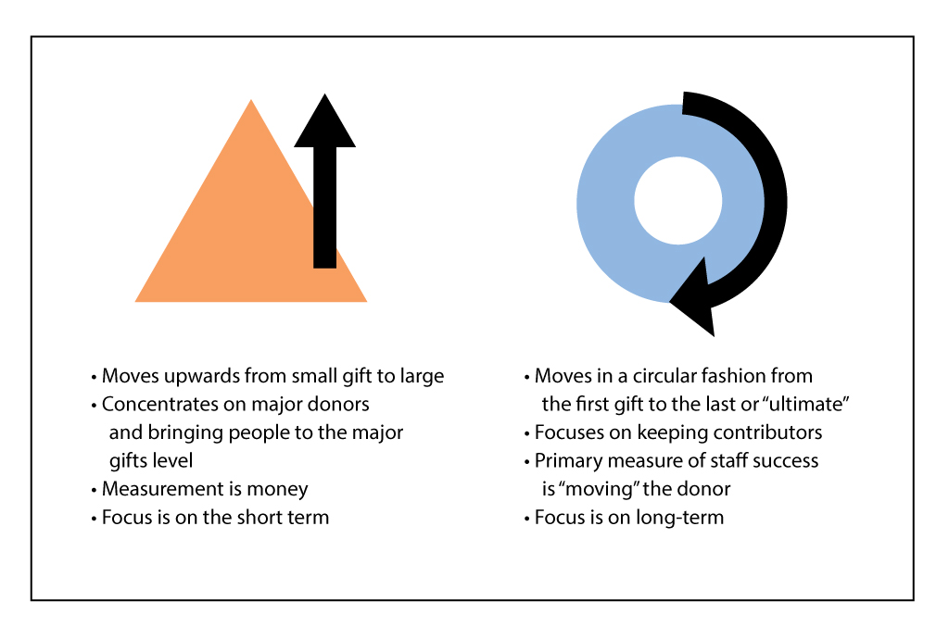
The Donor Pyramid vs the Donor Lifecycle Map

Slide 16
Two views from the Chronicle of Philanthropy (October, 2017)
“I wish I had a dime for every meeting I have sat in in which a nonprofit has denigrated the small donor, treated that donor as an after-thought, as an also-ran, as the last item on the agenda, often tabled because time ran out.”
“The group’s fundraising pyramid is in full swing.”
“You’re trying not have your giving pyramid become a space needle”

Slide 17
What really happened?

Slide 18
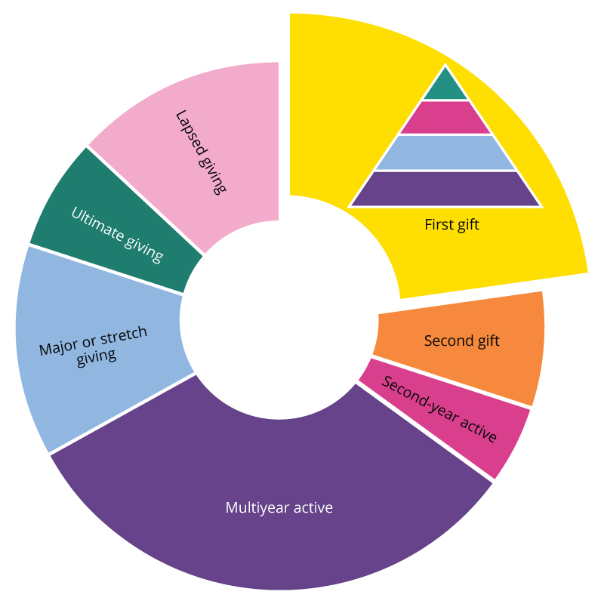

Slide 19
Newsletters
Face to face meetings for major, new donors
Social media
Phonathon to say thank you
Annual report using internet/ with letter to major donors
Personal letter

Slide 20
What are the challenges to effecting change?
Ensure that executive staff and board understand the new model.
Conduct data analysis and create Donor Lifecycle Maps for your organization.
Create three-year strategic plans in order to measure success.
Do away with the “One Number” as a measure of success.
Introduce ongoing training.

Slide 21
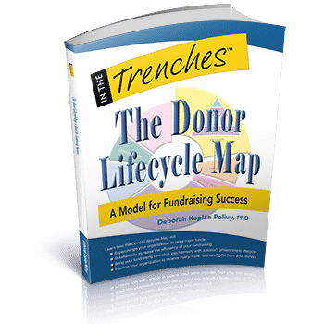
The graphics on slide #s 1, 7,-12 , 15 and 16 were designed by Kim O’Reilly.

