Slide 1
Beyond Cash: Donor friendly gift options
Anne Vittoria
Director of Gift Planning
Mount Holyoke College

Slide 2
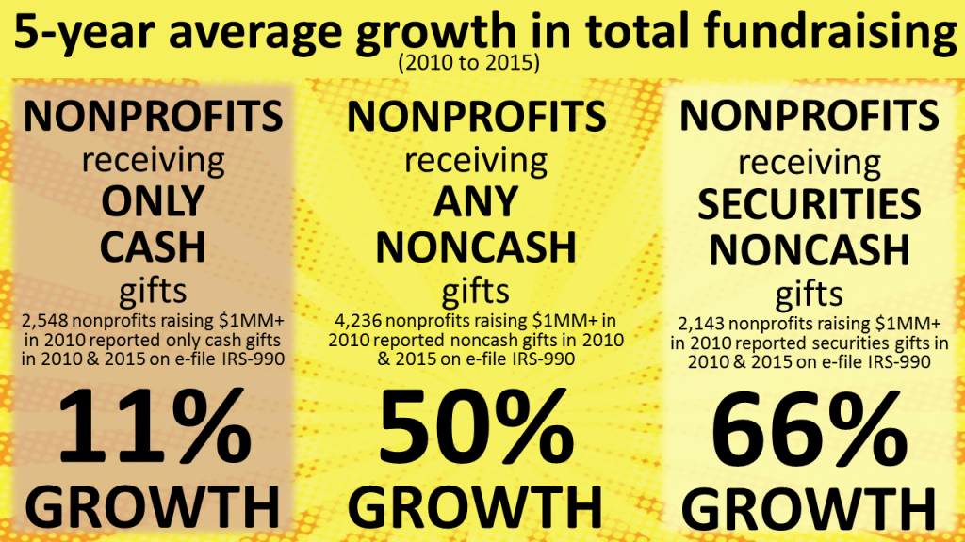
Results from 1 Million Nonprofit Tax Returns 2010-2015
Prof. Russell James III, JD, PhD, CFP, philanthropy researcher at Texas Tech University

Slide 3
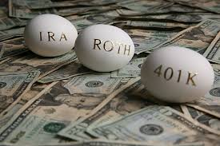
NON CASH APPRECIATED ASSETS
Securities: Stocks,
Bonds, Mutual Funds

Slide 4
Securities: Stocks,
Bonds, Mutual Funds
DOUBLE TAX BENEFIT WHEN GIVEN TO CHARITY
DOUBLE
Charitable Deduction for Full Market Value
(with 5 year carry over)
Avoid Capital Gain

Slide 5
GIVE A SECURITY KEEP A SECURITY
I’ve decided to give $10,000 to
Camp this year
I have $10,000 in cash
as well as securities.
The securities have performed really well and increased in value over the past few years. I’d like to keep them in my portfolio.

Slide 6
?
GIVE A SECURITY KEEP A SECURITY
Transfer $10,000 of
favorite securities to Camp
Double Benefit:
charitable deduction for full $10,000
pay no capital gain tax when given to charity
Use $10,000 cash to
re-purchase favorite securities
Benefit:
same amount invested in the favorite security
higher cost basis, saving future capital gains tax

Slide 7
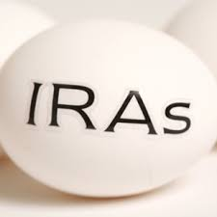
QUALIFIED CHARITABLE DISTRIBUTION
Making a gift from an
Individual Retirement Account
Attractive to donors who do not itemize deductions
2018 increase in standard deduction will mean fewer people itemizing
Keeps reportable income lower because it passes directly to charity
not considered income
Potentially avoiding Social Security and other income from being taxed at a higher rate

Slide 8
QUALIFIED CHARITABLE DISTRIBUTION
Donor must be age 70 ½ or older when the gift is made
Gift must come from a traditional IRA
401(k), 403(b), SEP IRA, and other retirement accounts do not qualify
The gift must come directly from the IRA to charity
Able to distribute any amount, $1 to $100,000

Slide 9
QUALIFIED CHARITABLE DISTRIBUTION
?
Satisfies all or a portion of the Required Minimum Distribution (RMD) if not already taken in that calendar year
Excluded from income therefore not available as an income tax charitable deduction
Donors should contact their
fiduciary company to initiate a charitable distribution

Slide 10
NAME CAMP A BENEFICIARY
Last Will and Testament
Living Trust

Slide 11
NAME CAMP A BENEFICIARY
?
I give to NAME OF CAMP in LOCATION, Federal Tax Identification Number: XX-XXXXX, (___% of my residuary estate) or (all of my residuary estate) or (the sum of $ ) to be used for the benefit of CAMP as the Trustees thereof may direct.

Slide 12
DONOR ADVISED FUNDS
DAF is a charitable account sponsored by a public charity that donors can use to support their philanthropy
Donor makes an irrevocable gift to the sponsoring public charity gets a tax deduction and advises on where distributions are to be made
Good for donors wanting to make a larger gift in one year (often for tax purposes) with distributions given over a period of years

Slide 13
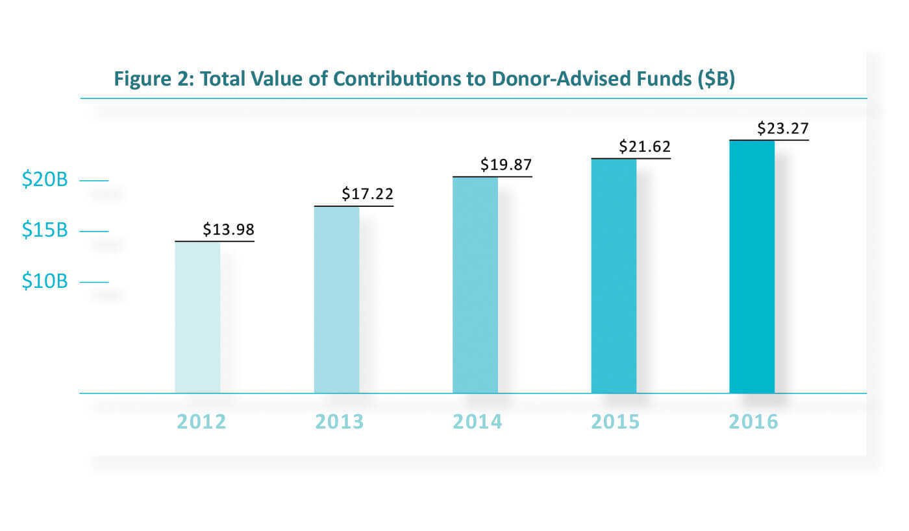
DONOR ADVISED FUNDS
National Philanthropic Trust 2017 DAF report

Slide 14
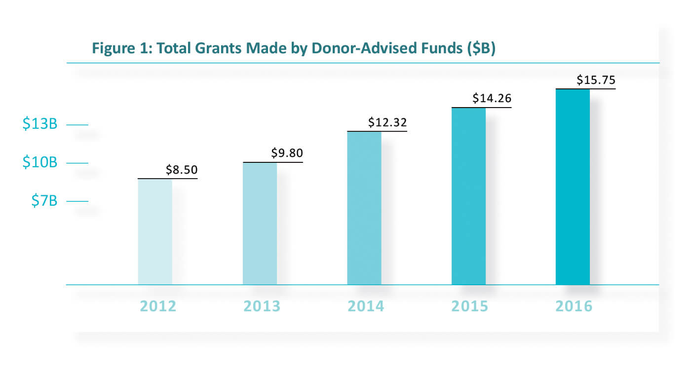
DONOR ADVISED FUNDS
National Philanthropic Trust 2017 DAF report
Notes:
Growth in distributions to charity

Slide 15
?
DONOR ADVISED FUNDS
Who are your donors giving through DAFs?
Can they be cultivated to give more through their DAF?
Is your camp named an ultimate beneficiary of their DAF?
Be certain of the IRS regulations around crediting and restrictions around using DAFs for pledge payments and restrictions around events and gifts.

Slide 16
QUESTIONS
?
?
?

Slide 17
Resources:
Allen Thomas – Real Estate https://thomaspg.com/about-us
Chronicle of Philanthropy – Working with Donor-Advised Funds: The Basics https://www.philanthropy.com/article/Working-With-Donor-Advised/243282
Fidelity Charitable – Donor Advised Funds – Assistance With Complex Assets https://www.fidelitycharitable.org/nonprofits/overview.shtml
Jewish Federations of North America – Planned Giving Information http://www.jfnagift.org/
National Association of Charitable Gift Planners – General Information https://charitablegiftplanners.org/
National Philanthropic Trust – 2017 Donor Advised Fund Report
https://www.nptrust.org/daf-report/
Prof. Russell James III, JD, PhD, CFP – Philanthropy Researcher at Texas Tech University http://www.depts.ttu.edu/hs/pfp/james.php
Schwab Charitable – Donor Advised Funds https://www.schwabcharitable.org/public/charitable/home
Sharpe Group – Your Guide to Effective Giving After Tax Reform https://sharpenet.com/
Vanguard Charitable – Donor Advised Funds https://www.vanguardcharitable.org/

