Slide 1
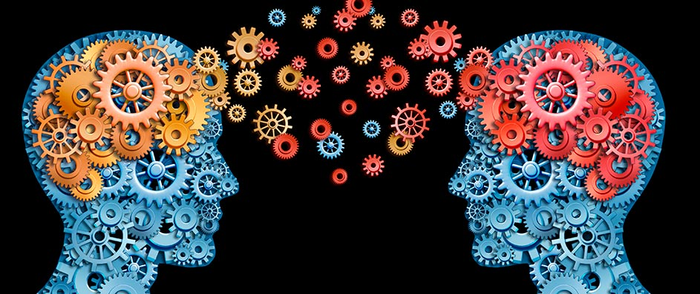

In the Donor’s Mind
The Science of Giving:
Evidence-based Research in Charitable Giving
Notes:
Distinguish between what we know about the tactics and strategies of fundraising and what is in the head and minds of the donors.
Now one approach is simply to say, “Why don’t we ask them?” and this would be a great start.
In fact I strongly urge you and your colleagues to spend a great deal of time asking your donors why they gave.
They will in most likelihood be incredibly frank and honest and in the process reveal things you never considered.
HOWEVER, this approach assumes that donors themselves know why they behave the way they do.
Often they are influenced by a number of factors that they have no control over and are not aware of.
Let’s start with a few.
NEXT

Slide 2
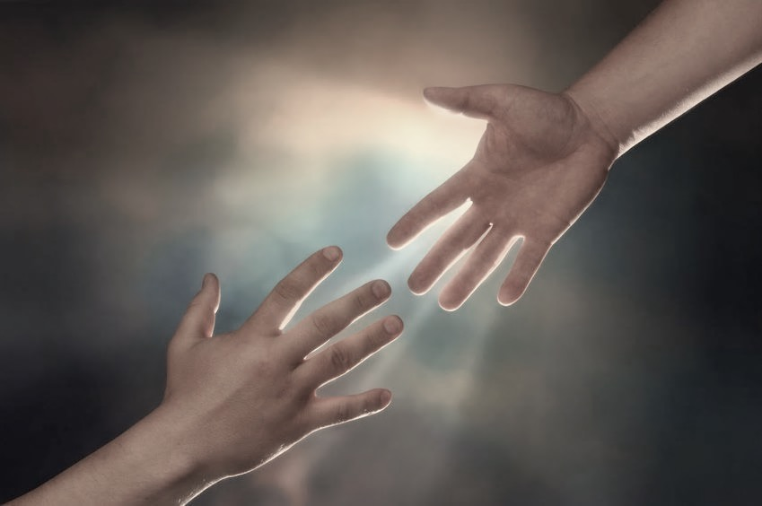
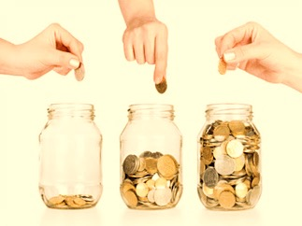

Notes:
In our nature
Demonstrated generosity
We’re irrational - behavior

Slide 3
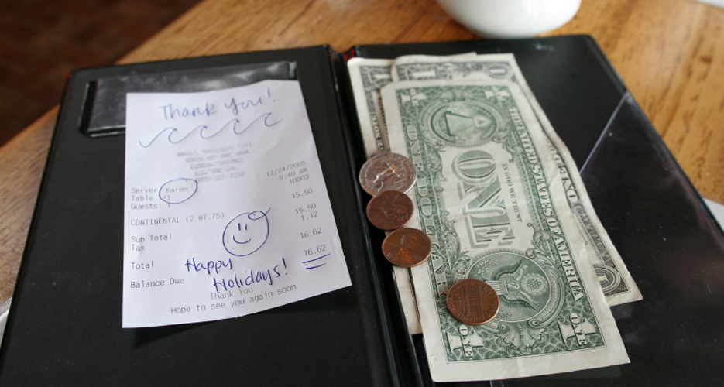
The Science of Tipping
Notes:
Prof Michael Lynn, Hotel Admins Cornell hundreds of research studies….
Touching the customer discretely, lightly, and in a neutral part (such as the forearm while laying down a napkin).
Squatting during initial contact at the table to ensure that eye contact is at the same level, or preferably in a position where the (all-)powerful customer is higher than the server.
Making additional "non-task" visits, but discretely and in moderation, just to check that all is well and nothing extra is required.
Smiling warmly and genuinely when greeting the customer and remaining pleasant and optimistic.
Introducing themselves by name—which personalizes service much better than wearing a name badge.
Even factors like writing "Thank You!" or drawing a cartoon on the bill works (at least in the U.S.).
Tips have been shown in studies to be, at least in part, a function of the weather: Sunny days lead to happier moods and more generous diners, for example. Tipping can also be a function of whether and how much guests drink: More alcohol, in many cases, leads to less rational judgement and bigger tips.

Slide 4
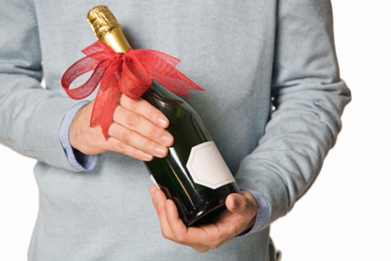
The Polite Dinner Guest
Thank you for inviting me to dinner tonight.
Here’s a bottle of wine. (worth $25)
Notes:
Gee this steak is expensive.
We don’t not talk about money explicitly.
Nice thing to do.

Slide 5
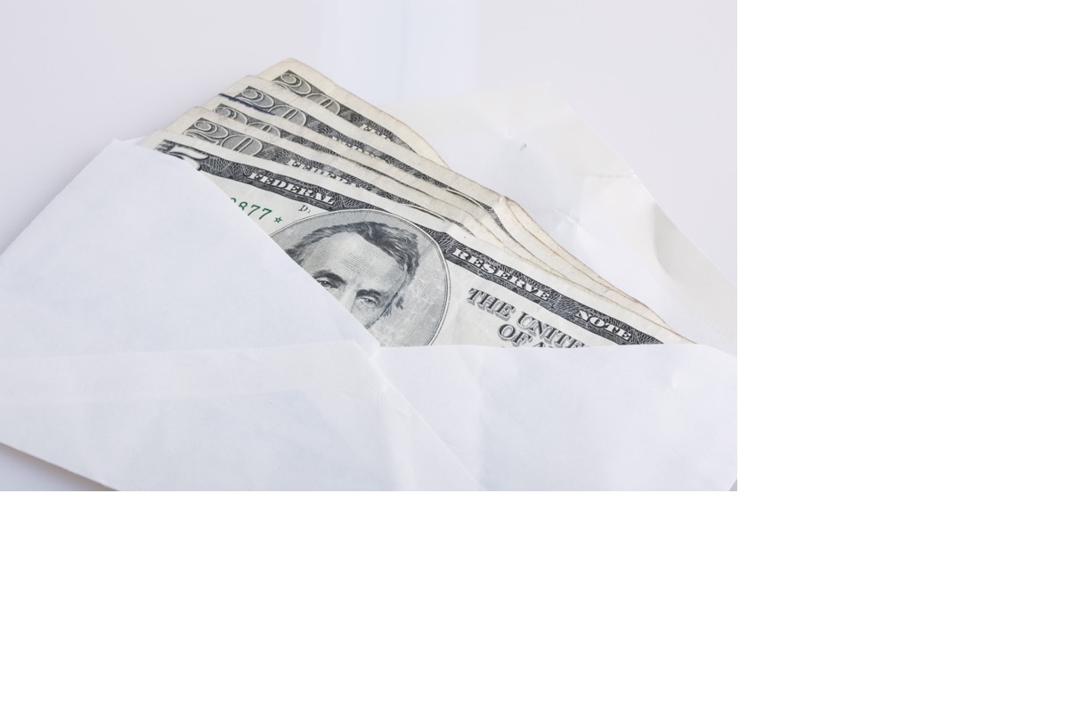
The Polite Rational Dinner Guest
Thank you for inviting me
to dinner tonight.
Here’s $35.
Notes:
How would you feel if a guest handed you $25 at the end of the meal (or the beginning).

Slide 6
The Amsterdam Airport
Notes:
Professor Mary Berenbaum, head of the department of entomology (the study of insects) at the University of Illinois told NPR that apparently, men have “a deep-seated instinct to aim at targets”. The fly decal fulfills that need, and men spend more of their attention making sure they hit the target, so to speak. Schilphol’s manager claimed that “spillage” was down 80% once the flies were added. That, of course, saves a lot of money on bathroom maintenance costs.

Slide 7
The Amsterdam Airport
…men have “a deep-seated instinct to aim at targets.”
Prof. Mary Berenbaum
Department of Entomology
University of Illinois
Notes:
Professor Mary Berenbaum, head of the department of entomology (the study of insects) at the University of Illinois told NPR that apparently, men have “a deep-seated instinct to aim at targets”. The fly decal fulfills that need, and men spend more of their attention making sure they hit the target, so to speak. Schilphol’s manager claimed that “spillage” was down 80% once the flies were added. That, of course, saves a lot of money on bathroom maintenance costs.

Slide 8
The Fly
Notes:
Professor Mary Berenbaum, head of the department of entomology (the study of insects) at the University of Illinois told NPR that apparently, men have “a deep-seated instinct to aim at targets”. The fly decal fulfills that need, and men spend more of their attention making sure they hit the target, so to speak. Schilphol’s manager claimed that “spillage” was down 80% once the flies were added. That, of course, saves a lot of money on bathroom maintenance costs.

Slide 9
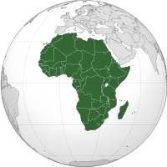
Q1 - Last 2 digits of SS#?
Q2 - How many countries in Africa?
’00
’99

Slide 10
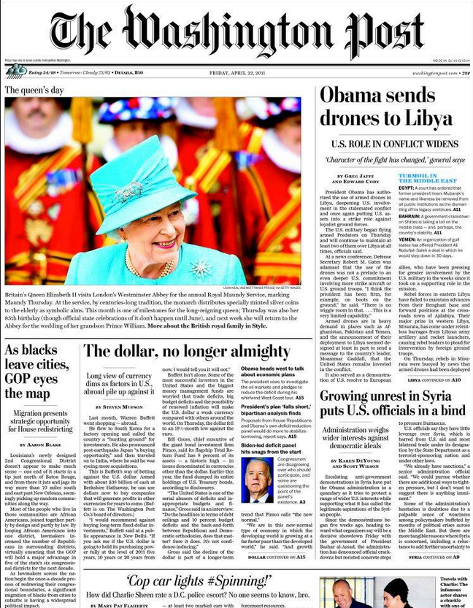
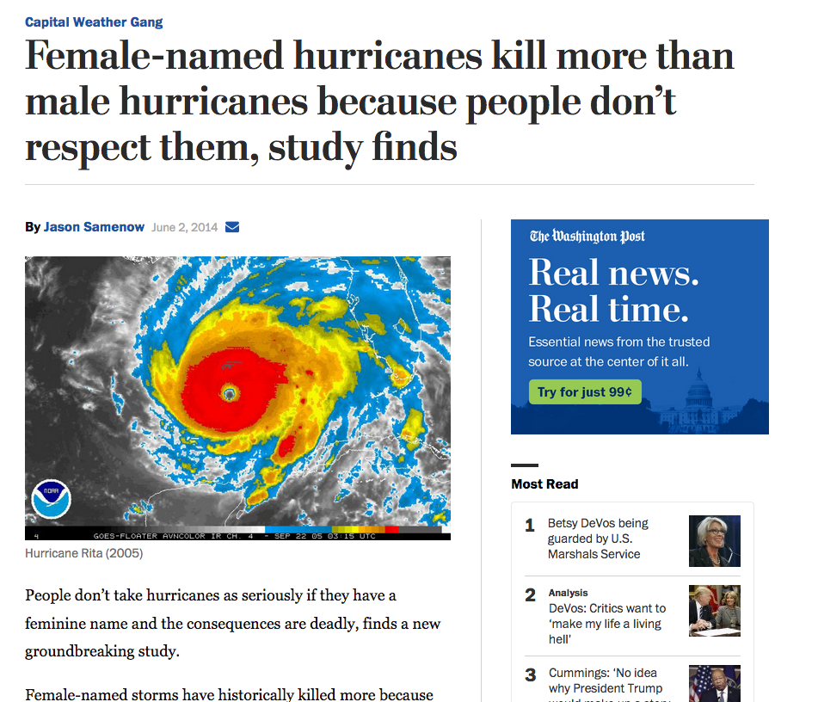
Sharon Shavitt, professor of marketing,University of Illinois
Notes:
Matthew vs Nicole
More about conscious and unconscious perception and the subsequent behavior.
1953 (WOMENS NAMES) and 1979 (MENS NAMES), too
45 woman
23 men
Mr and Mrs Hurricane
Tiffany vs Bruno

Slide 11
Hurricane Named Harry
260%
150%
100%
50%
33%
Charley
Francis
Ivan
Katrina
Rita

Slide 12
Organ Donations
Denmark
Holland
Germany
England
28%
17%
12%
4%

Slide 13
Organ Donations
98%
98%
98%
96%
Denmark
Holland
France
Germany
England
Belgium
Austria
Hungary
28%
17%
12%
4%

Slide 14
Organ Donations
Opt In vs Opt Out
98%
98%
98%
96%
Denmark
Holland
France
Germany
England
Belgium
Austria
Hungary
28%
17%
12%
4%

Slide 15
Opt In vs Opt Out
NOW
• $40 one year membership
• People renew when they go to the museum next not when due
ALTERNATIVE
• $25 for 6 months
• Charge to credit card, renew automatically
• Credit card statement: “JMA800-555-1212”
• Cancel, refund $25, keep membership
Notes:
Application of what I’m sharing is important.
So he’s number 1
Retirement plans

Slide 16
Everything matters
Notes:
Color of pledge card
Day of the week
Time of the day
Stamped not stamped
Timing: Hurricane earthquake: farah facett anf michael jackson died the same day

Slide 17
The Elements of Fundraising
Strategy
Tactics
Experience
Gut feelings, anecdotes, habit
Science
Notes:
The savviest of professionals and organizations are employing science and scientists to systematically improve performance.
Brian Mullaney, Smile Train, is an example that we’ll come back to.
Like pre 20th century medicine or quack doctors and quack remedies, we take our chances with things we think work until they don’t work.
Ant the truth is that nonprofits rarely go out of business – bad year in fundraising we might cut back services, let staff go, until things recover - which might mean we get lucky.
What are the sciecnes we speak of…

Slide 18
Fundraising Landscape
1,000,000 causes – and religious (+300,000)
3.8 billion pieces of solicitation mail
147 emails daily
58% increase in robocalls in 2018
45 times a day – check our cell phones (85% apps)
2+ hours of video daily
2.5 hours of desktop use daily
2.8 hours of mobile use daily
87% of millennials’ phones never leave their side!
Notes:
Distraction
Attention
I believe we truly are at a watershed moment in the social and technological landscape.
I think that technology – phones, computers - and the content that pervades these media are drastically changing how we think, how we react to our environment and how we process information.

Slide 19
Impact
Distraction (lack of attention)
Solicitation fatigue
Giving fatigue
39% retention rates

Slide 20
The Science of Giving
Behavioral Economics
Behavioral and Social Psychology
Neuroeconomics
Notes:
APPROACH
Principles and Concepts
Studies and Research
Applications
Bias
Fallibility
Irrationality
Rationality
Heuristics: People often make decisions based on approximate rules of thumb and not strict logic.
Framing: The collection of anecdotes and stereotypes that make up the mental emotional filters individuals rely on to understand and respond to events.
Market inefficiencies: These include mis-pricings and non-rational decision making.

Slide 21
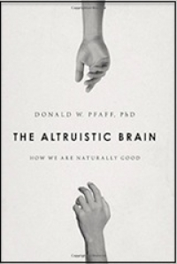
Altruistic Brain Theory:
“We cannot act toward another human being unless we can literally picture that person in all of his or her humanity.”
Donald W. Pfaff, PhD
Notes:
– or visualize a generic person –
Central nervous system registers act
You picture the person who will be the target of the act
The picture of the person blurs with that one’s self
You experience “feeling” which allows you to evaluate the consequences of the potential act
You decide whether or not to act

Slide 22
Value of Giving
Social Norms
Happiness

Slide 23
Intent vs Action
“How many times did you give to the business school in the past 5 years?”
Cornell University, Johnson School 1987

Slide 24
Intent to Give vs. Action
4.0
Gave Less
Gave More
1 2 3 4 5 6 7

Slide 25
Intent to Give vs. Action
(A) Donors think they gave
(B) Donors intend to give – but don’t
2.9
4.0
Gave Less
Gave More
1 2 3 4 5 6 7

Slide 26
Pre-Commitment
Separate the act from the pain:
Monthly giving: start now vs. in 2 months

Slide 27
Pre-Commitment
On January 1, 2020 ask your donors:
“Are you willing to make a gift to the Annual Fund before December 31?”

Slide 28
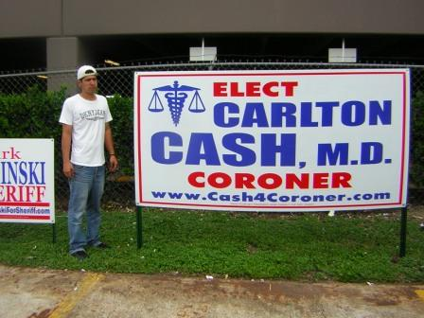
Incremental
17%

Slide 29

Incremental
17%

Slide 30
Incremental
17%
76%

Slide 31
Incremental
$5 or $25
Notes:
First date:
Wanna have coffee? or
Want to go on a Caribbean cruise?

Slide 32
Anchoring
$5 or $25
First gift
Test data: amount of first gift vs. lifetime and yearly average of gifts

Slide 33
Anchoring
“Put me down for what I gave last year.”
Notes:
Important for another reason – within reason people have a wide range that they would consider since they do not remember the amount (or date) of their last gift.
Cornell phonathon -

Slide 34
Reciprocation – Rejection then Retreat
Show higher price before customer settles for more reasonable – which was original intention of sale
“Will you consider a gift of $500?”
Notes:
Q: How much do you ask for if you want $250? More less exactly amount?

Slide 35
Matching or Challenge Grants
Do matching campaigns work?
Does the multiple have any impact on the results?
1 : 1
2 : 1
3 : 1
4 : 1
Prof. John List

Slide 36
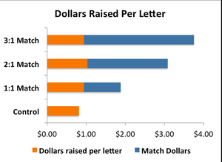
Matching or Challenge Grants

Slide 37
Matching or Challenge Grants
Anonymous
Named Challenge
Group Challenge

Slide 38
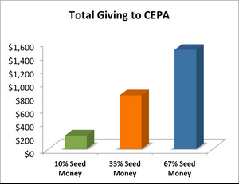
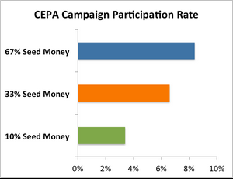
Seeding a Campaign
Prof John List
Notes:
United Way seeding campaign

Slide 39
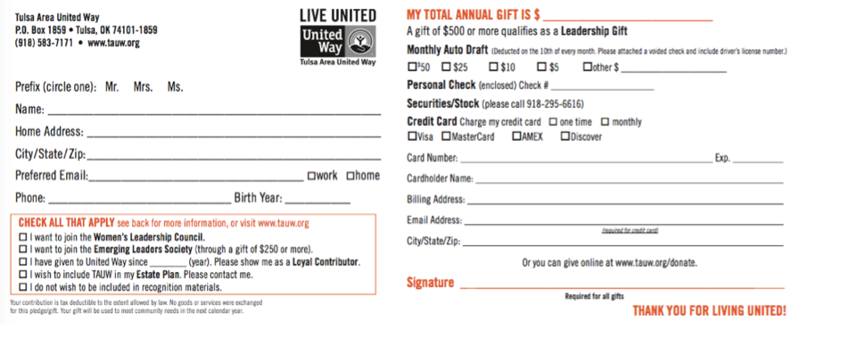
Menu Effect
Pledge card amounts
Donor picks numbers
Donor picks emotion and then states amount
Single blank
Single blank with question
Happiness question: college, vacation….

Slide 40
Names
Annual Fund
Scholarship
Operating Fund
Capital Campaign

Slide 41
Names
Annual Fund
Scholarship
Operating Fund
Capital Campaign
Loyal Alumni Initiative
Presidential Scholar
Campus Beautification Fund
Campus Core Values Fund
New Century
Creating the Future
Centennial Fund

Slide 42
Names Matter
bovine spongiform encephalopathy
Peter Gene Bayot Hernandez
Patagonian toothfish

Slide 43
Names Matter
bovine spongiform encephalopathy
Peter Gene Bayot Hernandez
Patagonian toothfish
Mad Cow Disease
Bruno Mars
Chilean Sea Bass

Slide 44
Value of Giving
Social Norms
Happiness
Notes:
Psychology, behavioral sociology, human behavior in its glorious irrationality and mystery.

Slide 45
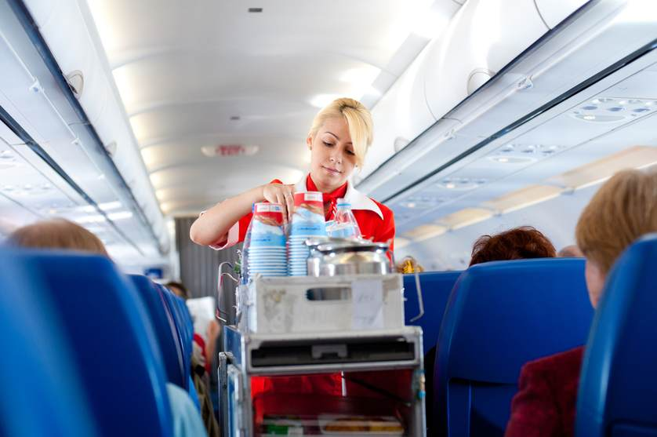
Social Influences: “I’ll have what she’s having.”
We take cues from others
People need help in determining what an “appropriate gift” is – whether phone or mail.
Shang and Corson (2009)
Notes:
Social norm. Social influecnes
SUMMARY: People need help in determining what an “appropriate gift” is. Same as phone and mail
Has positive year to next year impact – giving stays higher.
DISCUSSION: Control: “we had another donor who gave X dollars. How much would you like to give today. [Note: did not say “Would you give this amount?”
NEW DONORS
Control: $87
$75: $87
$180: $97
$300: $107
Note that people gave more but gave less than the amount suggested for $180 and $300.
RENEWING (vs previous gift)
Control: $1
$75: $4
$180: $19
$300: $26
Importance of anchoring at high level initially.
APPLICATION: Do this! BUT ethics is that you have to have a donor who gave that amount. And there is danger in revealing this strategy to the public and to your donors. Careful if you have prizes and rewards for giving at certain levels. May negate the impact of this strategy/tactic.

Slide 46
Social Influences
$107
People need help in determining what an “appropriate gift” is – whether phone or mail.
Cues from others
$97
$87
$87
Control
$180
$75
$300
Shang and Corson (2009)
Notes:
Social norm. Social influecnes
SUMMARY: People need help in determining what an “appropriate gift” is. Same as phone and mail
Has positive year to next year impact – giving stays higher.
DISCUSSION: Control: “we had another donor who gave X dollars. How much would you like to give today. [Note: did not say “Would you give this amount?”
NEW DONORS
Control: $87
$75: $87
$180: $97
$300: $107
Note that people gave more but gave less than the amount suggested for $180 and $300.
RENEWING (vs previous gift)
Control: $1
$75: $4
$180: $19
$300: $26
Importance of anchoring at high level initially.
APPLICATION: Do this! BUT ethics is that you have to have a donor who gave that amount. And there is danger in revealing this strategy to the public and to your donors. Careful if you have prizes and rewards for giving at certain levels. May negate the impact of this strategy/tactic.

Slide 47
Social influences: Share identity
$142
“We had another donor. He/she gave $300.”
=
$106
≠
Cialdini (2001)
Notes:
Social information
Profound:
Mismatch +$105.70
Match $141.88
34% difference!!!!
Rich Asiamah Story: Phonathon
DISCUSSION: No research on whether men and women respond differently to their gender match Do men give more when referencing men than women and women?
People give to people
People give to people like them.
APPLICATION: Do it.

Slide 48
Homophily
"love of the same” – the tendency of individuals to associate and bond with similar others.
Notes:
Social networks – marketing by getting message to people who will likely connect with others of similar traits.
Jewish Federation: Lawyers Division, Accounting, Medical, Finance/Banking.
Cornell: Class, Football team, geography, Hotelies.
Ideas: Wisconsin Cornell alumni vs Illinois. Cubs vs Cleveland.

Slide 49
Notes:
Feel likes everyone’s your friend and neighbor
Hugging strangers in a bar
News for you – Progressive Field is not the center of the world

Slide 50
Notes:
Google’s most search trends,….
The watchout
Make sure your fundraising is not based on your perspectives but a true understanding of the market and attitudes of your prospects and donors.

Slide 51
Social Decision Making
“Individuals are motivated not only by monetary gains but also by some reward derived from cooperating in social situations.”
Crowdfunding
Peer-2-peer
Giving Tuesday
24-Hour Giving
Notes:
Alan Funt – Black and White Squares

Slide 52
Autobiographical Connections
Emphasize autobiographical connections between the donor and the charity (or its beneficiaries)…
…rather than focusing on
the charity’s need for funds.
Notes:
Narrative
Rich Asiamah – MBA Ghana 2 hours of calling
Kathy Dillon – have something in common..
Deb Arbitman – blunt; GIVE SOMETHING
Heidi ‘79

Slide 53
Identified Victims or Beneficiaries Effect
One vs more
Happy vs sad
Before and after
Before or after
Notes:
Jessica McClure $100,000 to save one life immediately than spend $100,000 for ambulance that could save several lives.
Smile Train: caucasian (Afghani)
Before and after cleft pallet surgery less effective than just before picture. John List (U of Chicago)
One and Done Campaign

Slide 54
Seed Money
Crowdfunding parallels
Quantity
Quality (denominations)
Foreign money
“How do you want to feel?”
“How do you feel now?”
Martin Randel (2008)

Slide 55

Credit Card Donation: Social Swipe

Slide 56
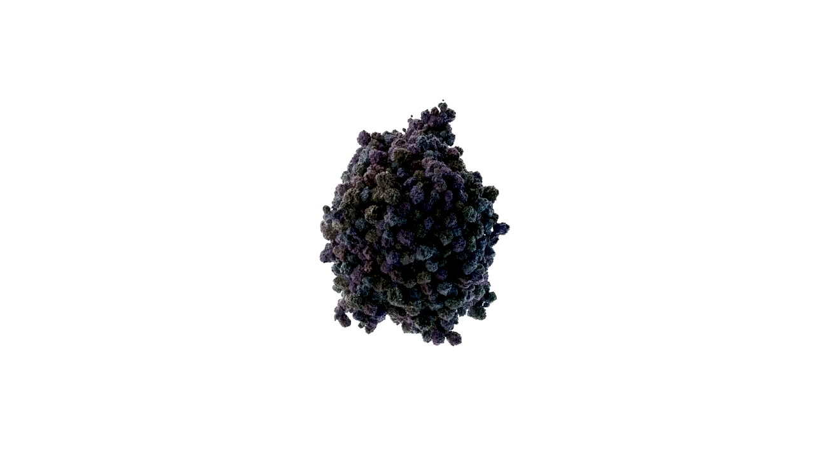
Credit Card Gift: Interactive Billboard
https://
Notes:
Cannot understand everything e’s saying but you can follow on the screen.

Slide 57
Value of Giving
Social Norms
Happiness

Slide 58
Happiness
“Trying to be happy accumulating possessions…. is like trying to satisfy hunger by taping sandwiches all over your body.”
George Carlin
Notes:
Giving money has similar effect as other brain stimulants like alcohol, drugs, and sex. Highlights parts of brain of pleasure and reward. Functional Magnetic Resonance Imaging (fMRI). Volunteering increases life satisfaction (as does social networks).
“How much” was not as important as simply “how” money was spent.

Slide 59
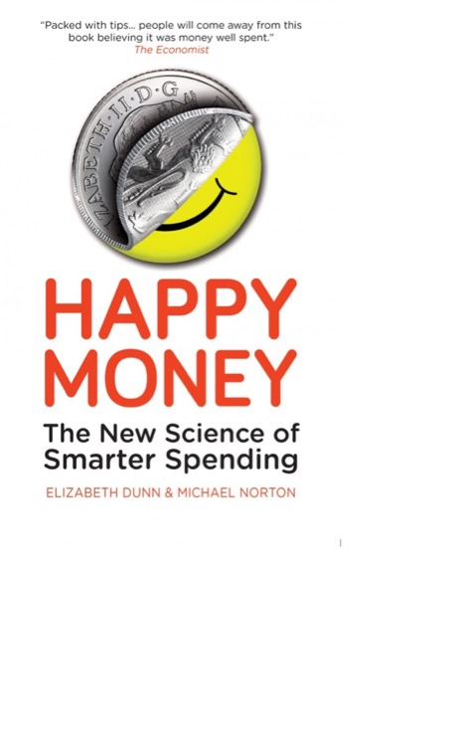
“Money Buys Happiness”
Buy experiences
Make it a treat
Buy time
Pay now – consume later
Invest in others
Michael Norton & Elizabeth Dunn, Harvard

Slide 60
Giving Makes People Happier
1 Bills and expenses
2 Purchase for themselves
3 Gifts for others
4 Charitable donations
Don’t describe giving as a transaction
Dunn, Aknin, Norton (2008)
Notes:
Giving money has similar effect as other brain stimulants like alcohol, drugs, and sex. Highlights parts of brain of pleasure and reward. Functional Magnetic Resonance Imaging (fMRI). Volunteering increases life satisfaction (as does social networks).
“How much” was not as important as simply “how” money was spent.
Doing something for others makes us feel good.

Slide 61
“Happy Money” and Altruism
Make it a choice
Make a connection
Make an impact
Michael Norton & Elizabeth Dunn, Harvard
Notes:
United Way
“Should” give vs would you “consider” giving

Slide 62
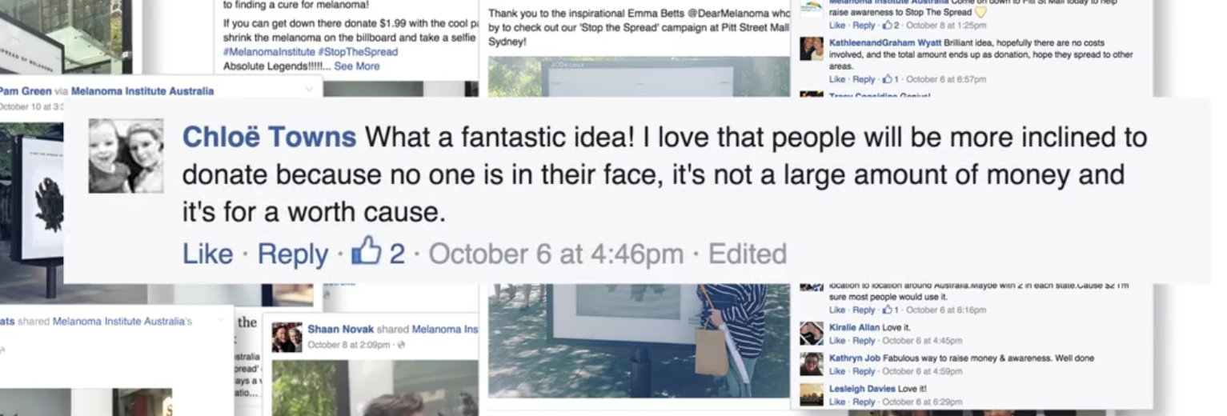

Slide 63
Happy People Increase Giving
After experiencing positive events participants were more likely to help others.
After remembering positive events participants were more likely to give.
Isen and Levin (1972)
Notes:
: After experiencing positive events participants were more likely to help others. People who felt good were more likely to help others. Other positive moods are also applicable, such as a feeling of competence. This applies to those experimentally induced or naturally occurring.
OTHER RESEARCH: Impact of negative vs positive thoughts; happy people vs sad people giving habits.
APPLICATION:
(1) Instill a positive, happy memory
(2) Focus on message of hope not despair when raising money for poverty, disasters.

Slide 64
Happiness Runs in Cycles
Renewal, loyalty, retention and appropriate behaviors support happiness.
Don’t break the loop.

Slide 65
Drugs, Alcohol, Sex, and Giving
Giving engaged mesolimbic reward systems in the same way as when subjects received monetary rewards.
Giving elicited neural activity in reward processing areas.
Notes:
Subjects tested with fMRI.

Slide 66
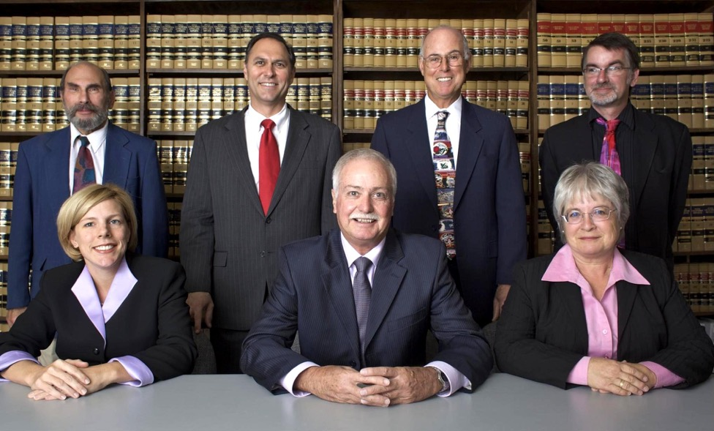
Heart not Wallet
“Crowding out” intrinsic motivation thorough external incentives may move those behaviors from the social realm into the economic realm with detrimental results.
Dunn
Notes:
Do not rationalize giving by telling people they will be happier, feel better, etc.
Lawyers – pro bono vs discounted fees

Slide 67
How to Ask without Asking
A challenge in asking is that while it may increase the amount raised it can also decrease donor well-being.
An experiment found that people may avoid solicitors in a public fundraising campaign setting.
Andreoni, Rao, Trachtman (2002)
Notes:
You should give
Will you join me
It’s completely up to you.

Slide 68
Feeling Good
Salvation Army
Door #1 – Direct gaze
Door #2 – Eyes averted

Slide 69
Another thought: “Ignore everything I’ve said”

Slide 70
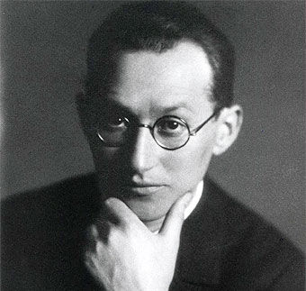
“Identify and then eliminate the obstacles standing in the way of the desired behavior.”
Kurt Lewin
Notes:
Who ordered a book? Or could order a book
Using today’s technology it’s easier to buy a book about hurricanes than help its victims.

Slide 71
Obstacles preventing donors from giving
It’s hard to give

Slide 72
Obstacles preventing donors from giving
It’s hard to give
Don’t know whether I gave already

Slide 73
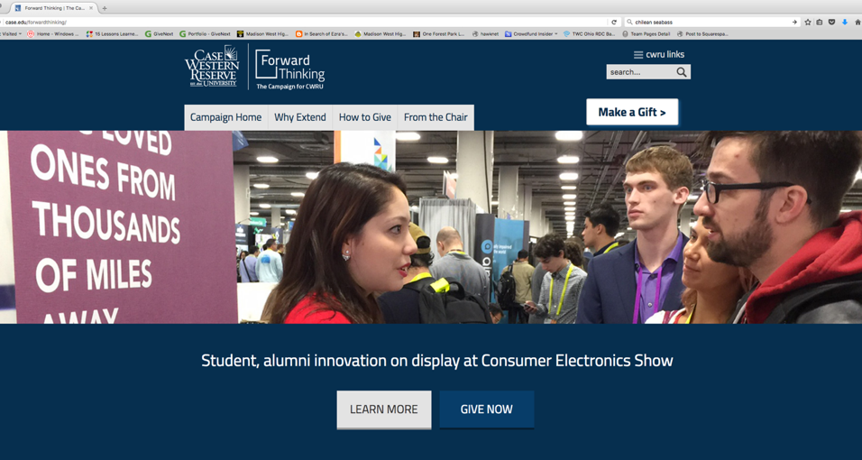
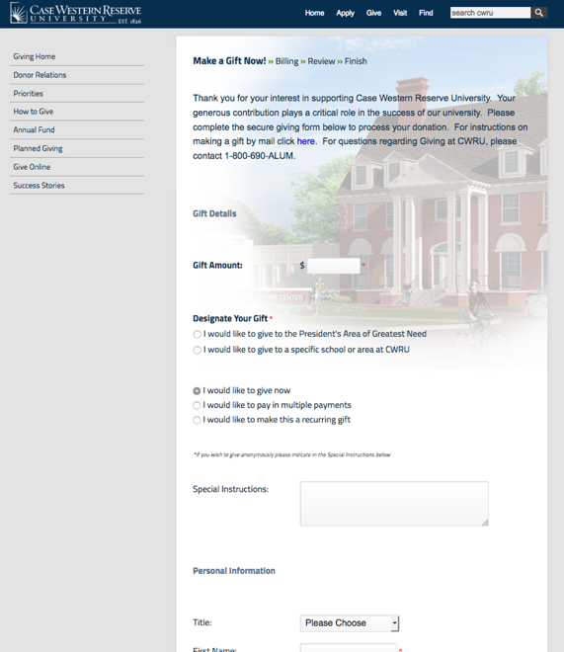
“How hard can we make it”
3 Web pages
3 Screens
0 Close window
2 Position cursor
4 Drop down menus
2 Buttons
9 Tab keys
7 Shift key
130 Characters and numbers

Slide 74
CORNELL
UNIVERSITY
Your done!
Now a special message
from Cornell.
Tax Receipt
Last Gift
Amount: $100.00
Date: 2015 Dec 30

Slide 75
CORNELL
UNIVERSITY
Your done!
Now a special message
from Cornell.
Tax Receipt
Last Gift (320 days)
Amount: $100.00
Date: 2015 Nov 29

Slide 76
CORNELL
UNIVERSITY
Your done!
Now a special message
from Cornell.
Tax Receipt
Last Gift (320 days)
Amount: $100.00
Date: 2015 Nov 29

Slide 77
Creativity
Passion
Perseverance
Boldness

Slide 78
Daniel Pink: “A Whole New Mind”
Agricultural Revolution
Industrial Revolution
Information Age
Conceptual Age

Slide 79
Daniel Pink: “A Whole New Mind”
Design
Story
Symphony
Empathy
Play
Meaning
Agricultural Revolution
Industrial Revolution
Information Age
Conceptual Age

Slide 80

Creativity
Cleveland History Center
Western Reserve Historical Society
Save the Date
200th Birthday

Slide 81
Creativity
Cleveland History Center
Western Reserve Historical Society
Save the Date
200th Birthday
Saturday, April 16, 2067
Notes:
The non-event event…. Black tie that wasn’t/
Breakthrough Schools – event run by the students.....

Slide 82


Slide 83
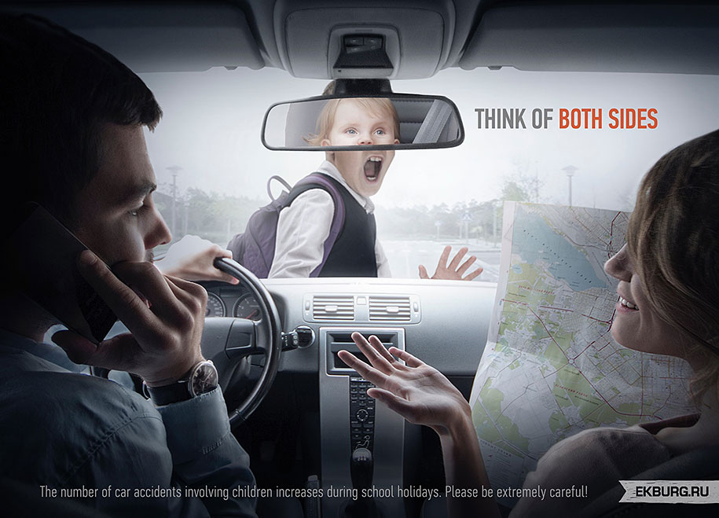

Slide 84
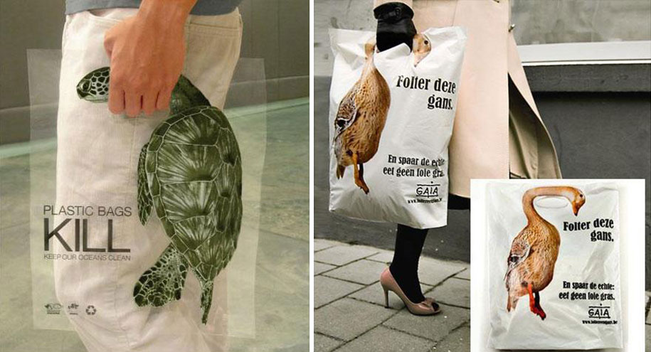

Slide 85
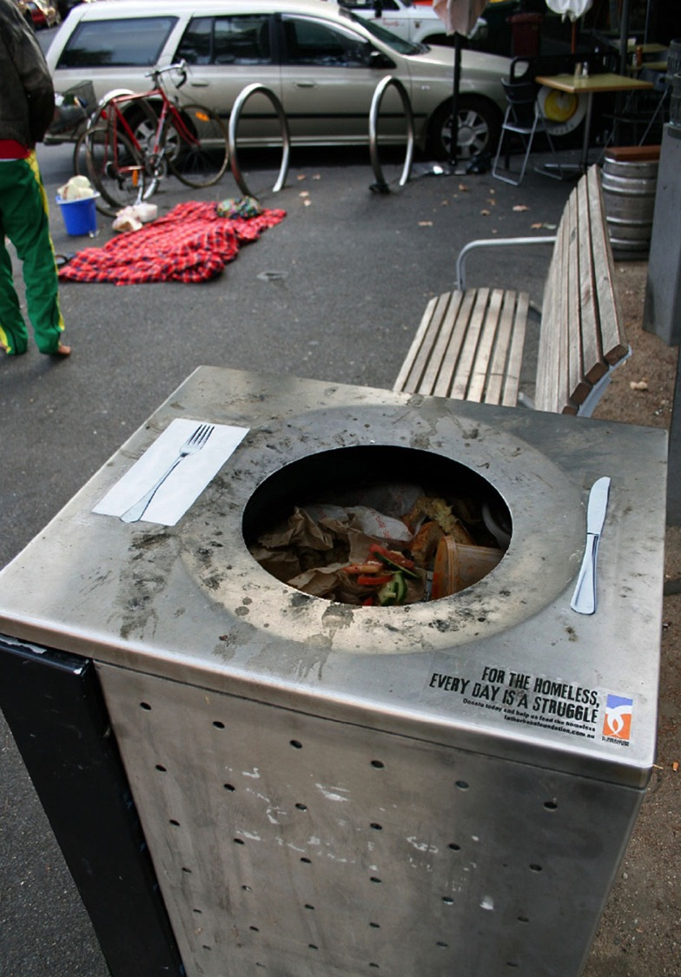

Slide 86
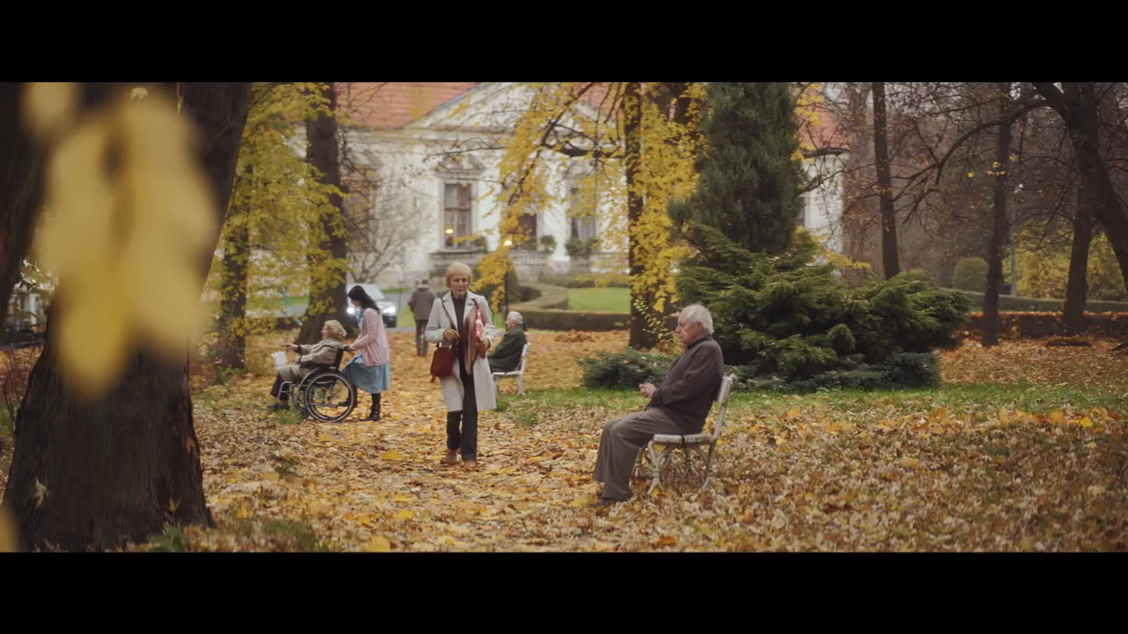

Slide 87
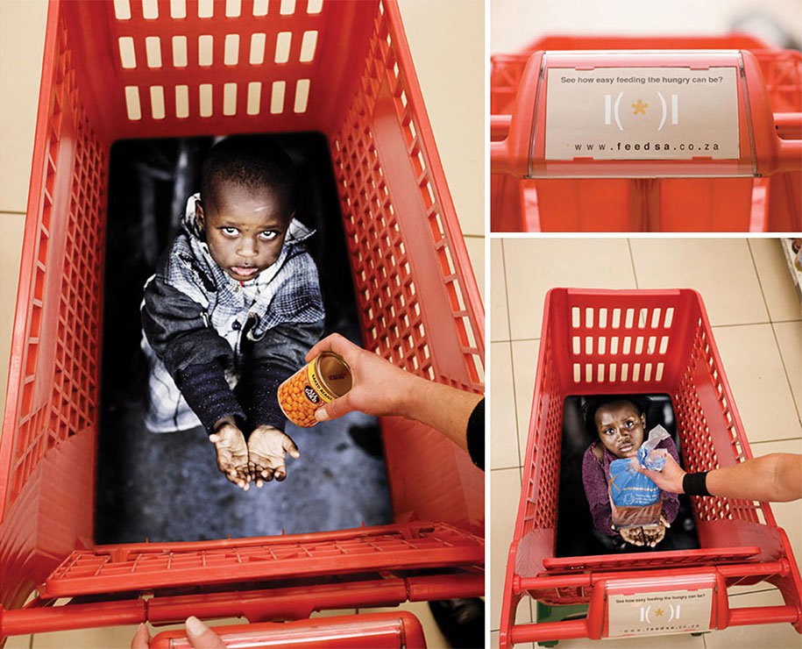

Slide 88


Slide 89


Slide 90
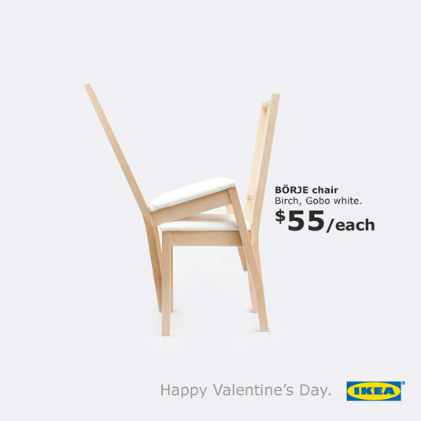

Slide 91

ADL • Anti-Defamation League

Slide 92
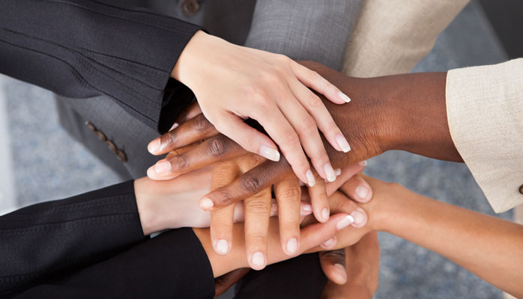


Slide 93
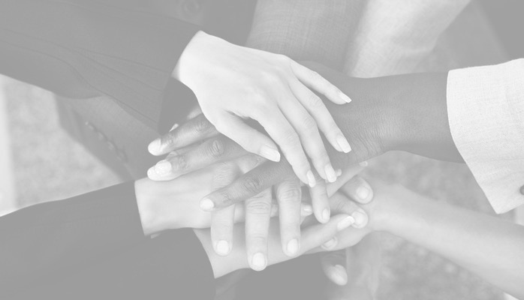

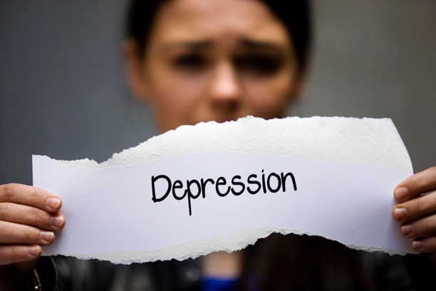
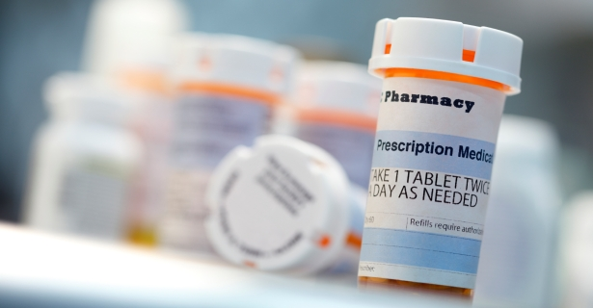

Slide 94

Daniel Mansoor
e: dan@goodworksgroup.com
m: 917.974.2325

