Slide 1
Bored to Brilliant
Eric Phelps
RAINMAKER Consulting

Slide 2
…Better Board Meetings

Slide 3
RAINMAKER Consulting
Fundraising Consulting
Strategic Planning
Executive Coaching
Organizational Development

Slide 4
Norms
We are all responsible for the success of the workshop and our own learning
We agree to speak with respect and in turn
We seek clarity
Check tech at door
We assume the best
It’s okay to just listen
We honor confidentiality
We are equals in this room
Our goal is to move our camp forward
Small ideas can have a big influence
Start/Stop on time

Slide 5
Meetings – Not Just Boring
Also a waste of time
11 million meetings each day in US
91% admit to day dreaming during meetings
76% admit to bringing other work to meetings
37% admit to dozing off!

Slide 6
Unproductive
Average of 62 hrs. of meetings per month
50% rated as “unproductive”
31 unproductive hours/ month (372 hours annually – 15 days!)
Results
Lost work time/free time
Frustration
Stress
https://www.shoretel.com/blog/how-many-hours-are-wasted-in-meetings-each-week

Slide 7
Why Do We Doo Doo This?
Most individuals have never experienced or witnessed the power of a truly effective meeting
It’s the way we’ve always done it (badly)
Many don't have access to information they need to improve their meetings
Staff and Board feel there's hardly enough time in a day to complete basic tasks. Who has the time or energy to commit to improving meetings?

Slide 8
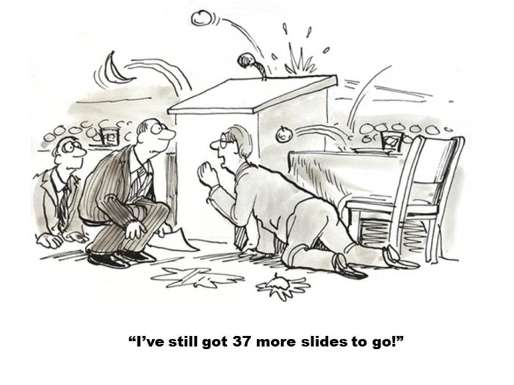

Slide 9
What looks like “a people problem” is often a situation problem

Slide 10
The Meeting Starts
Before

Slide 11
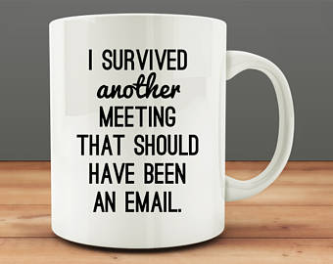

Slide 12
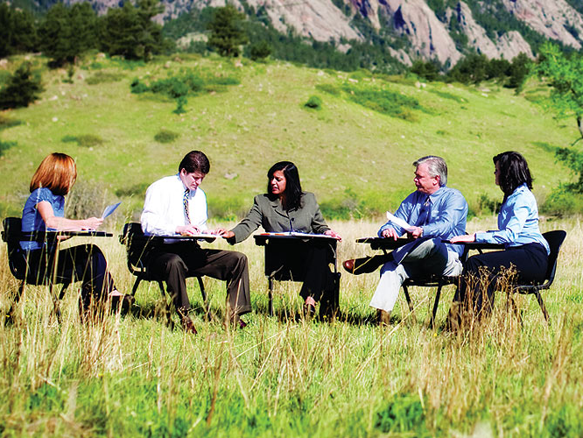
Where are we meeting?

Slide 13
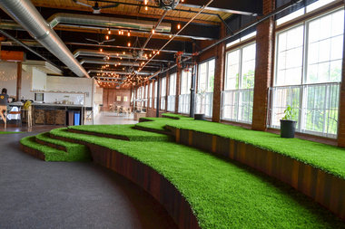
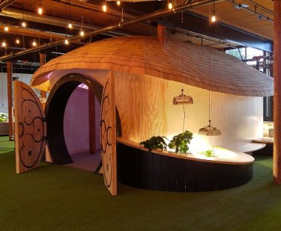

Slide 14
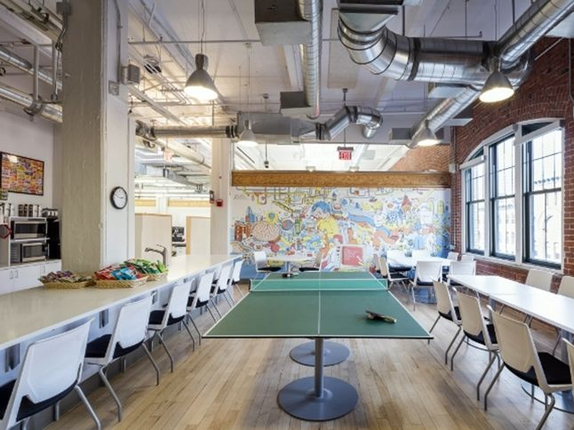

Slide 15
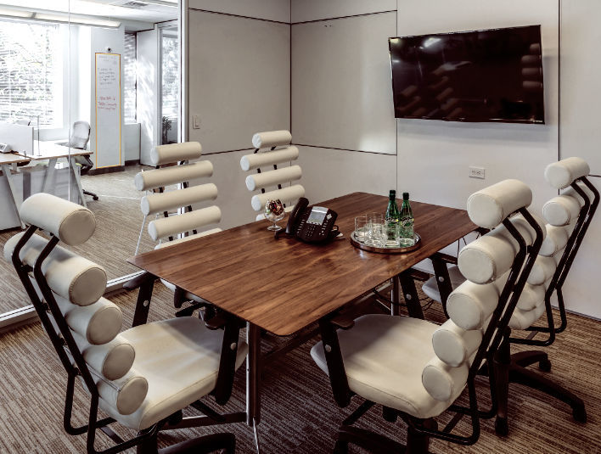

Slide 17
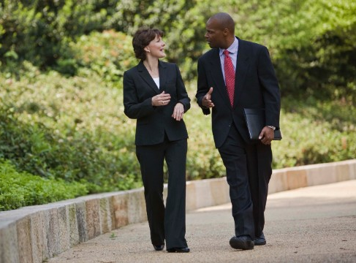

Slide 18
What looks like “Resistance”
is often confusion

Slide 19
Set A Clear Agenda

Slide 20
Something like this…
Item | Lead | Purpose | Duration
Call to Order | Kia |  | 2 mins.
Consent Agenda Approval | Kia | Vote | 5 mins.
Audit Report | Bill | Discussion/Vote | 20 mins.
Event Update | Beth | Information | 5 mins.
Mission Moment | Kerry | Information | 20 mins.
Strat Q: Board Development | Ramon | Discussion | 20 mins.
Other Business | Kia | Discussion | 10 mins.
Next Meeting | Kia | Information | 2 mins.
Adjourn | Kia |  | 1 min.

Slide 21
Or something like this…
Item | Lead | Purpose | Duration
Meeting Agenda | Jennifer | Decision | 2 mins.
Keynote Speaker | Emily | Information | 5 mins.
Marketing | Jo Ellen | Discussion/ Dec. | 20 mins.
Registration Update | Allyson | Information | 5 mins.
Conf. Location Problem | Jennifer | Discussion/ Dec. | 20 mins.
Sponsorships | Duane | Discussion/ Dec. | 10 mins.
Other Business | Jennifer | Discussion | 10 mins.
Next Meeting | Jennifer | Information | 2 mins.
Adjourn | Jennifer |  | 1 min.

Slide 23
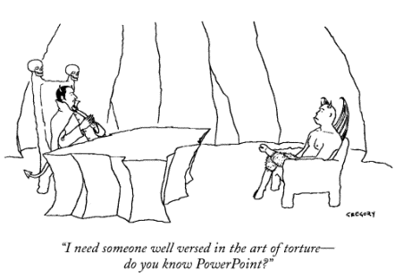
Plan for Technology

Slide 24
Help People Be Prepared
Request committee and staff reports two weeks in advance
Send materials to all meeting participants well in advance (3 – 5 Business Days)
Put a Summary in the Email (Note any controversial or urgent matters)
Use a Board Portal
Google shared docs
Web site portal for members only
Send reminders

Slide 25
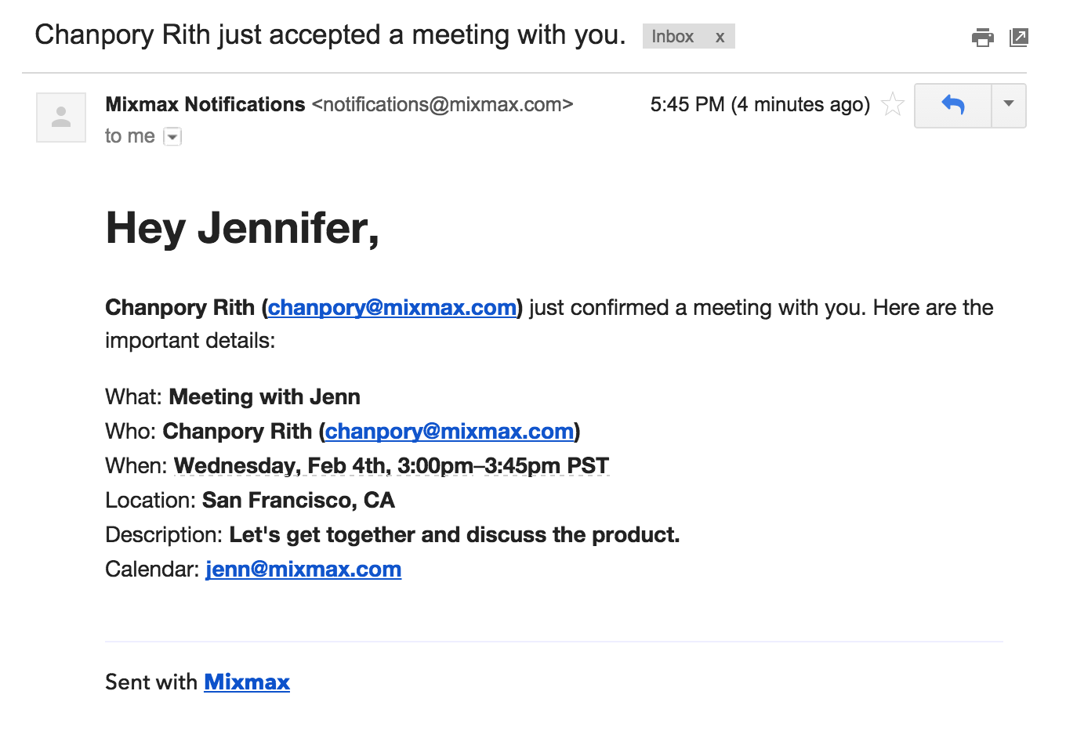
Confirm All Information – 24 hrs.

Slide 26
The Meeting

Slide 27
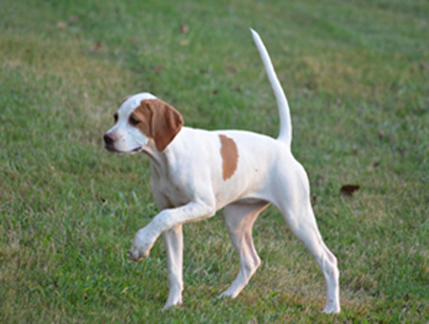
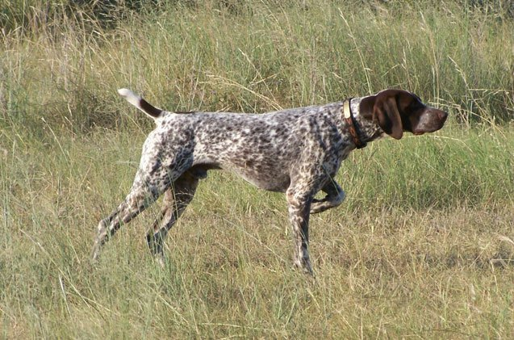
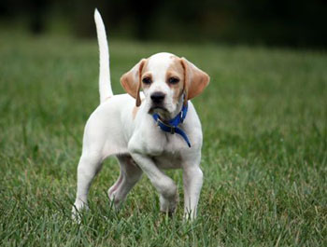
A Few Pointers…

Slide 28
Set a Clear Agenda
Be sure to set a strategic agenda
Include a Strategic Question
Stick to the Agenda
Talk, Table, Delegate, Decide
Use a timer

Slide 29
Consent Agenda
Designed to address routine items and information only reports in less time
Board agrees to review material in advance of meeting
Developed by President and Secretary and distributed week in advance
Questions/Discussion
Approved as single agenda item
Agenda Includes
President’s Report
Executive Director Report
Meeting Minutes
Committee Reports
Note: Cannot contain…
Budget approval
Controversial items
Policy changes

Slide 30
Simplify and Clarify Comm. Structure
Committees are loci of most board activity
All members participate in committees
Do not have TOO MANY committees
May The Task Force Be With You!

Slide 31
Committee vs. Task Force
Committees are loci of most board activity
All members participate in committees
Do not have TOO MANY committees
May The Task Force Be With You!
A short period of time
A clearly defined job to complete

Slide 32
Committee or Task Force
Committee
Task Force
Executive
Fundraising/Development
Board Development
Finance
Marketing/Outreach
Search
Strategic Planning
Event Sub-Comm.
Handbook Revision
Other

Slide 33
Build A Team

Slide 34
Build A Team
Implement team-building exercises
Include in-depth introductions at each meeting
Applaud Committee efforts and successes!
Be true to your word
Take advantage of conflict by resolving it
Value all contributions
Small ideas can have a BIG impact (Trim Tab)
Establish and maintain group norms

Slide 35
Listen and Ask

Slide 36
+ Delta

Slide 37
Recognize and Thank

Slide 38
Review Action Items
Immediately send out detailed minutes
Motions/Votes
Discussion
Summarize Action Items
WHO is responsible
By WHEN?
WHAT else?
HOW will you do it?

Slide 39
Check Technology at the Door

Slide 40
Implement 1:1 Meetings

Slide 41
Make Preparedness Mandatory

Slide 42
No Surprises!

Slide 43
Include Vision & Inspiration

Slide 44
What looks like “Laziness”
is often exhaustion

Slide 45
Don’t Meet Too Often

Slide 46
Culture Eats Strategy for Breakfast

Slide 47
Model the Culture You Want
YES
NO
Be on time for your meetings
Greet everyone in your meeting
Stay on track
Take responsibility
Be prepared with questions
Engage in side conversations
Come unprepared
Be negative
Avoid responsibility
Have distractions
Rehash what’s in your report
Be redundant & repetitive

Slide 51
Summary
2BON2B
Clear
Prepared
Creative
Strategic
Decisive
Action-oriented
Modeling what you want
Of your word

Slide 53
Eric Phelps
eric@rainmkr.com
Twitter @rainmkr
@ericlphelps

