Slide 1


Part 1: Understanding Financial Statements and Reports
Financial Literacy Series
Gina McDonald, CPA, Lead Consultant

Slide 2
Introductions & initiative overview

Slide 3


Financial Literacy Webinar Series
Part 1: Understanding Financial Statements and Reports
March 20, 2018
Tara Acker
Mentor
tacker@hgf.org

Slide 4


Welcome & Introductions
Today’s Presenter
Gina McDonald
Lead Consultant, FMA

Slide 5
Agenda
Essential IRS Classifications
Understanding Financial Statements
  Statement of Financial Position (Balance Sheet)
  Statement of Activities (Income Statement)
  Statement of Functional Expenses
  Cash Flow/Projection
Evaluating Performance
  Understanding Costs
  Key Performance Indicators (KPI’s) and Ratios
The Form 990
Q&A
!

Slide 6
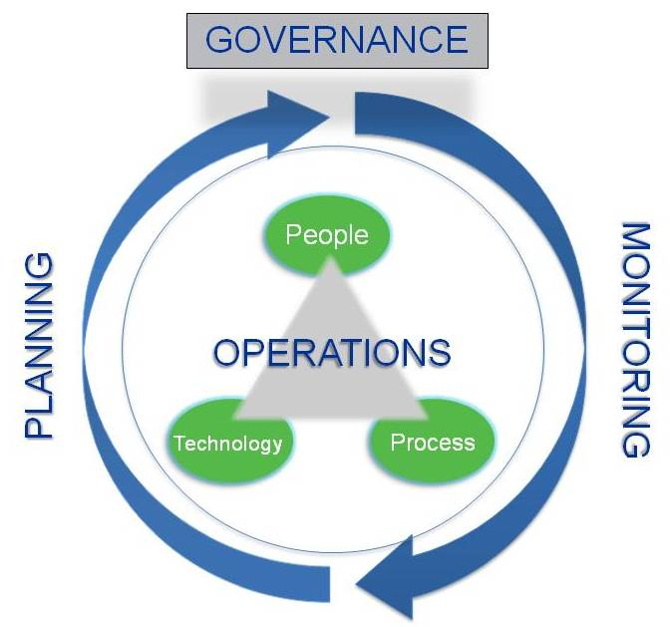
Strategic Financial Management

Slide 7
Internal Financial Reporting Hierarchy
Strategic
Organization
Departments
Programs
*Many organizations are embracing a top down as well as bottom-up approach to budgeting.

Slide 8
Key Questions
Operating Results
What are the organization’s trends in operating results?
  Overall surpluses or deficits
  How does financial aid affect bottom line?
Financial Position
How much cash is on hand and does it represent prepayments for a future camp season?
What are the immediately due liabilities versus longer-term obligations?

Slide 9
Statement of Financial Position
(Balance Sheet)
What We Own:
Cash
Receivables
Investments
Property, Plant & Equipment, net
Assets
Liabilities
What We Owe:
Bills due
Line of Credit
Deferred Revenue
Debt (short- and long-term)
=
+
Net Assets
Our Available Capital
Unrestricted
  Board Designated
  Fixed Assets
  Other
Temp. Restricted
Perm. Restricted

Slide 10
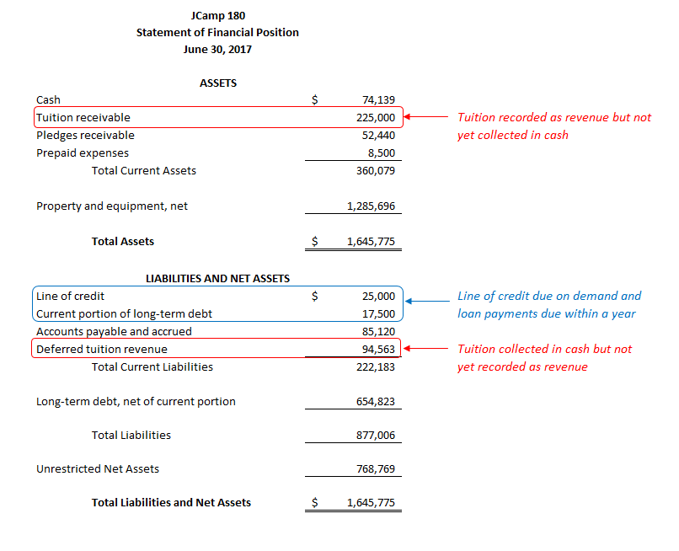
(Balance Sheet)

Slide 11
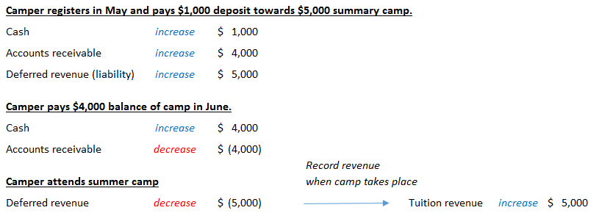
Example transaction – Camper Tuition
Balance Sheet – shows assets & liabilities
Income Statement – shows income & expense
11

Slide 12
Statement of Activities (Income Statement)
Organizational performance for period of time (quarter, year, etc.)
Revenues by type and restriction
Expenses broken out for each activity
Fiscal year’s operating results (surplus/deficit)
Amount released from restrictions
Balance of Donor Restricted Net Assets being carried forward into the next fiscal year
Revenues released from restriction

Slide 13
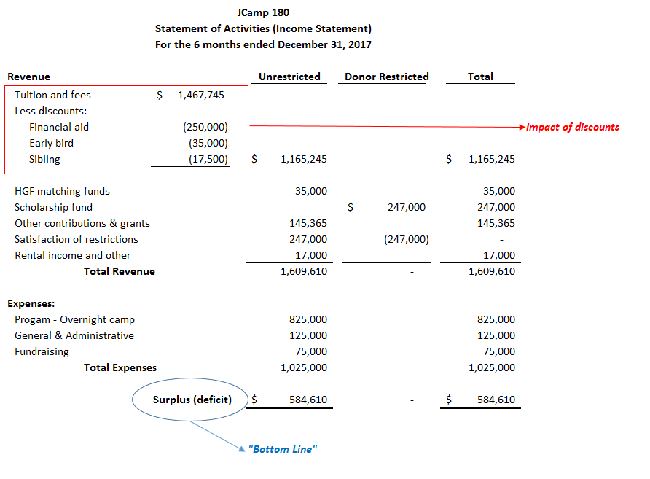

Slide 14
Types of Costs
Fixed Costs
Variable Costs
Semi-variable Costs
Other Costs
Remain the same regardless of activity level (enrollment)
Vary with each unit (camper)
Equipment, Furniture, Software
May include insurance, rent
May include food, supplies
Vary with activity, but not in a direct relationship
May include maintenance costs, telephone, staff training
!

Slide 15
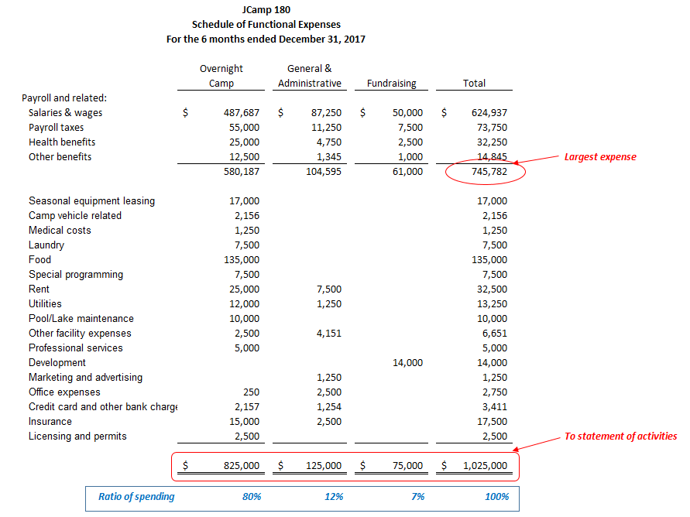
Evaluate expenses for each different activity (arts & crafts, horseback riding, etc.)

Slide 16
Evaluation of Expenses
Statement of Functional Expenses: Resource Allocations
Indicator
Calculation
Functional Expense Composition
Program Expense
Total Expenses
General & Administrative Expense
Total Expenses
Fundraising Expense
Total Expenses

Slide 17
Evaluation of Expenses
Statement of Functional Expenses: Resource Allocations
Indicator
Calculation
Cost per camper
Camp Expenses
Total Campers
Assumes camp tuition should cover all camp expenses.
Consider whether other revenue sources (donations) cover administrative expenses.
What is the cash inflow timing of revenues compared to timing for payment of expenses… use the cash projection.

Slide 18
Cash Projection
6 to 12-month plan for cash disbursements and receipts, month by month, incorporating both operating and capital requirements
Translates budget items into calendar of cash receipts and disbursements
Includes cash outlays that may not be included in the operating budget (e.g. repayment of debt principal or purchase of fixed assets)
Identifies periods of potential cash shortfall or excess
Should be updated monthly to account for actual results and revised expectations

Slide 19
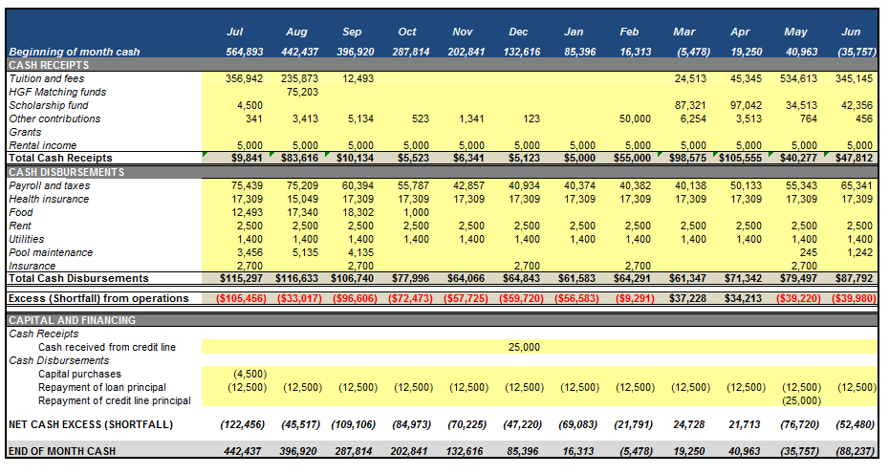
Sample Cash Flow Template

Slide 20

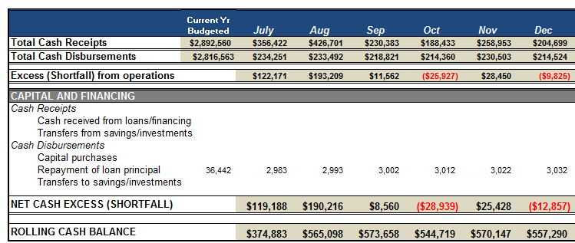
Cash Flow Projections: Where to Focus
www.strongnonprofits.org
Cash Flow Projection Template

Slide 21
Question BREAK

Slide 22
What should we measure?
Key Performance Indicators (KPIs): metrics used to assess performance
Successful Key Performance Indicators (KPIs) will:
  Represent business model drivers
  Reflect progress toward intended outcomes
  Guide priorities and decisions (“what gets measured gets done”)
The “Key” in KPIs is important: limit total KPIs to a number that can realistically be monitored
A set of KPIs isn’t forever: metrics should be periodically reassessed for efficacy and organizational alignment

Slide 23
PART 2 PREVIEW- The Annual Budget
Where have you been and where are you going?
Financial trends:
  Provide insight into the previous year’s results
  Allow an organization to use historical results to inform future decision-making
Set financial goals for the upcoming fiscal year, incorporating the Board’s perspective:
  Budget for a surplus, deficit, or break-even?
  Recoup past deficits?
  Build reserves?
Define how budgetary goals continue or reverse past financial trends

Slide 24
IRS Form 990

Slide 25
IRS Form 990
What is it?
Information return for organizations exempt from income tax
Provides the IRS and state charity agencies with information to assist them in enforcing the laws governing nonprofits
TRANSPARENCY
Notes:
25

Slide 26
IRS Form 990
990 Considerations:
PUBLIC DOCUMENT
Mission Statement, Program Service Accomplishments
DISCLOSURES – Compensation, Policies and More Policies…
Audits conform to Generally Accepted Accounting Principles (GAAP), which is not required of data in the 990
Form 990 does not provide detail about donor-imposed restrictions on revenue

Slide 27
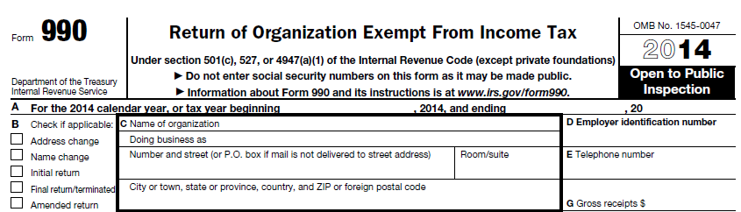
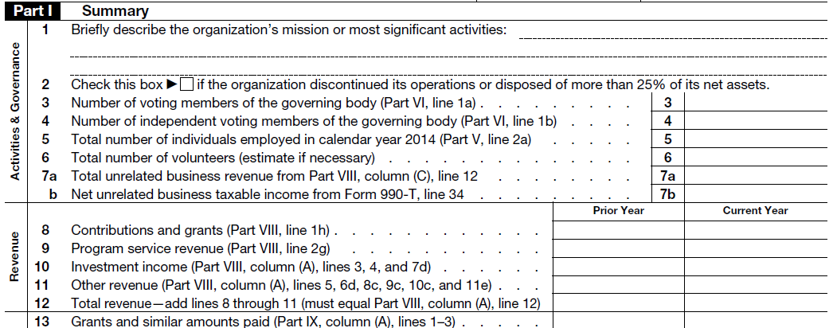
Front Page: Part I, Summary

Slide 28
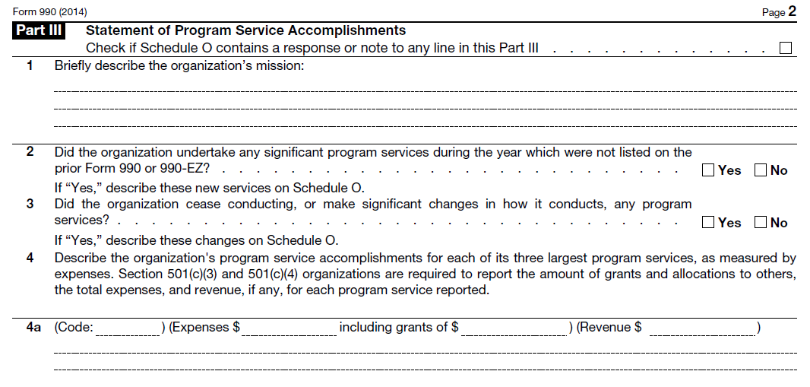
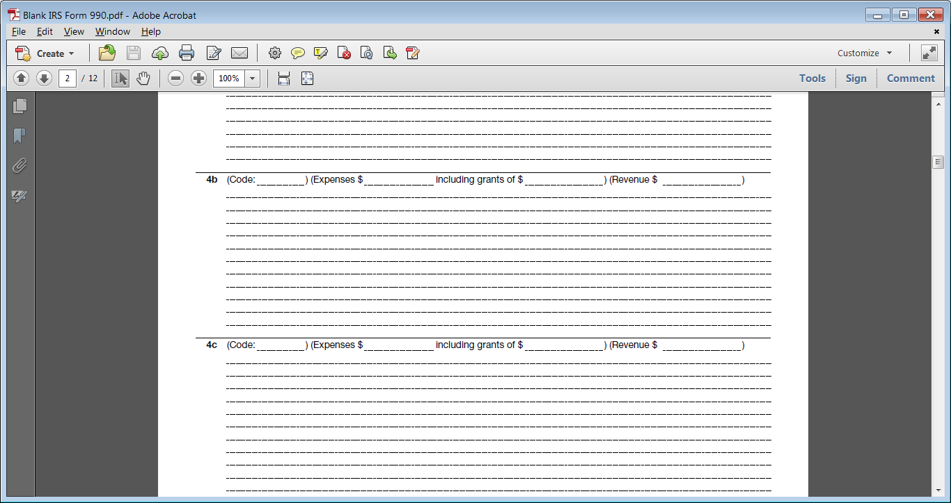
Part III: Statement of Program Service Accomplishments

Slide 29
Questions?

Slide 30
Join us for part 2
Building Your Organization’s Financial Planning Muscle
April 10th
1pm EST

Slide 31



Fiscal Management Associates, LLC
Established in 1999 to serve not-for-profit organizations around the country
Provides customized financial management, accounting, software, organizational development, human resources, and other consulting services
Works directly with organizations or through funder-supported management and technical assistance programs
FMA's mission is to empower not-for-profit organizations with the knowledge and skills to successfully serve their constituents and fulfill their missions
New York | Chicago | Oakland | LA
@FMA4Nonprofits
www.fmaonline.net
/FiscalManagementAssociates
linkedin.com/company/fiscal-management-associates-llc

