Slide 1
Board Engagement: Everybody Talks About It but What Does It Look Like?
JCamp 180 Annual Conference
Springfield, MA
October 23, 2017

Slide 2
Today!
Key Ingredients of an Engaged Board
Expectations/ Accountability
Engaging Board Meetings
Ambassadors
Other Engagement Strategies
Next Generation Recruitment

Slide 3
Why Is Board Engagement Important?
“When truly engaged, board members will become your nonprofit's best ambassadors, advocates, strategists, and all around supporters.”
- National Council of Nonprofits

Slide 4
Why Is Board Engagement Important?
Engagement
Passion
Decision-Making
Productivity
Results
Fiscal Health
Organizational Direction
Executive Director Support

Slide 5
Signs of a Disengaged Board
Absenteeism/Tardiness
High Turnover
Low Productivity
Poor Fundraising Results

Slide 6
Key Ingredients of an Engaged Board
Belief in Mission
Trust
Shared Purpose & Collaboration
Clear, Actively Managed Expectations

Slide 7
More Key Ingredients of an Engaged Board
Individual Talents Tapped
Responsiveness to Members’ Input
Effective, Efficient Structure and Processes
Leadership Pipeline
Rock-Star Board Chair

Slide 8
Key Ingredients of an Engaged Board Trust
“Trust, an essential element of engagement, is a by-product of understanding one another’s values, learning from one another, holding each other accountable for decisions, and completing meaningful work together…When trust is present, boards can more easily and quickly move into difficult conversations with honesty and openness.”
- Susan Whealler Johnston, Martha W. Summerville and Charlotte Roberts, Trusteeship Magazine, 2010

Slide 9
Key Ingredients of an Engaged Board Trust
Provide Ample Opportunity for Board Members to Get to Know Each Other
Team Building Exercises
Social Opportunities
Encourage “Culture of Positive Dissent” in Boardroom
Regular KPAWN (what Keeps the President AWake at Night) Sessions
Board Self-Assessments

Slide 10
Key Ingredients of an Engaged Board Setting Expectations
Obligations of Time, Talent and Treasure (Jean Block)
Roles and Responsibilities
Starts with Recruitment, Onboarding!
Re-visit Annually

Slide 11
Setting Expectations Key Resource: Trustee Manual
Policies, e.g. conflict of interest, gift acceptance
Planning, e.g. strategic, fund development, operating plan
Fiscal, e.g. personal liability, insurance, budget approval & monitoring
Fundraising, e.g. give & get, endowment, relationship development

Slide 12
Accountability
Board Member Sign-Off on Annual Expectations, Goals
Board and Board Member Performance Tracking, Assessment
Role of the Board Chair
Role of the ED

Slide 13
The Board Chair
Time
Energy
Relationship with Executive Director
Understanding of “Key Ingredients of an Engaged Board”
Comfort Level with “Evolved” Leadership Role

Slide 14
Board Assessment
At Least Bi-Annual
Assess Both Self and Board as a Whole
Elicit Responses to Gauge Engagement
Work collaboratively? Come prepared?
Willing to offer dissenting opinions?
Anonymous

Slide 15
Exercise: 3-Minute Board Assessment!
How Engaged Is Your Board?
See Handout #1
How Does Your Board Rate??

Slide 16
Engaging Board Meetings
“Foster a culture of openness, independence, broad participation and constructive dissent.”
-David Nadler

Slide 17
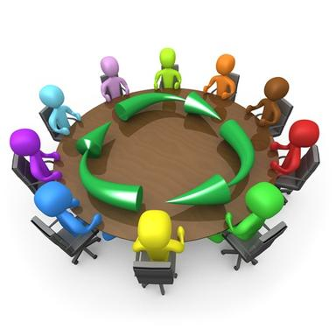
Engaging Board Meetings
Are they
run efficiently?
focused on the big picture?
varied?

Slide 18
Engaging Board Meetings Efficiency
Request Quality Materials in Advance (then read them)
Start/End on Time – and Set Time Limits
Avoid Topics More Appropriate for Committees, Staff
Board Chair Is “On It”

Slide 19
Engaging Board Meetings Big Picture Discussions
Prepare Topics of Discussion with Clear Objectives, Decision Points
Frame in Relation to Strategic Plan
Encourage Divergent Viewpoints

Slide 20
Engaging Board Meetings Big Picture Discussions
Model “Active Listening” – Encourage Strategic Questions (Robert Nelson, CAE, Nelson Strategic Consulting), e.g.:
What does that mean for us?
What information would we have to know to make the best decision?
Does this really advance our mission?
Who does this issue impact? What would they think about the issue?
What could be the unintended consequences?

Slide 21
Engaging Board Meetings Mixing It Up
Guest Speakers
Board Trainings
Off-Sites
Break-Out Groups
Go Multi-Media!

Slide 22
Engaging Board Meetings Mission Moments
“Short, inspirational examples of your work that put a face on what you do.”
– Lori Jacobwith

Slide 23
Exercise: Mission Moment
Describe a “Mission Moment” that you experienced. Keep in mind:
It should have an emotional pull.
It could be easily shared with other Board members.
Share it!

Slide 24
Ambassadors, Not Fundraisers
It’s About Sharing the Passion
Reframe Fundraising as “Relationship Development”
Consider a Menu of Options

Slide 25
Ambassadors, Not Fundraisers
Request Specific Tasks, Goals, Deadlines
Messaging Policies/Guidelines
Consistent Messaging
Provide Feedback on What Is/Is Not Working

Slide 26
Ambassadors, Not Fundraisers
Ask for Toolkit to Make Your Job Easier
Get the Training and Support You Need, e.g.
Case for Support – Talking Points, Elevator Pitch
Dashboard – Key Metrics
Peer-to-Peer Fundraising Page
How to Host a Funder Site Visit

Slide 27
More Engagement Strategies Active Committees
Choose Committees Wisely (Fewer Often Better)
Join a Committee Where You Can Add the Most Value (i.e. aligns with your skills, interests)
Board Members Should Chair Committees

Slide 28
More Engagement Strategies Active Committees
Define Clearly Committee’s Role, Workplan
Keep Them Small & Efficient
Pipeline of Next-Gen, Future Leaders

Slide 29
Active Committees Do You Need an Executive Committee?
Simone Joyaux is on a mission (to kill it)!
Just One More Committee
Crises Should Involve Full Board
Have Chair and ED Set Full Board Meeting Agendas
Can Foster Disengagement of Other Members!

Slide 30
Active Committees Fundraising Committee
Data Driven
Closer Collaboration with Staff
Executive Director as Member
Hold Board Accountable

Slide 31
Active Committees Fundraising Committee
Subcommittee Examples:
Fund Development Plan
Young Professionals
Major Gifts
Annual Appeal
Event

Slide 32
More Engagement Strategies Raise the Tough Questions
Conflict of Interest
Board Diversity
Executive Transition / Emergency Succession

Slide 33
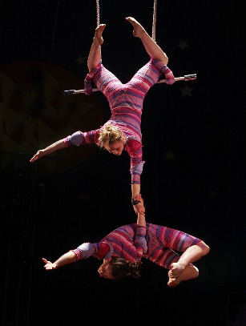
More Engagement Strategies Donor Retention
“Own” a Set of Donors
Hold Thank-You-Call Evening
Write Personal Thank You Notes
Brainstorm Other Donor Recognition Activities/Events

Slide 34
More Engagement Strategies Hold Case Statement Retreat
Case Statement Is Crux of All Fundraising
Your Key Communication Tool
½ Day, Off-Site
Bring In Key Stakeholders
Fosters Ownership of Message – and Relationship Development

Slide 35
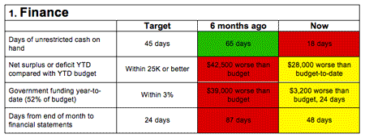
More Engagement Strategies Create/Review a Board Dashboard

Slide 36
More Engagement Strategies Consider Advocacy
Provide Opportunities and Tools for Advocacy
“Advocacy is too important to the success of our missions to be considered something ‘extra’ or ‘nice to do.’ It’s absolutely essential to the work of our organizations and our ability to fulfill our missions and serve our communities.”
– Anne Wallestad, President & CEO, BoardSource
www.standforyourmission.org

Slide 37
Exercise: Make Your Case!
See Handout: “Map Out the Flow of Your Case!”
Share It!
Would You Give Them Money?

Slide 38
The Next Generation
Determine Board Gaps
Ensure Mission Alignment, Passion
Onboard, Orient with Clear Expectations
Assign a Mentor
Incorporate Technology

Slide 39
Final Thoughts
Creating an Engaged Board Likely Means More Work on the Front End
Take the Long View, i.e. Plan for Incremental Change
Positive Return on Investment of Time

Slide 41
Thank You!
kweill@kweillconsulting.com
617-680-2672
Sign up for my free e-newsletter, “3 for Thursday!”
kweillconsulting.com/stuff-for-you.html

