Slide 1
Using video to Drip-market legacy giving
Presented by:
Rachel Rosenman, M.A. LIFE & LEGACY™ Manager and Development Officer

Slide 2
Why video
People engage MUCH more with visual content (images and videos) than text alone
more likes, comments, click-throughs, shares on social media

Slide 3
Why video
Visual storytelling activates more centers in the brain

Slide 4
What video can do
Plant seeds of engagement
Build relationships
Make people feel something
Share information
Share moments of celebration
And more!

Slide 5
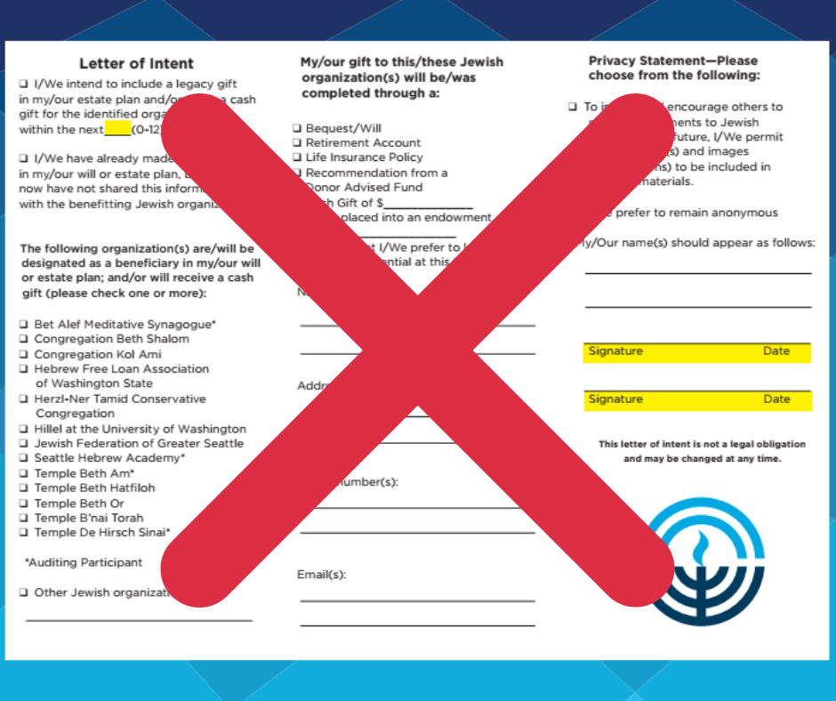
What video likely Won’t do
Close a legacy gift

Slide 6
Helpful tips
From Vinay Koshy: “5 Powerful Social Media Visual Content Trends That Will Boost Your Marketing Results”
Use captions
Most viewers watch Facebook videos without sound, so add captions to ensure viewers receive the message.
Front-load your key messages
if a user notices your video, the most critical moment to capture their attention is during the first few seconds. Deliver key messages early and make the first part of a video compelling enough to earn more extended views.
Try live video
to promote events, capture authentic moments, and share your organization’s personality in an informal setting.

Slide 7
Helpful tips continued
From: Vinay Koshy “5 Powerful Social Media Visual Content Trends That Will Boost Your Marketing Results”
Experiment
Several variables can make a social video resonate with your audience, including the length of the video, subject, platform, copy, and more. Regardless of how much you know about videos that perform well for your business, trying new content and formats—and measuring the results⎯will only help you better your campaigns.
Analyze your data
With so many social media analytics tools available, it helps to look at the data to identify what is working well for you and then build content based on that.

Slide 8
Our Facebook analytics: legacy content

Slide 9
Our Facebook analytics: legacy content

Slide 10
Our Facebook analytics: legacy content

Slide 11
Example: discover L&L Video

Slide 12
Example: jumping Video

Slide 13
Example: Great news Video

Slide 14
Example: Plant Video

Slide 15
Example: Tu b’av Video

Slide 16
Low-cost Resources & Tools
Biteable.com ($276/yr or $29/month for watermark-free subscription: used to be $99/yr)
An online video making software that’s super easy to use.
Canva.com (free or premium)
A free graphic-design tool website. It uses a drag-and-drop format and provides access
to over a million photographs, graphics, and fonts. It is used by non-designers as well as professionals.

Slide 17
Questions?

Slide 18
Thank You!
Rachel Rosenman, M.A. LIFE & LEGACY™ Manager and Development Officer
rachelmr@jewishinseattle.org 206-774-2220

