Slide 1
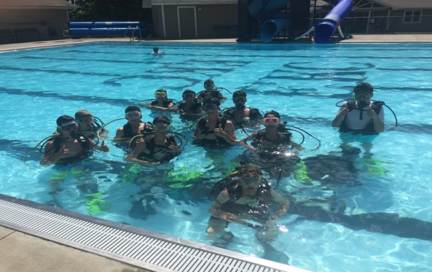
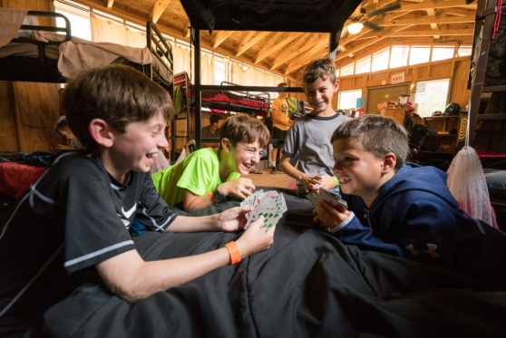
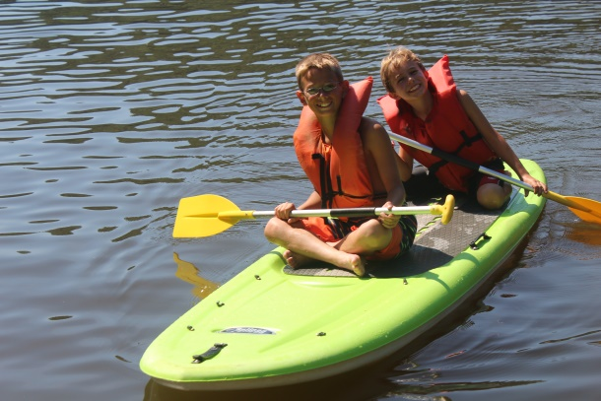
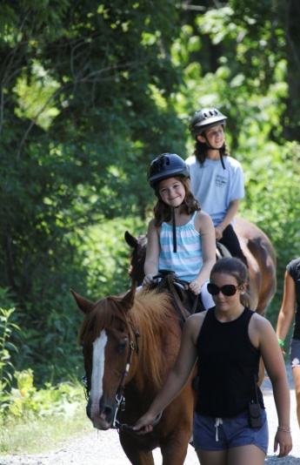
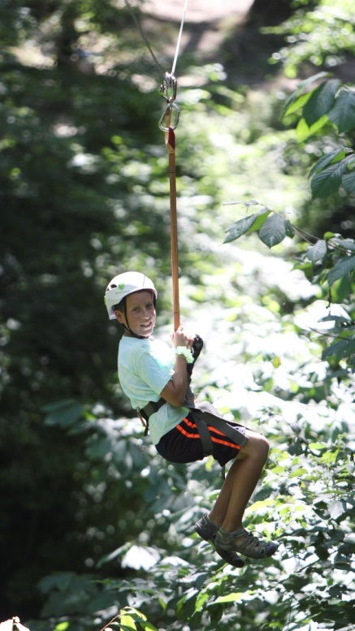
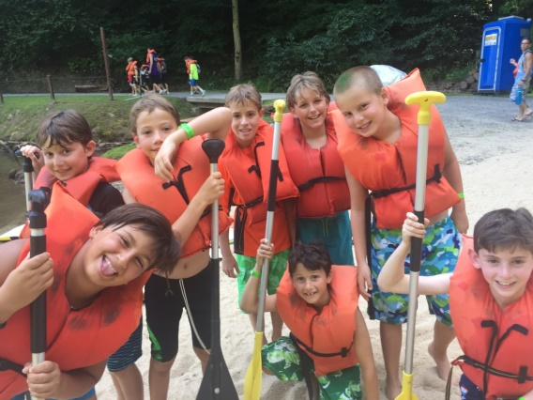
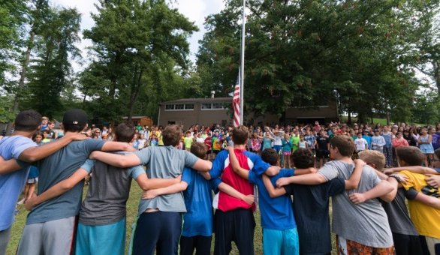
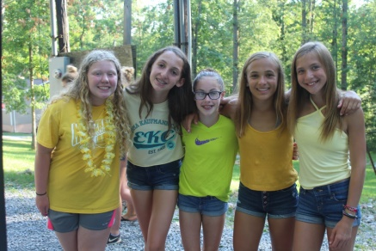
Emma Kaufmann camp three-year strategic plan
JCC of Greater Pittsburgh
Camp Committee Meeting
February 26, 2018
© 2018 JCC Pgh All Rights Reserved. Confidential.

Slide 2
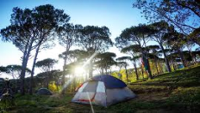
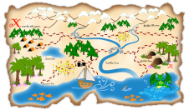
Agenda
Welcome and introductions
Methodology for developing the strategic plan
The current condition
The target condition
How we are going to get there
Discussion
© 2018 JCC Pgh All Rights Reserved. Confidential.

Slide 3
Strategic planning process: broad engagement, well-informed, methodical
JCamp180 Annual Conference
Informational interviews
Data
Internal meetings and discussions
Competitive analysis
HGF Mentor
COOs from other JCCs
Association of Independent Jewish Camps
American Camp Association
Directors of overnight camps
Independent overnight camping consultant
Director of Camp Ramah New England
Director of Camp Tevya
Director of Camp Barney Medintz
JData
FJC Annual Census
ACA research
National and local survey results
Benchmarking against a combination of 16 competitors and best-in-class Jewish overnight camps
JCC senior leadership, including CEO, Senior Director of Jewish Life & Senior Director of Marketing
EKC full-time staff
JCC program staff
October 2017 through February 2018
© 2018 JCC Pgh All Rights Reserved. Confidential.

Slide 4
2018-2020 Strategic plan: Intentionally emphasizing our strengths/opportunities
EKC Today: Current State
Solid national reputation
Diversity of geographies represented at camp (national reach)
Competitive, all-in pricing model
Highly regarded facilities that are managed by external company
Progressive camper/staff inclusion policy
Overall staff satisfaction is 6% higher than national average
Parents are pleased (relative to other camps) with EKC’s ability to build camper independence, resilience and problem solving skills
Building the pipeline: 18 more Sabra campers and one (1) more First Experience camper registered as of 1/31/18 vs. 1/31/17
Untapped market: Only 10% of U.S. Jewish children attend Jewish overnight camp
Participation in FJC’s Hiddur initiative as well as the Harold Grinspoon Foundation’s JCamp 180
Proximity to WVU and Morgantown, WV
Recently launched alumni/parent engagement group already paying recruitment dividends
© 2018 JCC Pgh All Rights Reserved. Confidential.

Slide 5
2018-2020 Strategic plan: Intentionally addressing our weaknesses/threats (W/T)
EKC Today: Current State
2 out of the last 3 years % of camp capacity has been under 90% and 2018 is trending 5.3% lower in camper days than YTD 2017 (W)
Camper retention rate is 10% behind industry standard (W)
Lack of professional specialty staff and relatively low number of adult staff (W)
Not enough housing suitable for adults/families (W)
Low rate of camper choice activities and lack of program differentiation between 1st and 2nd session and from year-to-year (W)
Inconsistent enforcement of camp rules & regulations (W)
Insufficient “cocoon of care” for parents and campers (W)
Weak marketing campaign, including “tired” website (W)
Out of touch with what the competition is doing (W)
EKC does not impact the Jewish identity of campers or staff as strongly as the national average (W)
Staff are critical of the quality & professionalism and visibility & engagement of camp leadership (W)
Underperforming in several key indicators related to camper/parent satisfaction: overall satisfaction, camp leadership and the way camp is run, camp’s communication with parents and competitive cost (W)
Compressed summer calendar (T)
Competing interests for the attention of campers and staff (T)
Increasingly more difficult for parents to let go of their kids for the summer (T)
Camp not perceived as valuable work experience during college (vs. internship ) (T)
Insufficient data on the benefits of overnight camp, specifically on the journey of camper to staff (T)
25% decline in the number of new campers (2017 vs. 2012) and 22% decline in campers from Pittsburgh (2017 vs. 2013) (T)
Overall decrease in the number of school-aged Jewish children in Pittsburgh and fewer campers at J&R (T)
© 2018 JCC Pgh All Rights Reserved. Confidential.

Slide 6
Target condition: definition of “winning”
% CAMP CAPACITY: 85%
% CAMP CAPACITY: 88%
% CAMP CAPACITY: 92%
By August 2018
Camper/parent satisfaction: 70%
Jewish identity¹: 45%
By August 2019
Camper/parent satisfaction: 75%
By August 2020
Camper/parent satisfaction: 80%
Camper retention: 70%
Staff satisfaction: 90%
Staff retention: 60%
Alumni/parent engagement: 70 new camper referrals
Camper retention: 72%
Staff satisfaction: 92%
Staff retention: 60%
Jewish identity¹: 50%
Alumni/parent engagement: 80 new camper referrals
Camper retention: 75%
Staff satisfaction: 94%
Staff retention: 60%
Jewish identity: 55%
Alumni/parent engagement: 90 new camper referrals
¹Defined as the percentage of CSI respondents who rate the impact EKC has on their child’s Jewish identity as “excellent.”
© 2018 JCC Pgh All Rights Reserved. Confidential.

Slide 7
2018-2020 strategic plan: aspirations for the future
Best-in-class communications
“Cocoon of Care”
High-quality programming & specialties
Be the leading Jewish overnight camping experience in the Tri-state region, and to be the first choice of campers, staff, and community participants
Staff development
Operations
Facilities
Staff development
Operations
Fundraising
Marketing
Staff development
Fundraising
Operations
Facilities
© 2018 JCC Pgh All Rights Reserved. Confidential.

Slide 8
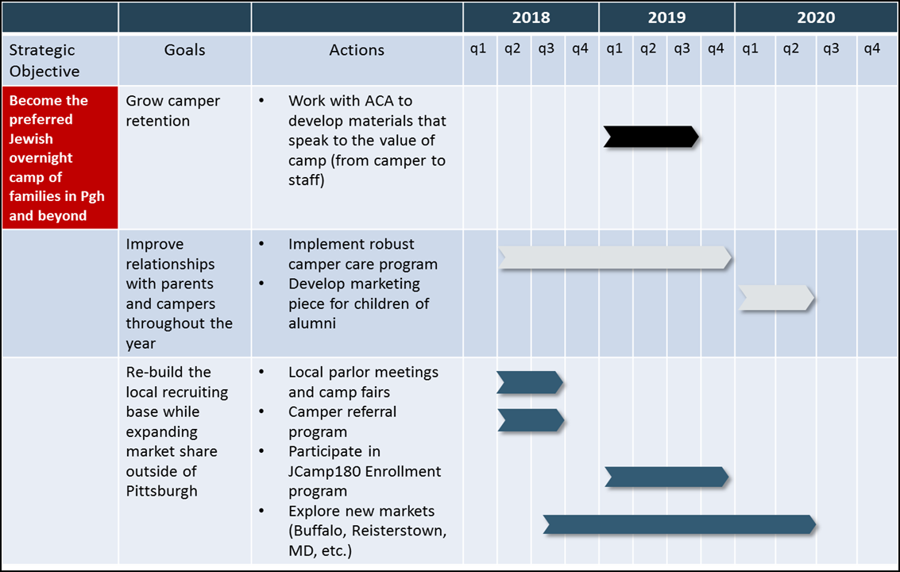
2018-2020 strategic plan action items: camper recruitment
© 2018 JCC Pgh All Rights Reserved. Confidential.

Slide 9
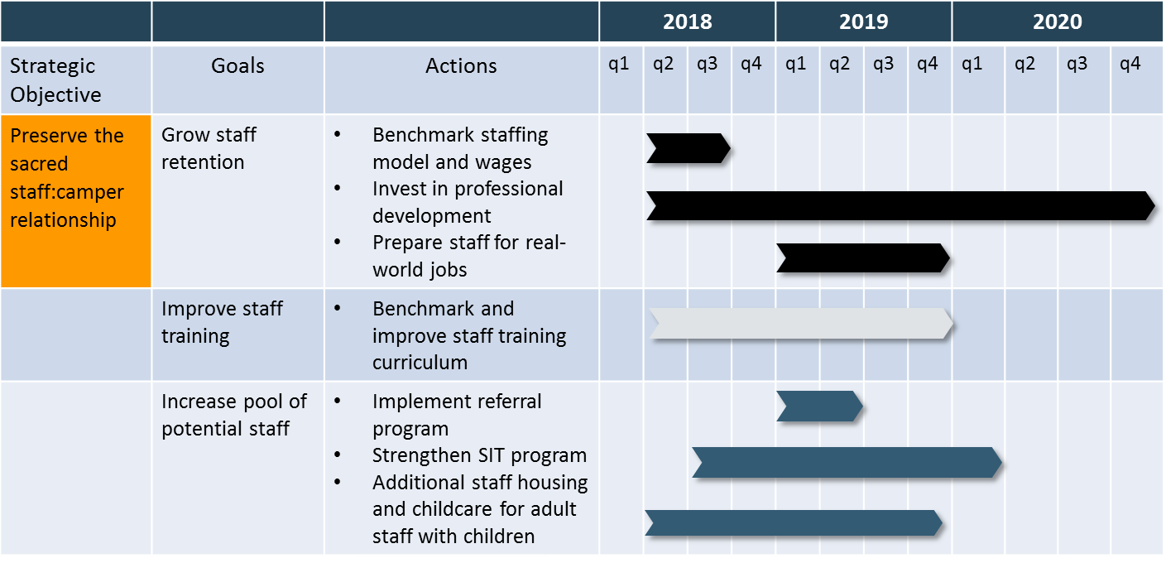
2018-2020 strategic plan action items: staff & staff development
© 2018 JCC Pgh All Rights Reserved. Confidential.

Slide 10
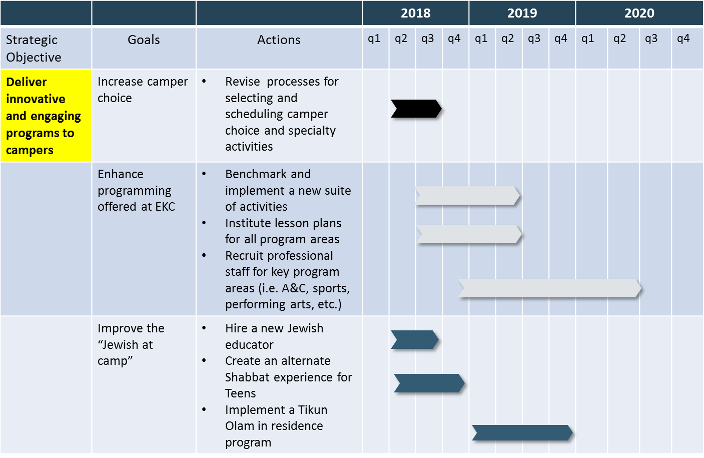
2018-2020 strategic plan action items: programming
© 2018 JCC Pgh All Rights Reserved. Confidential.

Slide 11
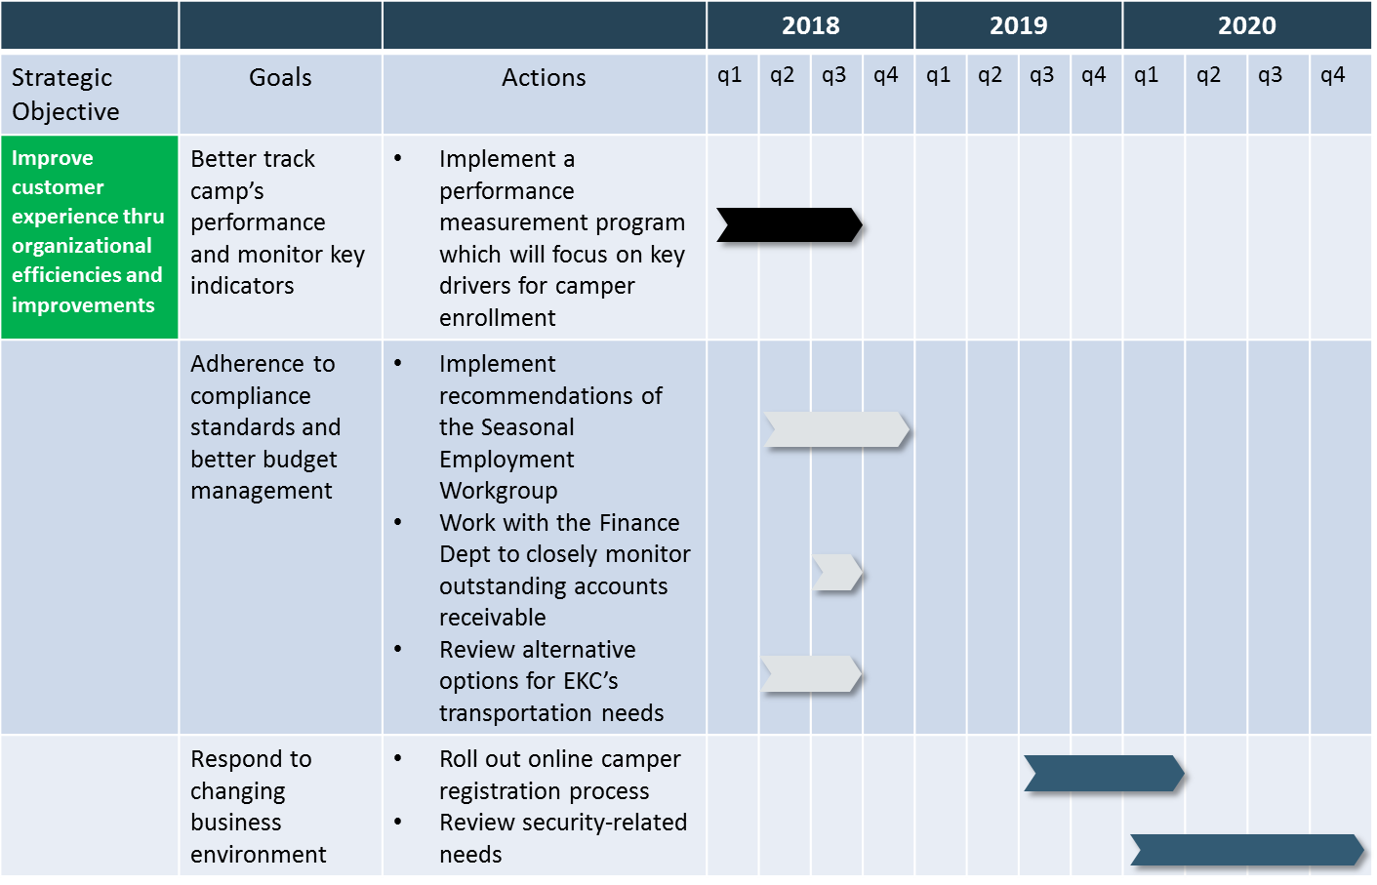
2018-2020 strategic plan action items: Operations
© 2018 JCC Pgh All Rights Reserved. Confidential.

Slide 12
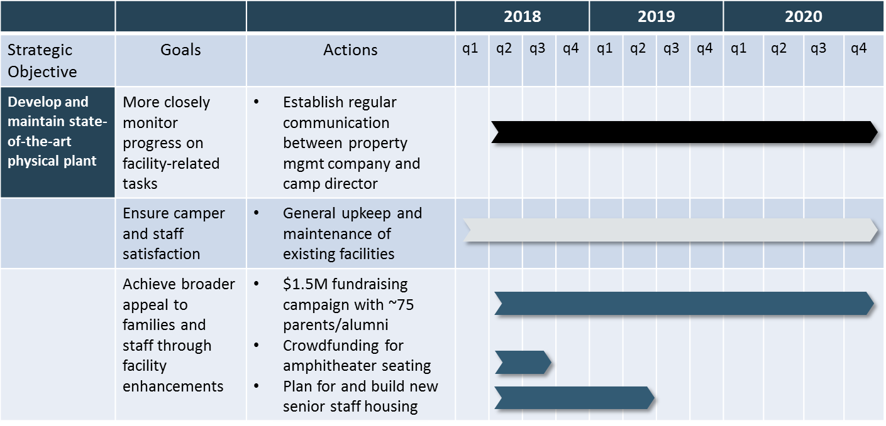
2018-2020 strategic plan action items: Facilities
*
* Once more fully vetted by CEO and Sr Director of Development
© 2018 JCC Pgh All Rights Reserved. Confidential.

Slide 13
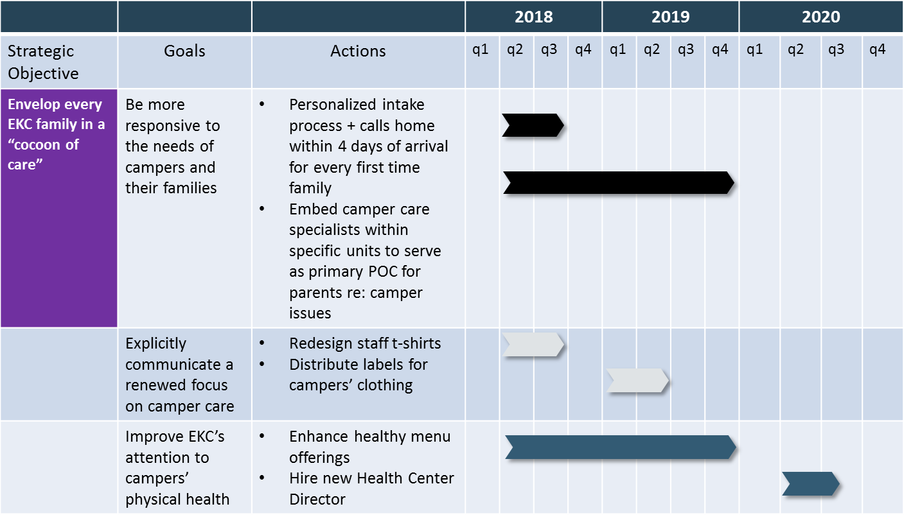
2018-2020 strategic plan action items: Camper care
© 2018 JCC Pgh All Rights Reserved. Confidential.

Slide 14
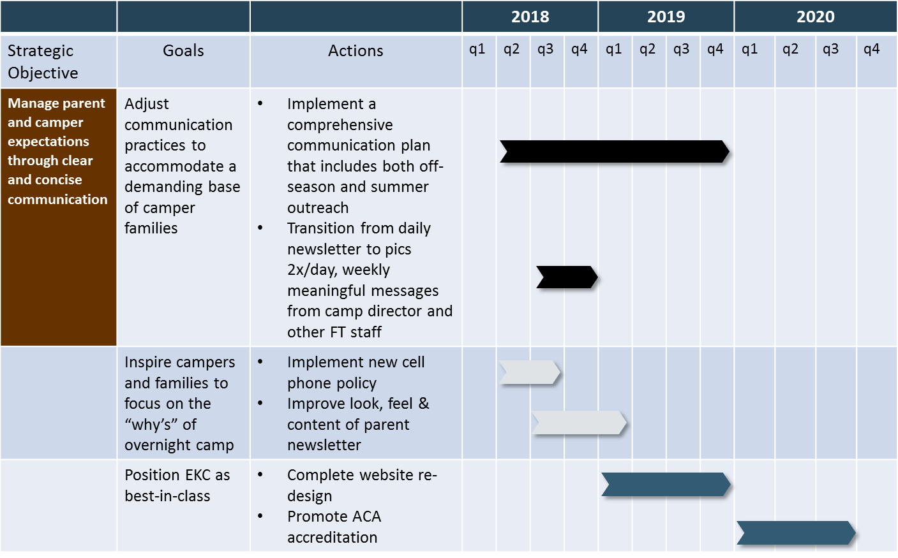
2018-2020 strategic plan action items: communications
© 2018 JCC Pgh All Rights Reserved. Confidential.

Slide 15
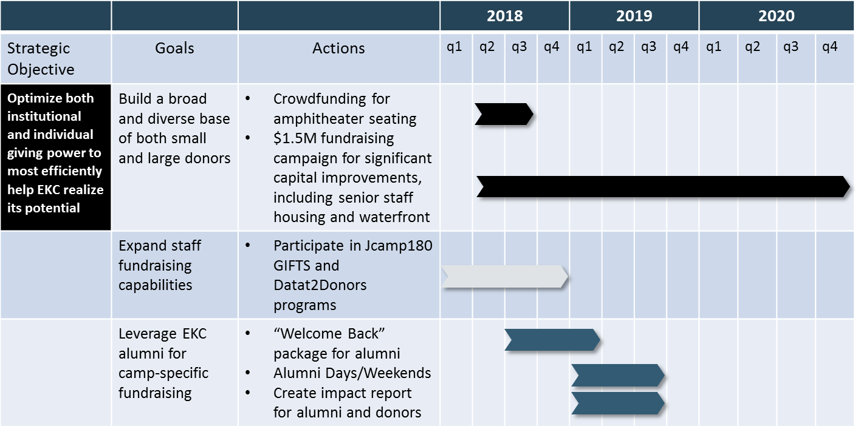
2018-2020 strategic plan action items: fundraising/development
*
* Once more fully vetted by CEO and Sr Director of Development
© 2018 JCC Pgh All Rights Reserved. Confidential.

Slide 16
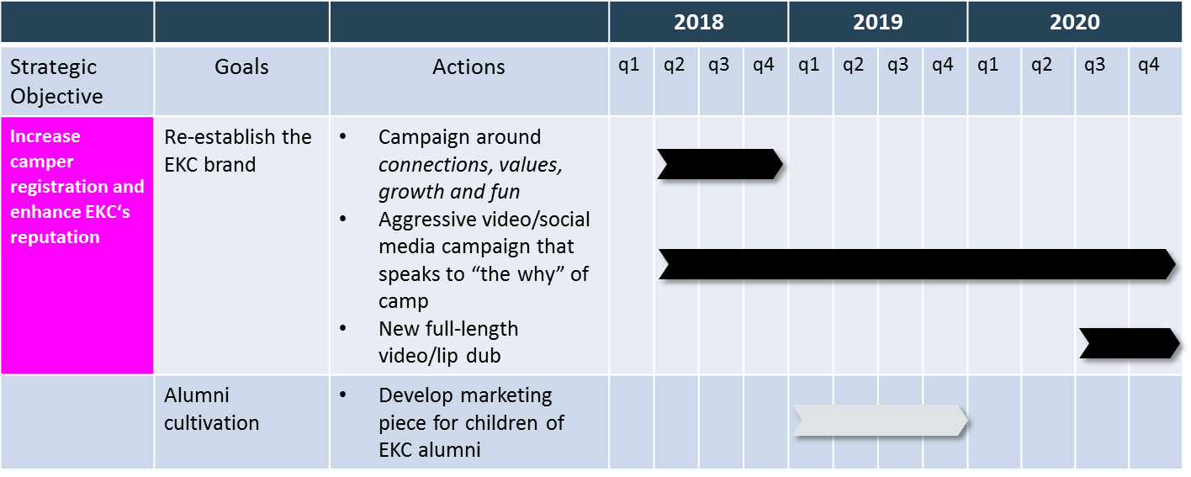
2018-2020 strategic plan action items: Marketing
© 2018 JCC Pgh All Rights Reserved. Confidential.

Slide 17
Strategic plan estimated to pay for itself
Option 1: Status quo
Option 2: Strategic plan
% of camper capacity declines to 75% by end of summer 2020
Increased staff turnover
Inadequate adult supervision to address camper issues
Minimal investment in enhanced programming
Difficulty raising required funding for facility upgrades
Projected 3-year revenue = $7,835,512
% of camper capacity increases to 92% within 3 years
Increased camper, parent and staff satisfaction
Significant improvements in camper care, programming and communication
Investment in core infrastructure to support an overnight camp of the 21st century
Projected 3-year revenue = $8,776,827
Est’d cost of plan = $878,500 (excluding facility upgrades)
Estimated net impact: $62,815
© 2018 JCC Pgh All Rights Reserved. Confidential.

Slide 18
discussion
© 2018 JCC Pgh All Rights Reserved. Confidential.

