Slide 1

#JCampConf
Productivity Hacks Free-for-All
October 23, 2017
Kevin Martone
Technology Program Manager
kevin@hgf.org

Slide 2
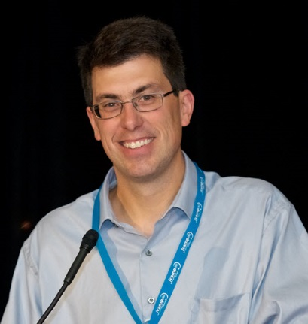
Kevin Martone
Technology Program Manager
JCamp180

Slide 3
Agenda
What Do We Mean by “Productivity Hacks?”
What’s Your Biggest Productivity Issue?
What Productivity Hack Works for YOU?
Sharing Productivity Hacks

Slide 4

Who Will Be Our Scribe?
http://bit.ly/JCampConf_Productivity_Hacks

Slide 5
What Are Productivity Hacks?

Slide 6

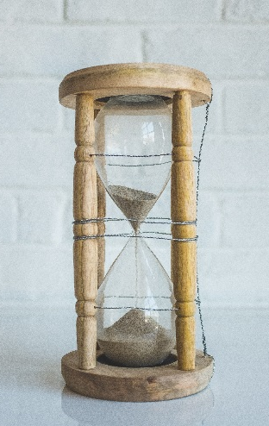
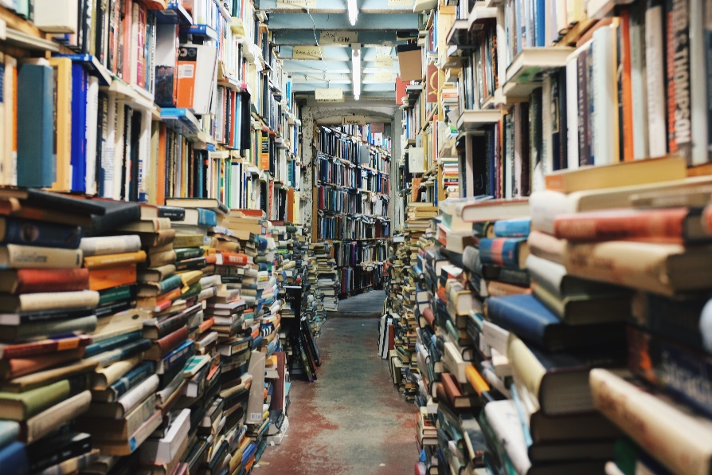
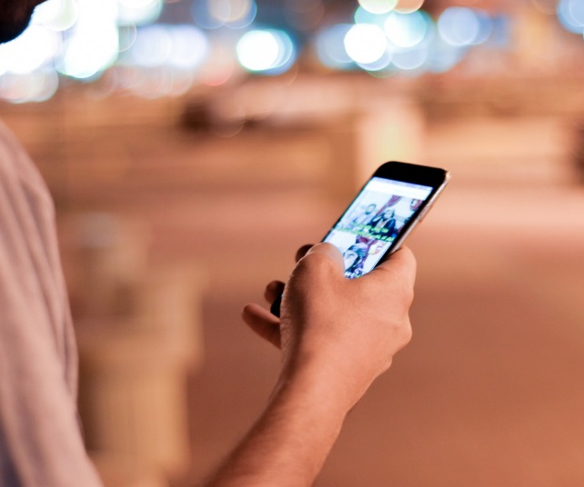

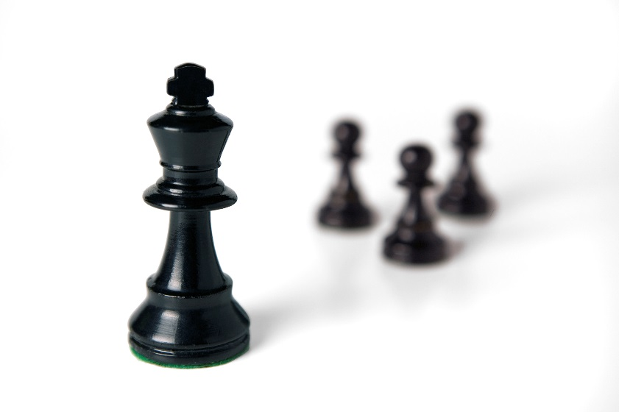
Processes, Policies, Habits, Tools, Tricks, Apps, and ?

Slide 7
What Are Productivity Hacks?
Anything That Helps You Be More Productive

Slide 8
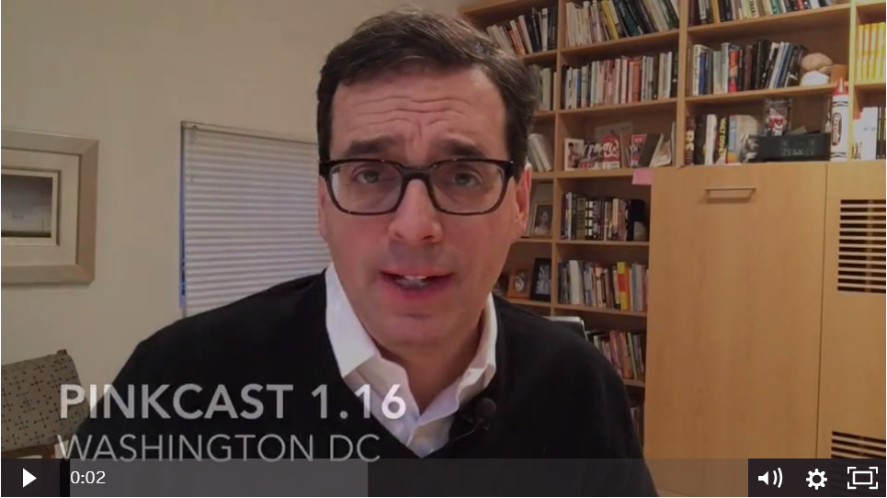
Productivity Hacks
Notes:
In addition to Dan Pink, anyone have a blog or eNewsletter or video series they recommend for learning more ideas and hacks?

Slide 9
What’s Your Biggest Productivity Issue?
Notes:
Ask for answers – write on Flipchart
We’ll find hacks for as many of these as we can during the session.

Slide 10
What Productivity Hack Works for YOU?
Notes:
Share pairs – talk about a process, habit, tool, or app that helps you be more productive.
It can be something that helps with an issue we’ve listed here…or something completely different.
Take a few minutes to speak with someone next to you – make sure each of you has a chance to discuss their hack.
We’ll come back and ask for some examples afterward. Focus on hacks that help an issue that isn’t on the flipcharts yet.

Slide 11
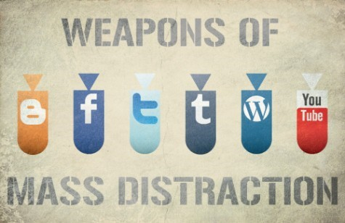
How can I more effectively use my time by limiting distractions?

Slide 12
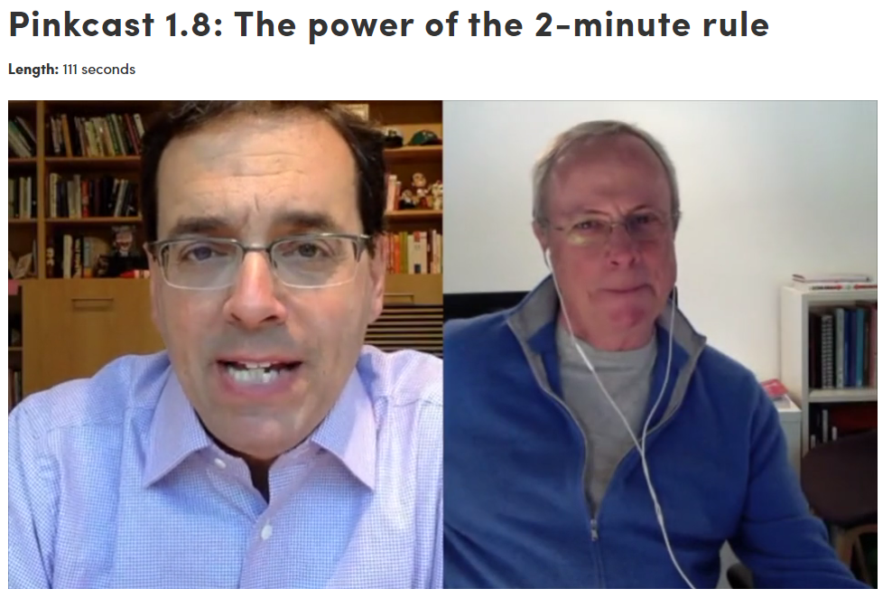
How can I more effectively use my time by limiting distractions? – EMAIL Edition
  Have certain times when you check email (Noon and End of Day?) and turn it off otherwise
  OR
  Have email open to be aware; respond to real urgent requests, but do not act on others
  OR
  Act on emails/tasks that take less than 2 minutes now, save others for later.

Slide 13
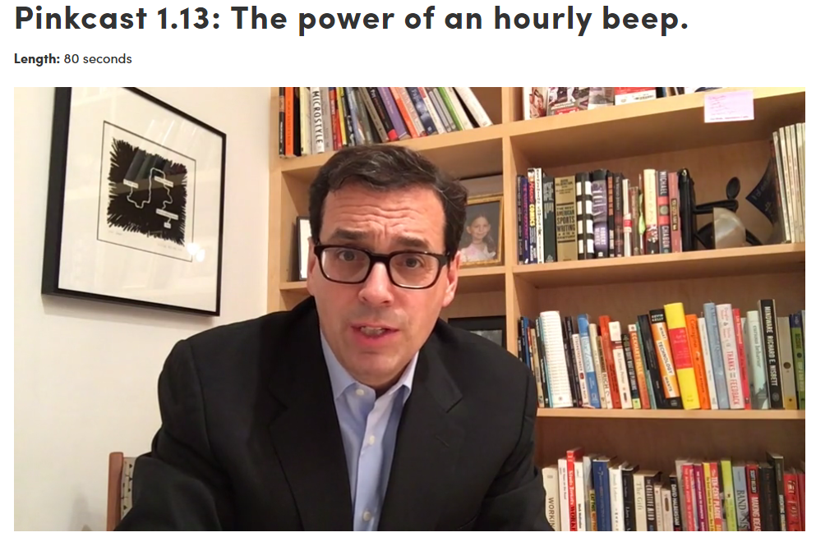
How can I more effectively use my time by limiting distractions? – CALENDAR Edition
  Block off long blocks of time for important tasks like thinking, reading, planning – and stick to it
  Include both personal and professional items in your calendar but use color coding and privacy settings to manage effectively (instead of having to use more than one calendar)
  Hourly Beep – Are you doing what you should be doing right now?

Slide 14
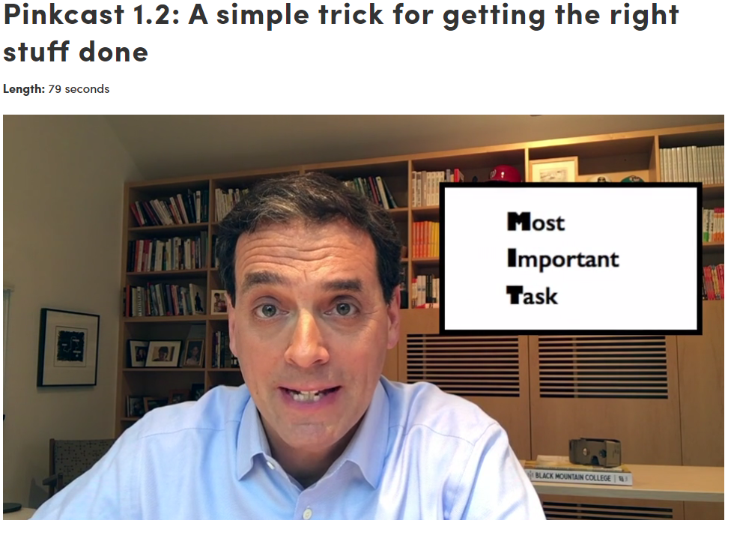
How can I make sure I complete the most important thing today?
MIT (Most Important Task)

Slide 15
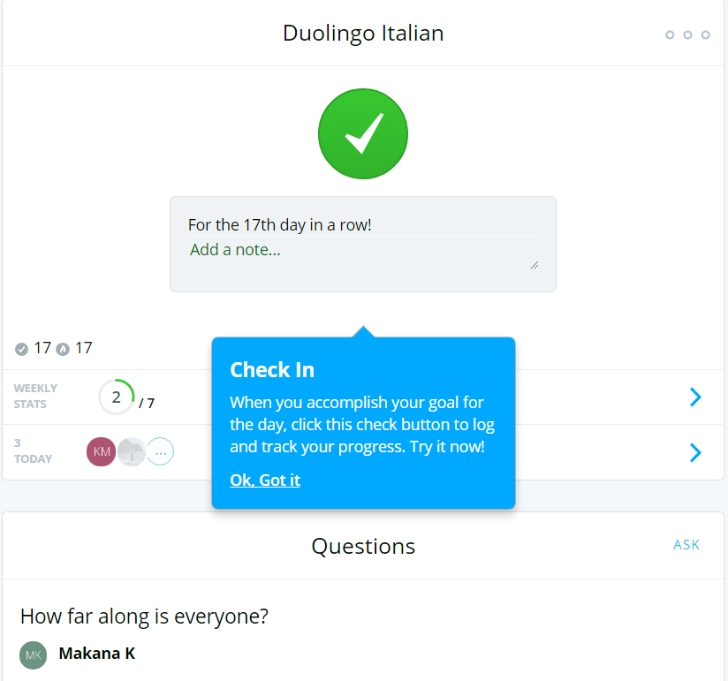

How can I create positive productivity habit?

Slide 16


How can I track my own (and my team’s) to-do’s organized by project?
Wunderlist
  Has an Outlook add-on to let you add to Wunderlist right from email

Slide 17
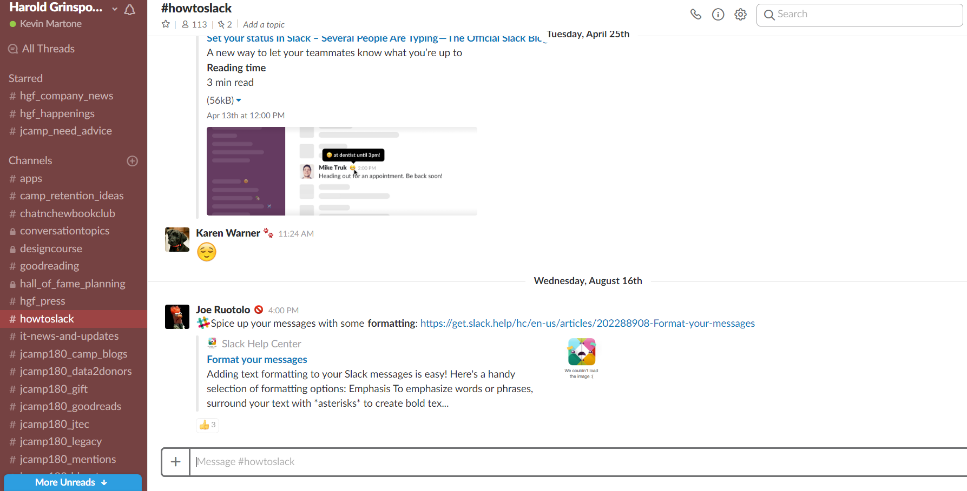
How can our team keep in touch and limit email throughout the year…and allow us to save conversations for future review?
Slack

Slide 18

How can I store, crowdsource, and share documentation like training materials and board policies with various groups of people?
Google Drive
Box.com
Dropbox
Other?

Slide 19
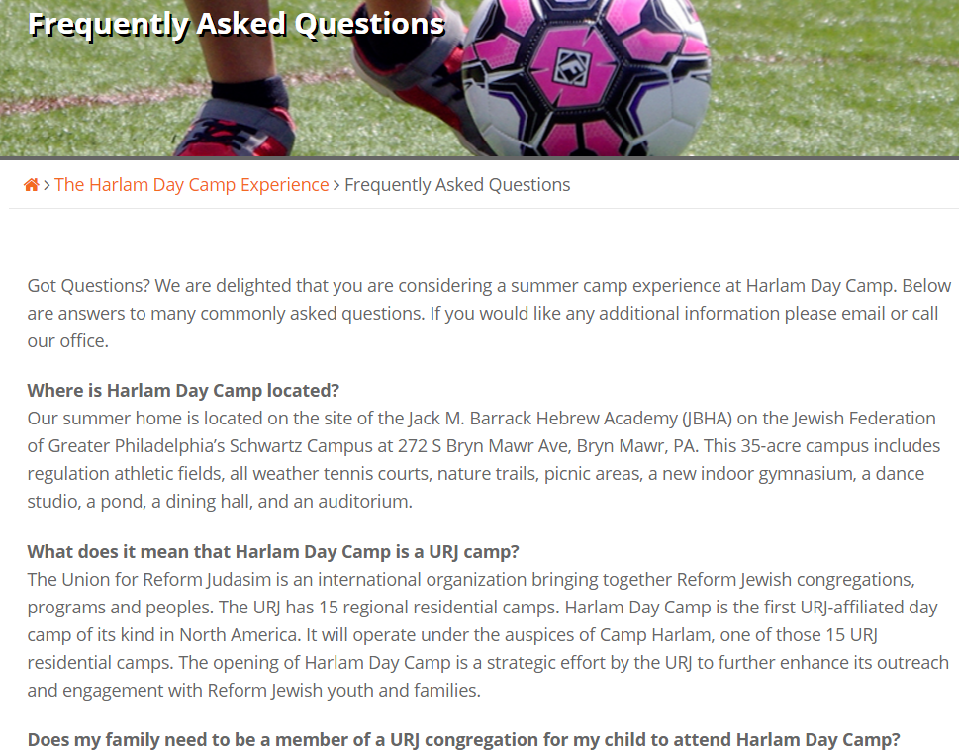
How can I – as a director/manager - get fewer calls from parents but still provide good customer service?
Create FAQs on website
Don’t forget script/answers for people who answer the phone!

Slide 20


How can I automate some tasks that someone on our team does over and over again?
Automation Tools:
  IFTTT
  Zapier

Slide 21
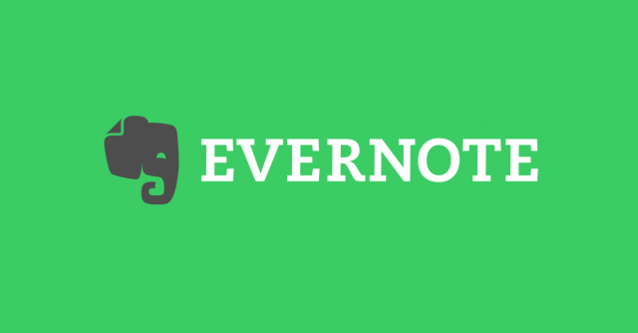


How can I write down and remember important notes and emails while I am driving or cooking?
Transcription!
  Evernote has voice transcription
  Free Dragon Dictation app
  Even mail/text on the iPhone has the microphone option to transcribe text. Or just ask Siri!

Slide 22
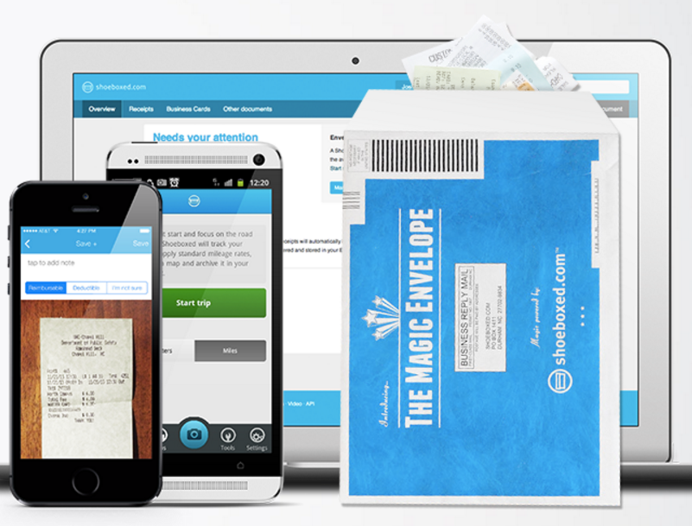
How can I easily track all of my business expenses and receipts while on the road?
https://www.shoeboxed.com/
https://www.expensify.com/

Slide 23
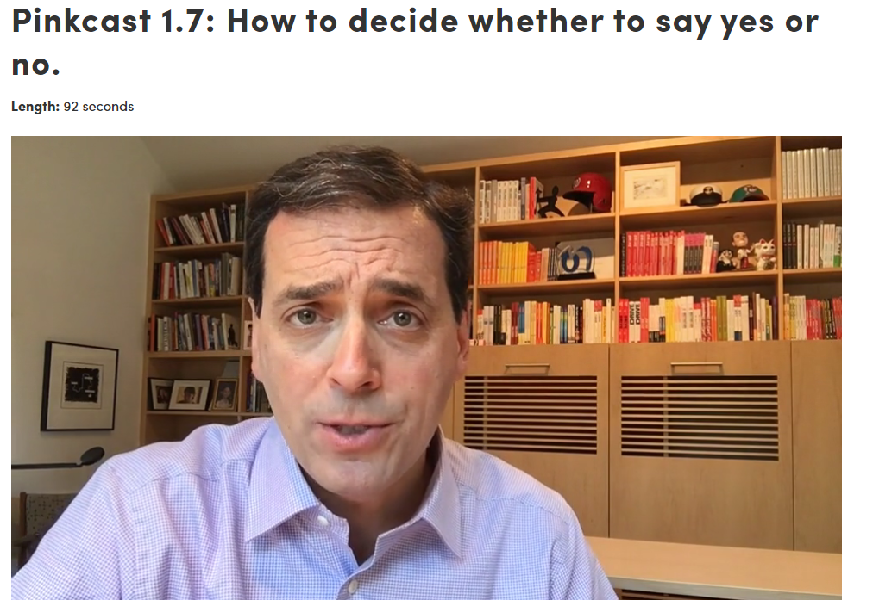
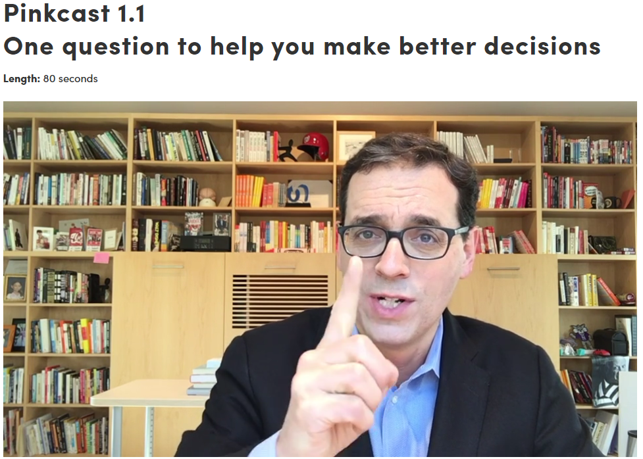
How can I make better decisions?
“Hell Yes” rule
“What would you tell your best friend to do?”
From Decisive by the Heath Brothers: http://heathbrothers.com/books/decisive/)

Slide 24
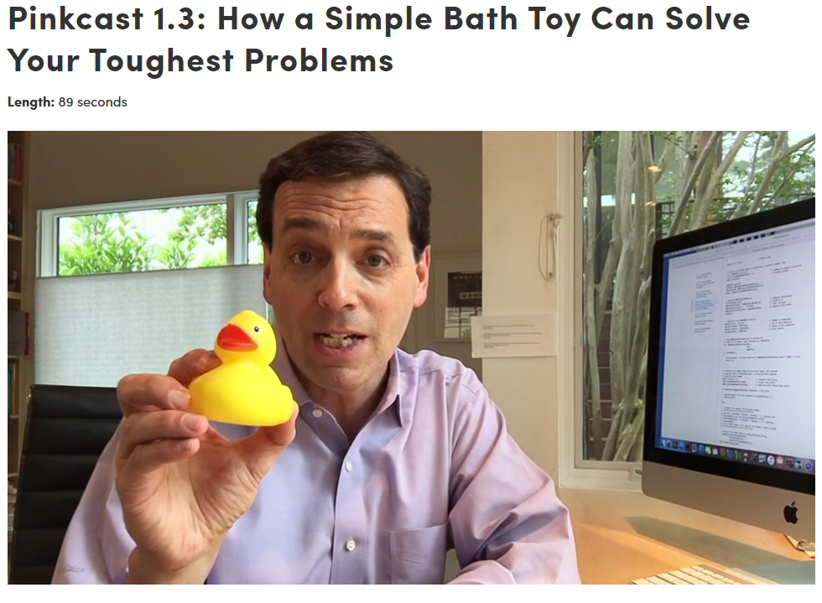
How can I resolve issues or find solutions to sticky problems?
Rubber Duck Method

Slide 25
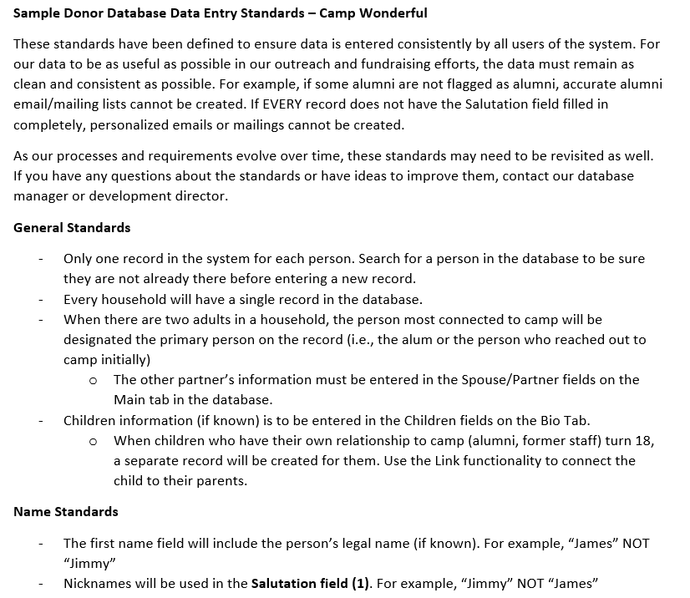
How can I ensure our data is tracked consistently by all users?
Create data standards and train all users

Slide 26
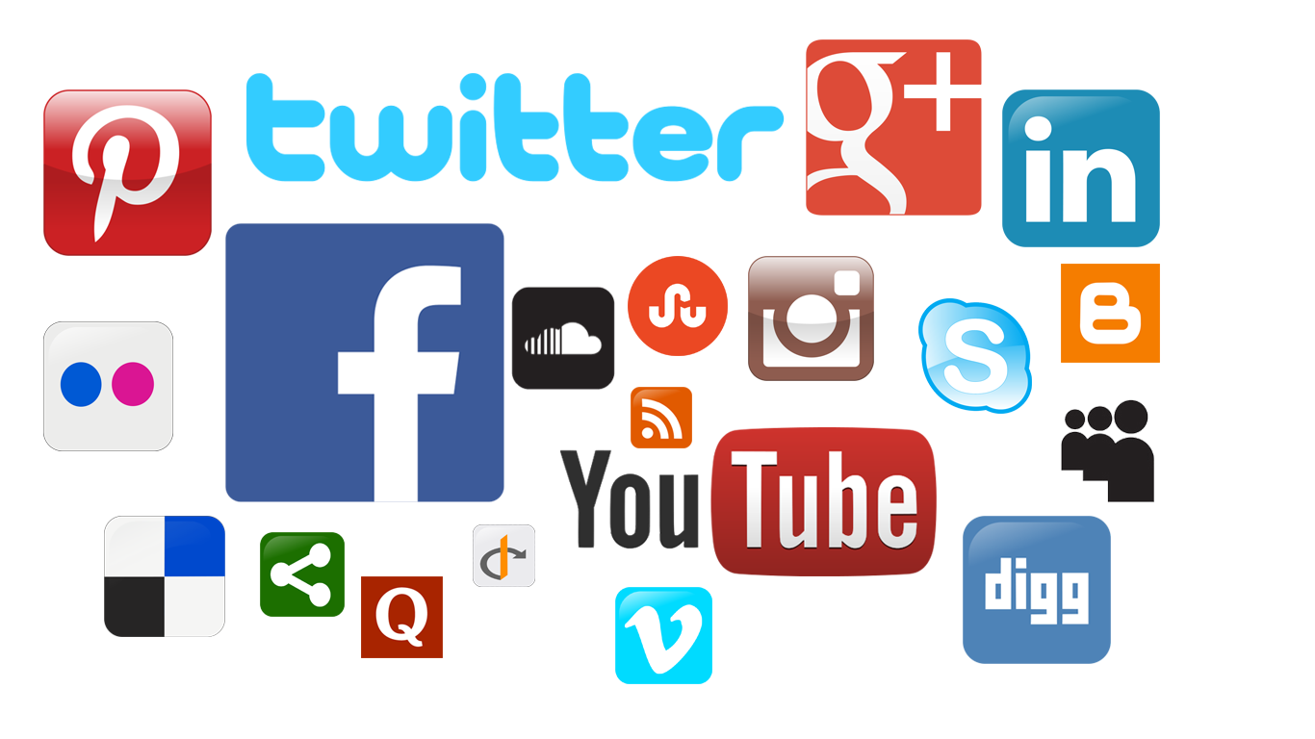
How can I more effectively manage my social media accounts – finding, posting, and tracking content?
Curating/Scheduling: Buffer
Curating: Pocket/Evernote – for tracking articles to read later (also in professional development?)
Facebook App (schedule posts, check analytics, etc.)

Slide 27
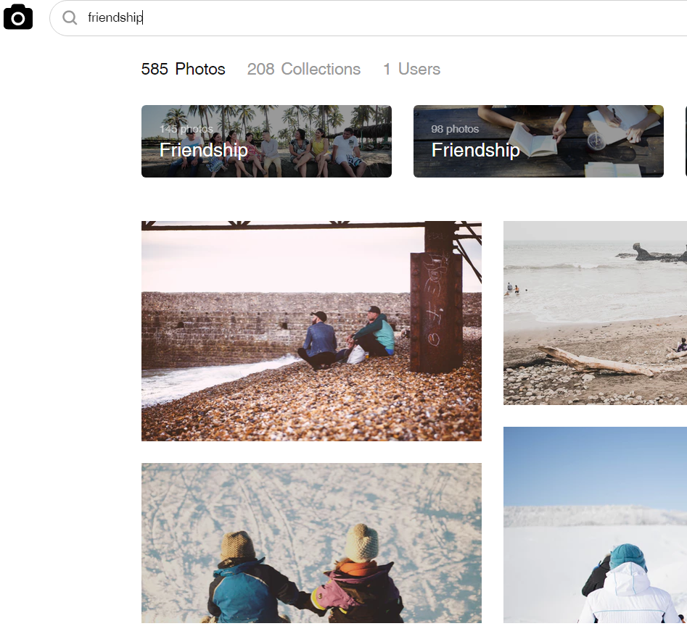
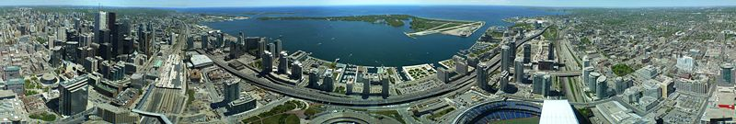
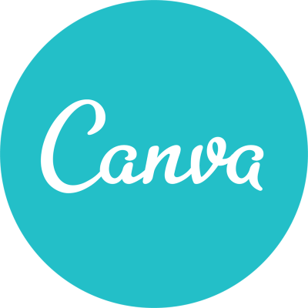
How can we create useful images for our blog, social media, and eNewsletter?
Google Streetview App – 360 degree photos
Unsplash.com – for fantastic stock photos
Canva.com – for creating flyers, infographics, etc. (free/cheap adobe alternative)

Slide 28

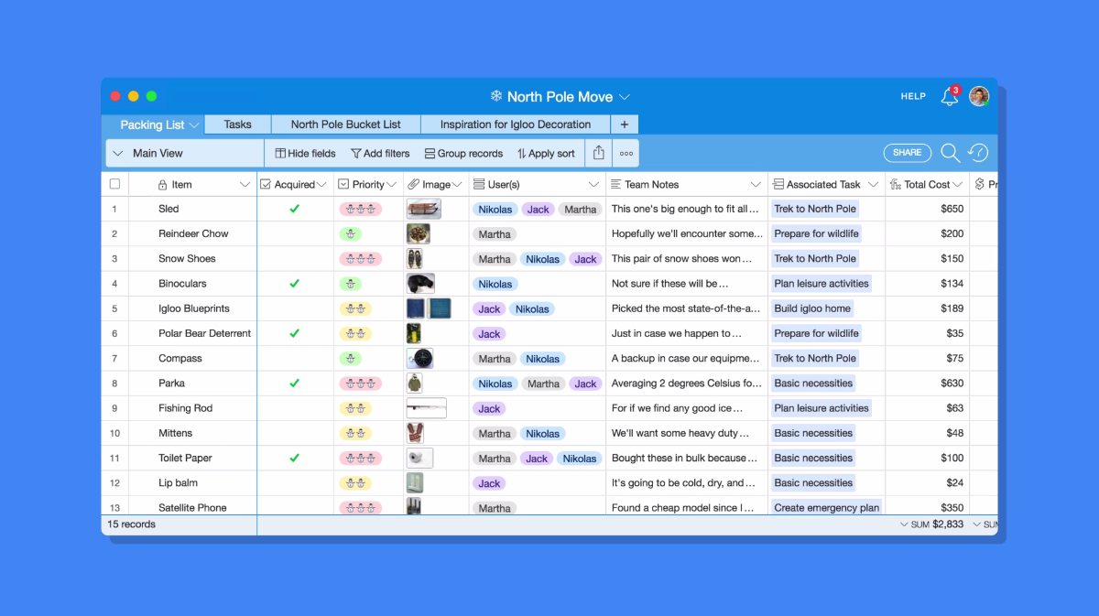
How can I organize photos, events, event participants, and other multimedia in any way I like?

Slide 29
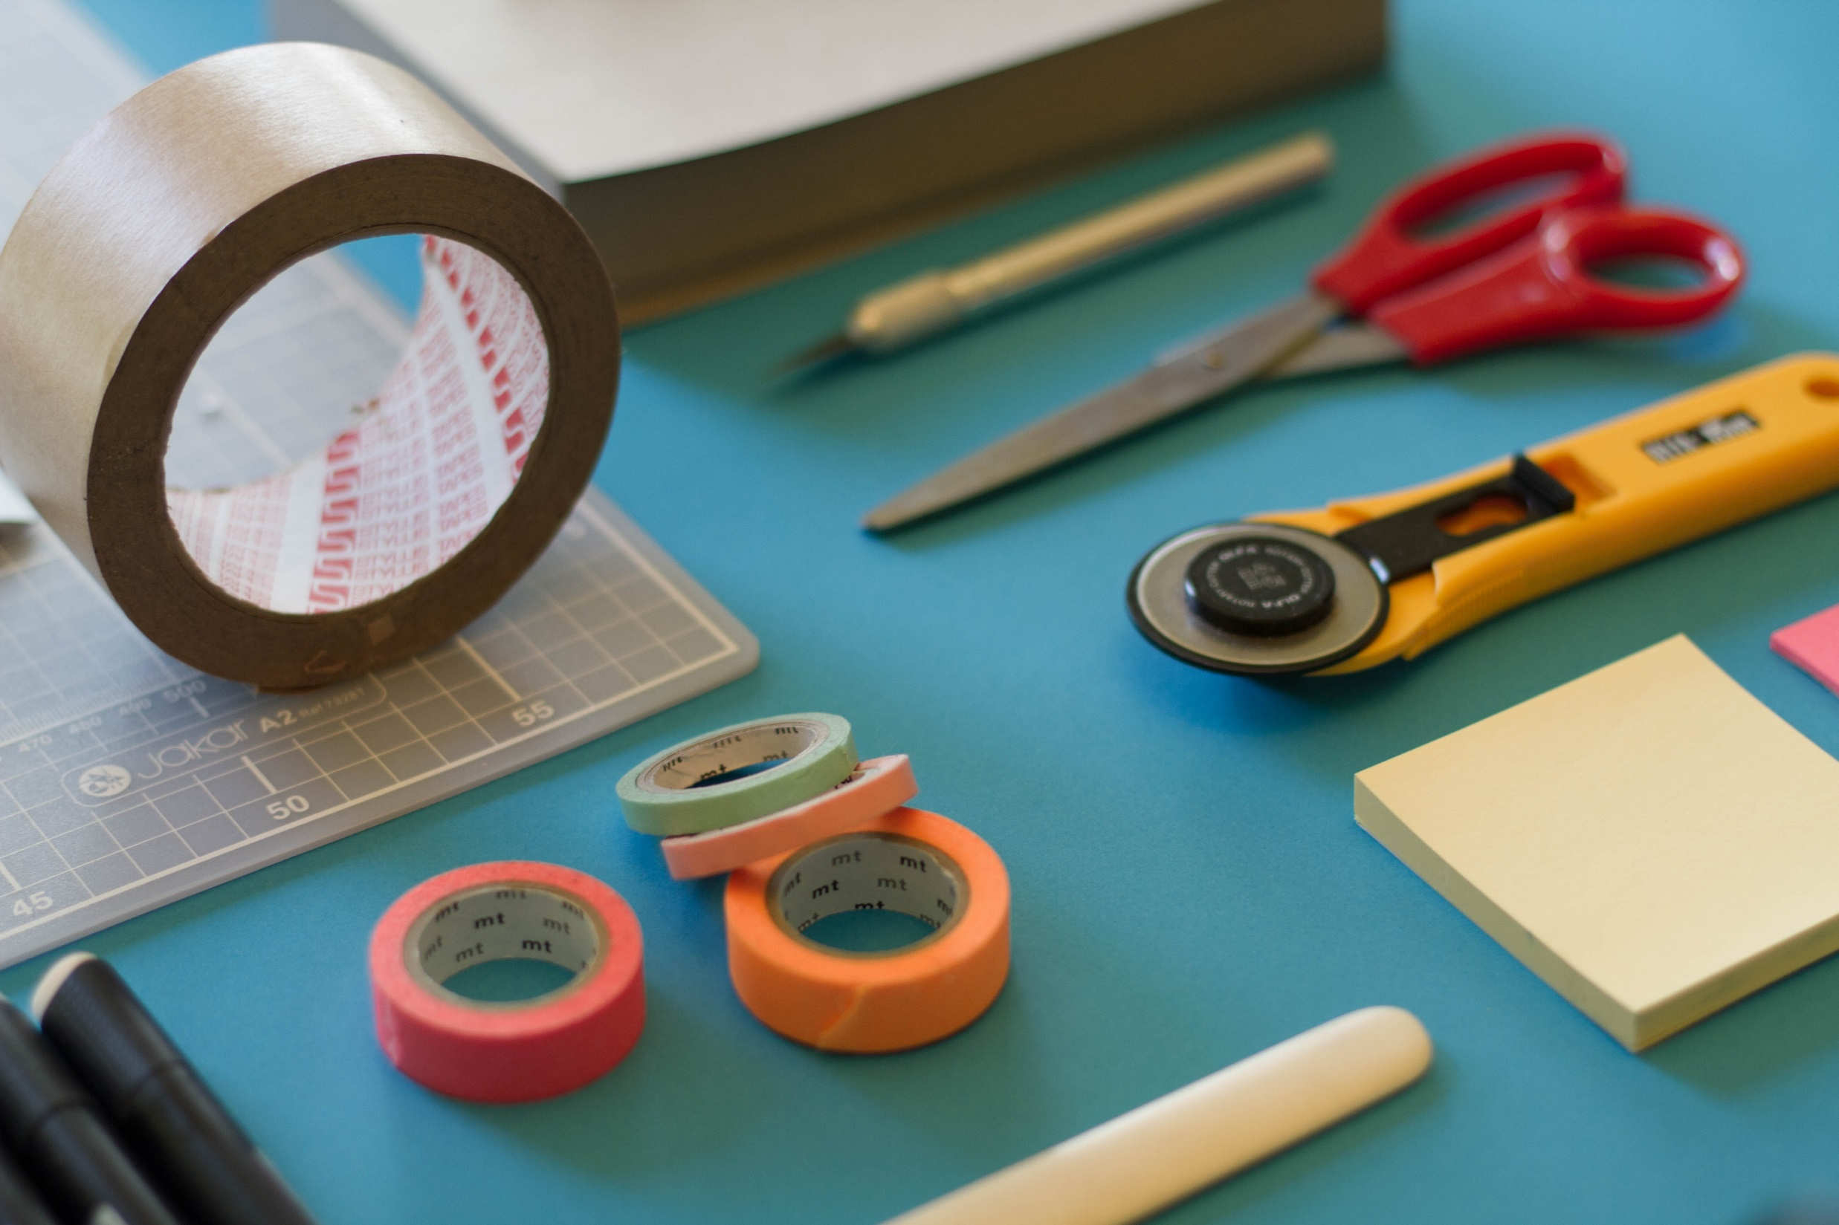
Other Hacks to Share?
Notes:
Check Flipchart – any issues we didn’t cover?

Slide 30
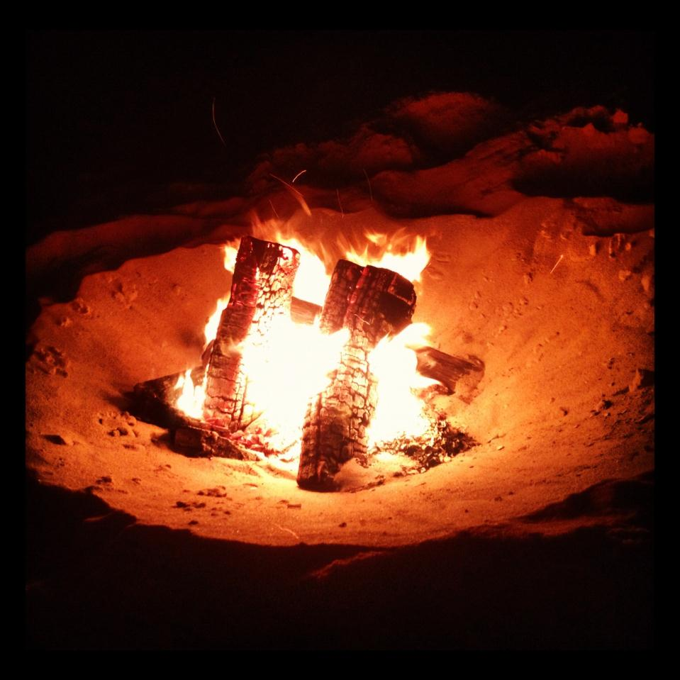
Ideas? Issues? Concerns?

