Slide 1
Creative Ideas for Keeping your Community Connected and Engaged this Summer
June 30, 2020
Tara Acker, Mentor
tacker@hgf.org

Slide 2
Creative Ideas for Keeping your Community Connected and Engaged this Summer
June 30, 2020
Tara Acker, Mentor
tacker@hgf.org
Please change your nametag in Zoom to:
Your first name
Your favorite hobby
Ex. Tara Mandolin
Hover over your video, click on the three dots, and select “Rename” to change your nametag.

Slide 3
Agenda
Title Box
Welcome
Virtual Camp – Two Very Different Models
Engaging Alumni and Donors
Innovative Day Camp Program & Overnight Family Camp
PJ Library Resources for Camps
Open Forum to Share Ideas
Contest
Thank You & Upcoming Webinars

Slide 4
Virtual Camp – Two Very Different Models
Aaron Hadley
Executive Director
Camp Ben Frankel
Yoni Stadlin
Founder and Director
Eden Village Camp

Slide 5
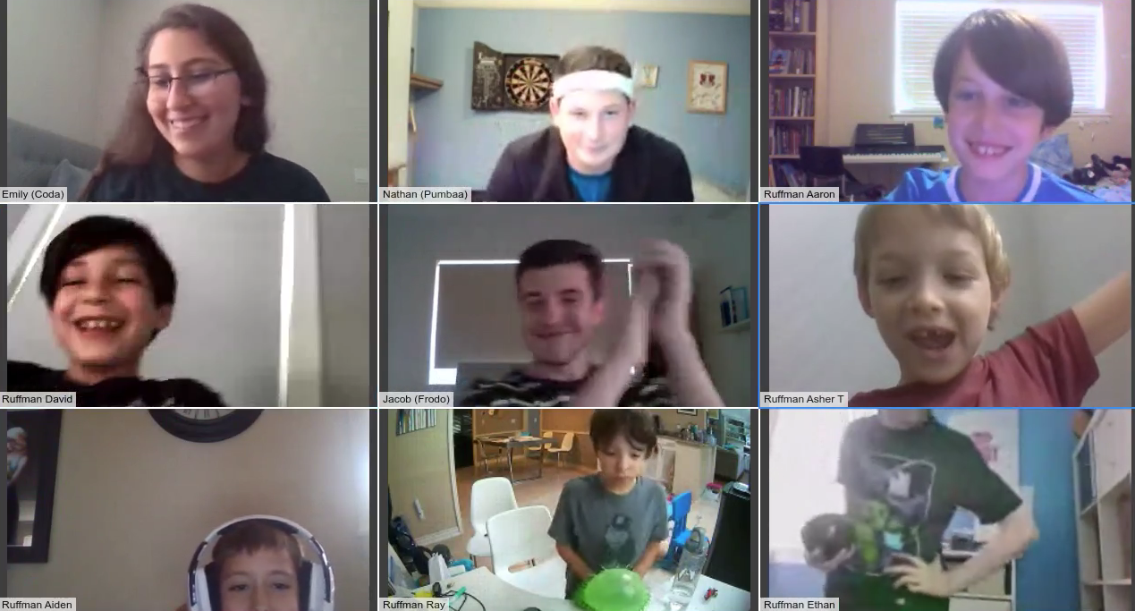

Slide 6
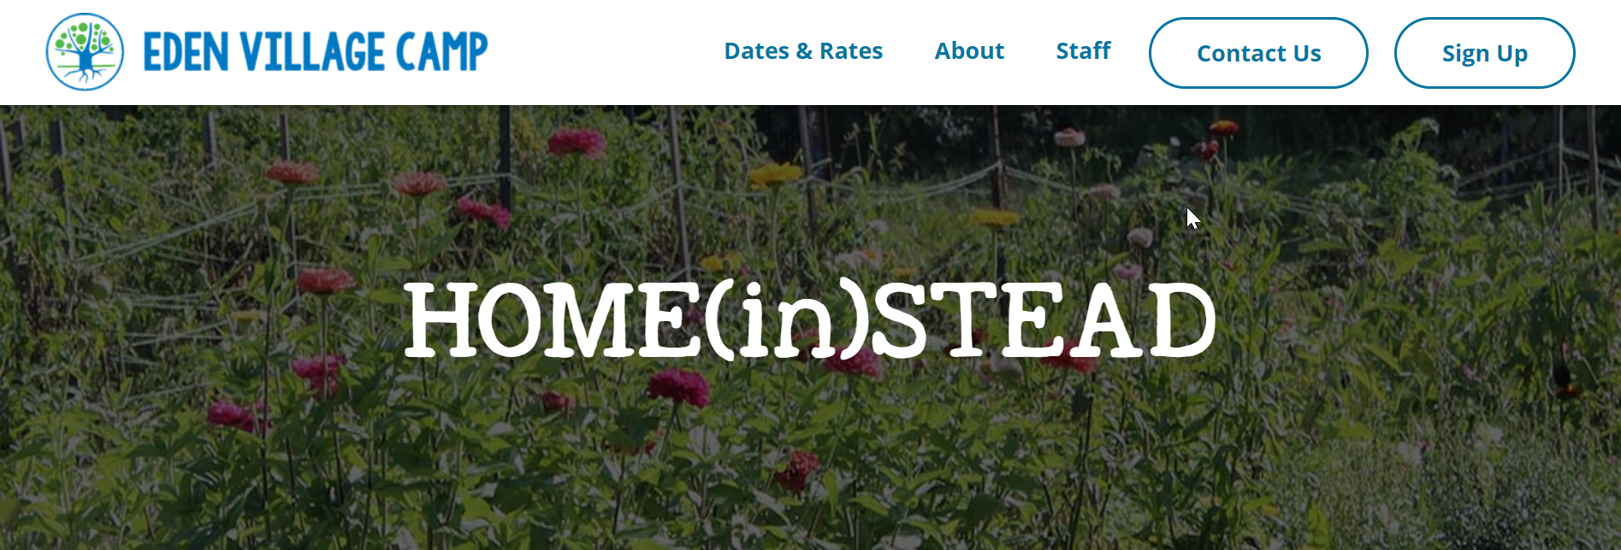

Slide 7
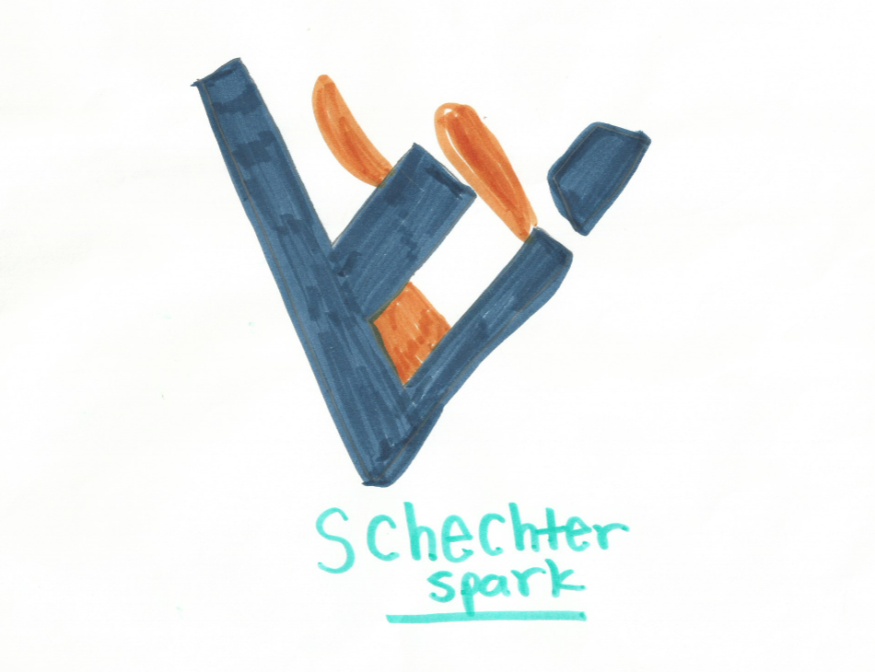
Engaging Alumni and Donors Online
Zach Duitch
Executive Director
Solomon Schechter

Slide 8
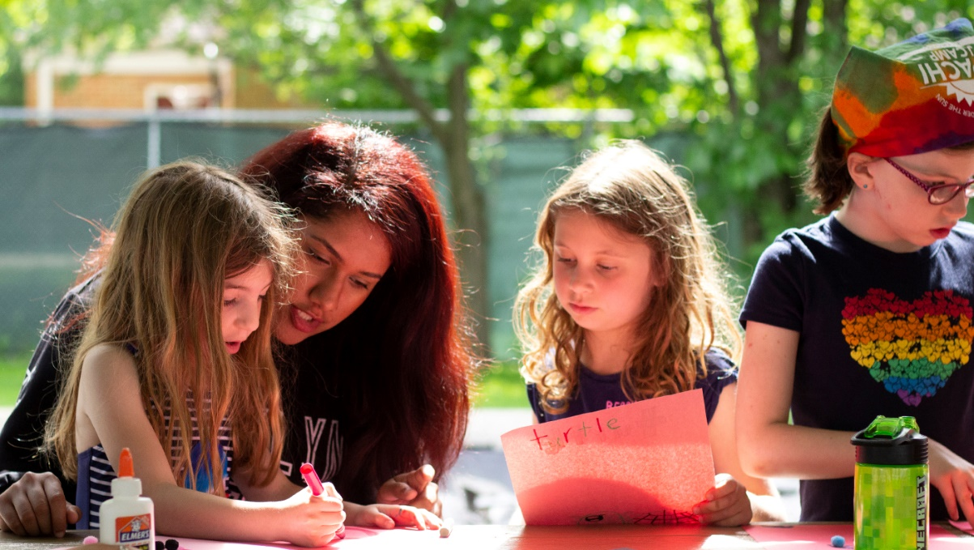
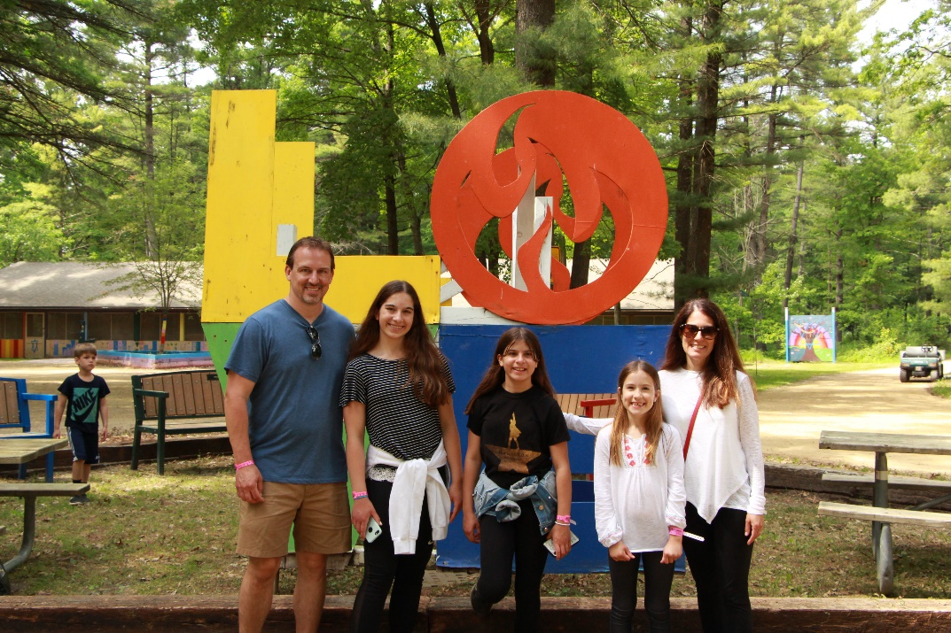
Innovative Day Camp Program and Family Camp Overnight Program
Beth Miller
Director of JCC Chicago City Camps
Apachi on the Go-Go
Brad Finkle
Chief Operating Office, JCC Chicago
Family Camp at Camp Chi

Slide 9
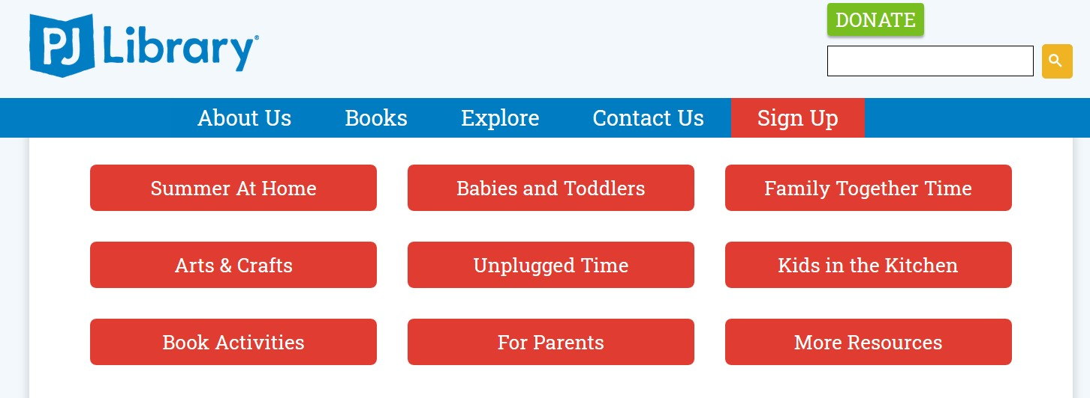
https://pjlibrary.org

Slide 10
YOUR Creative Ideas!

Slide 11
Shabboxes! Toni Davison Levenberg Camp Director Steve & Shari Sadek Family Camp Interlaken JCC

Slide 12
Contest!

Slide 13
Upcoming ADAPT Offerings
JULY 1
July 7
July 9
July 14
Master the Fundamentals Session 2: Stewardship a.k.a. Donor Love
How Can BOARD CHAIRS Support their Top Professional NOW?
COVID-19 & Legacy…The Work Goes On
Communicating to Keep Your Community Together
Full Schedule: jcamp180.org/adapt

