Slide 2
Welcome!
Update your ZOOM name to include your camp or organization.

Slide 3
YOUR Strategy for Success Aligned with Your Goals & Plan

Slide 4
Setting Your Strategy
1.) Target Audience | 3.) Methods
2.) Uses for the Money Case for Support | 4.) Timing / Urgency

Slide 5
One Camp’s Plan for 2021
March and April One-on-one major donor asks
May and June Public phase asks/ Spring Appeal
Summer On-line Alumni Event/ Giving Day
August/September Community-based Outreach
Year End Campaign Year End Appeal

Slide 6
One Camp’s Plan for 2021
March and April One-on-one major donor asks
Your donation, given now will go to work right away for this summer for things like . . . .
With your help we could try to get the $10K bonus early, before the start of camp, to help with the unprecedented need this summer.

Slide 8
People like me donate
Collect SHORT Testimonials
Donating outright after donating tuition last year: Why?
Alumni who gave for the first time
Parent donor / Grandparent donor / Camp staff donor

Slide 9
Here for Your Success
Fundraising Toolkit (www.jcamp180.org/toolkit)
ATN 2021 drop-in/learning sessions open to all camps

Slide 10
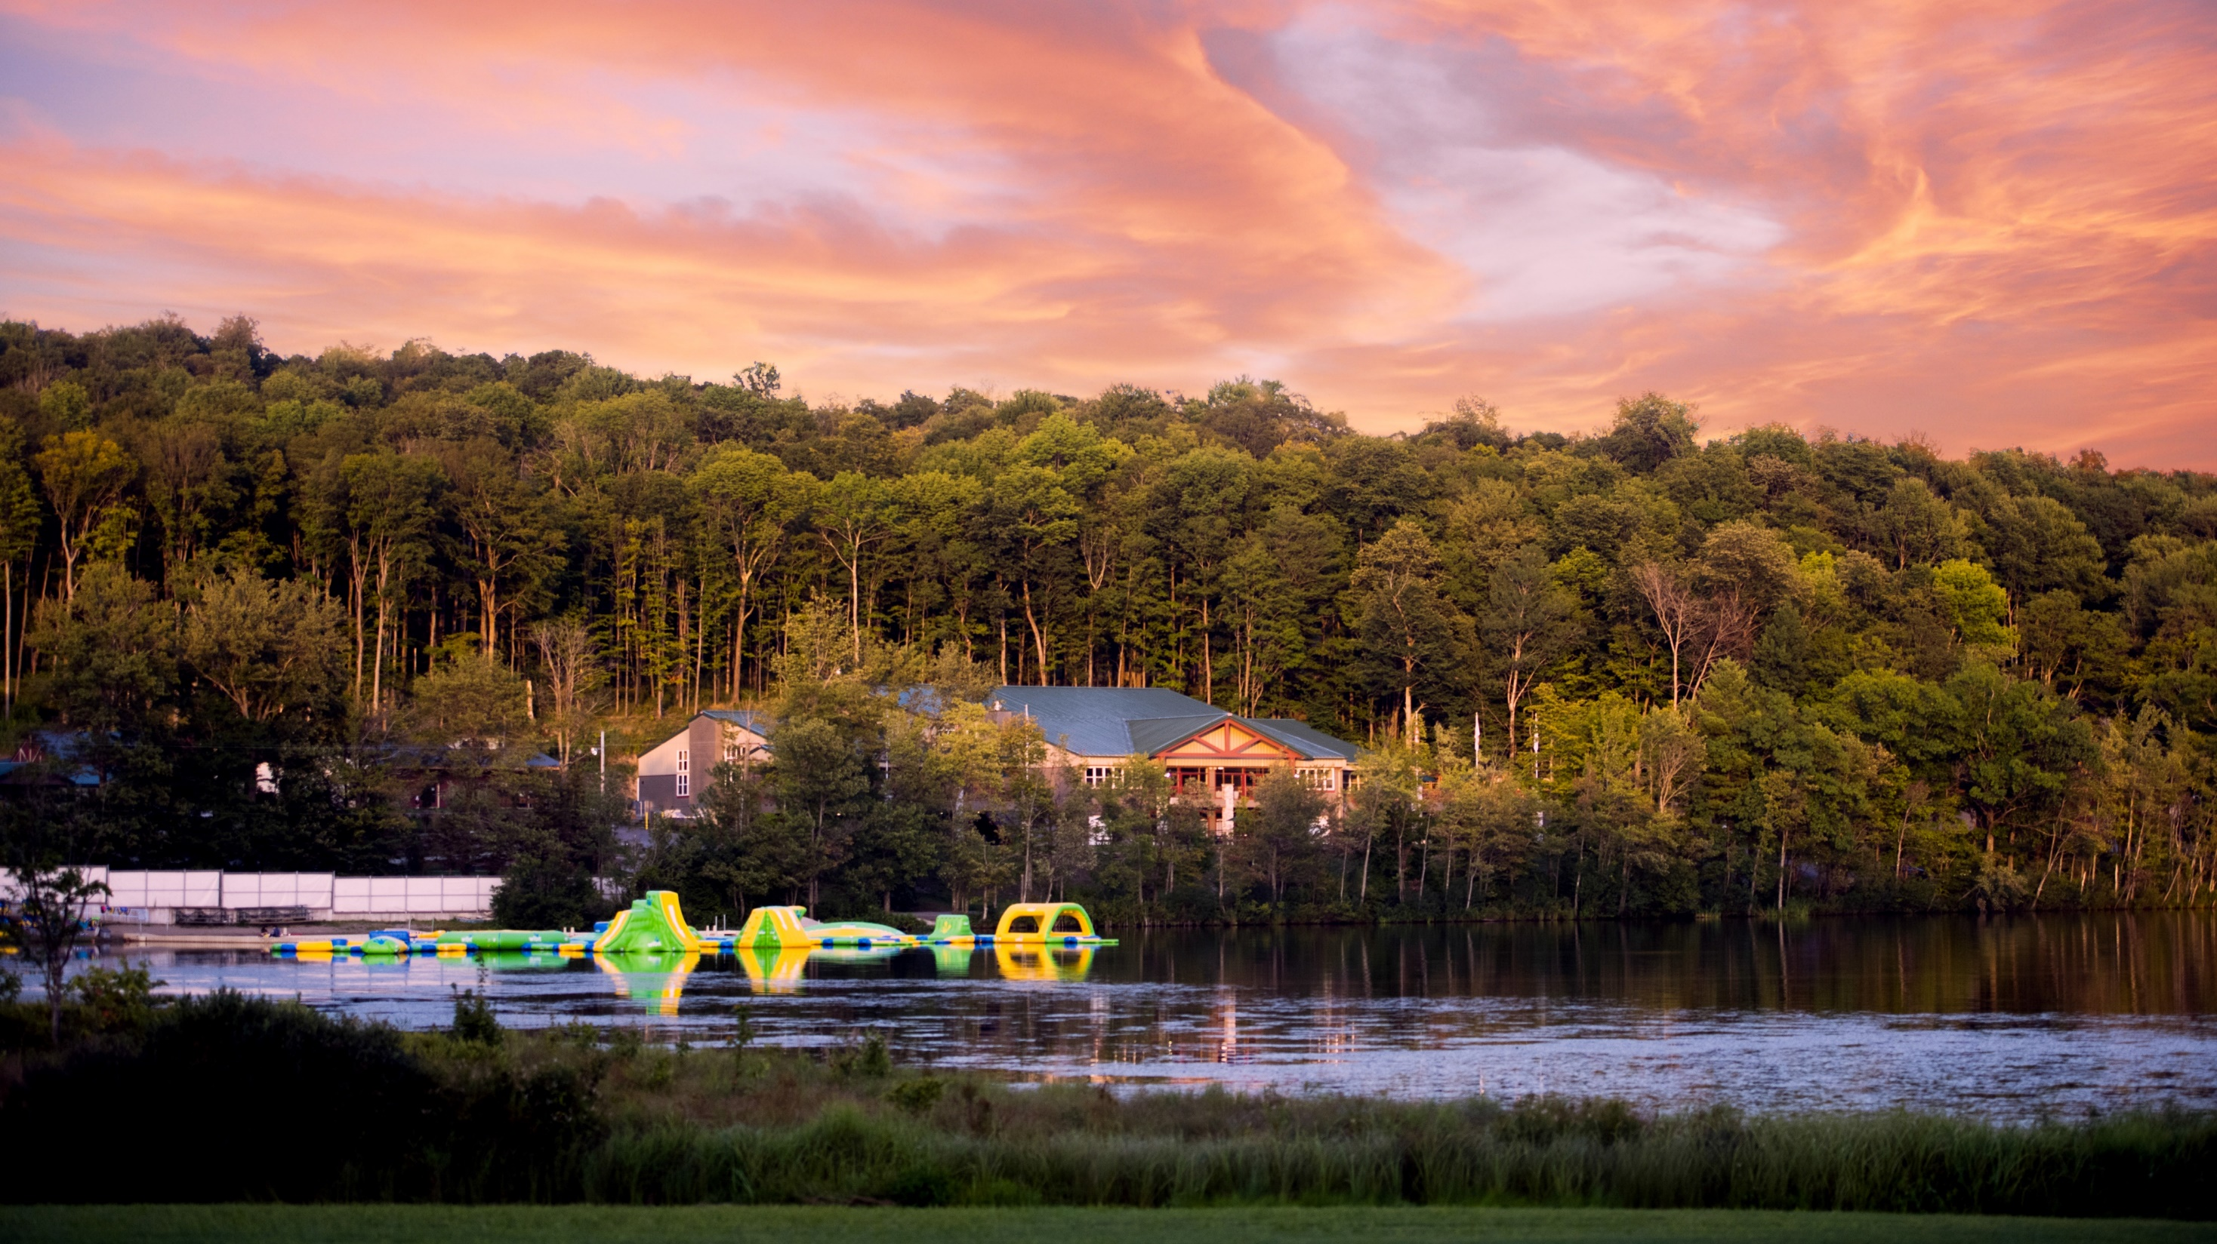
Thank you!

