Slide 1
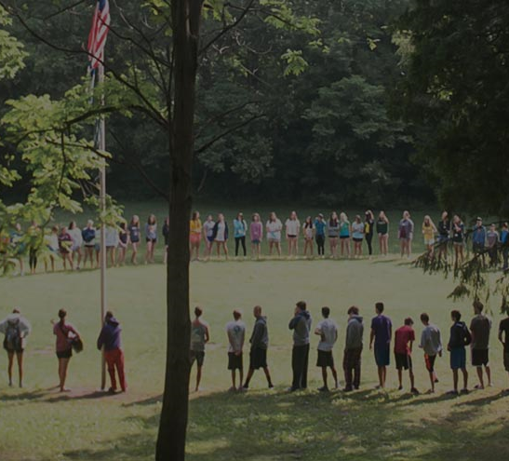
WELCOME
while you are waiting ..,
If we could drone-deliver a care package to you right now, what one thing would you most want?
Use chat to share your answer, ask questions, offer ideas throughout the hour.
All Together Now
A Matching Grant from the Harold Grinspoon Foundation

Slide 2
AGENDA
Updates
Field reports: Sharing from Camps & discussion
Answer your questions
What’s next? A look up ahead
Recap and Resources
All Together Now A Matching Grant from the Harold Grinspoon Foundation

Slide 3
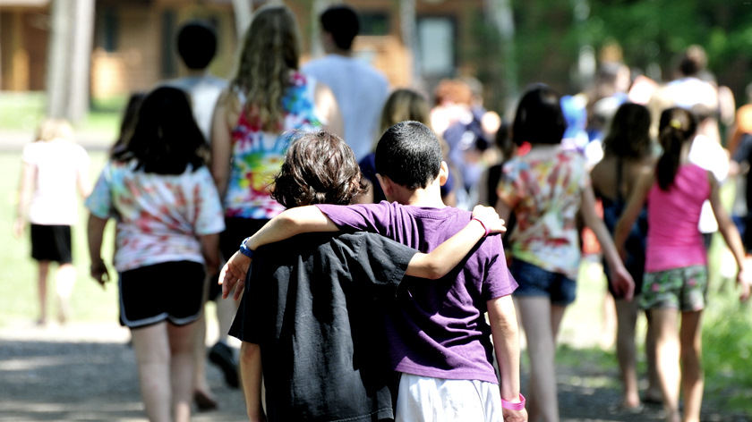

Slide 4

Schechter Spark
The Show Must Go Online!
BE THE SPARK, LIGHT THE WAY.
An online celebration honoring the legacy of Rabbi Joshua & Goldie Stampfer, Z”L
May 3, 2020 – 11:00 am
Julie Shumofsky Chivo, Camp Solomon Schechter

Slide 5
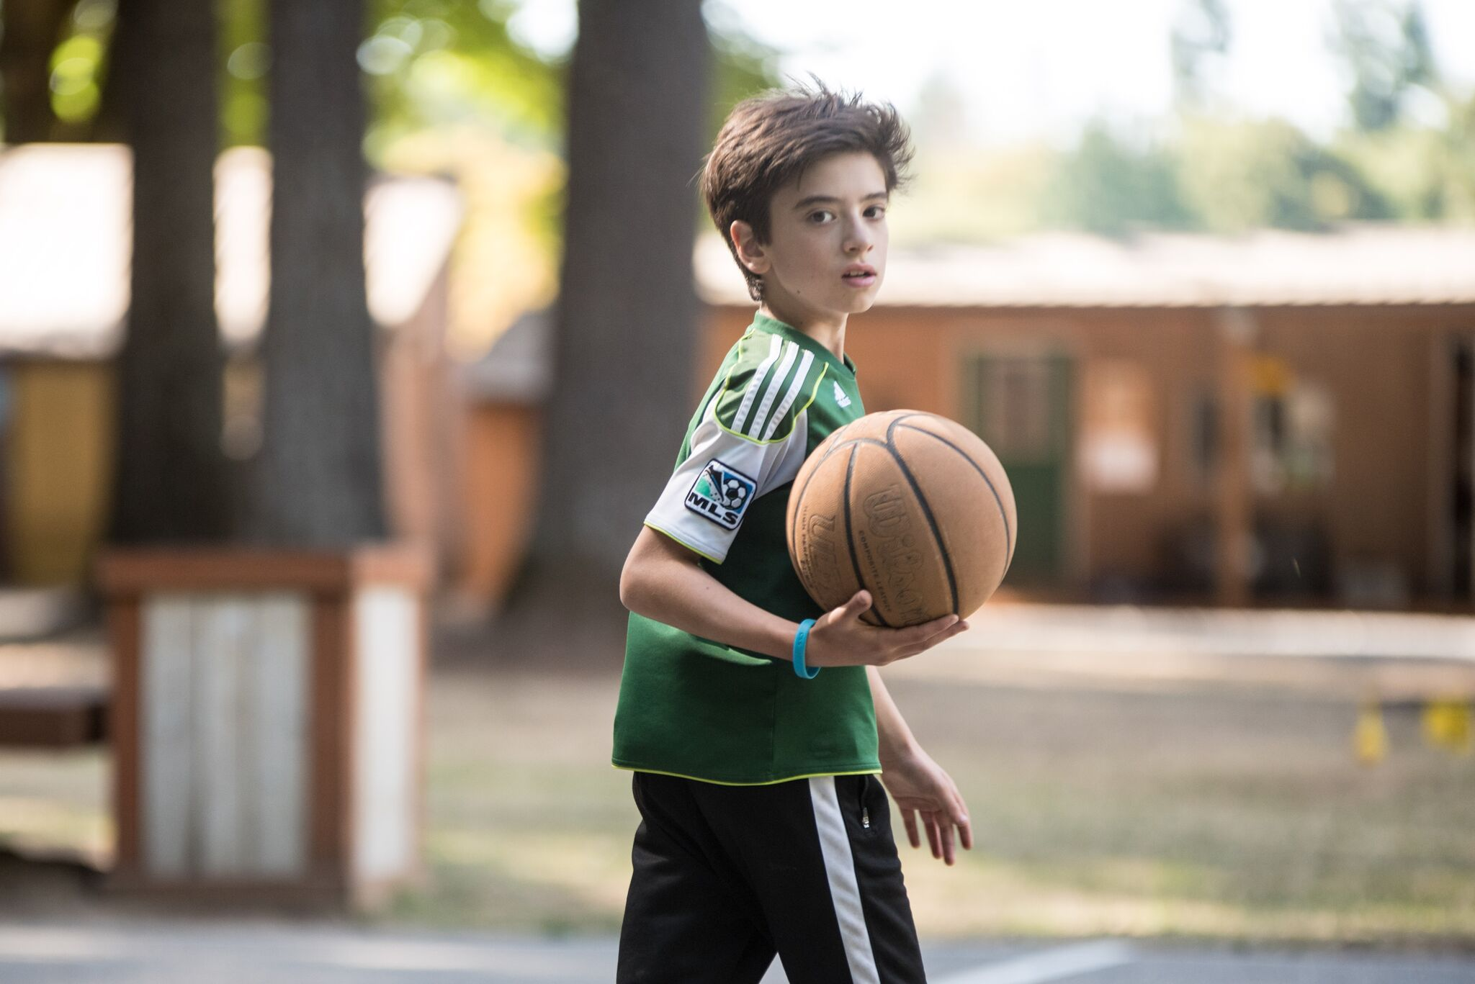
Questions?

Slide 6
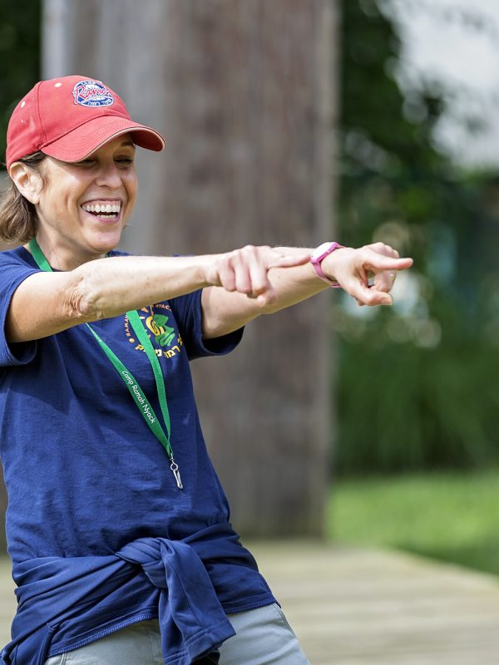
Amy Amy Skopp Cooper
Executive Director
Ramah Nyack
National Associate Director
National Ramah Commission
amy@campramah.org

Slide 7
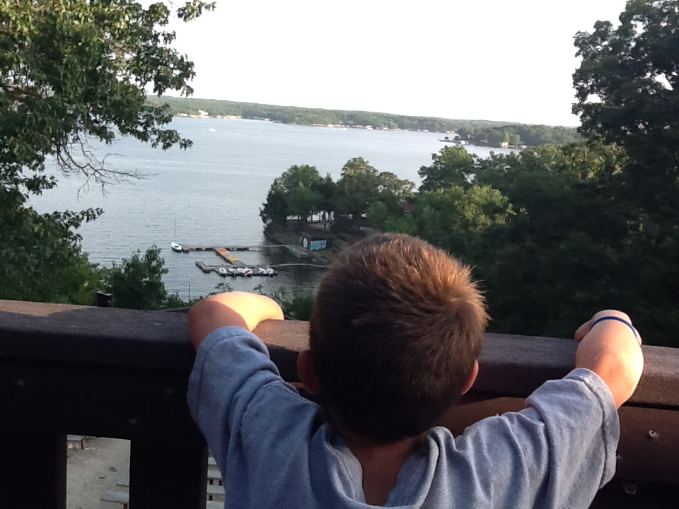
Questions ?

Slide 8
Strategy and Tactics
April | May / June | Fall / December
Gather your volunteer team Engage your Inner Circle One or a few Major Gifts? Start planning broader public campaign (Go/ No-Go Announcement) | Broader Public Phase | End of Year Campaign + Celebration Phase
Major Gifts | Many Gifts | Finish line

Slide 9

Successes and challenges

Slide 10

Your Toolbox - Coming Soon
Marketing and PR resources
Case for Support
Talking Points
Sample Appeal Letters
Sample Thank You Letters
Social media post ideas
#JewishCampStrong

Slide 11
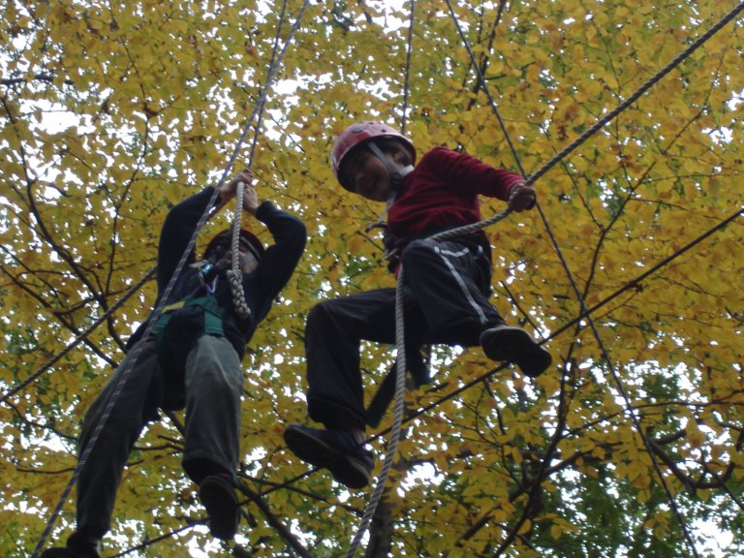
How Can We Help?

Slide 12
Recap – Do Now
Inform, Engage, Ask Major Donors
Submit Gifts to HGF
Prep for Public Phase
Resources
JCamp 180 Mentor
Weekly drop-in session on Tuesdays at 2pm
jcamp180.org/all-together-now

Slide 13
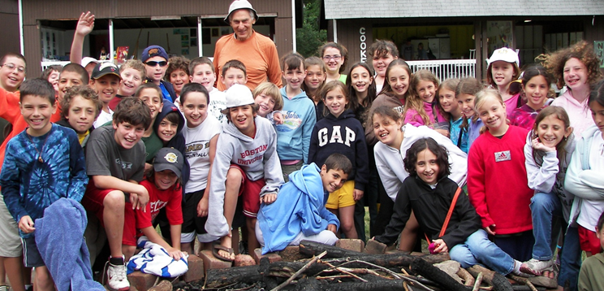
What topics would be most helpful to you?
Email Julia@hgf.org

