Slide 1
Chai Match 3
Information Session
September 3, 2014
Mark Gold Allison Macari-Wilhelm
Director, JCamp 180 Administrative Assistant
Mark@hgf.org Allison@hgf.org
413-276-0777 413-276-0720

Slide 2
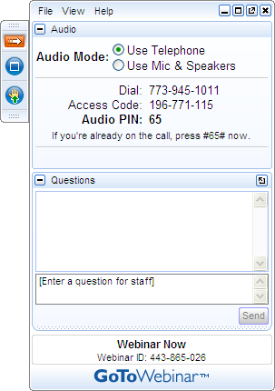
GoTo Meeting Logistics:
A) Grab Tab – Click red arrow to open/close Control Panel. Click square to toggle Viewer Window between full screen/window mode. Click mic icon to mute/unmute your audio.
B) Audio Pane – Select audio format. Click Audio Setup to verify Speakers & Microphone.
C) Questions Pane – Attendees can submit questions and review answers.
D) Type your question and click Send to submit it to the organizer.
A →
B →
C →
D →

Slide 3
Agenda:
Introduce the JCamp180
Chai Match 3 grant
Step by step overview
Creating a competitive application
Questions and discussion

Slide 4
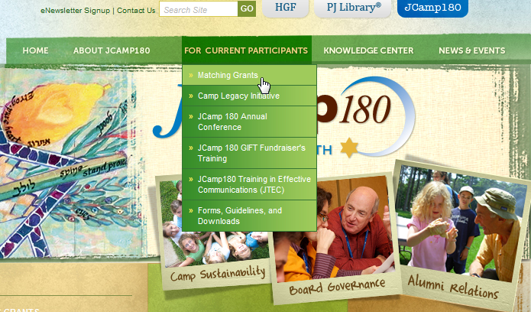
Follow-up:
Find today’s information on JCamp180.org

Slide 5
Goal Options:
Campaign total of:
  $432,000: Triple Chai
    Phase 1 goal is $54,000 (in $9000 gifts)
    Phase 2 goal is $324,000 (in $1800 gifts)
  $288,000: Double Chai
    Phase 1 goal is $36,000 (in $9000 gifts)
    Phase 2 goal is $216,000 (in $1800 gifts)
  $144,000: Single Chai
    Phase 1 goal is $18,000 (in $9000 gifts)
    Phase 2 goal is $108,000 (in $1800 gifts)

Slide 6
Why the choice?
A campaign goal should be realistic for the needs of the camp, not based on the JCamp180 challenge level
Match the giving capacity of your donor base
Have a successful campaign
Allows HGF to provide funds to the maximum number of camps

Slide 7
Campaign Restrictions:
Half
Camps must use at least half of the Chai Match 3 funds for:
  Capital improvements or
  Facility enhancements
Half
The remaining (up to) 50% is unrestricted and may be used for:
  scholarships
  endowments, or
  annual operating expenses

Slide 8
Program Overview
Phase 1 Gifts:
Phase 1
Your Major
Donor(s)
Identify and solicit major donors to partner with HGF
Gifts must be $9,000 or larger and must be paid in full prior to November 18, 2015.
Total depends on Phase 1 goal. Either:
$18,000 (one or two gifts)
$36,000 (one to four gifts)
or $54,000 (one to six gifts)

Slide 9
Program Overview
Phase 1 Gifts:
Program Overview
Phase 1 Gifts:
Phase 1
Your Major
Donor(s)
Grinspoon
Match
Identify and solicit major donors to partner with HGF
Gifts must be $9,000 or larger and must be paid in full prior to November 18, 2015.
Total depends on Phase 1 goal. Either:
$18,000 (one or two gifts)
$36,000 (one to four gifts)
or $54,000 (one to six gifts)
HGF matches these gifts 1:1
Total Phase 1 funds can range from $36,000 to $108,000

Slide 10
Program Overview
Phase 1 Gifts:
Phase 1
Your Major
Donor(s)
Grinspoon
Match
Phase 1 Gifts:
Must be cash or cash equivalents (no property, etc.)
Cannot be from FJC, Jewish Federation
Can be from related family members
Pledges in hand by July 18, 2015
Identify these pledges to HGF within 30 days
Pledges paid in full by November 18, 2015

Slide 11
Program Overview
Phase 2 Gifts:
Phase 1
Your Major
Donor(s)
Grinspoon
Match
GIFTS FROM CAMP COMMUNITY
Gifts must be $1,800 or larger
Matched from phase 1 funds 1:3
Phase 2

Slide 12
Program Overview
Phase 2 Gifts:
Phase 1
Your Major
Donor(s)
Grinspoon
Match
One year to get pledges:
In hand by 11/18/2015
Identify pledges to HGF within 30 days of receipt
1/3 paid within 60 days
Pledges paid in full by March 18, 2018
HGF share of pool is paid out when pledges are paid
Phase 2

Slide 13
Chai Match 3
Program Example:
Single Chai Match
Phase 1
$18,000
$18,000
Phase 2
$108,000
Campaign Total: $144,000

Slide 14
Chai Match 3
Program Example:
Double Chai Match
Phase 1
$36,000
$36,000
Phase 2
$216,000
Campaign Total: $288,000

Slide 15
Chai Match 3
Program Example:
Triple Chai Match
Phase 1
$54,000
$54,000
Phase 2
$324,000
Campaign Total: $432,000

Slide 16
Gift Restrictions:
Gifts in both phases may come from new or previous donors and from individuals, families (spouse, parents, grandparents, siblings, and children), foundations or corporations.
Family Foundation gifts through a Federation are allowed
Excluded are gifts from a Jewish Federation or the Foundation for Jewish Camp.

Slide 17
Application Process:
Application is now available on our website.
Submit by e-mail to Allison Wilhelm
Applications will be acknowledged within 24 hours of receipt. It is the camp’s responsibility to assure the application has been received.

Slide 18
Application Questions:
Describe your camp’s previous record with JCamp180 matching grant campaigns and your likelihood for success in this matching grant.
Describe the proposed use of the funds raised in the Chai Match 3 program
How does the timing of the Chai Match 3 program align with your Camp’s strategic goals, particularly with your overall fundraising plan?
Why should JCamp180 select your camp over others for this grant? What is your case for support?
What communications have there been (or will there be) with the Board/ Committee / Commission and staff of the camp to assure the success of the Chai Match 3 program?
And several administrative questions

Slide 19
Evaluation Process:
Appropriateness of timing to existing or planned campaigns
Proposed use of funds as described in application
Administrative track record with HGF
Recommendation of JCamp180 Mentor
Selection will be made by JCamp180 staff in consultation with HGF Founder and Trustees

Slide 20
Participation Is Limited:
There are limited funds available for Chai Match 3
A minimum of 18 camps will be invited to participate in this grant
Must not be active or eligible under a current JCamp180 matching grant program at the time of application
Applications must be received by Sept 24, 2014

Slide 21
Time Table:
Applications due by Wednesday,
September 24, 2014 at 5:00 PM PST
Participants announced before
October 18, 2013
Phase 1 pledges until July 18, 2015
Phase 2 fundraising until November 18, 2015
Payment of HGF matching funds available beginning July, 2015
All pledges paid in full by November 18, 2018

Slide 22
Grant Administration:
A Chai Match 3 donor information form must be submitted for each phase 1 donor
Proof of payment of first 1/3 (minimum) of each phase 2 gift must be sent within 60 days of sending pledge letters.
All submissions will be through IGAMS
HGF reserves funds based on proof of payment of phase 1 pledges and pays out matching funds upon proof of payment of phase 2 gifts.
Be aware of timelines for submitting proof of pledges and payments.

Slide 23
Fundraising Hints:
Phase 1
Start cultivating major donors now
Make a fundraising plan with your mentor
Proceed with a campaign even if you don’t get the Chai Match
Incorporate Chai Match in 2015 annual fundraising strategy
Phase 2
Start asking for and collecting pledges on phase 2 gifts as soon as possible.
Use visits to camp over the summer to inspire Phase 2 gifts from grandparents, parents, and alumni
Identify a major donor to help “close” phase 2 to finish (before Nov 18. 2015).

Slide 24
Questions:
Can the Campaign be larger?
How do I select the campaign goal (single chai, double, or triple chai)?
Can a few major donors fulfill Phase1 and
Phase 2 and finish the whole campaign quickly?
Yes, but 1.) be careful of how you describe the matching pool to donors, and 2.) JCamp 180 funds capped at $54,000.
Be realistic. Talk to your JCamp180 Mentor. There are as many pitfalls to taking on too large a campaign (you don’t get HGF funds) as there are to too small a campaign (you don’t maximize available HGF funds). There is no strategy for acceptance based on campaign size.
Yes, but it isn’t the intent of the grant. We are looking for Camps who will use the campaign to reach out to more alumni and camp supporters and increase the base of philanthropic support for camp. To encourage phase 2 outreach, a bonus will be given to the camp with the most phase 2 donors.

Slide 25
Questions:
Can excess phase 1 gifts be carried over to
phase 2?
What are you looking for in a “competitive application”?
What if we take a risk to reach out to more Alumni in phase 2 and don’t meet our full goal?
Yes. A gift of $10,800, if at least $9,000 is paid by 11/18/15, can have $9,000 count toward phase 1 and $1,800 count toward phase 2. HGF will help you best allocate major gifts to phases 1 and 2 to maximize your matching grant program.
A thoughtful fundraising strategy for this campaign. A current and compelling need.
Go for it, but plan accordingly. Speak with your mentor about strategies. Grinspoon payment of the Phase 1 match is dependent on receiving proof of payment of Phase 2 gifts. This will have budget implications.

Slide 26
Your Questions:
QUESTIONS?

Slide 27
Chai Match 3
Information Session
September 3, 2014
Mark Gold Allison Macari-Wilhelm
Director, JCamp 180 Administrative Assistant
Mark@hgf.org Allison@hgf.org
413-276-0777 413-276-0720

