Slide 1
Create Your Match 7
Information Session
August 23, 2018
The Webinar will begin shortly
Please Stand by

Slide 2
Create Your Match 7
Information Session
August 23, 2018
The Webinar will begin in 3 minutes
Please Stand by

Slide 3
Create Your Match 7
Information Session
August 23, 2018
The Webinar will begin in 1 minute
Please Stand by

Slide 4
Create Your Match 7
Information Session
August 23, 2018
Mark Gold Kathleen Rodowicz
Director, JCamp 180 Grants Administrator
Mark@hgf.org Kathleen@hgf.org
413-276-0777 grants@hgf.org
413-276-0719

Slide 5
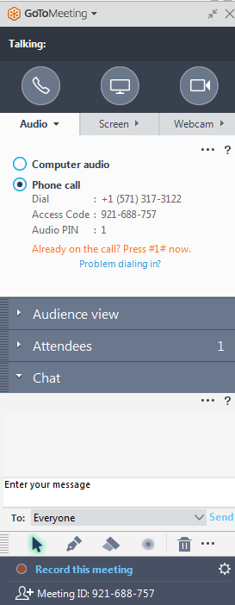
GoTo Meeting Logistics:
A →
A) Grab Tab – Click arrow to open/close Control Panel. Click square to toggle Viewer Window between full screen/window mode. Click mic icon to mute/unmute your audio.
B) Audio Pane – Select audio format. Click Audio Setup to verify Speakers & Microphone.
C) Questions Pane – Attendees can submit questions and review answers.
B →
C →

Slide 6
Agenda:
Introduce the JCamp180
Create Your Match 7 grant
Step by step overview
On-line grants administration
Questions and discussion

Slide 7
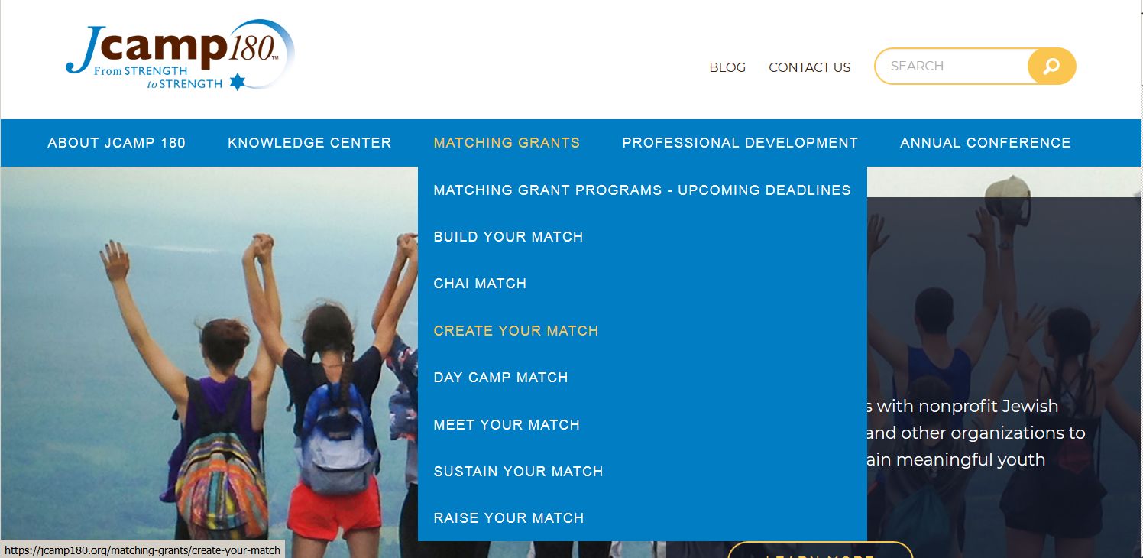
Follow-up:
Find today’s information on JCamp180.org

Slide 8
Follow-up:
Demonstration on how to access CYM 7 Information on JCamp180.0rg

Slide 9
Campaign Goal:
Create Your Match 7 is a two-phase matching grant program
Campaign total of $450,000 or more
  $150,000 in larger gifts (phase 1)
    $75,000 of this from your donors
      Minimum gift of $25,000 in this category
    $75,000 of JCamp 180 match
  $300,000 in smaller gifts (phase 2)
    Minimum gift of $3,600 in this category

Slide 10
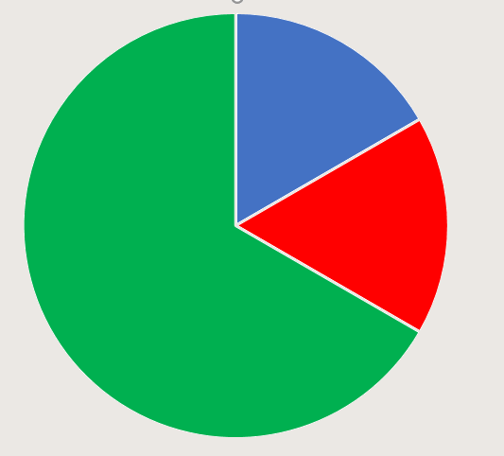
CYM 7
Program Summary
HGF Match:
$75,000
Phase 1 Gifts:
$75,000
Phase 2 Gifts:
$300,000
Campaign Minimum: $450,000

Slide 11
How does it work?
To earn the JCamp180 match of
$75,000
you must:
Raise $75,000 in major gifts (Phase 1)
Raise $300,000 in smaller gifts (Phase 2)

Slide 12
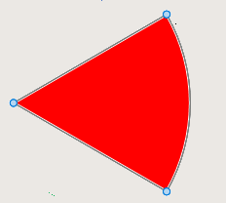
Program Overview
Phase 1 Gifts:
Your
Donors
Identify and solicit major donors to partner with HGF
  Gifts must be $25,000 or larger
    Funds pledged by March 31, 2019
    Paid in full by August 31, 2019.
JCamp180 matches these gifts 1:1 up to $75,000
One gift of $75,000 (or higher) earns the phase 1 match from JCamp180

Slide 13
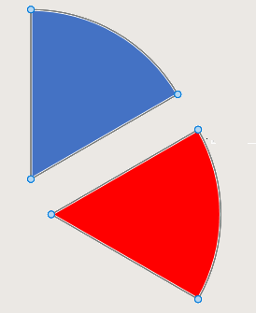
Program Overview
Phase 1 Gifts:
JCamp 180
Match
Your
Donors
Pledges must be in hand by March 31, 2019
Identify these pledges to HGF within 30 days
Pledges paid in full by August 31, 2019

Slide 14
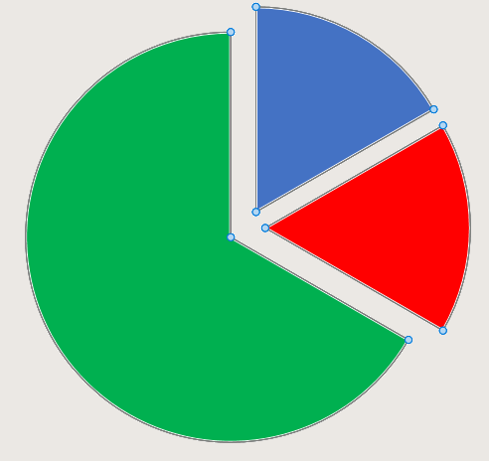
Program Overview
Phase 2 Gifts:
Phase 1
JCamp 180
Match
Your
Donors
GIFTS FROM CAMP COMMUNITY
Gifts must be $3,600 or larger
Matched from phase 1 funds 1:2
Phase 2

Slide 15
Program Overview
Phase 2 Gifts:
Identify and solicit phase
2 donors
Gifts must be $3,600 or larger
Funds pledged by
August 31, 2019
Paid in full by
August 31, 2021.
These gifts are matched 1:2 from
the phase 1 pool
  Camp raised phase 1 funds already in hand
  The HGF Match is 1:4
Identify pledges to HGF within 30 days of receipt
HGF share of pool is paid out when pledges are paid at the
minimum level of $3,600.00*
Phase 1
JCamp 180
Match
Your
Donors
Phase 2
* Exception is ongoing credit card payments

Slide 16
CYM 7
Program Summary
HGF Match:
$75,000
Phase 1 Gifts:
$75,000
Phase 2 Gifts:
$300,000
Campaign Minimum: $450,000

Slide 17
Campaign Restrictions:
Campaign funds must be designated for:
  Capital Improvements
  Camper scholarships
  Endowments, or
  annual operating expenses

Slide 18
Who is a JCamp180 matching grant donor?
An Approved Donor is:
  An Individual (alumni, parent, friend)
  A family (parents, siblings & children)
  A family foundation
  A business
  A “friends of” or pre-established 501(c)(3) group of alumni
An Approved Donor is NOT:
  Allocations, grants or designated funds from a Jewish Federation or national parent organization (Ramah, Chabad, etc.)
  JCCA allocations, grants or funds
  FJC grants or gifts
  A Foundation grant where applications were solicited (purpose specific)
  A group of alumni or friends who pool their gifts

Slide 19
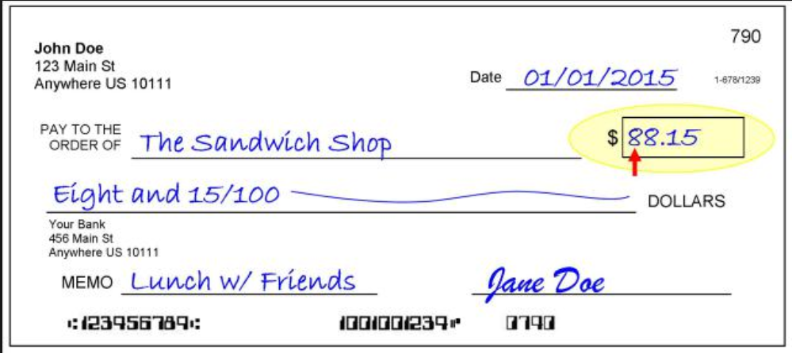
What is an eligible JCamp180 Gift:
Eligible payments must be dated after
September 1, 2018
It is:
Cash or cash equivalents
Stocks or bonds
Assets with market value
It is NOT:
Payment for events, raffles, sponsorships, etc.
In kind contributions
Discount in cost of goods or services
Non-liquid assets
  Land
  Art
  Gifts with liquidation restrictions

Slide 20
Fundraising Hints:
Phase 1
Start cultivating major donors now
Make a fundraising plan with your mentor
Use the JCamp180 1:1 match to attract these gifts
Phase 2
Start asking for and collecting pledges on phase 2 gifts as soon as possible.
Use visits to camp next summer to inspire Phase 2 gifts from grandparents, parents, and alumni

Slide 21
Fundraising Hints:
Phase 1
Incorporate Create your Match into your 2019 annual fundraising strategy
Gift payments can extend over two calendar (tax) years (2018 and 2019)
Phase 2
Use scheduled credit card payments to the advantage of donors.
($3600 is $100 per month)
To encourage recurring credit card gifts we will match these gifts on a quarterly basis.
Identify a major donor to help “close” phase 2 to finish (before Aug 31. 2019).
Payments can extend over four tax years (2018-2021)

Slide 22
Grant Administration:
All JCamp180 grants are administered through our on-line Grants Administration system.
Requires that you create an account
Documents are to be uploaded through the website.

Slide 23
Grant Administration:
There are three steps you need to take to participate in JCamp 180 matching grants using our on-line grants administration system:
Create an account (only need to do this once)
Your camp should already have an account from MYM 7
Register for CYM 7 (once for each matching grant program)
Plan on doing this soon
Process shown on 3 subsequent slides
Submit pledges and payment support for reimbursement
Plan to do this every 3 months
as pledges and gifts are received
Shown on 7 subsequent slides

Slide 24
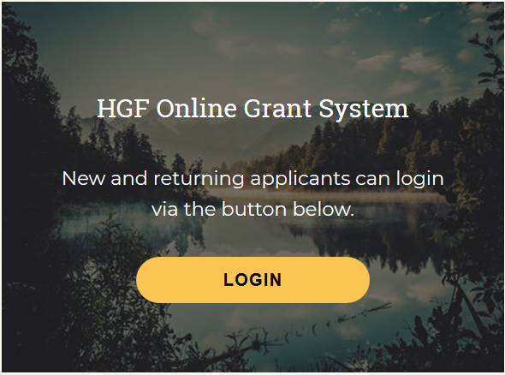
Grant Administration: How to create an account
  How to create an account
  on the on-line grant reporting system
  Open the home page of the JCamp 180 website: www.jcamp180.org
  Scroll to the bottom of the home page
  Click on the LOGIN button

Slide 25
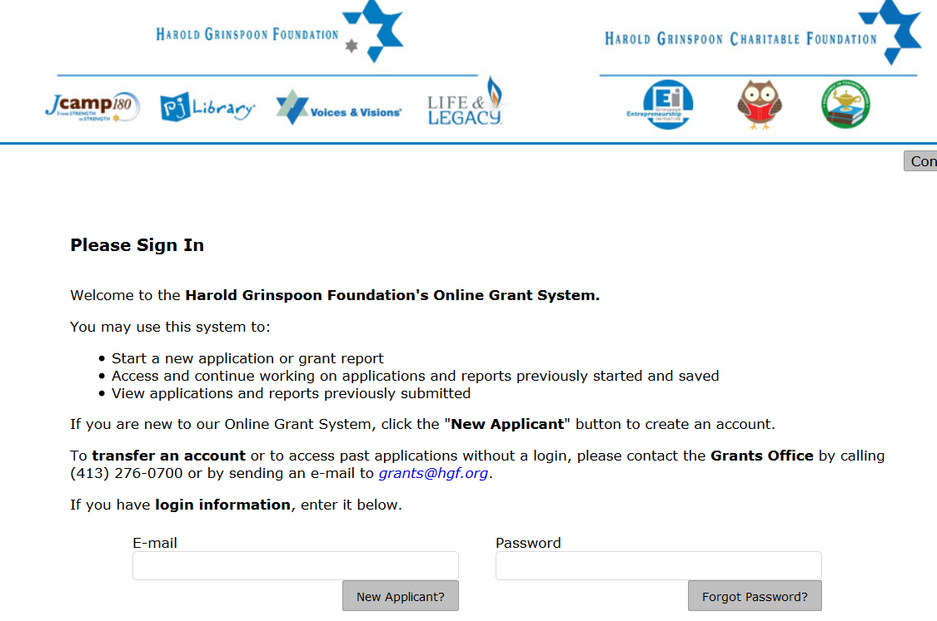
Grant Administration: How to create an account
Click on the “New Applicant” button

Slide 26
Grant Administration: How to create an account
Click on the “New Applicant” button
You should not have to do this again!

Slide 27
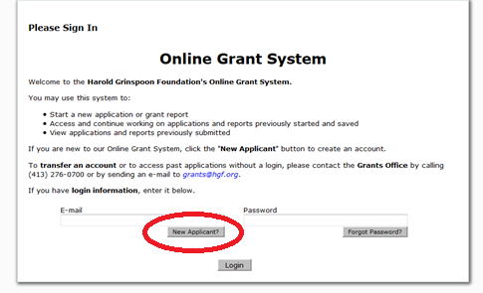
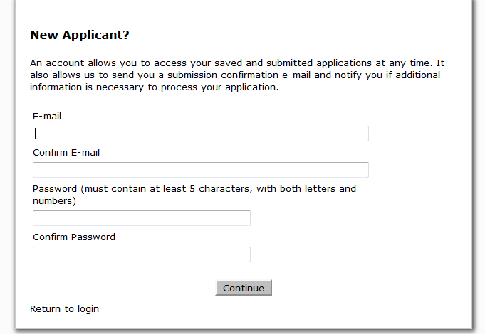
Grant Administration: How to create an account
  To create an account, you will need to select “New Applicant”
As a new applicant, please fill out the necessary fields
Select “New Applicant”

Slide 28
Grant Administration: How to create an account
  To create an account, you will need to select “New Applicant”
You should not have to do this again!
As a new applicant, please fill out the necessary fields
Select “New Applicant”

Slide 29
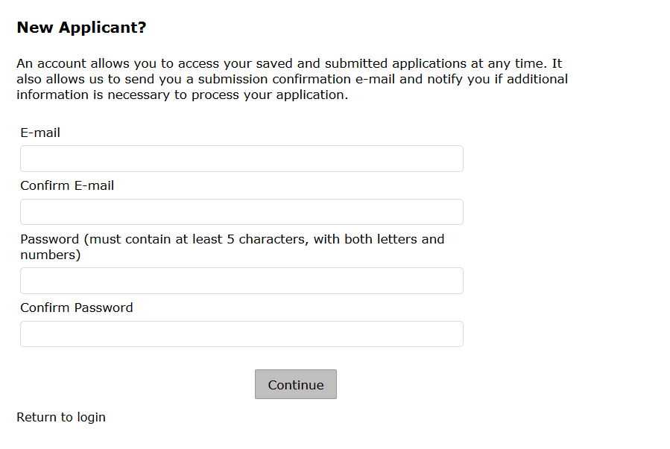
Grant Administration: How to create an account
Fill out the necessary fields and then click on the “Return to login” button.

Slide 30
Grant Administration: How to create an account
Fill out the necessary fields and then click on the “Return to login” button.
You should not have to do this again!

Slide 31
Grant Administration: How to register for CYM7
  How to register for CYM7
Start at the JCamp 180 web page: jcamp180.org
Select “Matching Grants” and then Create Your Match on the drop-down list

Slide 32
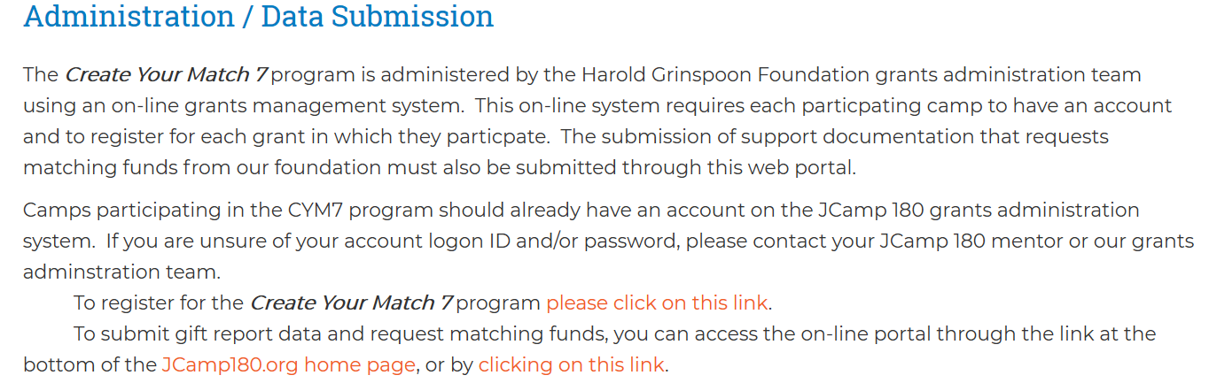
Grant Administration:
How to register for CYM7
On the Create Your Match page
Scroll down and then click on the Create Your Match 7 Icon
On the Create Your Match 7 page, scroll down to the section on Administration / Data Submission and click on the line
“To register for Create Your Match 7 program click here”
Select the Create Your Match 7 Link

Slide 33
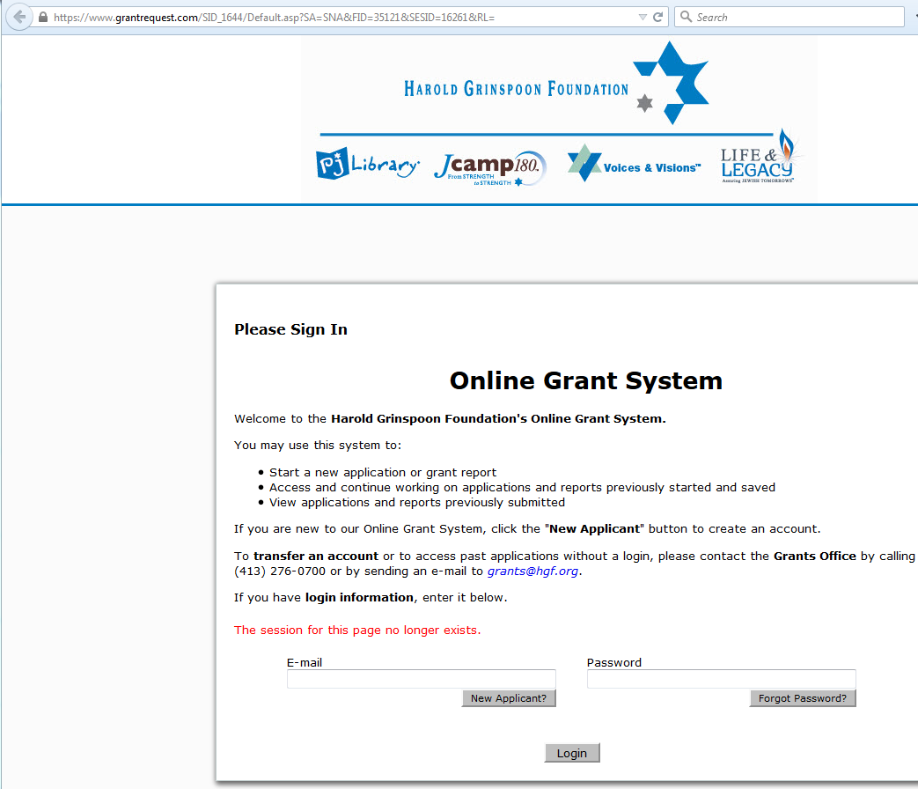
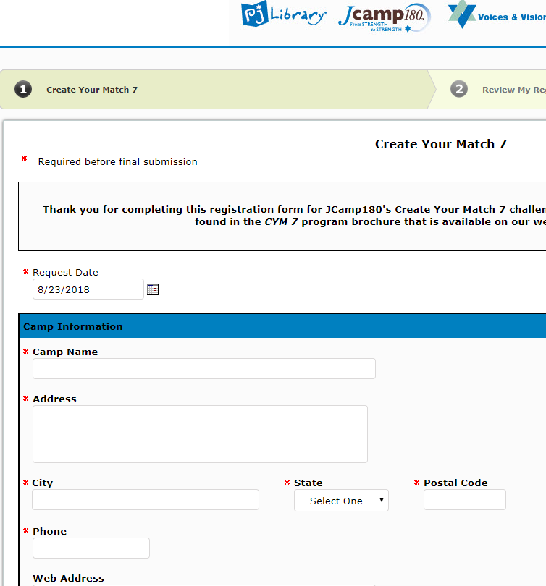
Grant Administration:
How to register for CYM7
You will then be brought to the CYM7 registration page to be completed and submitted
Please log in using your account information

Slide 34
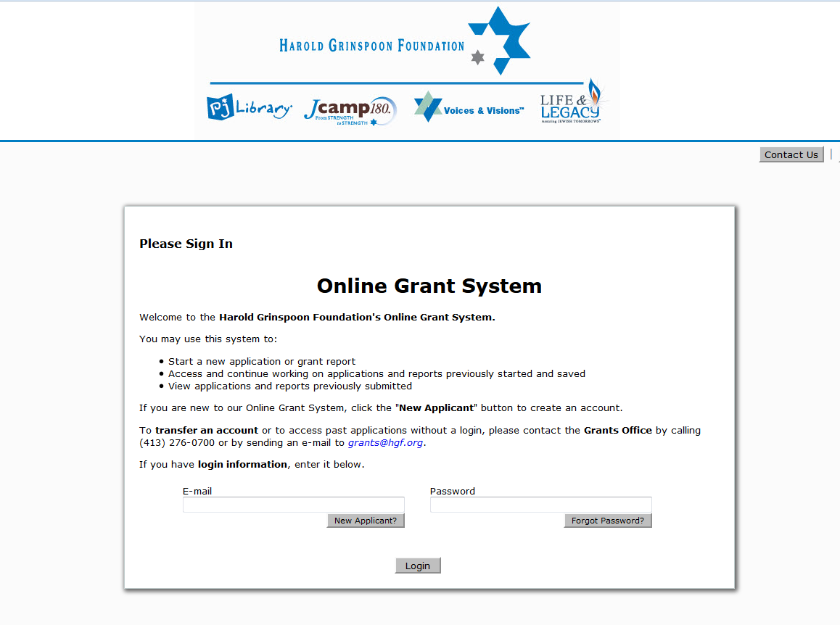
Grant Administration: How to submit pledges/payment support
  To submit pledges and payment support, please login to the Online Grant System:

Slide 35
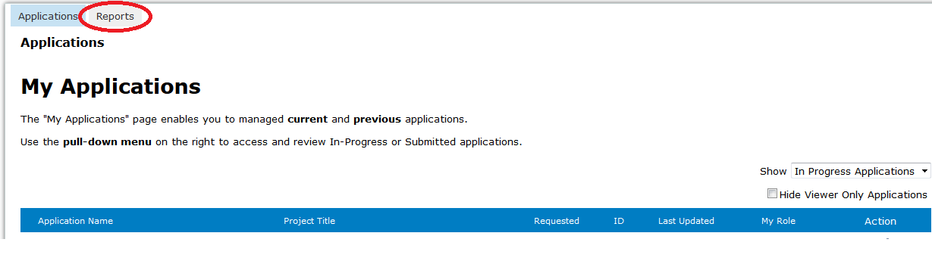
Grant Administration: How to submit pledges/payment support
To submit pledges & pledge payment support, please select “Reports”

Slide 36
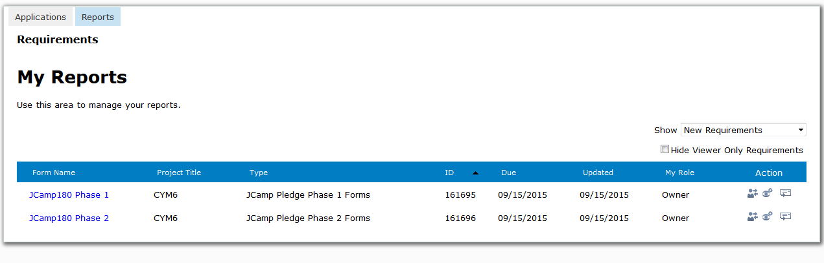
Grant Administration: How to submit pledges/payment support
Please click on the link (Phase 1 or Phase 2) to make a submission

Slide 37
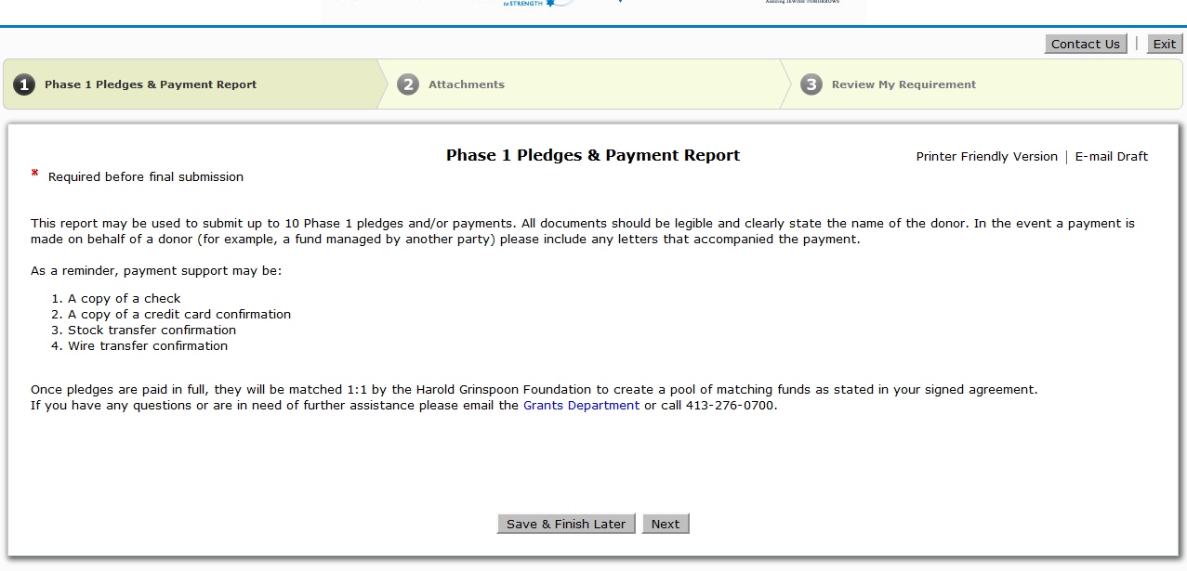
Grant Administration: How to submit pledges/payment support
Once you have clicked on the link for the correct phase, you will be brought to the first of three pages in which you will follow the step by step directions to upload and submit the documentation

Slide 38
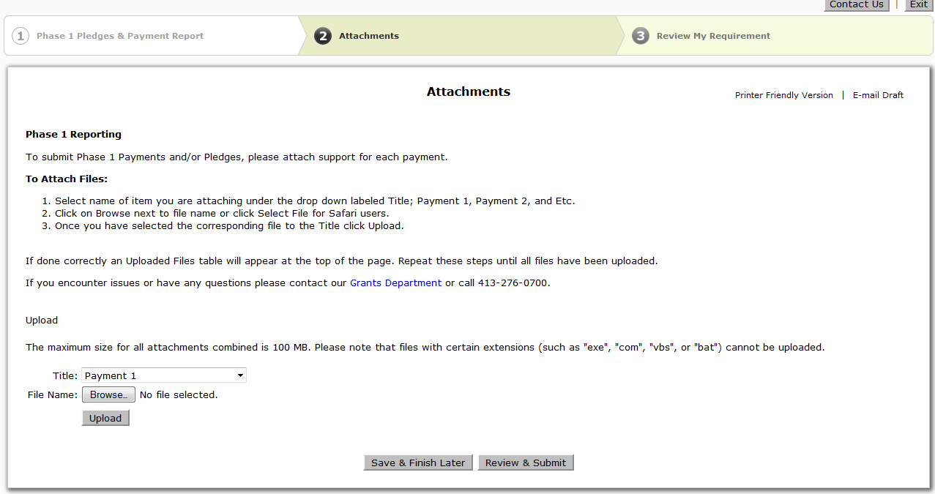
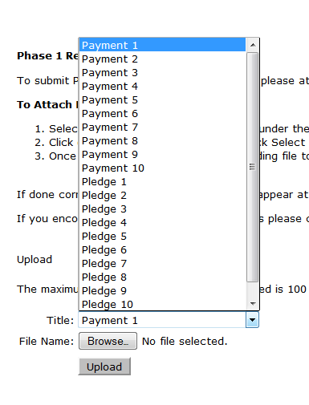
Grant Administration: How to submit pledges/payment support

Slide 39
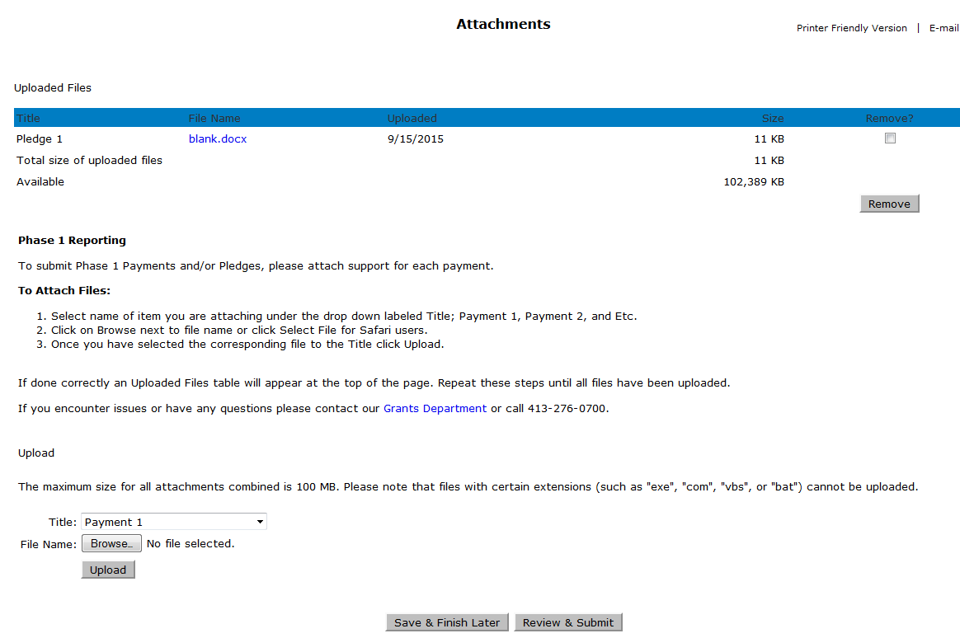
Grant Administration: How to submit pledges/payment support
Once you have uploaded the first document, it will appear up top
To attach another pledge form or payment support, please select another title, browse the file and finally select “upload”

Slide 40
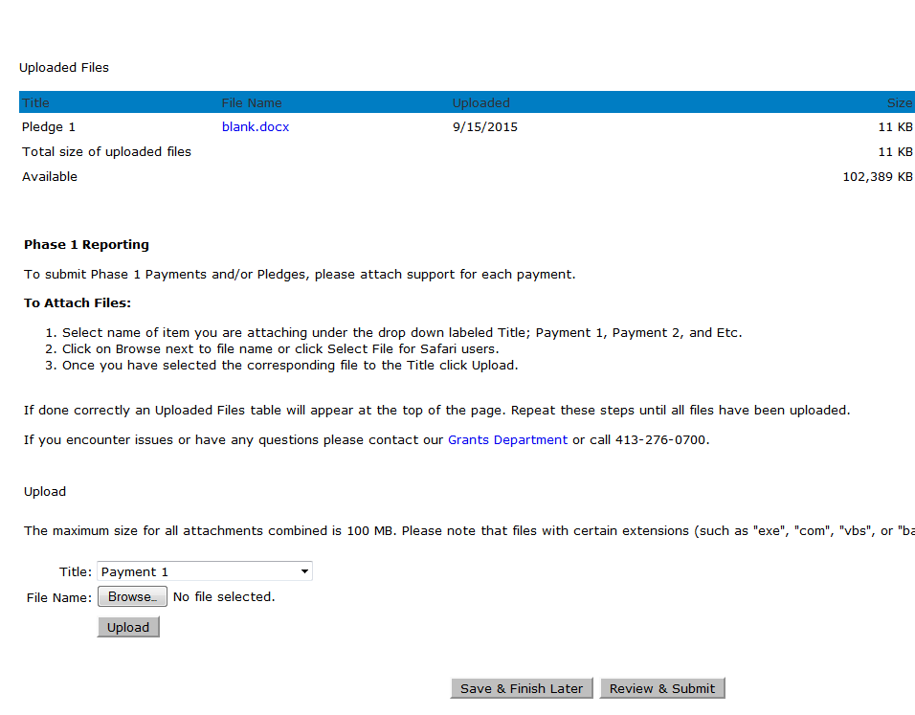
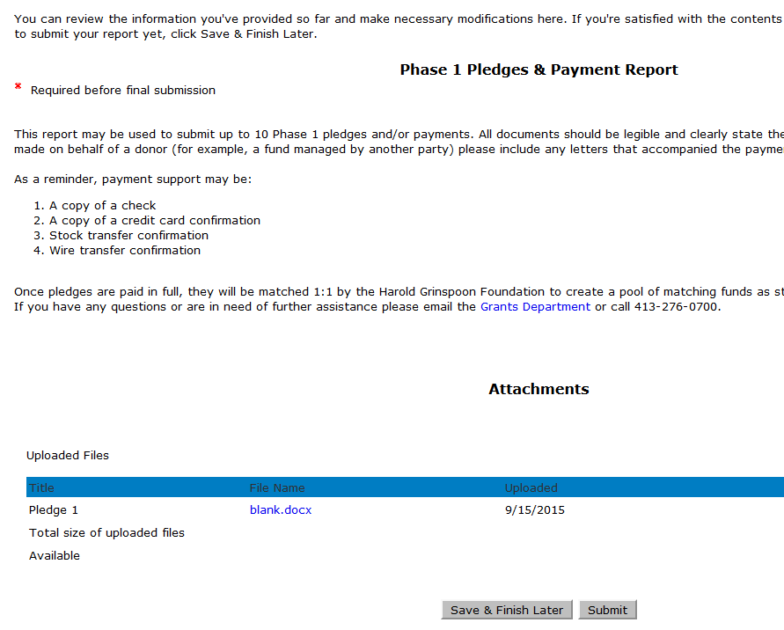
Grant Administration: How to submit pledges/payment support
Once you have uploaded all of the documentation to be submitted, please select “Review & Submit”
You will then be brought to the final page, where you will select “Submit” to send the documentation to the grants administration team for review

Slide 41
Grant Administration:
For any questions regarding the Online Grant System, please email us at Grants@hgf.org

Slide 42
Grant Administration:
A CYM7 donor information form must be submitted for each phase 1 donor
Proof of payment of all gifts must be submitted.
All submissions will be through our on-line system
HGF reserves funds based on proof of payment of phase 1 pledges and pays out matching funds upon proof of payment of phase 2 gifts.
Be aware of timelines for submitting proof of pledges and payments.

Slide 43
Questions:
Can the Campaign be larger than $450,000 ?
How do I select the campaign goal?
Can a few major donors fulfill Phase1 and
Phase 2 and finish the whole campaign quickly?
Yes, but
1.) be careful of how you describe the matching pool to donors, and
2.) JCamp 180 funds are capped at $75,000.
Be realistic. Talk to your JCamp180 Mentor. There are as many pitfalls to taking on too large a campaign as there are to too small a campaign
Yes, but it isn’t the intent of the grant. We are looking for Camps who will use the campaign to reach out to more alumni and camp supporters and increase the base of philanthropic support for camp.

Slide 44
Questions:
Can excess phase 1 gifts be carried over to
phase 2?
What if we take a risk to reach out to more alumni in phase 2 and don’t meet our full goal?
What is the most frequent pitfall others have run into that we should be aware of?
Yes. A gift of $30,000 can have $25,000 count toward phase 1 and $5,000 count toward phase 2. HGF will help you best allocate major gifts to phases 1 and 2 to maximize your matching grant program.
Go for it, but plan accordingly. Speak with your mentor about strategies. Grinspoon payment of the Phase 1 match is dependent on receiving proof of payment of Phase 2 gifts. This will have budget implications.
We give phase 2 donors three years to pay their pledges. Camps who get barely sufficient pledges to earn JCamp180 funds can be hurt if those pledges are not paid. Moral: Get pledges for 5% - 10% more phase 2 funds than you need if payments are being stretched out over 3 years.

Slide 45
Your Questions:
QUESTIONS?

Slide 46
Create Your Match 7
Information Session
August 23, 2018
Mark Gold Kathleen Rodowicz
Director, JCamp 180 Grants Administrator
Mark@hgf.org Kathleen@hgf.org
413-276-0777 grants@hgf.org
413-276-0719

