Slide 1
Donate at Your Camp 4
Information Session
July 17, 2018
Mark Gold Kate Rodowicz
Director, JCamp 180 Grants Administrator
Mark@hgf.org Grants@hgf.org
413-276-0777 413-276-0700 X2

Slide 2
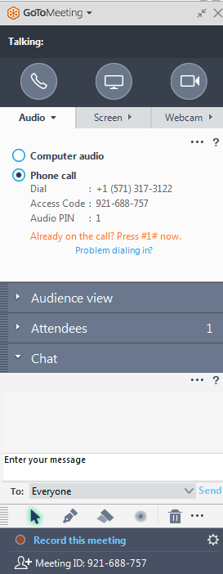
GoTo Meeting Logistics:
A →
A) Grab Tab – Click red arrow to open/close Control Panel. Click square to toggle Viewer Window between full screen/window mode. Click mic icon to mute/unmute your audio.
B) Audio Pane – Select audio format. Click Audio Setup to verify Speakers & Microphone.
C) Questions Pane – Attendees can submit questions and review answers. Type your question and click Send to submit it to the organizer.
B →
C →

Slide 3
Agenda:
DAY4 Overview
Donors
      New vs Previous
      Eligible Donors
      Gift Form
Pledges
Payments
      Eligible payments
      Proper Documentation
Grants System

Slide 4
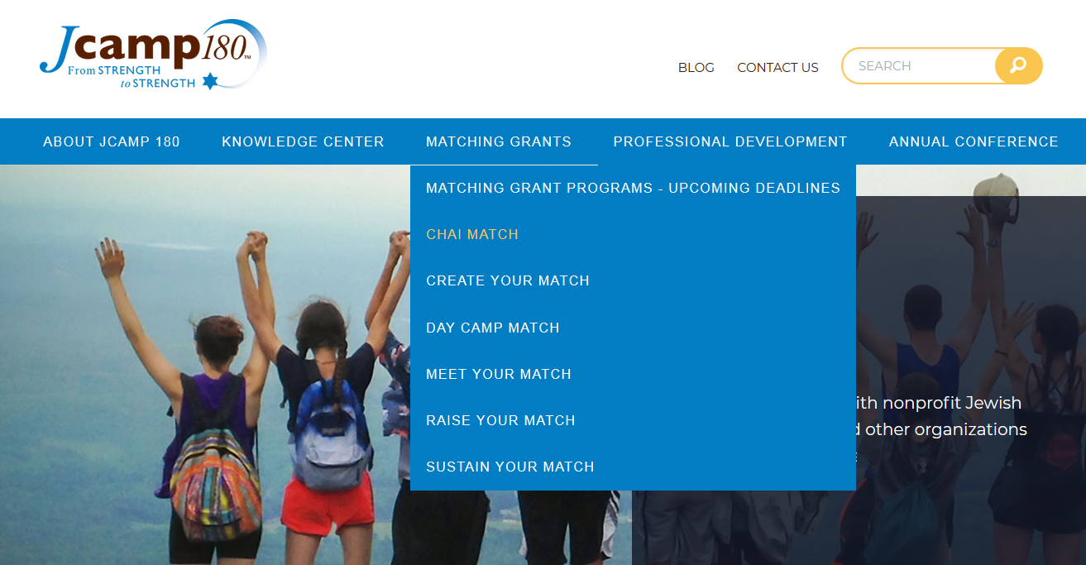
Follow-up:
Find today’s information on JCamp180.org

Slide 5
DAY4 Overview
The purpose of the DAY4 Matching Grant is to grow each camp’s base of major donors by securing gifts of $2,500 or higher to meet the campaign goal of $140,000 to be used exclusively for day camp improvements.

Slide 6
Day 4
Program Summary:
Campaign Total of $140,000 or More……..
  Raise $105,000 in gifts of between $2,500 and $35,000 (or more) in private gifts.
  Receive $35,000 in matching funds from the Harold Grinspoon Foundation (HGF).

Slide 7
Fundraising Goal:
To successfully fundraise $105,000 you should solicit:
Minimum of 3 major donors at $35,000
Or up to 42 donors at the minimum matching amount of $2,500
Donors may give more than $35,000 but our program will only match the first $35,000 of any one gift
We recommend always securing a few extra pledges as a safeguard

Slide 8
Important Deadlines
Date restrictions for qualifying pledges:
July 1, 2018 – June 30, 2019
Date restrictions for payment on pledges:
July 1, 2018 - June 30, 2021

Slide 9
Major Donors
New Donor
Has never given to camp or…
Last gift was before December 31, 2015
Previous Donor
Has given to camp since December 31, 2015
Must triple last largest gift and meet minimum pledge of $2,500

Slide 10
New Donors &
Previous Donors
An Approved Donor is:
  An Individual (alumni, parent, friend)
  A family (parents, siblings & children)
  A family foundation
  A business
  A “friends of” or pre-established 501(c)(3) group of alumni
An Approved Donor is NOT:
  Allocations, grants or designated funds from a Jewish Federation or national parent organization (Ramah, Chabad, etc.)
  JCCA allocations, grants or funds
  FJC grants or gifts
  A Foundation grant where applications were solicited (purpose specific)
  A group of alumni or friends who pool their gifts
  A gift for which anything of value is received

Slide 11
Major Donor Reporting:
Pledges must be dated between July 1, 2018 – June 30, 2019.
A donor form for each pledge must be completed and submitted.
All pledges and donor forms must be reported to the JCamp180 grants team by July 31, 2019.
Submission of donor form will reserve funds and allow us to budget for future payments.
Proof of payment must be submitted to release matching funds only once payment of $2,500 has been received.

Slide 12
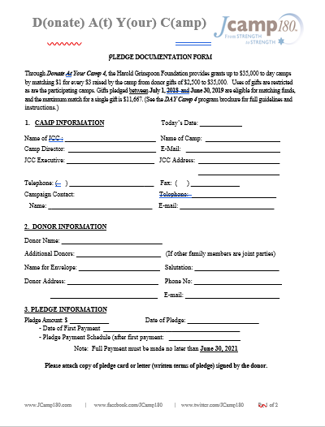
Donor Form
The Day 4 Gift Form can be found on the JCamp 180 website under the Day 4 tab.
You must fill out:
Gift Date
First/Family Name
Last Name
List Family (for family gifts)
Address
Gift Amount
Payment Schedule
Donor
Previous Donor Information

Slide 13
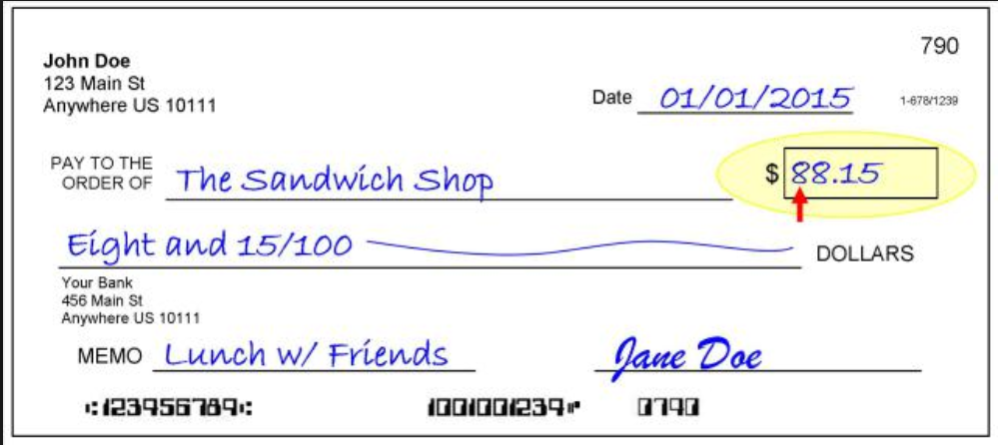
Eligible Payments
Eligible payments must be dated between
July 1, 2018 – June 30, 2021.
It is:
Cash or cash equivalents
Stocks or bonds
Assets with market value
It is NOT:
Payment for events, raffles, sponsorships, etc.
In kind contributions
Discount in cost of goods or services
Non-liquid assets
  Land
  Art
  Gifts with liquidation restrictions

Slide 14
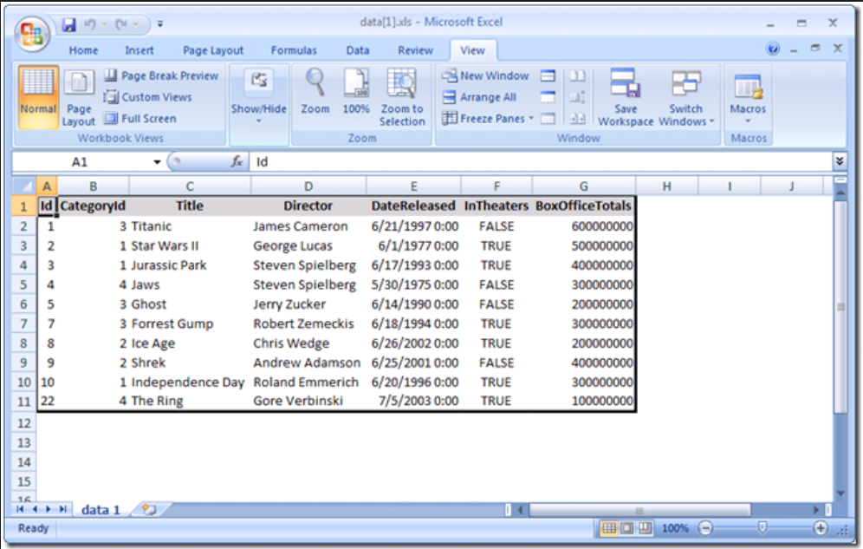
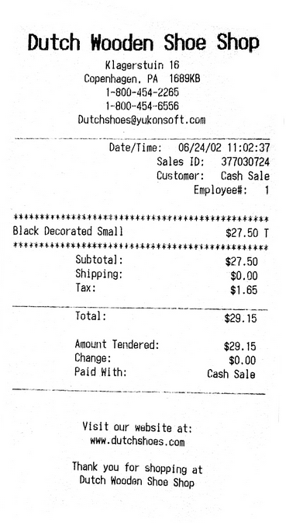
Proof of Payments
  Acceptable
    Credit Card Slip
Check Copy
Screenshot from camp’s accounting software
Not Acceptable
Copy of Credit Card
Word/excel document with list of donors with check numbers
Financial report in excel document

Slide 15
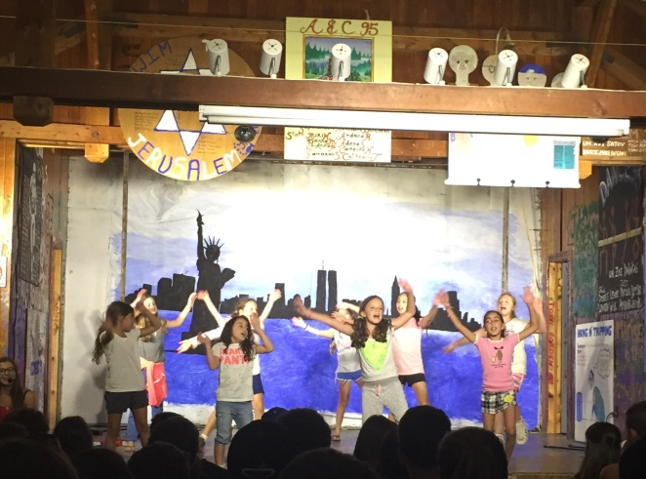
DAY4 Fund Restrictions
  Campaign funds must be used to benefit the day camp directly.
Supplement salaries to convert part time camper-facing staff to full time staff
Introducing new programming to attract campers
Implement improved staff training methodology
Purchase major pieces of program support equipment
Infrastructure construction or capital maintenance

Slide 16
Campaign Restrictions:
  Campaign funds must be used to benefit the day camp directly.
  Capital Improvements
    Construction of buildings or portions of buildings
    Major repairs or renovations to buildings
    Improvements to grounds
  Major Pieces of Equipment
  (capital items, not annual equipment purchases)
  Infrastructure Construction (water, sewer, etc.)
  Staff Changes:
    Permanently upgrade a part-time camp director to a full-time position
  New Programming:
    Additional Staff or teachers
    Investment in materials for new initiatives (kilns, theater arts, etc.)

Slide 17

Campaign Restrictions:
    *Funds Cannot be Used for Maintenance

Slide 18
DAY4 Review
  Identify and solicit major donors and
  secure pledges by 6/30/2019
Gifts must be $2,500 or larger
Only first $35,000 of large gifts will be matched
  Pledges must be paid in full by 6/30/2021
    Gifts may be paid in full or in installments
Complete donor form for each
Report pledges to the JCamp180 grants team by 7/31/2019

Slide 19
DAY3 Review
DAY4 Review
JCamp 180’s matching grants are reserved by the Harold Grinspoon Foundation (HGF) grants administration office when pledges (or gifts) are reported
JCamp180’s matching grant is paid when pledge payments are received at the minimum level of $2,500
Proof of payment of all gifts must be submitted
All submissions will be through our on-line system
Be aware of timelines for submitting proof of pledges and payments (30 days after pledge or payment deadline)

Slide 20

Grant Administration:
All HGF grants, including matching grants of the JCamp180 program, are administered through an on-line Grants Administration system.
Requires that you create an account.
Documents must be uploaded through the website.

Slide 21
Grant Administration:
Overview
(A three step process)
1. Create An account (shown on next 5 slides)
done one time for each organization from the HGF home page
2. Register for DAY Camp 4
(shown on 4 subsequent slides)
done from the JCamp180 home page for each grant program
3. Submit pledges and payment support
(shown on 7 slides)
done throughout matching grant program

Slide 22
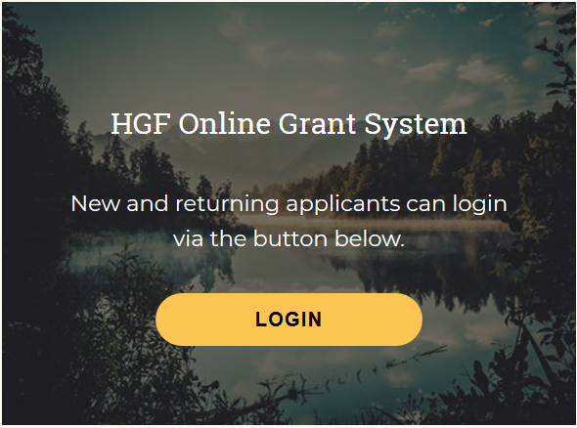
Grant Administration: How to create an account
  How to create an account
  on the on-line grant reporting system
  Open the home page of the JCamp 180 website: www.jcamp180.org
  Scroll to the bottom of the home page
  Click on the LOGIN button

Slide 23
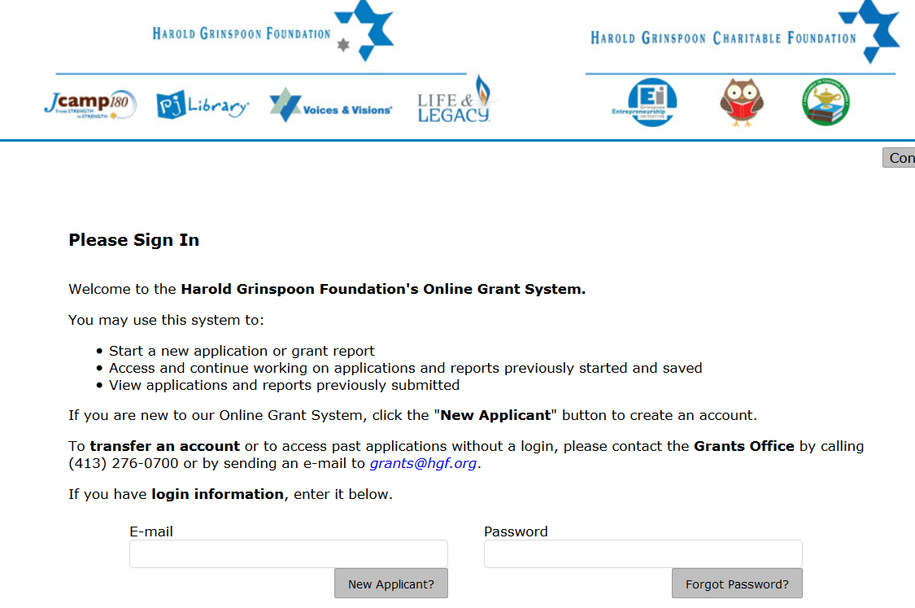
Grant Administration: How to create an account
Click on the “New Applicant” button

Slide 24
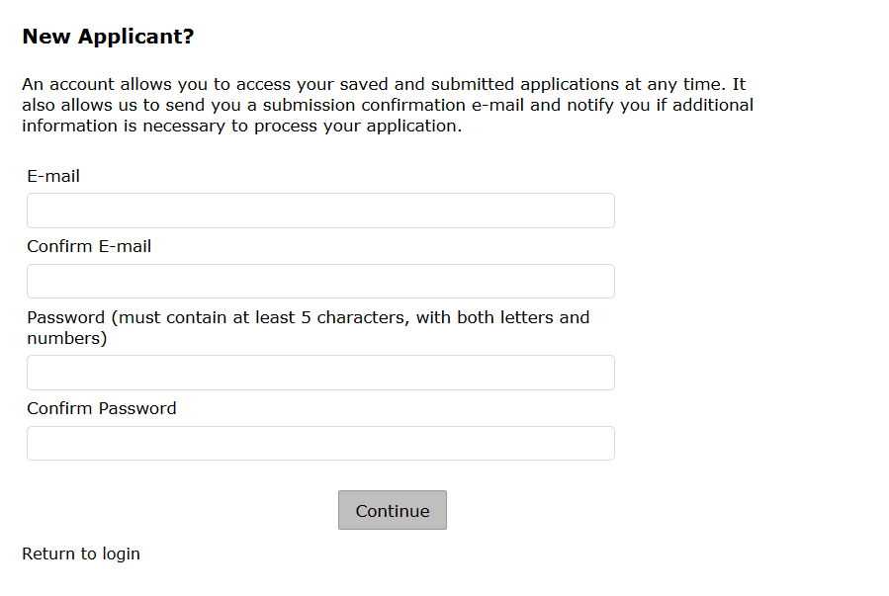
Grant Administration: How to create an account
Fill out the necessary fields and then click on the “Return to login” button.

Slide 25
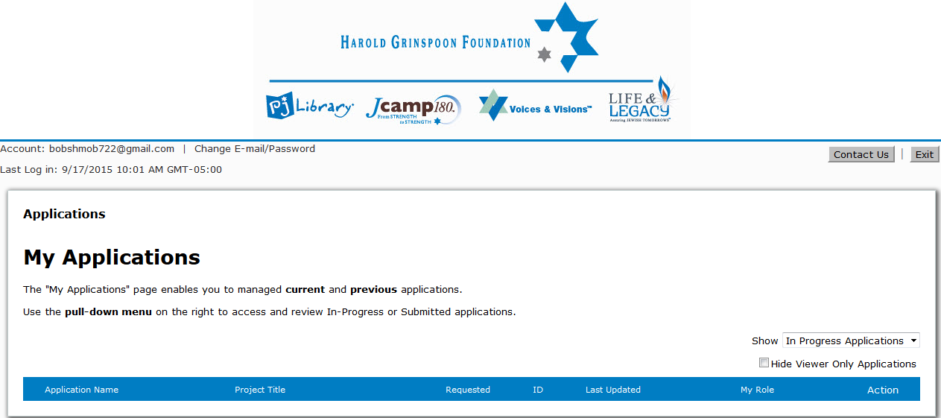
Grant Administration: How to create an account
  Congratulations on creating your new account!
  You will then be brought to the My Applications homepage:

Slide 26


Grant Administration: How to create an account
Please select “Exit” to log out of the online grants system

Slide 27
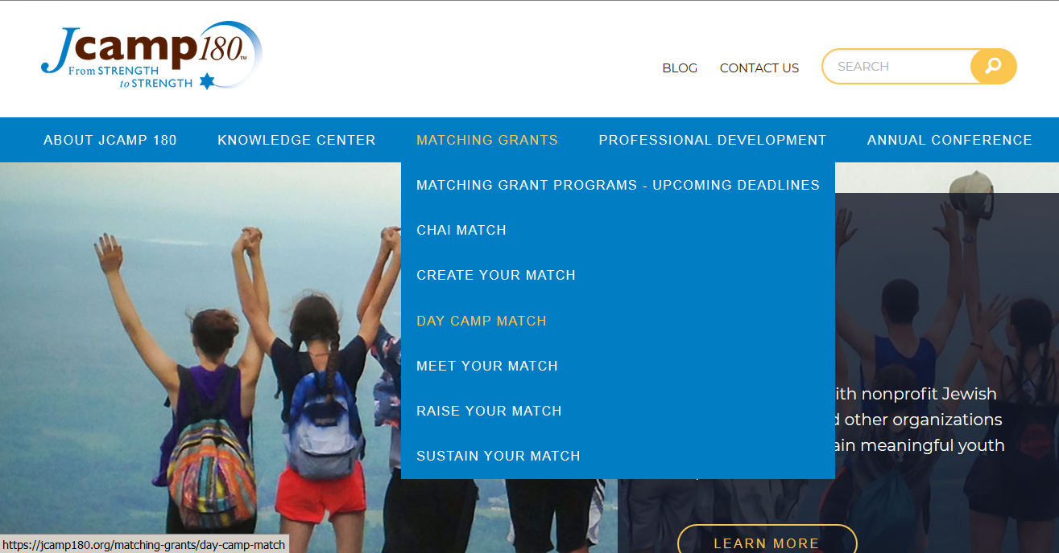
Grant Administration: How to register for DAY 4
  How to register for DAY 4
Start at the JCamp 180 web page: jcamp180.org
Select “Matching Grants” and then DAY Camp Match on the drop-down list

Slide 28

Grant Administration: How to register for DAY 4
  How to register for DAY 4
On the DAY Camp match page, click on “Donate At Your Camp 4”

Slide 29
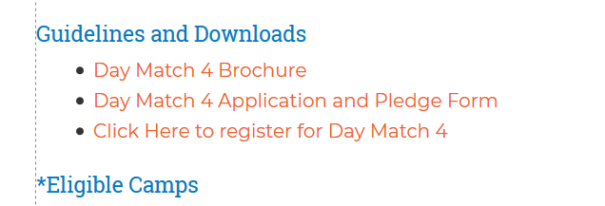
Grant Administration: How to register for DAY 4
On the Day Camp Match page
Scroll down and then click on the DAY Camp Match 4 Icon
On the DAY Camp Match 4 page, scroll down to the section on Guidelines and Downloads and click on the line
“Click Here to register for DAY Camp Match 4”
Select the DAY Match 4 Link

Slide 30
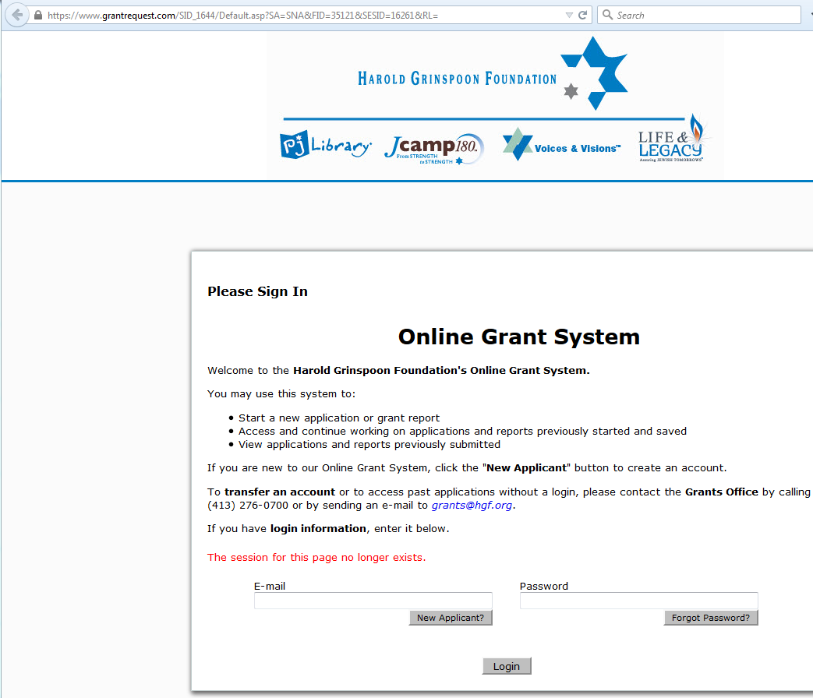
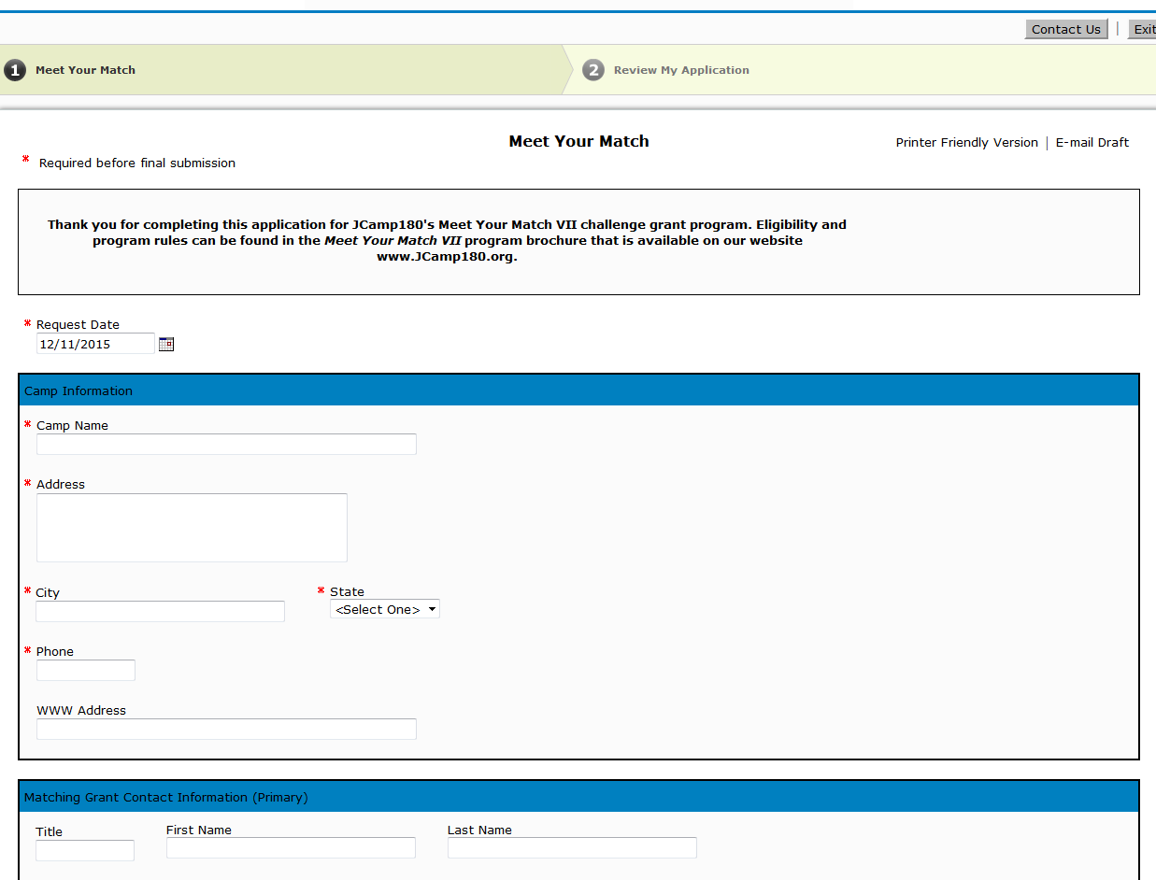

Grant Administration: How to register for DAY4
You will then be brought to the DAY 4 registration page to be completed and submitted
Please log in using your account information

Slide 31
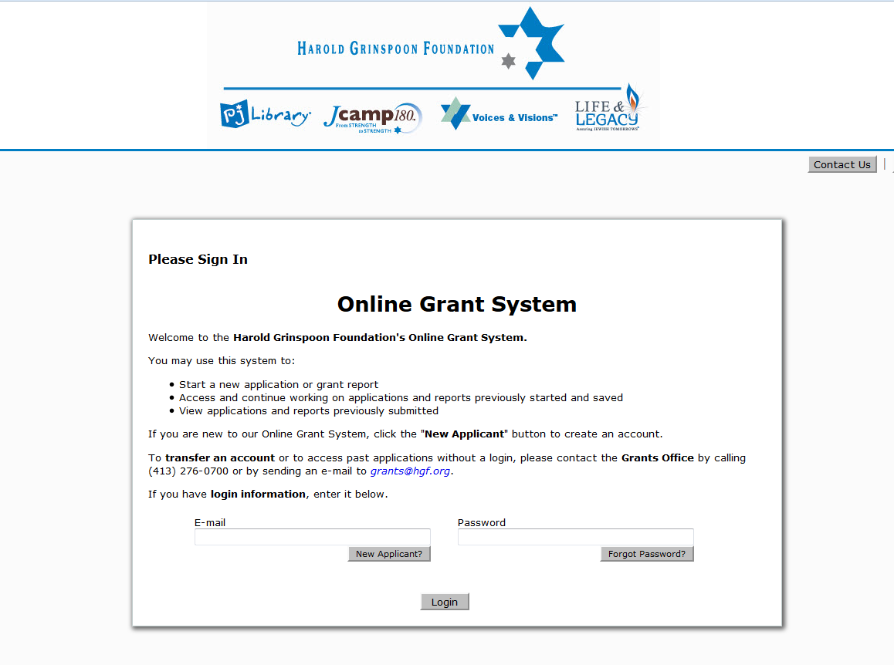
Grant Administration: How to submit pledges/payment support
  Step 3: To submit pledges and payment support, you must login to the Online Grant System each time you wish to submit information:

Slide 32
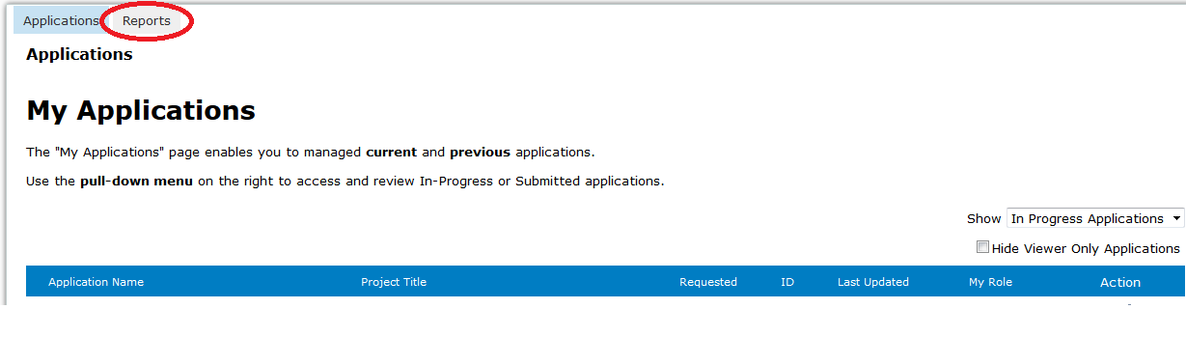
Grant Administration: How to submit pledges/payment support
To submit pledges & pledge payment support, please select “Reports”

Slide 33
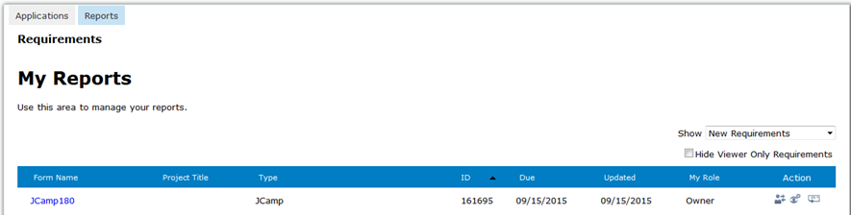
Grant Administration: How to submit pledges/payment support
Please click on the link to make a submission

Slide 34
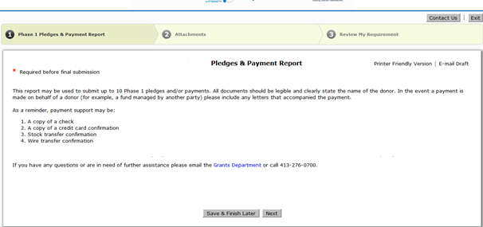
Grant Administration: How to submit pledges/payment support
Once you have clicked on the link, you will be brought to the first of three pages in which you will follow the step by step directions to upload and submit the documentation

Slide 35
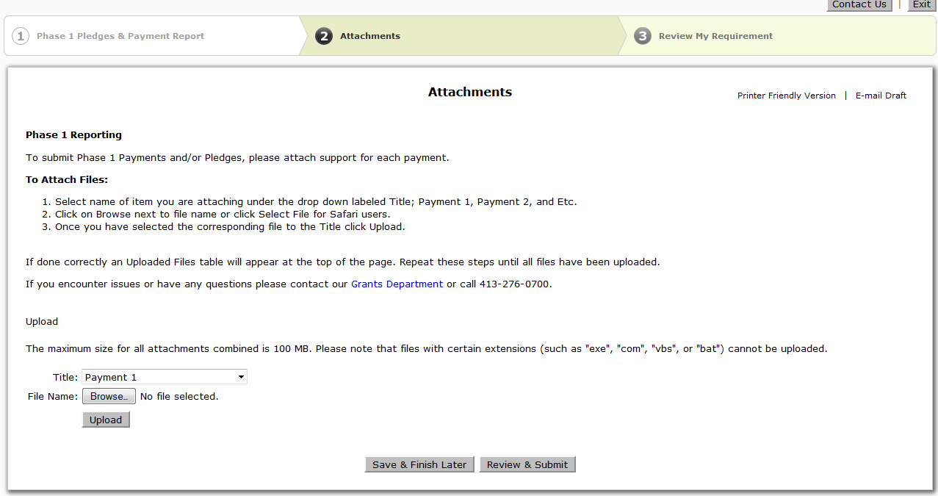
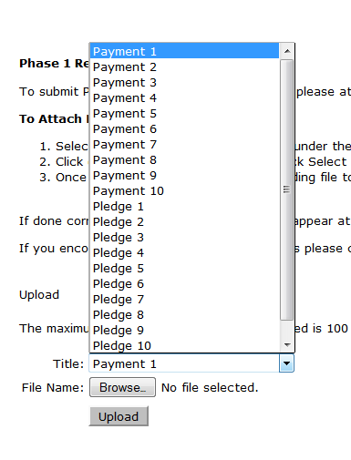
Grant Administration: How to submit pledges/payment support

Slide 36
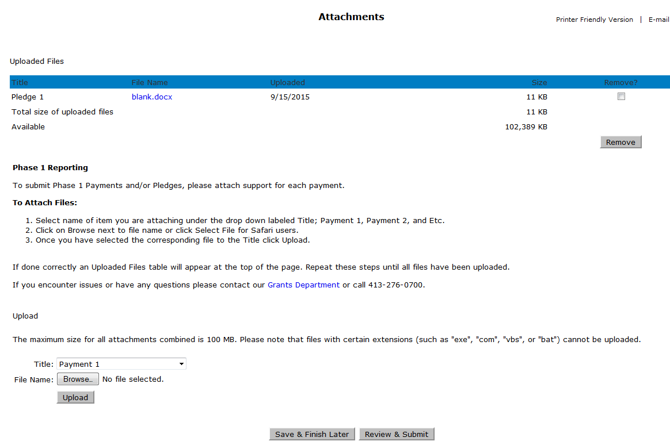
Grant Administration: How to submit pledges/payment support
Once you have uploaded the first document, it will appear up top
To attach another pledge form or payment support, please select another title, browse the file and finally select “upload”

Slide 37
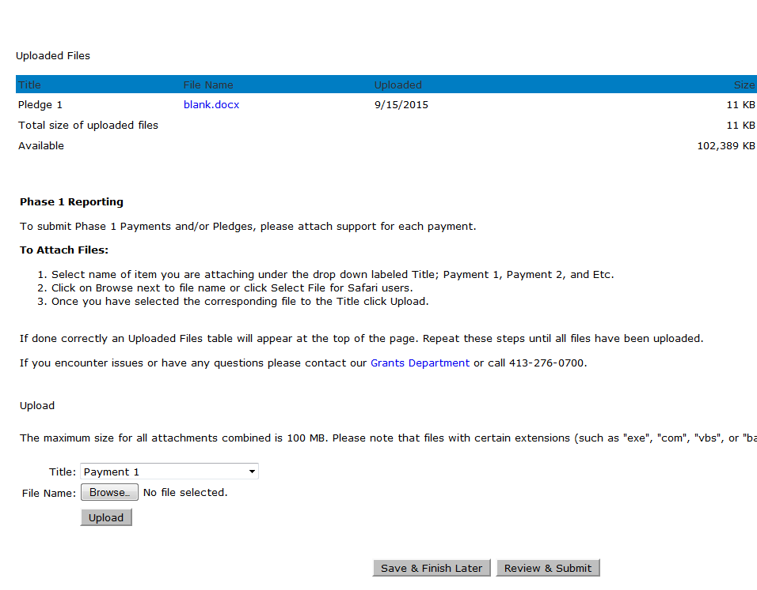
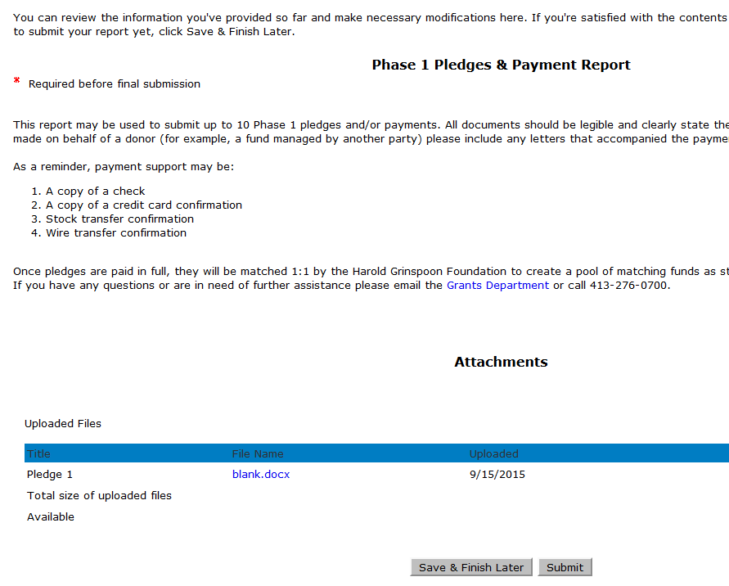
Grant Administration: How to submit pledges/payment support
Once you have uploaded all of the documentation to be submitted, please select “Review & Submit”
You will then be brought to the final page, where you will select “Submit” to send the documentation to the grants administration team for review

Slide 38
Grant Administration: How to submit pledges/payment support
Repeat the pledge / payment support submission process throughout the DAY Camp 4 program
Payments are made quarterly so submissions need not be more frequent than four times per year.
For any questions regarding the Online Grant System, please email us at Grants@hgf.org

Slide 39
Grant Administration:
A DAY Camp 4 donor information form must be submitted for each donor
Proof of payment of all gifts must be submitted.
All submissions will be through our on-line system
HGF reserves funds based receipt of documented pledges and pays out matching funds upon proof of gift payment.
Be aware of timelines for submitting proof of pledges and payments (particularly 30 days after close of event window).

Slide 40
Questions:
Can the Campaign be larger than $140,000?
Can a few major donors fulfill the whole campaign quickly?
Yes. We ask that you be careful of how you describe the matching pool to donors.
Only the first $35,000 of large gifts is matched. If your campaign brings in three gifts of $50,0000, you will earn $35,000 from JCamp180 – a match of $11,667 to each gift. If you get a 4th gift of $50,000 you will still only earn $35,000 from JCamp180
Yes. You need a minimum of 3 gifts of $35,000 each to earn the entire $35,000 from JCamp180.
At the other extreme, you need 42 gifts at the minimum match level of $2,500 to earn the maximum JCamp180 match of $35,000.

Slide 41
Questions:
Why should we seek (and submit documentation for) more than the minimum number of pledges?
Should we be concerned about the timing of submitting pledges to JCamp 180?
Life happens. Sometimes pledges made with the best of intentions cannot be paid by the end of our campaign. By submitting documentation for more than the minimum required number of grants, you assure that if one or two do not get paid, you will still receive sufficient gifts to qualify for the entire JCamp180 match. YOU CANNOT REPLACE A PLEDGE after the 6/30/2019 deadline, so make sure you have submitted enough pledges to cover all our funds.
You should work with your donors so they do not submit a pledge until they are fully committed to fulfill that pledge. Pledges must be signed and dated after July 1, 2018 and before June 30, 2019. We ask that you submit pledges within 30 days after they are received so we properly reserve matching funds. All pledges must be submitted by July 31, 2019.

Slide 42
Your Questions:
QUESTIONS?

Slide 43
Donate at Your Camp 4
Information Session
July 17, 2018
Mark Gold Kate Rodowicz
Director, JCamp 180 Grants Administrator
Mark@hgf.org Grants@hgf.org
413-276-0777 413-276-0700 X2

