Slide 1


Part 2: Building Your Organization’s Financial Planning Muscle
Financial Literacy Series
Gina McDonald, CPA, Lead Consultant

Slide 2
“RE”-Introductions & initiative overview

Slide 3

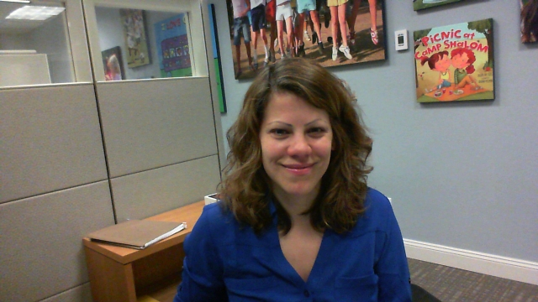
Financial Literacy Webinar Series
Part 1: Understanding Financial Statements and Reports
March 20, 2018
Tara Acker
Mentor
tacker@hgf.org

Slide 4


Welcome & Introductions
Today’s Presenter
Gina McDonald
Lead Consultant, FMA

Slide 5
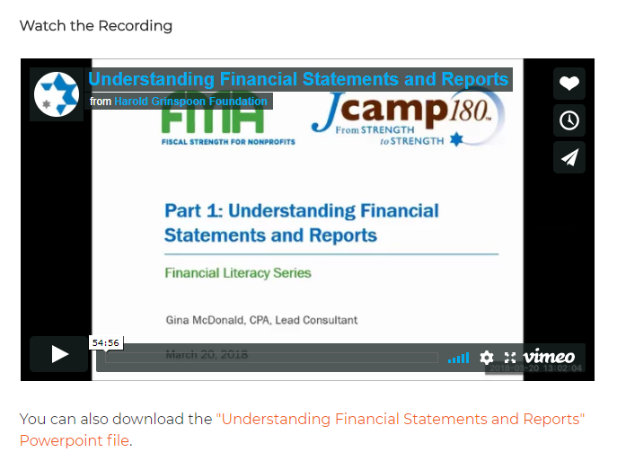
Welcome & Introductions
If you missed Part 1 …
https://jcamp180.org/professional-development/financial-literacy

Slide 6
Agenda
Essential IRS Classifications
Best practices in budgeting
  Financial planning overview
  Revenue and expense drivers
  Monitoring
  Multi-year planning
Budget vs. forecast: when and how do we reforecast?
Q&A
!

Slide 7
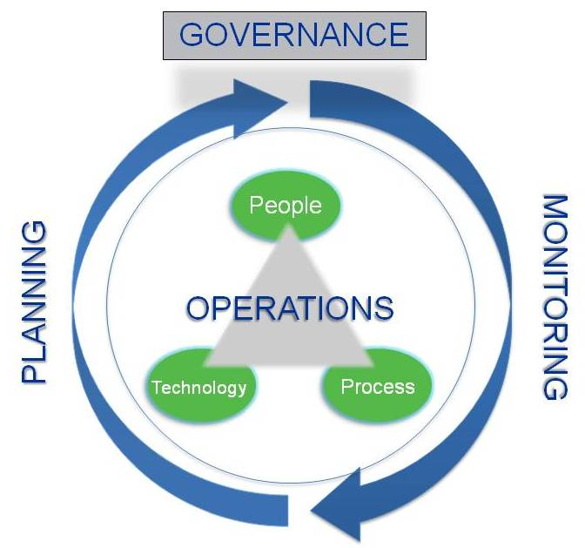
Strategic Financial Management

Slide 8
Financial Strategy and Planning
Organizations engage in effective financial planning to prioritize the use of resources
  Create annual and long-term financial plans and goals
  Establish mechanisms to monitor financial performance
!

Slide 9
The Budget:
an Action Plan
stated in Dollar Terms

Slide 10
Budgeting Process - Timetable
Sample: Fiscal Year ending September 30
April
May-June
August
1
Gather information – FORECAST current year end
2
Establish Program & Financial Goals
3
Budget Expenses
4
Budget Revenue
5
Review & Modify Draft Budget
6
Present Budget Draft for Board Approval
Post October 1: Monitor Budget vs. Actual; revise budget if necessary

Slide 11
Budgeting Process - Considerations
Budget = Best Guess formed using
Best Information Available
Forecast Current Year Results
Project out anticipated spending for the rest of the year
These spending projections will reveal:
  Where the organization as a whole will be at the end of the fiscal year (surplus or deficit?)
  A more complete picture of the accuracy of last year’s budget
!

Slide 12
Budget Process - Considerations
Understand where we have been:
Revenue and Expense Trends
Cost Structure (different types of costs)
Understand where are we going:
Document Program Assumptions
% capacity
Tuition rates
Scholarship levels
Understand other Organizational Needs –
Recurring maintenance
Capital Assets
Building Reserves
Repaying Debt

Slide 13


Budgeting Process - Considerations
Document assumptions
Options include:
              Annotation within budget
              Budget narrative
              Executive summary
Consider documenting “contingency plan” or “Plan B”

Slide 14
budgeting revenues and expenses

Slide 15
Understanding Expense Drivers –
Types of Costs
Fixed Costs
Variable Costs
Semi-variable Costs
Other Costs
Remain the same regardless of activity level (enrollment)
Vary with each unit (camper)
Equipment, Furniture, Software
May include insurance, rent
May include food, supplies
Vary with activity, but not in a direct relationship
May include maintenance costs, telephone, staff training, seasonal employees
!

Slide 16
Understanding Expense Drivers
Expenses generally fall into one of two categories
  Personnel Services – year round and seasonal
  Other Than Personnel Services – includes food, transportation, occupancy
Personnel Services
OTPS

Slide 17
Understanding Expense Drivers - Personnel Services
Budgeting - Full Cost of Personnel Services
Salaries, plus planned raises
Fringe Benefits
  Payroll Taxes
  Worker’s Compensation
  Health Insurance
  Employer pension contribution
  Consider the staff mix . . .
Year-Round and Seasonal have different benefit costs
!

Slide 18
Understanding Revenue Drivers
Contributed Revenue
Earned / Other Revenue
Individual (Inc. Scholarships)
Tuition
Foundation / Corporate
Investment Income
Special Events
Other ?
➔ What are the risks associated with each revenue source?

Slide 19

Understanding Revenue Drivers
Will we budget a surplus or deficit?
Are the revenue goals achievable?
Are goals in line with prior trends?
Do goals require additional fundraising efforts?
Is fundraising income being used to balance the budget realistic?
What are the discount/scholarship trends?

Slide 20
Cash Impact of Budget
12-month plan for cash disbursements and receipts, month by month, incorporating both operating and capital requirements
Translates budget items into calendar of cash receipts and disbursements
Includes cash outlays that are not included in the P&L (e.g. repayment of debt principal or purchase of fixed assets)
Identifies periods of potential cash shortfall or excess
Should be updated monthly to account for actual results and revised expectations

Slide 21
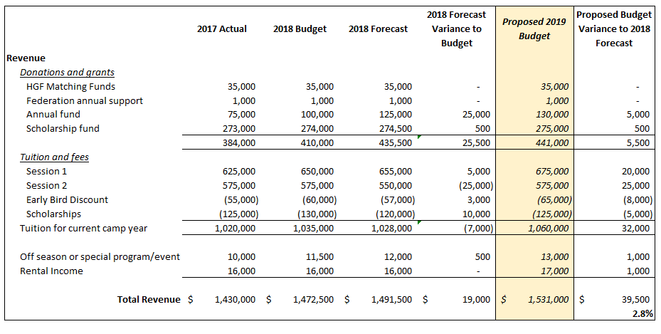
Building Your Budget

Slide 22
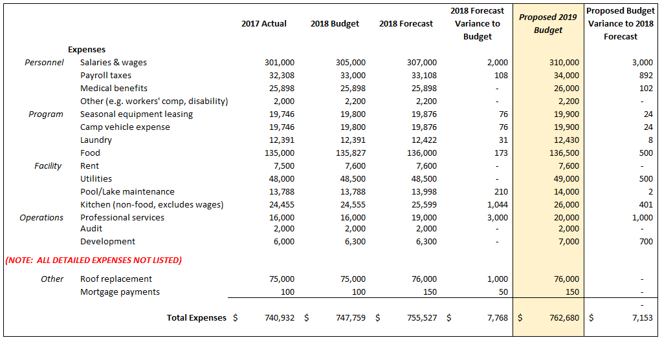
Building Your Budget

Slide 23

Strategy for Funding Costs
Successful Budget will Identify Gaps in Funding
How will the “gap” be funded?

Slide 24
Budget Monitoring
Review variances between budget expectations vs. actual revenues and expenditures
Determine underlying causes
Develop action plans to manage variances
Monitoring
Reporting
Accurate, timely and relevant info to Board and managers
*Important to set thresholds for monitoring, such as small % or dollar amount

Slide 25
5 Key Elements for Successful Budgeting
1
Well conceived
2
Considers seasonality
3
System for visibility
4
Timely monitoring
5
Corrective action plans can be made when needed

Slide 26
Question BREAK

Slide 27
Post-budgeting activities
FORECASTING AND MULTI-YEAR PLANNING

Slide 28
Budgeting versus Forecasting
Budget
A plan based on a series of assumptions (best guess)
Forecast
Updated expectation based on more current information
Re-Forecast
Reality test and readjust

Slide 29
Forecasting as Management Practice
Why take the time to forecast?
Allows staff to proactively identify potential roadblocks
Enables team to adjust plans to meet desired goals
Facilitates rapid adaptation to unanticipated changes in the funding environment
Shifts the focus from analysis of the past to proactive management of future events

Slide 30
Multi-Year Planning
SUSTAINABILITY

Slide 31
Multi-Year Planning
Why create multi-year plans?
Facilitates the integration of operational and strategic planning
Provides a forum to address significant long-term issues
Creates a space for planning around multi-year funding
Increases focus on long-term financial sustainability

Slide 32
PART 3 PREVIEW- Understanding Key Issues in Financial Management
With a focus on fiduciary oversight, the final webinar in the series will explore the following:
The board’s role in financial oversight
Policies and procedures that are key to maintaining effective internal controls
Considerations in managing financial risk for camps
Roles and responsibilities of your Audit and/or Finance committees

Slide 33
Questions?

Slide 34
Join us for part 3
UNDERSTANDING KEY ISSUES IN FINANCIAL MANAGEMENT
May 1ST
1pm EST

Slide 35



Fiscal Management Associates, LLC
Established in 1999 to serve not-for-profit organizations around the country
Provides customized financial management, accounting, software, organizational development, human resources, and other consulting services
Works directly with organizations or through funder-supported management and technical assistance programs
FMA's mission is to empower not-for-profit organizations with the knowledge and skills to successfully serve their constituents and fulfill their missions
New York | Chicago | Oakland | LA
@FMA4Nonprofits
www.fmaonline.net
/FiscalManagementAssociates
linkedin.com/company/fiscal-management-associates-llc

