Slide 1


Title

Slide 2

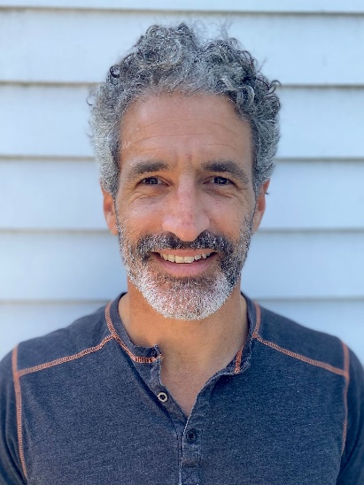


Enrollment 2021 Drop-in: Pulse Survey Results
August 13, 2020
Aron Goldman Kevin Martone Herschel Singer
Mentor, Enrollment Program Director Technology Program Manager Analytics Manager
JCamp 180 JCamp 180 JCamp 180

Slide 3
Agenda
Title Box
Welcome, Introductions
Pulse survey results & discussion
Enrollment Program Info

Slide 4
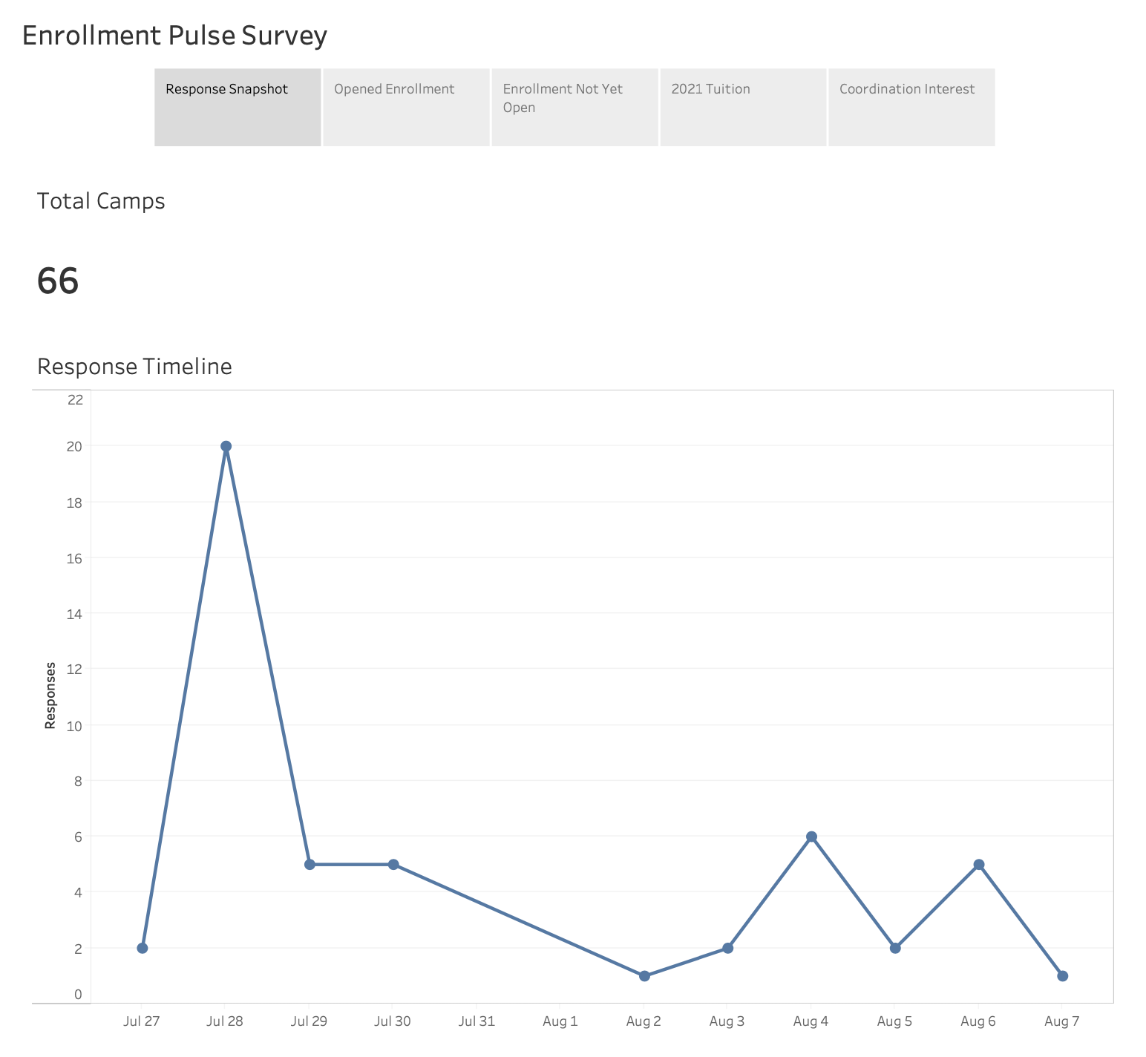

Slide 5
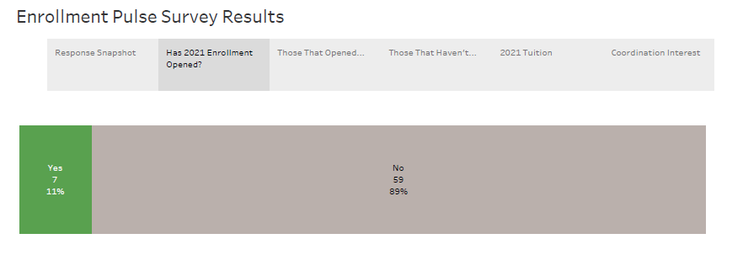

Slide 6
Discussion #1
Title Box
Does this surprise you? Does it confirm what you expected?
Have you opened enrollment for Summer 2021?

Slide 7
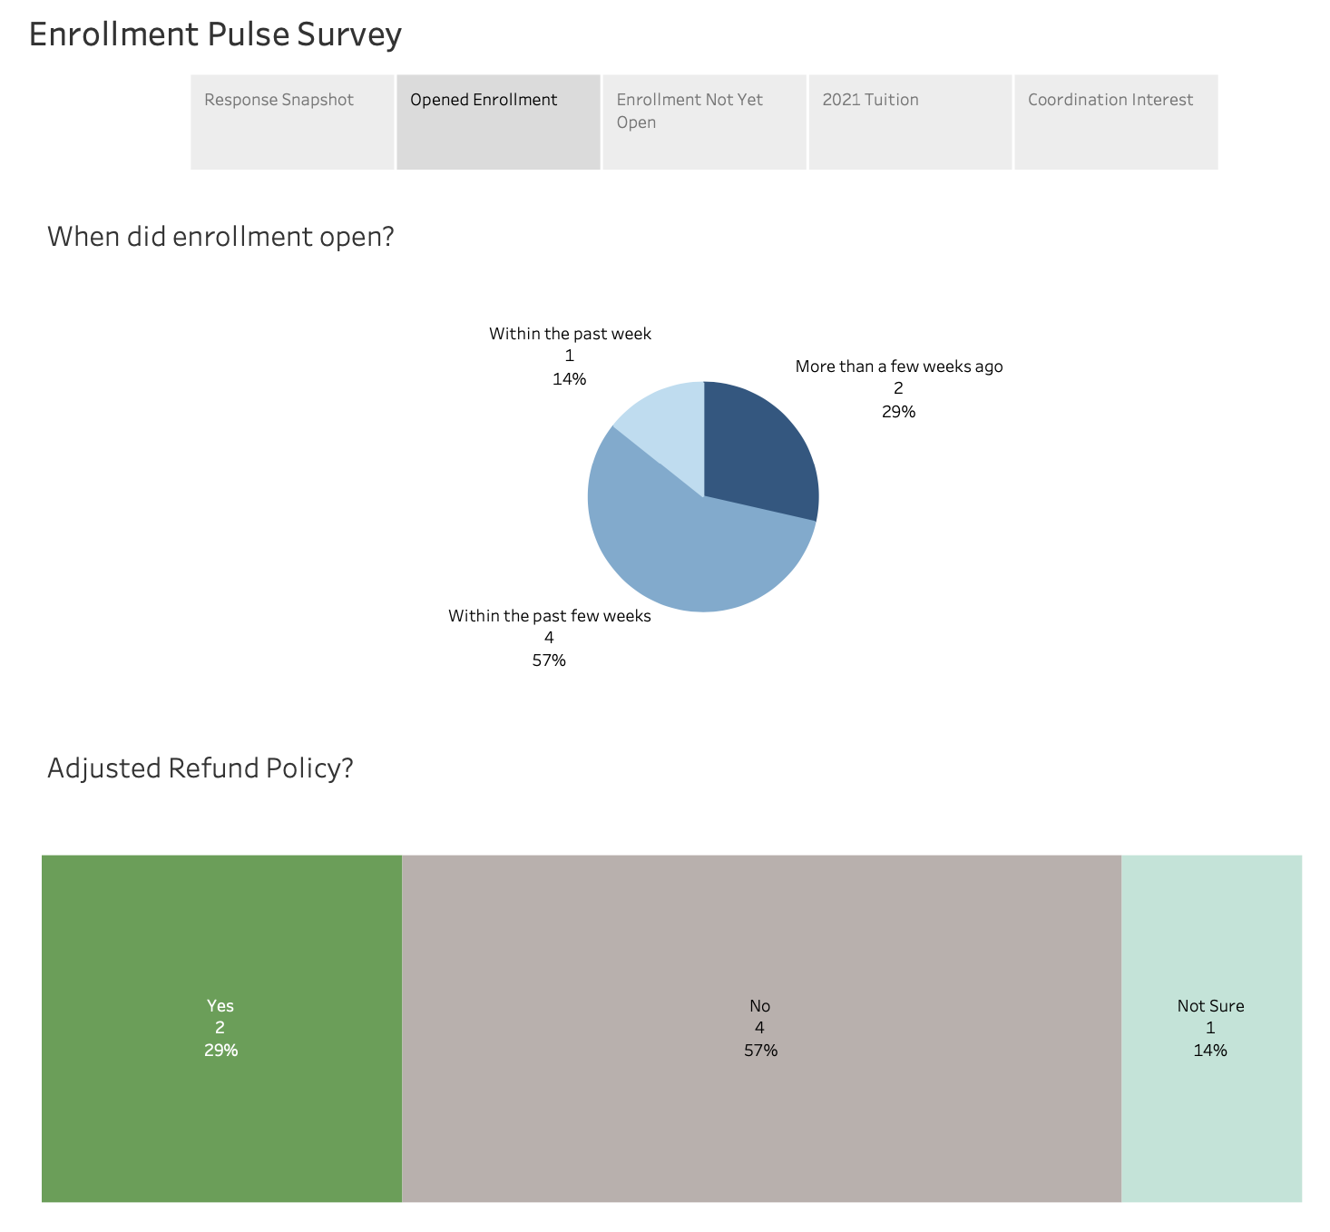

Slide 8
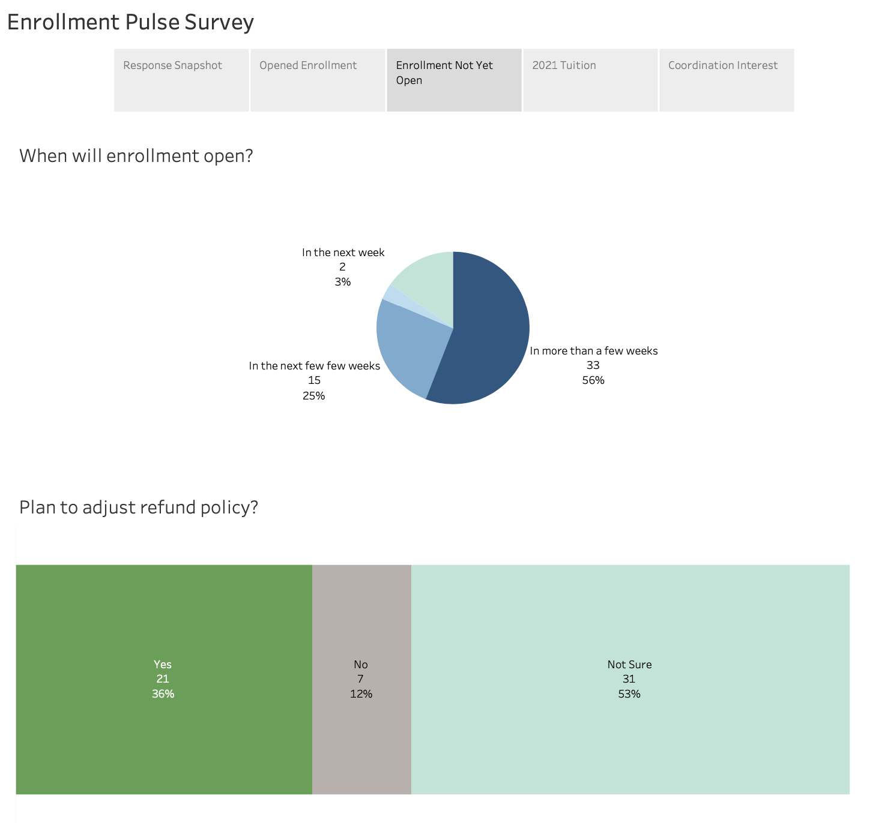

Slide 9
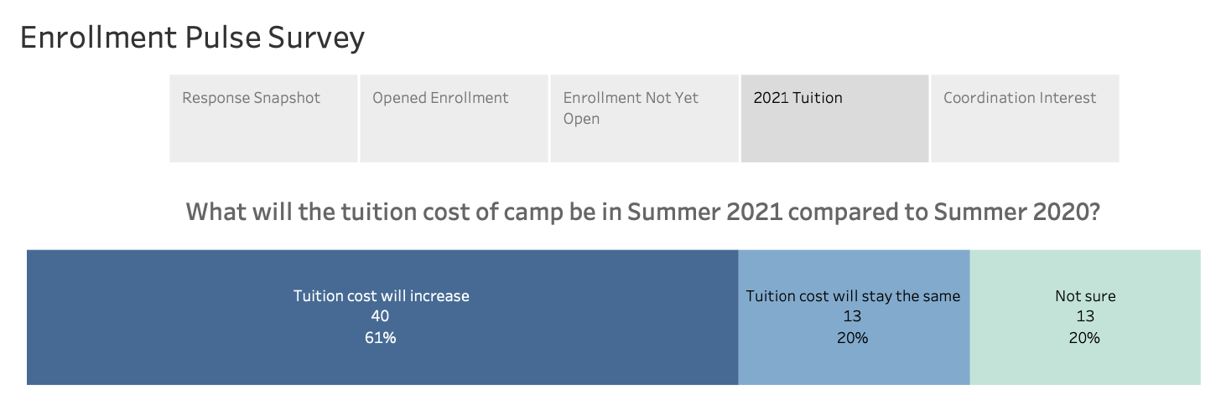

Slide 10
Discussion #2
Title Box
To get to ‘Dates and Rates’, need to be solid on Program and Policy
  Session type and duration?
  Attendees and capacity?
  Refund Policies?

Slide 11
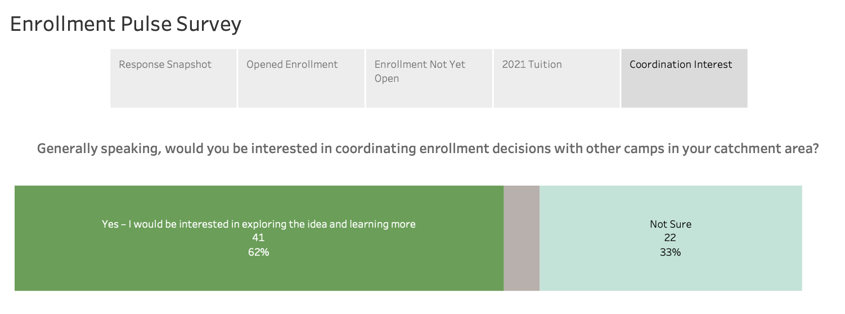

Slide 12
Discussion #3
Title Box
What would it look like to coordinate enrollment decisions? What are the benefits? Drawbacks?

Slide 13
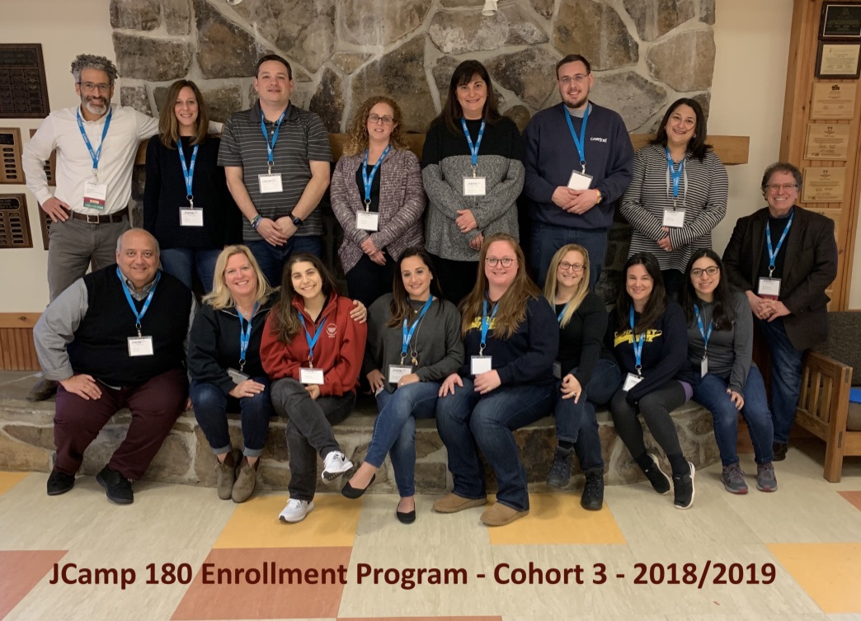
Drop-in Sessions
Get on board!
Title Box
Title Box
Register here: www.jcamp180.org/enrollment
Registration ends
tomorrow (Aug 14)!

Slide 14
Drop-in Sessions
Title Box
Final drop-in: August 20
Same Zoom link you used today

Slide 15
Drop-in Sessions
Title Box
So what are your next steps?

