Slide 2

JCamp180 Webinar
RETURN ON INVESTMENT ANALYSIS (ROI) for ENROLLMENT
June 12, 2015

Slide 3
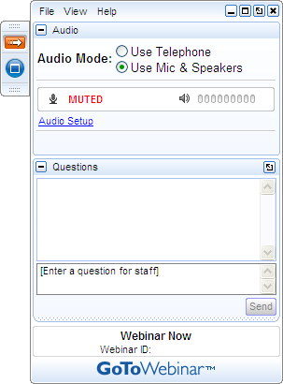
Get Involved
A) Grab Tab – Click red arrow to open/close Control Panel. Click square to toggle Viewer Window between full screen/window mode. Click mic icon to mute/unmute your audio.
B) Audio Pane – Select audio format.
C) Questions Pane – Attendees can submit questions and review answers.
D) Type your question and click Send to submit it to the organizers.
A →
B →
C →
D →

Slide 4
ENROLLMENT ROI CONTEXT
Maintaining and growing enrollment by new recruitment and retention is typically the top priority of camps
More campers means more impact and more economic sustainability
Given limited resources and multiple priorities, a key question for every camp is how much to invest in maintaining or growing enrollment

Slide 5
PURPOSE OF SESSION
Purpose of session is to present a return on investment (ROI) model to help camps determine how much they can invest in enrollment boosting activities
  It will not tell you what to do but can provide the motivation and set the stage for determining the best investments to boost enrollment.
  A number of camps have found the ROI approach to be useful.
A further purpose is to obtain your feedback so that we can continue to improve this model.

Slide 6
ROI APPROACH
Per Camper/Session
Direct Income for 1 additional camper
+ Incremental Expenses
= Net Income in Year 1
Reduced by attrition/retention rate over time
= Direct Lifecycle net income
+ Referral Lifecycle net Income
= Total Life Cycle net income
- Investment (Costs of Growing Enrollment)
= Return on Investment
Number of Retained Campers, Enrollment Costs, and
Life Cycle Net Income over multiple years
⬅➔
All dollars are in current $

Slide 7
And…
Feel free to ask questions or make suggestions as we go along
JCamp 180 is continuing to refine model – we will incorporate input from this session and distribute to camps over summer
JCamp 180 is glad to provide a customized briefing for leaders and individual camps.

Slide 8
Questions??
E-mail: Aron@hgf.org

Slide 9










