Slide 2
GIFT Reading Group: The Generosity Network
Guest Speaker: Jeffrey C. Walker
Date: April 7, 2014

Slide 3
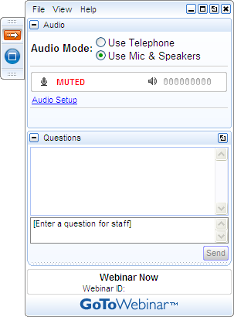
Get Involved!
A) Grab Tab – Click red arrow to open/close Control Panel. Click blue square to toggle Viewer Window between full screen/window mode. Click mic icon to mute/unmute your audio.
B) Audio Setup – Select audio format. Click Audio Setup to verify Speakers & Microphone.
C) Questions Pane – Attendees can submit questions and review answers.
D) Type your question and click Send to submit it to the organizers.
A →
B →
C →
D →

Slide 4
Agenda
Welcome
Review of Technology
Jeffrey Walker
Conclusion

Slide 5
What is a Generosity Network?

Slide 6
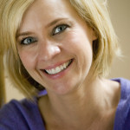
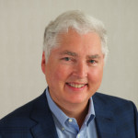
Jennifer McCrea
Jeffrey C. Walker

Slide 7
Why Did We Write the Book?
There are so many resources out there available to your nonprofit, but they’re blocked by
obstacles!!!

Slide 8
Competition
Photo Credit: BigStockPhoto.com

Slide 9
Photo Credit: BigStockPhoto.com

Slide 10
Issues Surrounding Money
Photo Credit: BigStockPhoto.com

Slide 11
Asking for “help”
Photo Credit: BigStockPhoto.com

Slide 12
Creating Customers vs. Partners
Photo Credit: BigStockPhoto.com

Slide 13
First Steps: Know Yourself and Others
Your attitude toward money impacts your relationship with donors
How do we look at others – a checkbook? What do donors want?
SELF
US
NOW

Slide 14
The Power of Story
Photo Credit: BigStockPhoto.com

Slide 15
▪An Alternative to Fund Raising Events

Slide 16
The First One on One Meeting

Slide 17
The Ask
Photo Credit: BigStockPhoto.com

Slide 18
Collaborative Relationships
CEO/Board chair – the most important
CEO/Board Chair/Chief Fundraiser – The Magic Triangle
Enhance the connection between the Board and your team

Slide 19
Cultivate Your Relationships
Use the Avatar Affect
Shared experiences
Photo Credit: BigStockPhoto.com

Slide 20
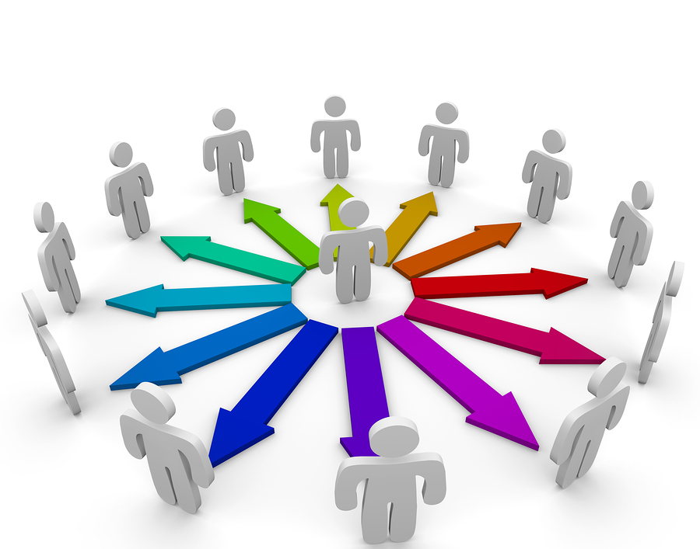
Expand and deepen your Generosity Network
Photo Credit: BigStockPhoto.com

Slide 21
What questions do you have about The Generosity Network?

Slide 22
www.thegenerositynetwork.com

