Slide 1
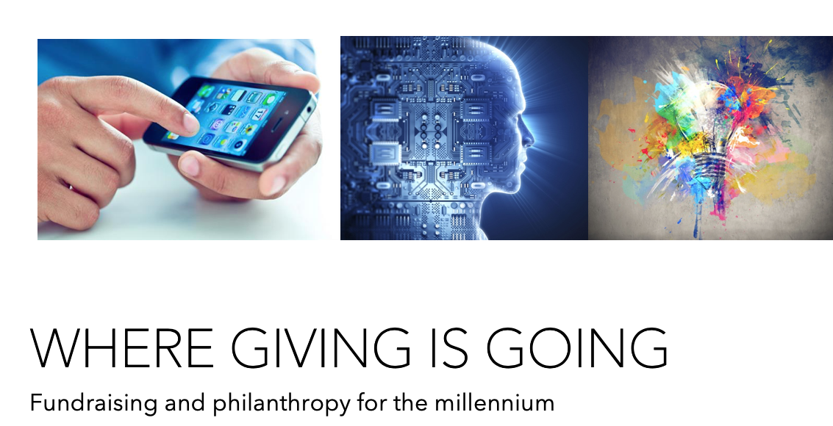

Daniel Mansoor – GoodWorks Group

Slide 2
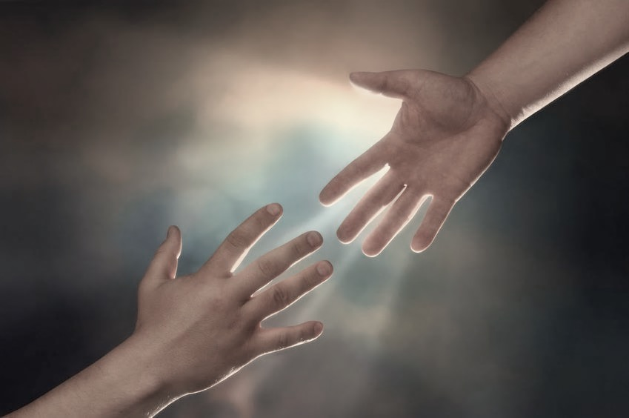
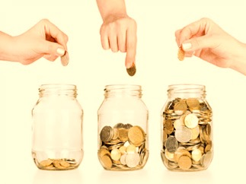

Notes:
In our nature
Demonstrated generosity
We’re irrational - behavior

Slide 3
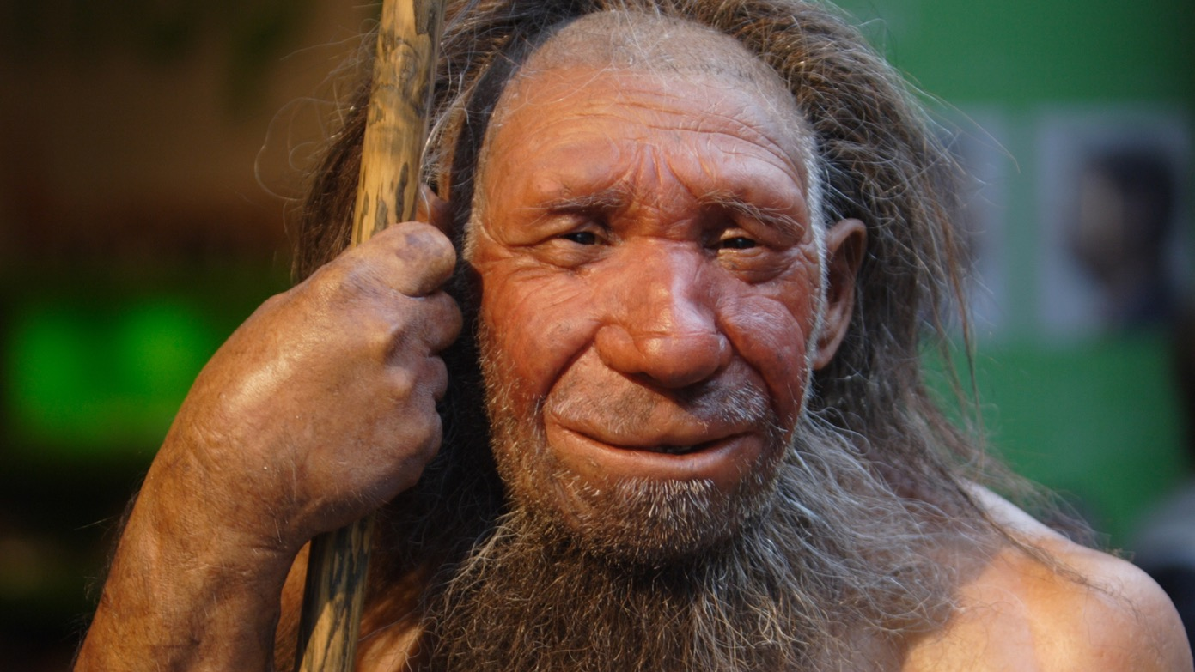
Personal Solicitation
A Tuesday – 843,001 BCE
Notes:
Nothing new

Slide 4
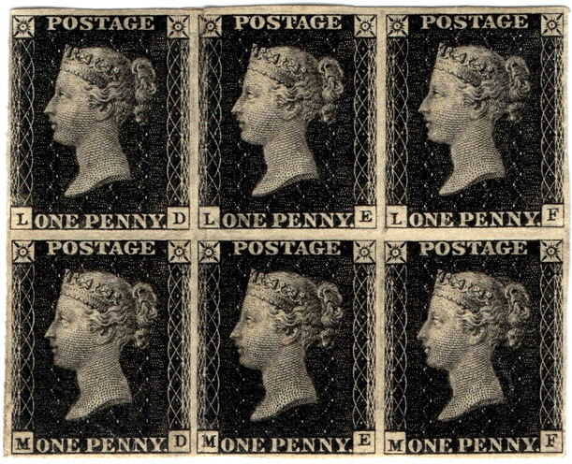
Direct mail
1840

Slide 5
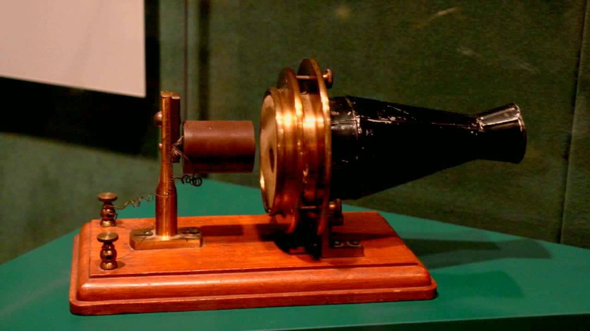
Telemarketing
1876

Slide 6
Online Everything – except giving
BANKING
SHOES
BOOKS
TRAVEL

Slide 7
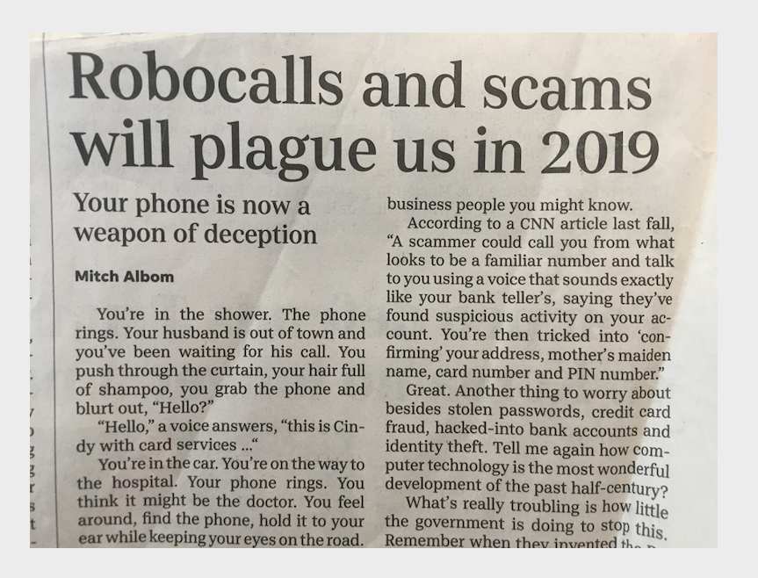
Noise
57% increase
from 2018

Slide 8
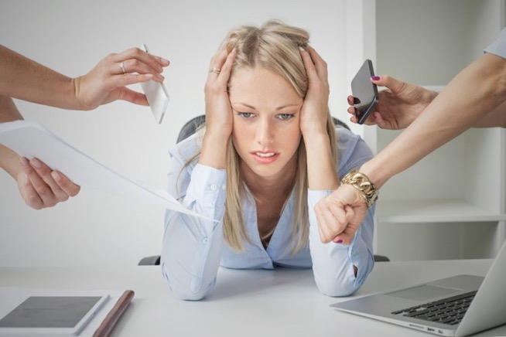
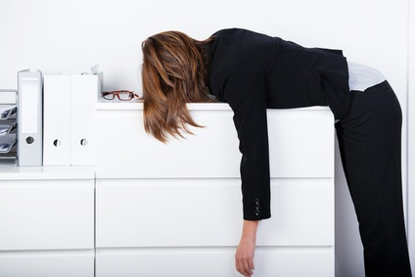
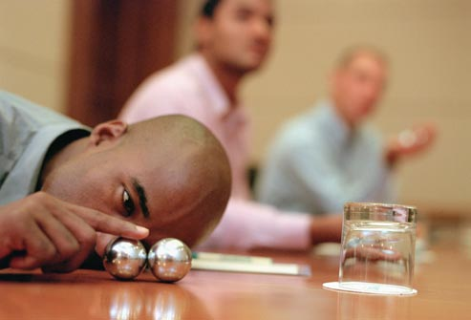
The Big Three
Giving Fatigue Solicitation Fatigue Attention
Notes:
4 billion pieces of solicitation mail
58% increase in telemarketing – robo calls last year
Half of fundraisers in the top job would like to quit
3.7 hours on devices daily

Slide 9
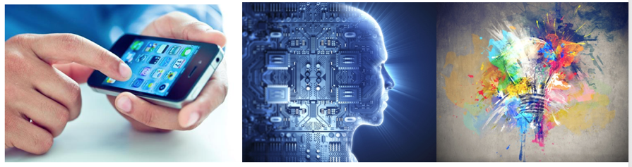
Response
Technology Science Design
Giving Fatigue Solicitation Fatigue Attention

Slide 10
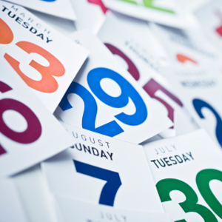


Trendy

Slide 11
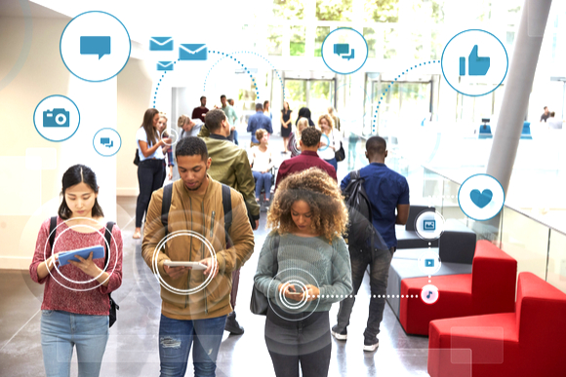
Millennials

Slide 12

Women

Slide 13
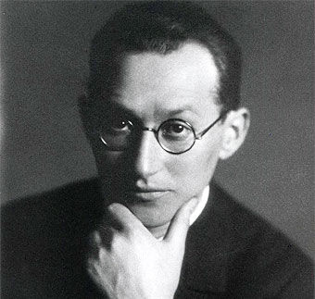
“Identify and then eliminate the obstacles standing in the way of the desired behavior.”
Kurt Lewin
Notes:
Who ordered a book? Or could order a book
Using today’s technology it’s easier to buy a book about hurricanes than help its victims.

Slide 14
1 – Hard
2 - Confusing

Slide 16
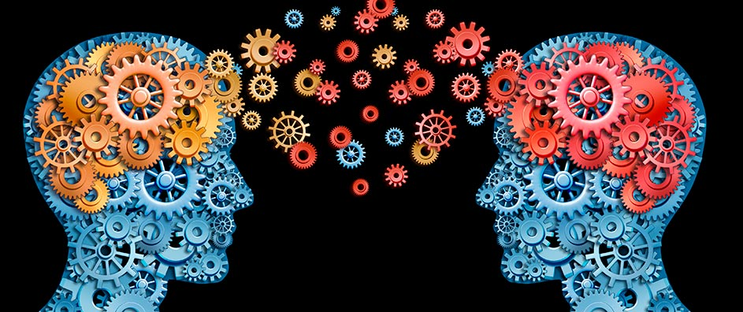
In the Donor’s Mind
The Science of Giving:
Notes:
Distinguish between what we know about the tactics and strategies of fundraising and what is in the head and minds of the donors.
Now one approach is simply to say, “Why don’t we ask them?” and this would be a great start.
In fact I strongly urge you and your colleagues to spend a great deal of time asking your donors why they gave.
They will in most likelihood be incredibly frank and honest and in the process reveal things you never considered.
HOWEVER, this approach assumes that donors themselves know why they behave the way they do.
Often they are influenced by a number of factors that they have no control over and are not aware of.
Let’s start with a few.
NEXT

Slide 17
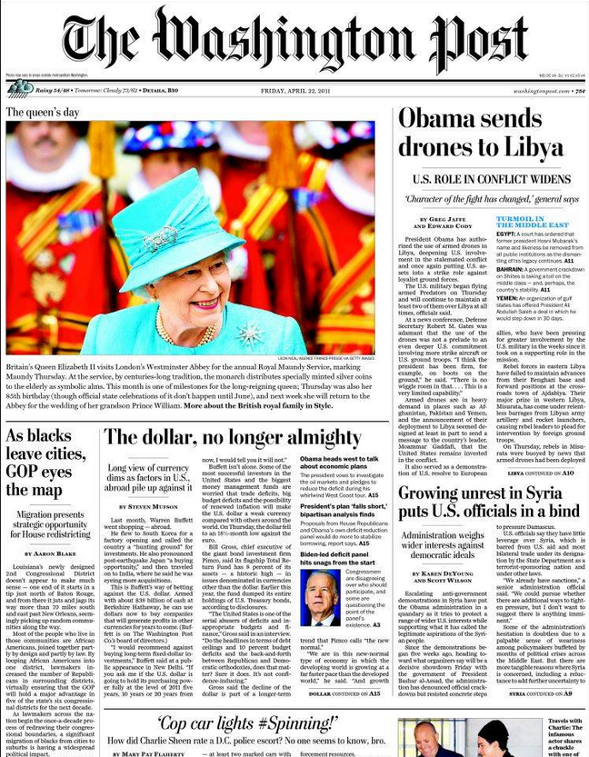
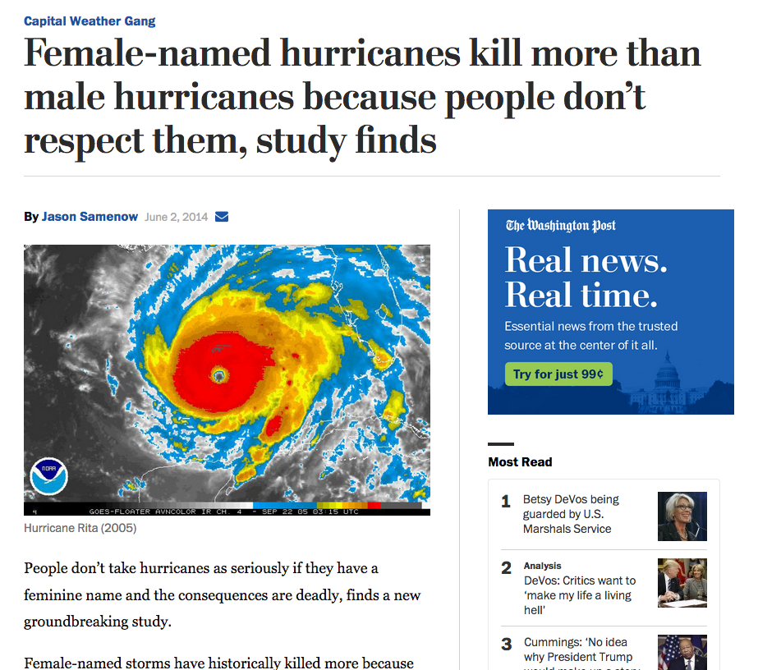
Sharon Shavitt, professor of marketing,University of Illinois
Notes:
Matthew vs Nicole
More about conscious and unconscious perception and the subsequent behavior.
1953 (WOMENS NAMES) and 1979 (MENS NAMES), too
45 woman
23 men
Mr and Mrs Hurricane
Tiffany vs Bruno

Slide 18
Hurricane Named Harry
260%
150%
100%
50%
33%
Charley
Francis
Ivan
Katrina
Rita

Slide 19
Organ Donations
Holland
Denmark
Germany
England
28%
17%
12%
4%

Slide 20
Organ Donations
98%
98%
98%
96%
Denmark
Holland
France
Germany
England
Belgium
Austria
Hungary
28%
17%
12%
4%

Slide 21
Organ Donations
Opt In vs Opt Out
98%
98%
98%
96%
Denmark
Holland
France
Germany
England
Belgium
Austria
Hungary
28%
17%
12%
4%

Slide 22
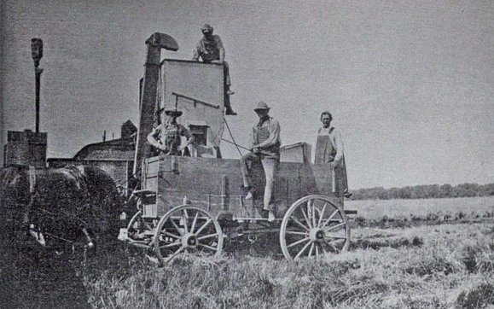
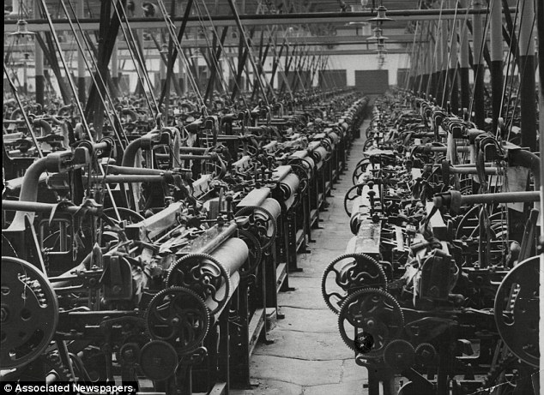

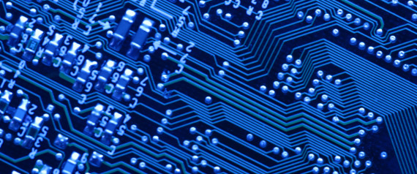

Slide 23
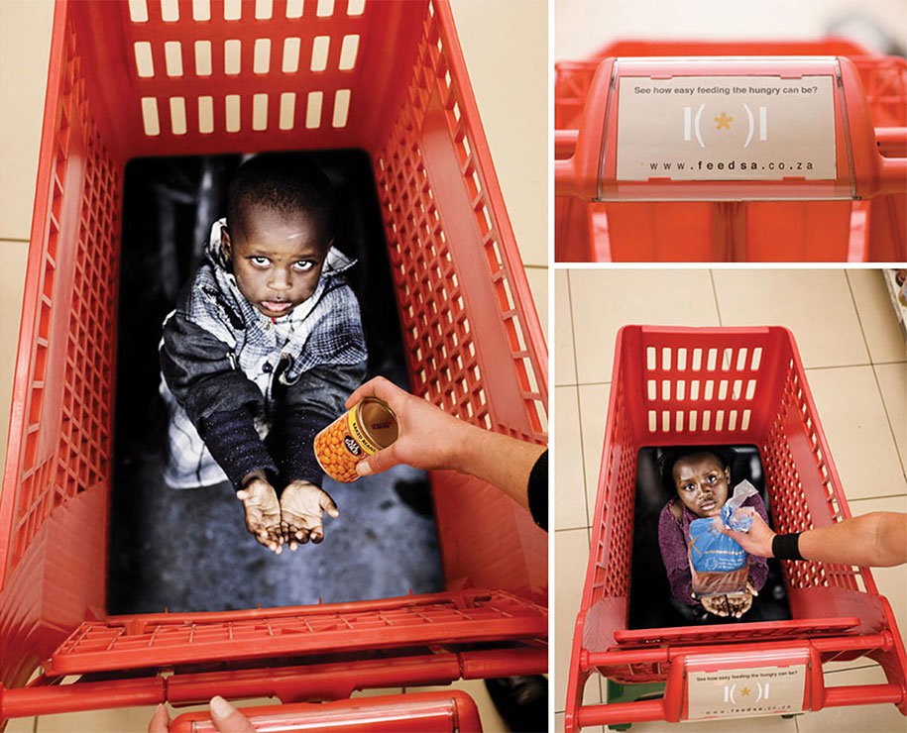

Slide 24
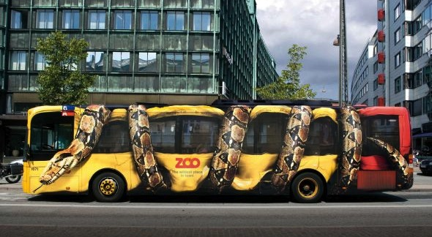
Cleveland Zoo?

Slide 25
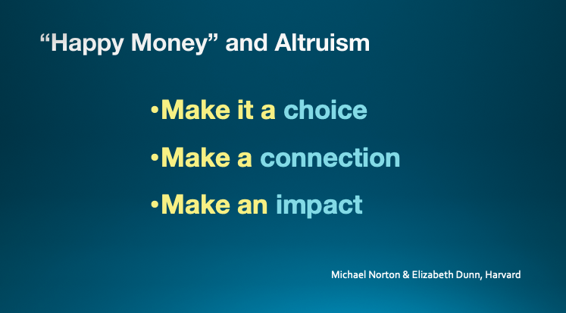

Slide 26
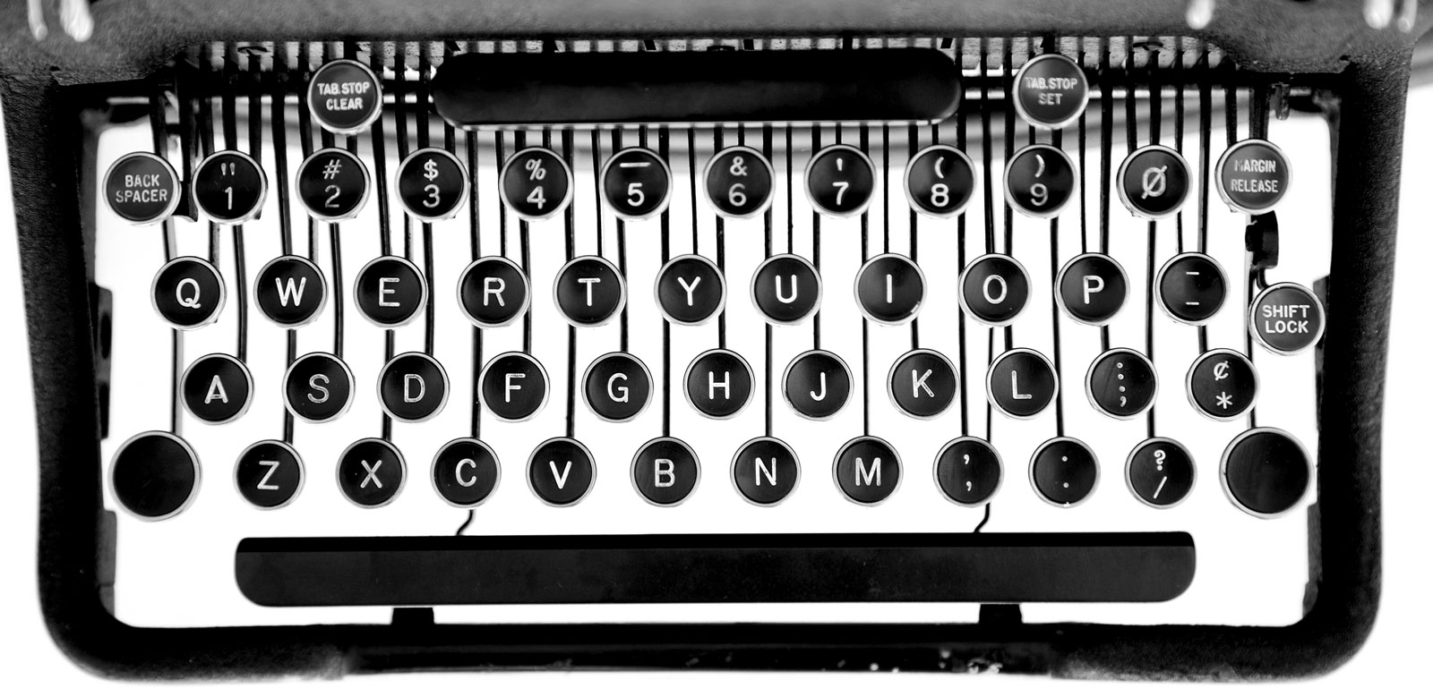
QWERTY 1868

Slide 27
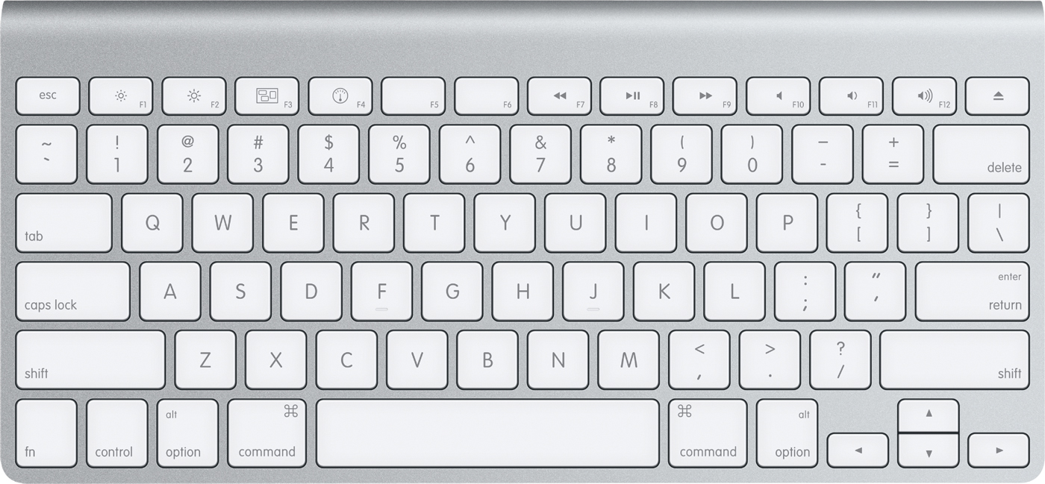
QWERTY 2015

Slide 28
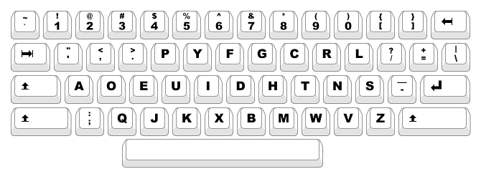
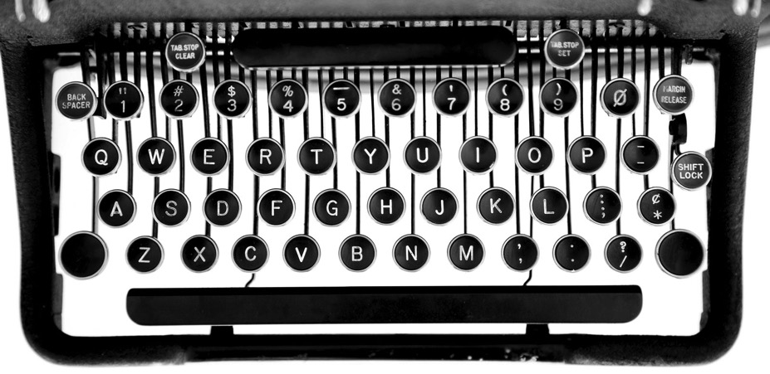
Dvorak

Slide 29

ADL • Anti-Defamation League

Slide 30

Daniel Mansoor
dan@GoodWorksGroup.com
917 974 2325

Slide 32
Outline
1 billion – altruistic, generous, irrational (3)
History of fundraising –face to face / mail/ phone (3)
Landscape – more orgs + more solicitations = more noise
Challenges (3) – donor, solicitation, attention
Response – solutions (3) – tech/data; science; design
Trends – information, engagement, value – Conceptual age
  Design, Story, Symphony, Empathy, Play and Meaning
  Millennials, women, non-alumni, technology, recurring…. Soul of writer
Be bold, be original
Norton control connection impact
Video ask? Letter your soul
Ending

