Slide 1


Title

Slide 2
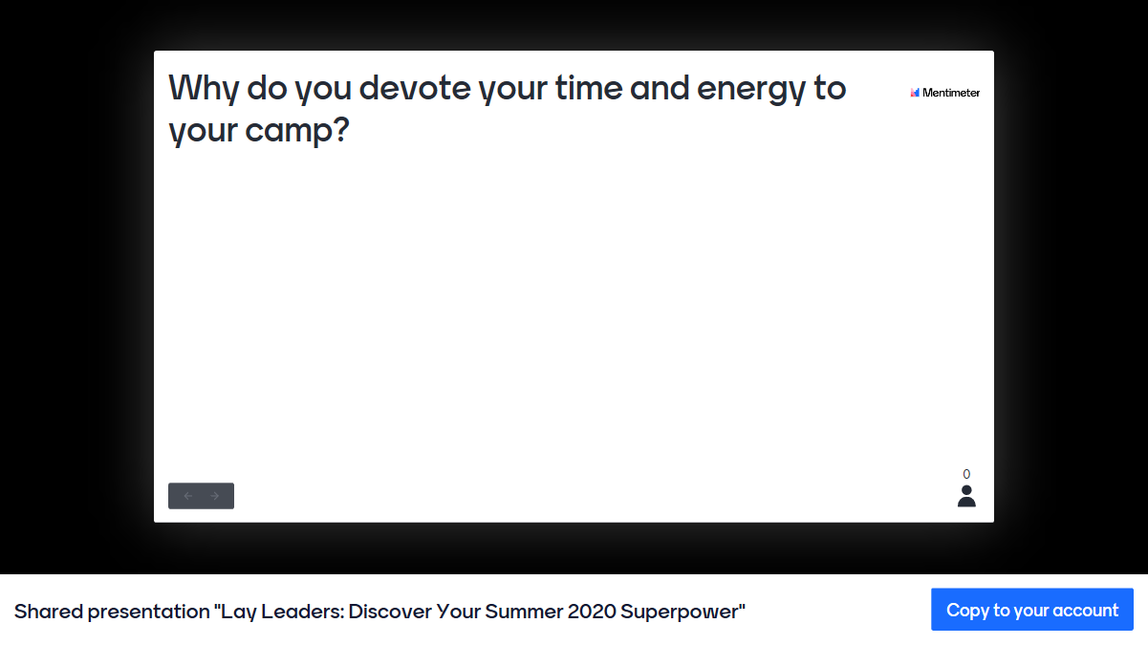

Slide 3

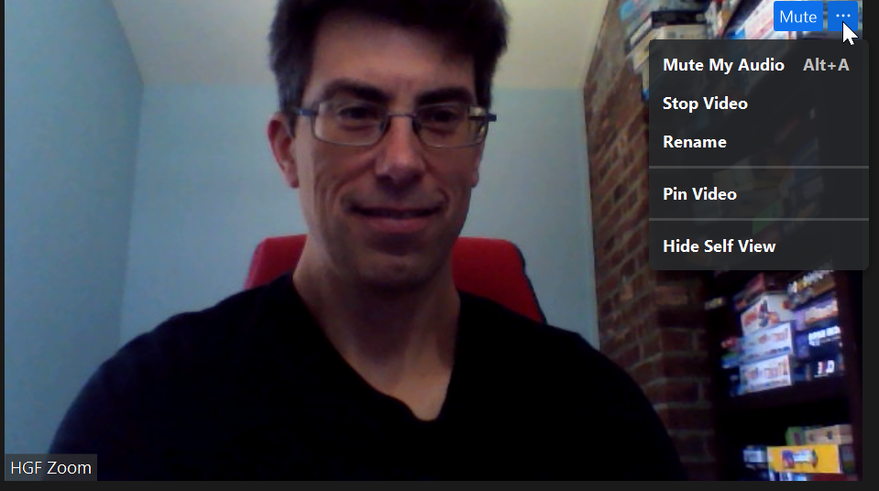
Change Your Zoom Nametag
Notes:
https://app.mural.co/t/kmartone1739/m/kmartone1739/1593030770657/93cf9952debd55ceea79dd7d855e67cb313eff89

Slide 4
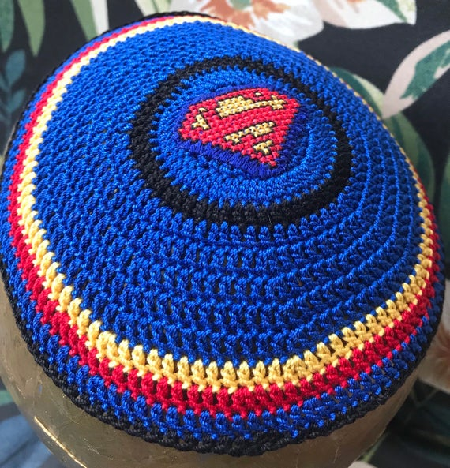
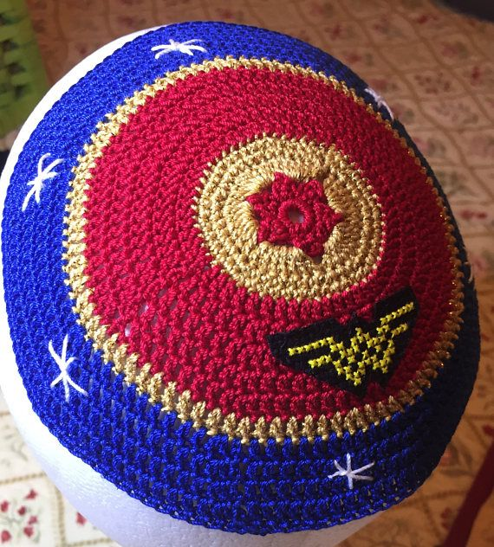
Lay Leaders: Discover Your Summer 2020 Superpower
July 21, 2020
Natasha Dresner
JCamp 180 Mentor and LEAP Director
Natasha@hgf.org

Slide 5

Breakout 1
Title Box
What are you, as a lay leader, doing to support your camp this summer and fall?

Slide 6
Camp’s top 3 short-term needs/priorities:
1.
2.
3.
Camp’s top 3 long(er)-term needs/priorities:
1.
2.
3.
Title Box

Slide 7

Camp’s top 3 needs/priorities:
1.
2.
3.
Top 3 things I do to support camp:
1.
2.
3.
Title Box

Slide 8
Breakout 2
Title Box
What do you do/could do to better align your camp’s needs/priorities with your efforts?

Slide 9
What can we do to align:
know/figure out camp’s needs/priorities (2021 scenarios)
are you filling in for any staff-related gaps?
balance between activities, including short- and long-term work
recruit new blood (have job descriptions)
talk to each other and encourage honest, out-of-the-box conversations
identify and stick to your “superpower”
say “No”
speak up if your talents aren’t being utilized or your load is too big
promote and model transparency and accountability
remember why you are doing this/what your common vision/goals are

Slide 10



Slide 11



Slide 12

“The program was very helpful in focusing me on the critical function of our Board of Directors and specifically my role in facilitating that. Natasha has been an expert in distilling what is most critical for each participant in the program. She has deftly balanced the skills of the participants, highlighted and supported our growth opportunities and matched all that with the needs of each specific camp’s lifecycle. Wow! The experience has been worthwhile, fulfilling and provided an excellent foundation for present and future Board service.”
Joshua Charlat, Board Chair of Camp Ramah Canada

Slide 13
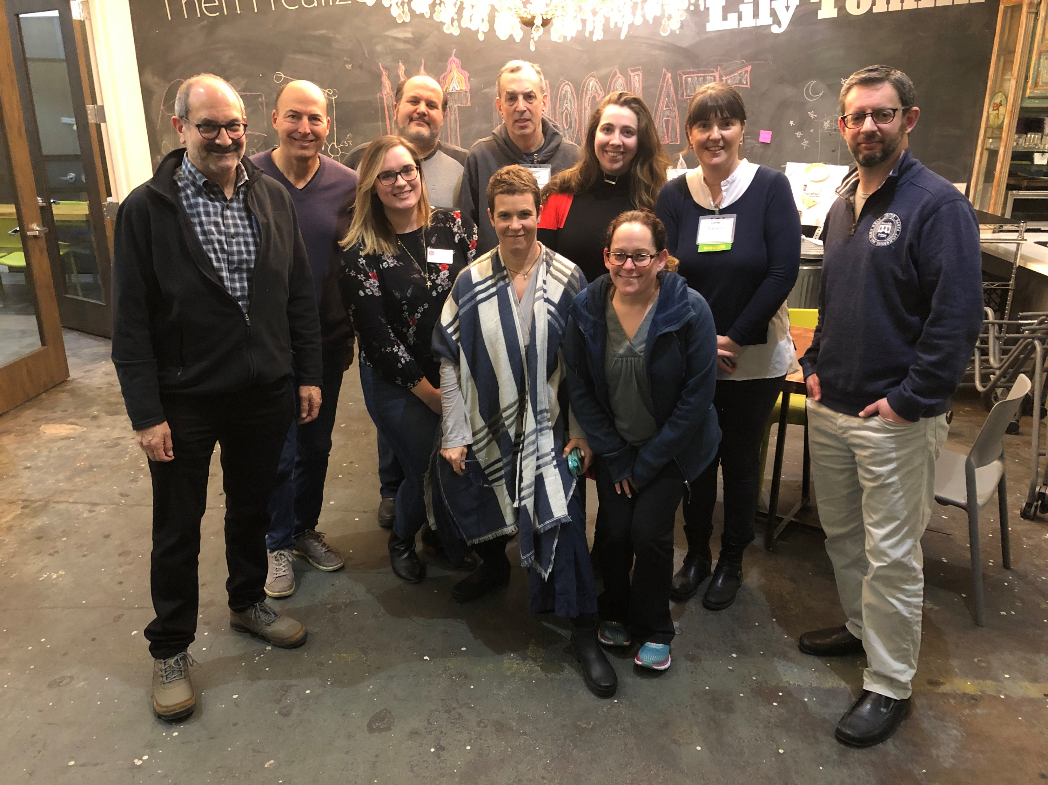
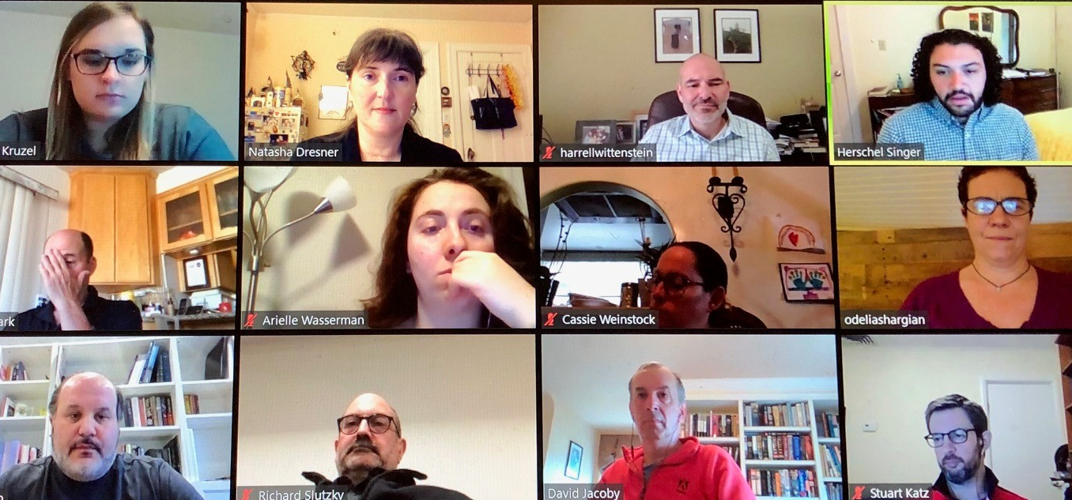

Headline here
“…I thought it was really helpful to have in the midst of this communal crisis. Thank you!”
Title Box
LEAP 2020

Slide 14
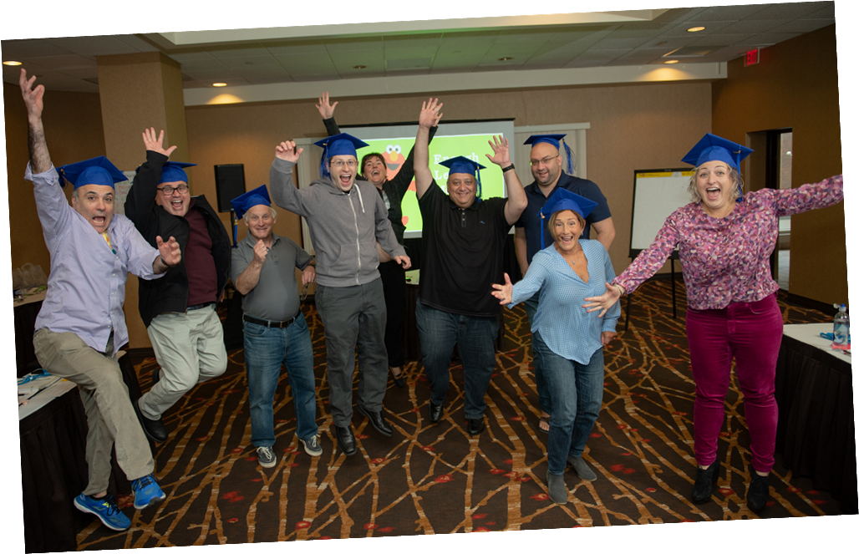
8-12 participants
For Board Chairs/Camp Committee Chairs and Vice Chairs ONLY
New Cohort applications will open in September
https://jcamp180.org/leap

Slide 15



Upcoming ADAPT Offerings
JULY 23
JULY 28
July 29
Tackling Your Biggest Enrollment Issues: A Taste of the Revised Enrollment Program
From the Ground Up: Jewish Camps Working Toward Racial Equity and Justice
The Fundamentals of Sustainer/ Monthly Giving
2020/2021 JCamp 180 Enrollment Program
jcamp180.org/enrollment
Full Schedule: jcamp180.org/adapt

Slide 16
Wrap up
Title Box
What is/are my immediate next step(s)?
1.
2.
3.

Slide 17
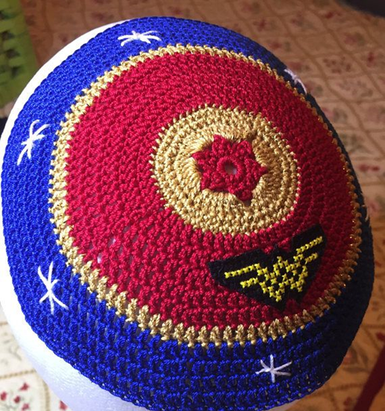
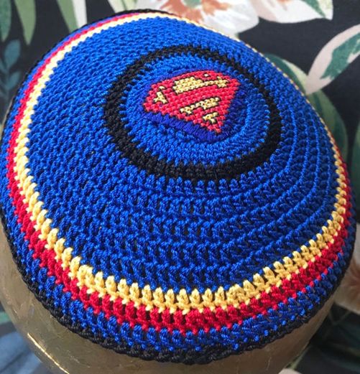
Title
Thank you! Your love of camp and the generosity of your time, energy, and resources DO NOT go unnoticed!

