Slide 1

Camp Legacy Program
David Sharken
Mentor & Legacy Program Director
JCamp 180
david@hgf.org

Slide 2
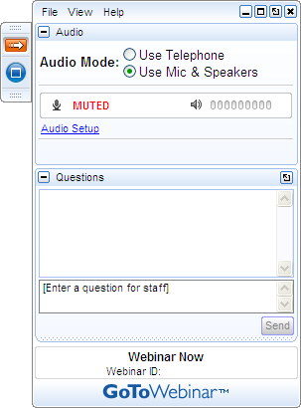
Getting Involved
A) Grab Tab – Click red arrow to open/close Control Panel. Click square to toggle Viewer Window between full screen/window mode. Click mic icon to mute/unmute your audio.
B) Audio Pane – Select audio format. Click Audio Setup to verify Speakers & Microphone.
C) Questions Pane – Attendees can submit questions and review answers.
D) Type your question and click Send to submit it to the organizer.
A →
B →
C →
D →

Slide 3
Tonight’s Agenda
Overview of the Legacy Program
Key Steps in the Legacy Action Plan:
  Case Statement
  Identifying Prospects
  In-reach/Marketing
  Conversations
  Management
  Brief Overview of Financial Vehicles
  Stewardship
Common Myths

Slide 4
Legacy Program Overview
High quality, results-oriented
Training, consulting, coaching
Simple legacy action plan
Note: We will use the terms “Legacy”
& “Planned Giving” interchangeably.
Notes:
A results-oriented four year program in which Grinspoon has partnered with 50 camps to establish bequests and other planned gifts. 17 have completed the program, 9 are in year 4 of the program, 11 are in year 3, and 6 are in year 2.
Grinspoon will provide training, consulting, and coaching,
The legacy plan is what has made this work.

Slide 5
What is Legacy /
Planned Giving?
Legacy giving is a deliberate, planned, formal action by a donor to share a portion of their assets with a charity.
Often, but not always, the gift is provided for after the donor’s lifetime.

Slide 6

Why Now?
Transfer of wealth is underway
“If only asked”
Thank donors while they are alive
Increased annual giving
Securing our future
Notes:
Transfer of Wealth
They say there will be a 41 to 131 trillion dollar transfer of wealth and a rough estimate is that, at a minimum, there will be $1.7 trillion in charitable bequests in the next 20 years. 74 million baby boomers are coming of age. If these individuals were to give 2% of their estimated wealth away, that could mean as much as $500 billion to $1 trillion in new gifts to charities! Approximately 80% of individuals give to charities during their lifetimes and only 8% leave a gift after their lifetimes.
After Lifetime
Why bequests and other planned gifts? There are hundreds if not thousands of people in the Jewish community who may be hesitant to give large gifts during their lifetimes, but would willingly leave bequests. Historically, bequests have produced, by far, the greatest amount of revenue as a percent of fundraising dollars.
“If only asked”
How many of you have been asked by your University to consider leaving a gift after your lifetime or by a hospital, the symphony, etc.? How many of you have been asked by your synagogue or the Reform movement to leave a gift after your lifetime? Universities, hospitals and large nonprofits are active in planned giving. Why isn’t the Jewish community doing more to cultivate and solicit planned gifts? These answers are most given:
We mean to, but we are to busy with everything else.
We need training to equip ourselves.
We just don’t have the resources.
Increased Annual Giving
When legacy donors are thanked and recognized appropriately, this can lead to other significant gifts. Studies also show that legacy donors tend to increase their annual giving.
Securing our Future
Fast forward to when your children and grandchildren are sitting around your board tables and deciding what to do with the endowment payout instead of wondering where they are going to get the funds for the operating annual budget.

Slide 7
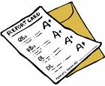
JCamp 180 Camp Legacy Program
Results Since January 2008
(As of February 2013)
50 Participating camps:
  Nearly 3,100 Letters of Intent
  Estimated Value of $78.9 Million
  $1,652,184 Realized
Notes:
Average planned gift of $25,000 if value is unknown. National Average is $77,000

Slide 8
Lessons Learned
from Camp Legacy
Culture of giving has changed
All ages & means are participating
Improved relationship-building skills
“Easy” way to solicit funds
Notes:
There is a new sense of urgency about the importance of bequests/planned gifts and endowments - and our organizations have built it into their overall fundraising.
This initiative has been the spark that helps motivate an individual or family to create legacies for the organizations they love.
Many donors are reporting that they are being thanked and appreciated more regularly and in more meaningful ways. There is an overall positive impact both on annual and capital campaigns. Statistically, legacy donors will give twice as much to the annual campaign.

Slide 9
Key Steps in the Legacy Action Plan
Case Statement
Identifying prospects
In-reach/marketing
Conversations
Management
Brief Overview of Financial Vehicles
Stewardship

Slide 10
Camp’s Legacy Plan
The Case Statement
  Why should anyone want to leave a bequest or other planned gift?
  What are the values your camp stands for?
  What is the value of your camp to the community?
  What is the impact of planned giving / endowment building on your camp?
  What are the top 3 benefits of planned giving for camp?

Slide 11

Camp’s Legacy Plan
(continued)
Identify Groups
  Closest & most loyal donors/families
  Consistent givers over ten or more years
  Past presidents & board members
  Staff
  Volunteers
  Seniors
  Alumni

Slide 12
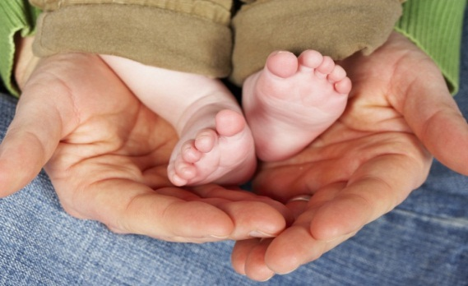
Camp’s Legacy Plan
(continued)
Marketing Plan
  “In-reach” not “out-reach”
  Identify target markets
  Identify best communications vehicles
  Communicate through multiple channels (online, print, at camp)

Slide 13

Camp’s Legacy Plan
(continued)
Implementing the Plan with Personal Contacts & Conversations
  Family histories & values
  Preparing for personal meetings
  Personalized mailings
  The Jewish conversation

Slide 14
Camp’s Legacy Plan
(continued)
Management Plan
  Who is responsible for the plan?
  To whom do they report?
  How are you going to measure success?
  Who will track gifts, document, & record?

Slide 15
Camp’s Legacy Plan
(continued)
Setting Goals
  Years 1 & 2 – Number of individual conversations, small, & large group presentations
  Year 3 – Stewardship activities
  Beyond – Sustaining the effort

Slide 16

How People Give
Provisions in wills (bequests)
IRA & other retirement beneficiaries
Charitable Gift Annuities
Charitable Remainder Trusts
Charitable Lead Trusts
Appreciated Asset Gifts
Life Insurance

Slide 17


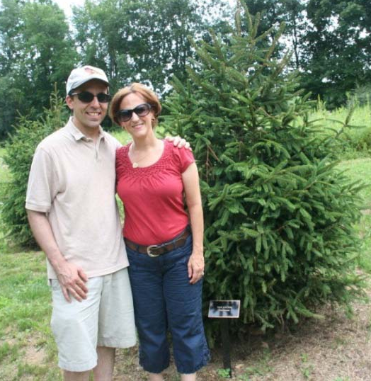
Camp’s Legacy Plan
(continued)
Recognition & Stewardship
  How are you going to publicly recognize?
  How will you communicate regularly?

Slide 18
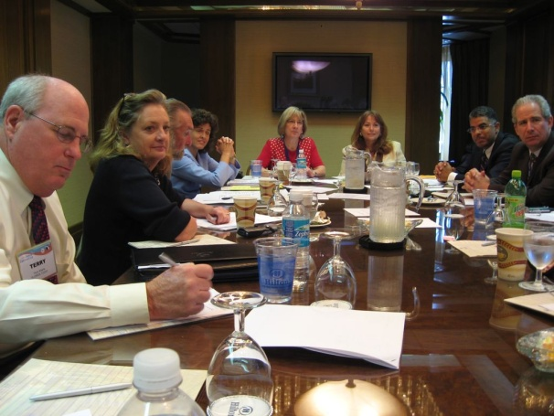
Responsibilities of Board/Camp Committee
Prospecting
Education & cultivation
Personal participation
Asking
Thanking
Notes:
Who do you know that cares? Bring names to the staff
Why we need endowment
Showing strong support with personal giving to the endowment
Asking in meaningful ways; face-to-face; in teams
Engagement in the thank you process

Slide 19
Debunking Myths
Myths About…
  what planned giving really is
  organizational barriers
  who makes a good legacy prospect
  personal / emotional barriers to asking
Note: We will first present the “myths” in black followed by the “truths” in blue

Slide 20
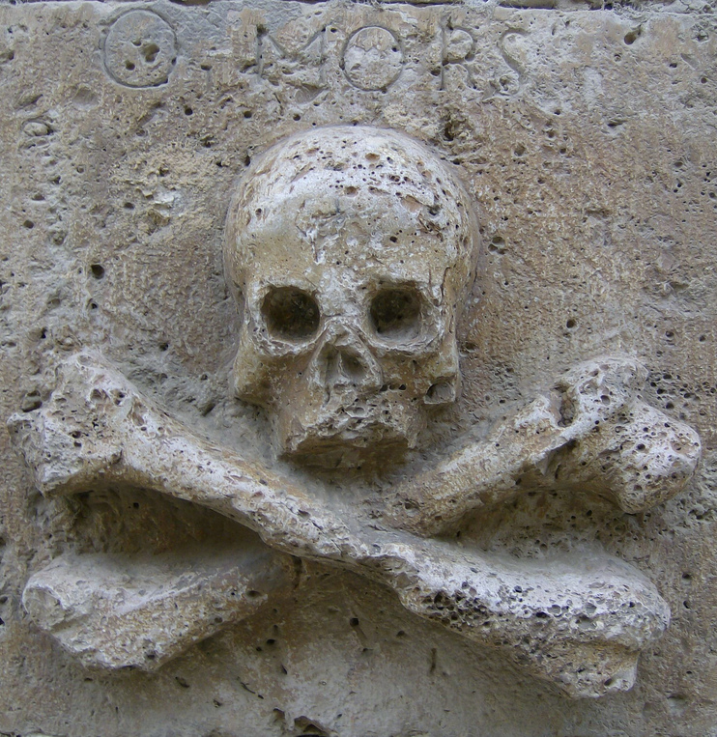
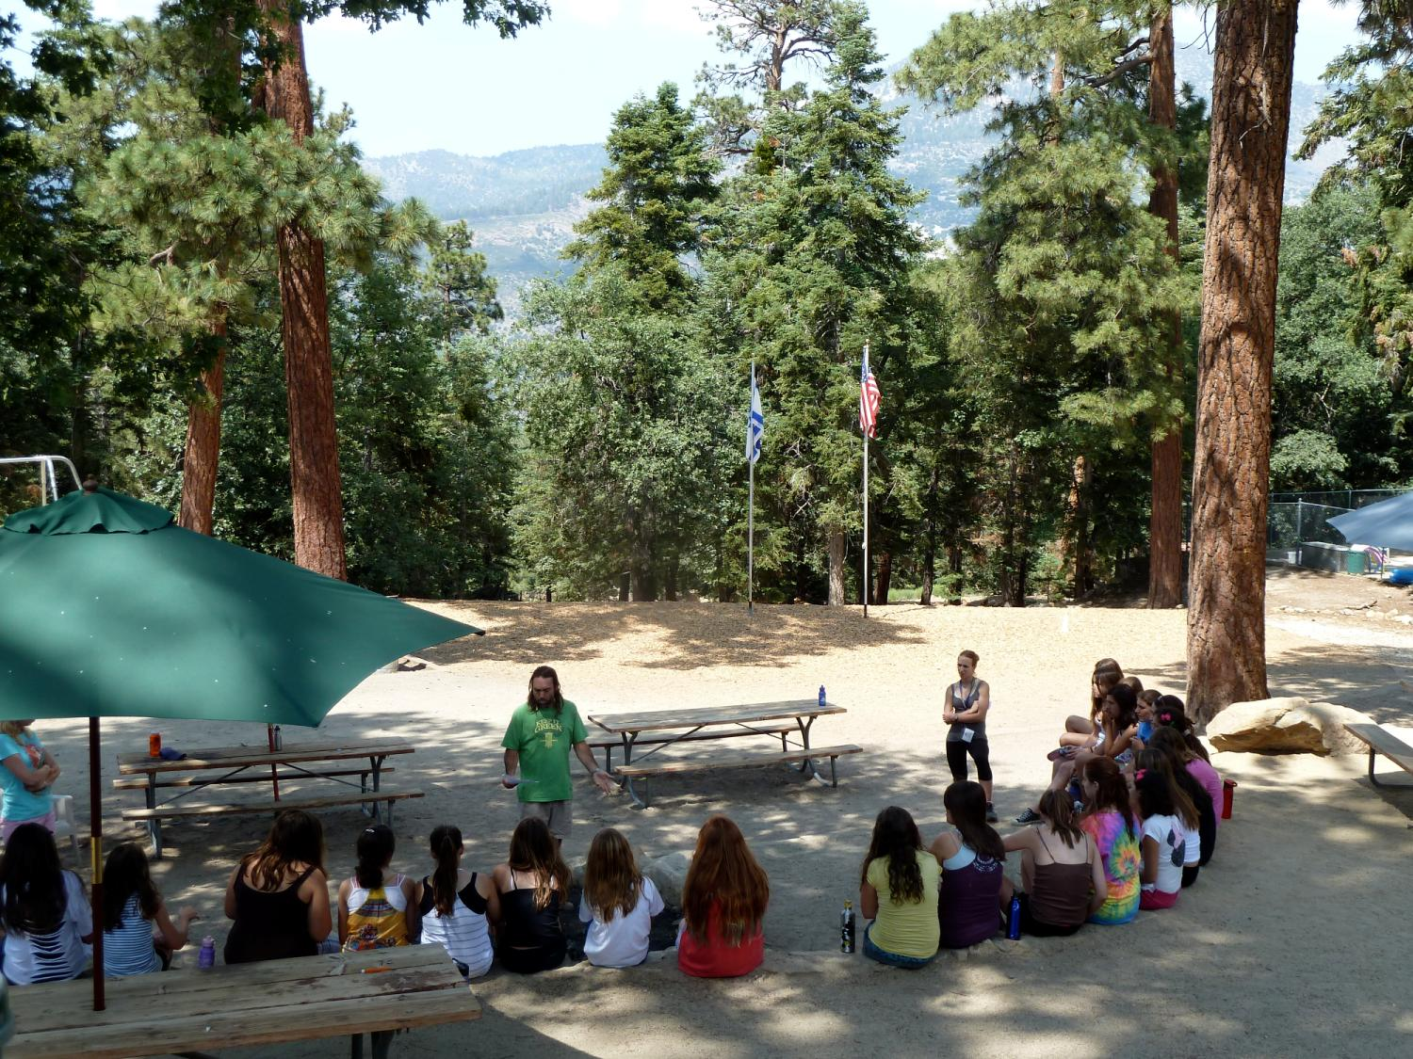
Myth: Having legacy conversations means I have to talk about death (I cannot emotionally handle that).
Legacy conversations are about mission & future vision.

Slide 21
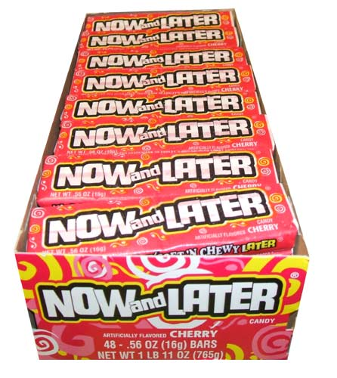
Myth: Soliciting legacy gifts is the same as raising money for an endowment.
Endowment campaigns have the goal of raising money NOW –
Legacy gifts are NOW or LATER.

Slide 22

Myth: We need money now & cannot possibly think about legacy giving.
You can’t afford NOT to think about legacy activities.

Slide 23
Myth: All planned gifts are deferred gifts.

Slide 24
Myth: All planned gifts are deferred gifts.
Planned gifts could be given today, through vehicles such as gift annuities.

Slide 25

Myth: We just don’t have the time to do planned giving.
You’re already spending time on donor relations –
Don’t miss the opportunity…

Slide 26
X
Myth: Planned giving hurts annual giving –
If people make a legacy commitment, they’ll stop giving annually because they think they are “off the hook.”
Legacy donors increase their annual giving.

Slide 27
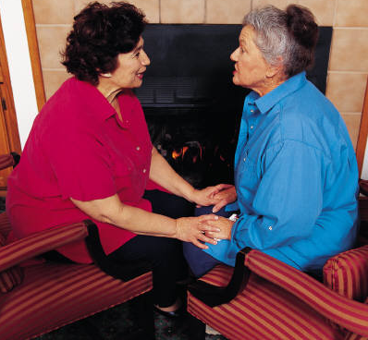
Myth: We can’t ask someone to join the legacy society AND ask for a capital gift in the same year.
Every donor is different.

Slide 28
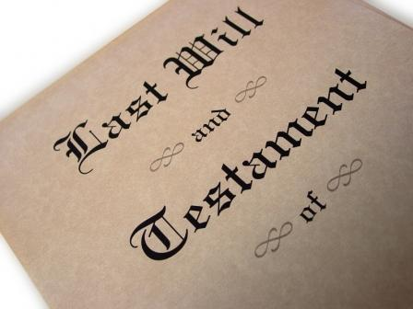
Myth:
If there is no will, there is no planned gift.
There are other planned giving vehicles, such as retirement funds, life insurance beneficiaries, etc.

Slide 29
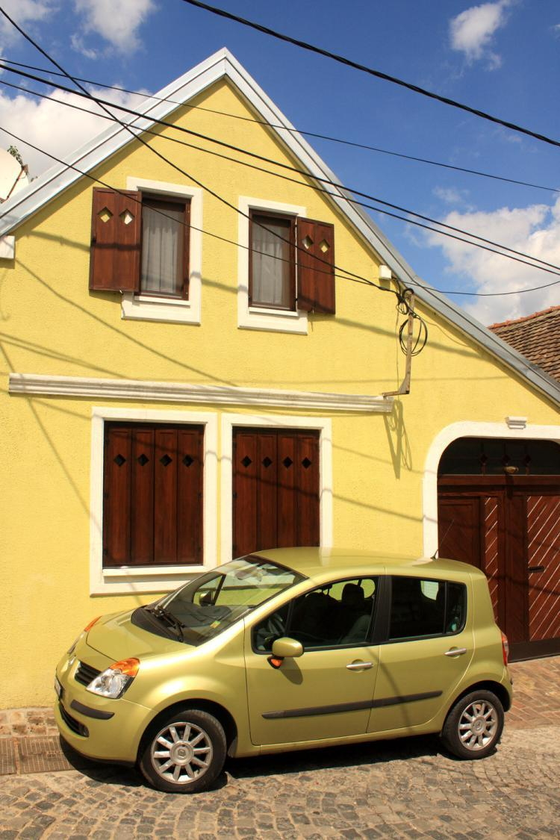
Myth: If a donor doesn’t have an “estate” they cannot or will not make a legacy gift.
Everyone you’re approaching has assets.

Slide 30
Myth: Single people or people without heirs have no need for a will, so they’re not going to want to talk about legacy.
Donors without heirs are often MORE willing to provide for their favorite charity.

Slide 31

Myth: Only seniors over 65 years old are planned giving prospects.
Young professionals have 401(k)s and 403(b)s, too.

Slide 32

Myth: Asking for a legacy gift is like stealing someone’s inheritance.
There are usually plenty of funds or other assets given to the heirs.

Slide 33
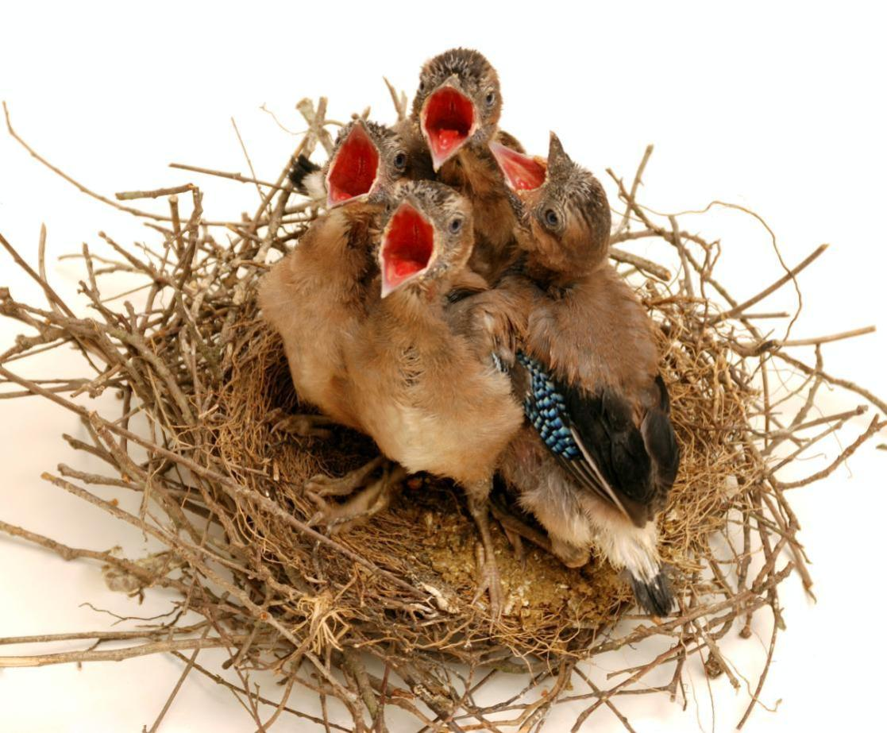
Myth: The donor is just going to leave everything to their kids, so there is no point in asking.
The children of the donor will object if the donor bequests something to an organization.
The donor wants to leave their estate to his/her kids to decide if they want to support camp after s/he dies.
Heirs are usually still well taken care of.

Slide 34

Myth: Planned giving is not appropriate for a young organization.
Even young organizations have a base of loyal donors.

Slide 35
Myth: The donor who only gives $50 a year and has never raised her gift in all the years she’s been giving obviously doesn’t have anything to give us in her will.
Only wealthy people are planned giving prospects.
Planned giving is egalitarian.
Annual $50 Donor Leaves $1 Million Bequest!

Slide 36

Myth: Just signing a letter of intent will not lead someone to include us in their will.

Slide 37
Myth: Just signing a letter of intent will not lead someone to include us in their will.
Donor stewardship is the key –
for the rest of their natural life!

Slide 38

Myth: A legacy letter of intent should be required of every board member.
Planned giving is a very personal decision.

Slide 39
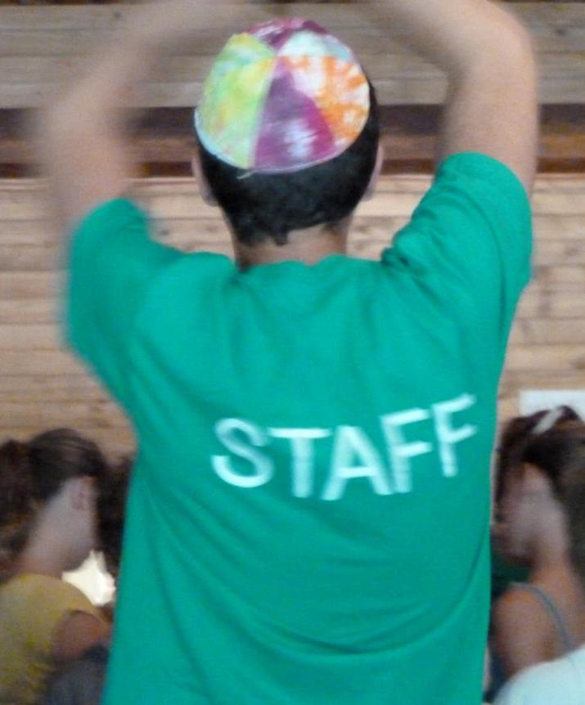
Myth: I don’t have to make my own legacy gift because I am on staff.
Only ask of others what you’ve already done yourself.

Slide 40

Myth: I need more technical training before I can even begin to raise the topic of a major planned gift.
I need to be a planned giving expert to be involved in gift planning.
I will suffer eternal mortification if a prospect or donor asks me a tax or financial planning question that I can’t answer.
I shouldn’t start a legacy program at my camp unless I know all of the legal nuances about giving vehicles – otherwise I could get our agency sued.
Your job is NOT to be an expert

Slide 41
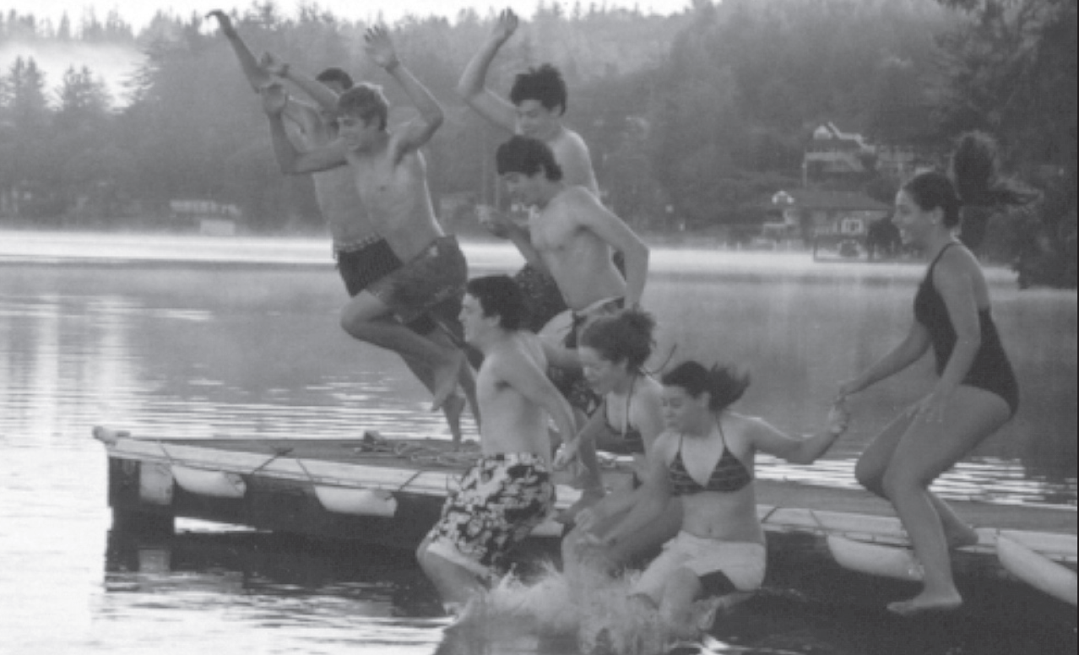
Myth: We can’t launch a successful legacy program without an experienced planned giving officer on our staff.
Legacy lay leaders need to be tax attorneys or financial advisors.
We need to be planned giving experts.
Your job is passion.

Slide 42
Camp Legacy Program
David Sharken
Mentor & Legacy Program Director
JCamp 180
david@hgf.org

