Slide 1
Build Your Match 1
Program Overview
June 21, 2018
Mark Gold Kathleen Rodowicz
Director, JCamp 180 Grants Administrator
Mark@hgf.org Kathleen@hgf.org
413-276-0777 grants@hgf.org
413-276-0719

Slide 2
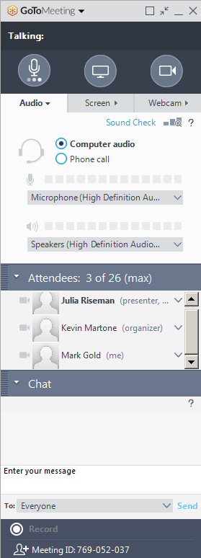
GoTo Meeting Logistics:
A →
A) Grab Tab – Click arrows to open/close Control Panel. Click square to toggle Viewer Window between full screen/window mode. Click microphone icon to mute/unmute your audio.
B) Audio Pane – Select audio format. Click Audio Setup to verify Speakers & Microphone.
C) Questions Pane – Attendees can submit questions and review answers.
D) Type your question and click Send to submit it to the organizer or other participant.
B →
C →
D →

Slide 3
Agenda:
Explain the Build Your Match 1 grant in greater detail
Provide training on the
Build Your Match 1 online grants administration system (including forms to be submitted)
Questions and discussion

Slide 4

Follow-up:
Find today’s information on JCamp180.org

Slide 5
Program overview:
Build Your Match 1 is a TWO PHASE program
  Phase 1: Create a matching fund pool
    50% of funds you raise
    50% of funds from JCamp 180
  Phase 2: Solicit gifts to draw against that pool

Slide 6
Program Overview:
Phase 1:
Camp donors: $ 75,000 +
HGF matching funds: $ 75,000
Phase 2:
Camp donors: $450,000 +
Total Campaign $600,000 +

Slide 7
Program Overview
Phase 1 Gifts:
Your Major
Donor(s)
Identify and solicit major donors to partner with HGF
A minimum of 3 gifts of at least $25,000
Six months to get pledges (or payments)
12 months to get payments on these pledges

Slide 8
Program Overview
Phase 1 Gifts:
Your Major
Donor(s)
Identify and solicit major donors to partner with HGF
A minimum of 3 gifts of at least $25,000
Six months to get pledges (or payments)
12 months to get payments on these pledges
Note that a minimum of 3 gifts are required:
Cannot “run the table” with one gift
HGF Matches these gifts 1:1
Total phase 1 pool becomes $150, 000

Slide 9
Program Overview
Phase 1 Gifts:
Your Major
Donor(s)
  Pledges must be dated AFTER 7/1/2018
  Pledges must be dated BEFORE 12/31/2018
  Proof of pledges must be submitted BEFORE 1/31/2019
  Pledges must be paid in full BEFORE 7/1/2019
Grinspoon
Match
§ Gifts may be from private or family foundations even if paid through a Jewish Federation
* See definition of “related” in program brochure

Slide 10
Program Overview
Phase 1 Gifts:
Your Major
Donor(s)
Phase 1 pledges must be paid to the minimum level of $25,000 before the JCamp 180 matching contribution is funded
We reserve funds based on proof of pledges, but we pay on proof of payment
Plan for unpaid pledges
Grinspoon
Match

Slide 11
Program Overview
Phase 1 Gifts:
Your Major
Donor(s)
If a phase 1 pledge is not paid due to unforeseen circumstances, you cannot replace one phase 1 pledge with another after December 31, 2018.
You should consider submitting more than the minimum phase 1 goal in fulfillment of phase 1 pledges.
Grinspoon
Match

Slide 12
Program Overview
Phase 1 Gifts:
Your Major
Donor(s)
A phase 1 pledge document form must be submitted for each gift by January 31, 2019
Include the completed participant information form the FIRST time you submit a phase 1 pledge document form.
Periodically, submit a Build Your Match 1 payment reporting form with phase 1 pledge payments
All phase 1 payment verification documentation must be submitted to JCamp 180 by July 31, 2019
Grinspoon
Match

Slide 13
Time Table:
Phase 1
Phase 1 Timetable
Phase 1 begins | July 1, 2018
Phase 1 pledge period ends | December 31, 2018
Phase 1 pledge reporting due | January 31, 2019
Phase 1 ends, all payments due | June 30, 2019
Phase 1 payment support submissions due | July 31, 2019

Slide 14
Program Overview
Phase 2 Gifts:
Your Major
Donor(s)
Identify and solicit gifts from your camp community
Gifts must be $1,500 or larger with only the first $25,000 of each gift eligible to be matched
One year to solicit pledges or payments
Three years to pay pledges
Goal is $450,000 in phase 2 gifts
Phase 2 gifts from Camp community
Grinspoon
Match

Slide 15
Program Overview
Phase 2 Gifts:
Your Major
Donor(s)
Identify and solicit gifts from your camp community
Gifts must be $1,500 or larger with only the first $25,000 of each gift eligible to be matched
One year to solicit pledges or payments
Three years to pay pledges
Goal is $450,000 in phase 2 gifts
Phase 2 gifts from Camp community
Grinspoon
Match
The phase 1 pool matches these gifts 1:3
HGF matches these gifts 1:6
Phase 1: Camp Raised: $ 75,000 +
HGF Match : $ 75,000
Phase 2: Camp Raised: $450,000 +
Total campaign becomes $600,000 +

Slide 16
Program Overview
Phase 2 Gifts:
Phase 2 challenges the $500 annual donor to pledge to sustain their gift for 3 consecutive years
The portion of any phase 2 gifts over $25,000 does not qualify for a matching gift. Only the first $25,000 of each phase 2 gift will be matched.
Identify pledges to HGF within 30 days of receipt
Pledges must be signed after July 1, 2018 and before July 1, 2019
Pledges must be paid in full by July 1, 2021
HGF share of pool is paid out when pledges are paid to the minimum level of $1,500*
Your Major
Donor(s)
Phase 2 gifts from Camp community
Grinspoon
Match
*With the exception of ongoing credit card payments

Slide 17
Program Overview
Phase 2 Gifts:
Your Major
Donor(s)
A Phase 2 pledge document form must be submitted within 30 days of the pledge.
All phase 2 payment support must be submitted to JCamp 180 no later than 30 days following the 7/1/21 deadline.
Phase 2 pledges must be paid to the minimum level of $1,500 before we release JCamp180 matching funds*
Periodically, submit a Build Your Match 1 payment reporting form that shows Phase 2 pledge payments received since the prior report.
We pay on proof of payment, not on proof of pledge
Phase 2 gifts from Camp community
Grinspoon
Match
*With the exception of ongoing credit card payments

Slide 18
Program Overview
Phase 2 Gifts:
Your Major
Donor(s)
Although you have until 7/31/2019 to submit Phase 2 pledge information, and two additional years to submit proof of payment, we encourage you to submit documentation in a timely manner. JCamp180 makes quarterly payments against matching grant commitments.
Plan for Unpaid Pledges
If a Phase 2 pledge is not paid due to unforeseen circumstances, you cannot go back and replace a Phase 2 pledge after June 30, 2019.
You should consider submitting pledges for more than the minimum Phase 2 goal.
Phase 2 gifts from Camp community
Grinspoon
Match

Slide 19
Program Overview
Phase 2 Gifts:
Your Major
Donor(s)
Phase 2 pledge is made in the amount of $4,000
  Payment schedule set up as:
  $1,000 during 2018
  $1,000 during 2019
  $1,000 during 2020
  $1,000 before 6/30/21
JCamp180 reserves its phase 2 match share of the phase 1 match ($667) when the pledge is submitted
JCamp180 payments from the matching pool are released when the sum of the phase 2 payments reported to us for this pledge meets or exceeds $1,500
Phase 2 gifts from Camp community
Grinspoon
Match

Slide 20
Program Overview
Phase 2 Gifts:
Your Major
Donor(s)
After the 1st payment the minimum phase 2 gift level of $1,500 has not been met. No matching funds are released.
After the 2nd payment ($1,000), the total paid is $2,000. At that time, JCamp 180 releases its share of the 1:3 match or $333. The camp already has its share of the matching pool funds.
After the 3rd payment of $1,000 JCamp 180 releases another $167 and
After 4th $1,000 payment JCamp 180 releases the final $167
Phase 2 gifts from Camp community
Grinspoon
Match

Slide 21
Program Overview
Phase 2 Gifts:
Your Major
Donor(s)
If no payments are received other than the first $1,000 payment, no JCamp180 funds are released.
If the sum of the payments for a phase 2 pledge never exceed $1,500, there are no JCamp180 funds released.
If payments against this pledge EXCEED $4,000 JCamp180 does not reserve, fund, or release dollars greater than the $666 originally reserved to be paid against this pledge.
Phase 2 gifts from Camp community
Grinspoon
Match

Slide 22
Time Table:
Phase 2 Timetable
Phase 2 begins | July 1, 2018
Phase 2 pledge period ends | June 30, 2019
Phase 2 pledge reporting due | July 31, 2019
Phase 2 ends, all payments due | June 30, 2021
Phase 2 payment support submissions due | July 31, 2021

Slide 23
Program overview:
Build Your Match 1 is a TWO PHASE program

Slide 24
Program Overview
Phase 2 Example:
$75,000 +
$450,000 +
$75,000
Campaign Total: $600,000 +

Slide 25
Build Your Match 1
Campaign Restrictions:
Half
Camps must use at least half of the Build Your Match 1 funds contributed by JCamp 180 for:
  Capital improvements or
  Creation of a facilities or scholarship endowment
Half
The remaining (up to) 50% is unrestricted and may be used for:
  Scholarships
  annual operating expenses
  deferred maintenance

Slide 26
Gift Restrictions:
Build Your Match 1
Campaign Restrictions:
Gifts in both phases may come from new or previous donors and from individuals, families (spouse, parents, siblings, and children), foundations or corporations.
Gifts may come from a pre-established alumni organization
Family Foundation gifts through a Federation or endowment foundation are allowed
Gifts pooled through an ad-hoc organization are not eligible to be matched
Excluded are gifts from a Jewish Federation or the Foundation for Jewish Camp.

Slide 27
How does JCamp 180 fund Grants?
Funds are RESERVED based on pledges that meet the program requirements
Dollars are FUNDED
  To the Phase 1 pool based on payments of phase 1 pledges that meet the minimum required gift level of $25,000 and
  to the Phase 2 pool based on payments of phase 2 pledges that meet the minimum required gift level of $1,500
Dollars are RELEASED based on phase 2 payments of $1,500 or more*
*With the exception of ongoing credit card payments

Slide 28
Grant Administration:
Proof of Payment
Camps must upload proof of each payment.
A Proof of Payment is:
A copy of the check before it is deposited
(feel free to redact check routing numbers)
A copy of your credit card receipt or statement
A copy of a bank EFT transfer documentation
Others support as appropriate that includes:
Name of payee (camp) and donor
Amount of the gift
Date of the gift

Slide 29
Grant Administration:
We recommend you submit your documentation quarterly. Waiting until the end of the year makes this a VERY time consuming job for you and us.
Please make note of these reporting deadlines for submitting proof of pledge payments:
Feb 28 for payment in Mar May 31 for payment in June
Aug 31 for payment in Sept Nov 30 for payment in Dec

Slide 30
Grant Administration:
All gifts must be in cash or cash equivalent
  Cash or stocks
  Land, art, other property, in-kind contributions are not eligible for matching funds
JCamp180 does not match contributions in excess of submitted pledges.

Slide 31
Grant Administration:
All JCamp180 grants are administered through our online system
Each camp will have an account for our online portal to upload reports
Our grants team is available to help you throughout the campaign

Slide 32
Grant Administration:
Overview
You created an account for your camp when you applied for this grant
How to submit pledges and payment support

Slide 33
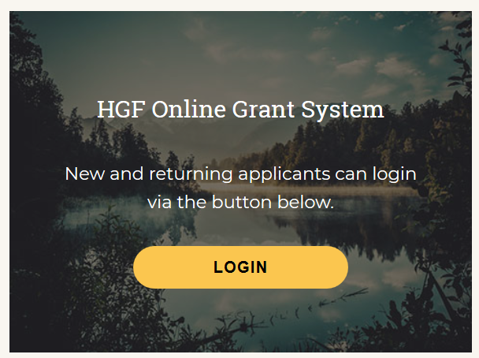
Grant Administration: How to submit pledges/payment support
  To submit Build Your Match 1 documentation, please log into the Online Grant System:
Scroll to the bottom of the JCamp 180 website home page:
www.jcamp180.org

Slide 34
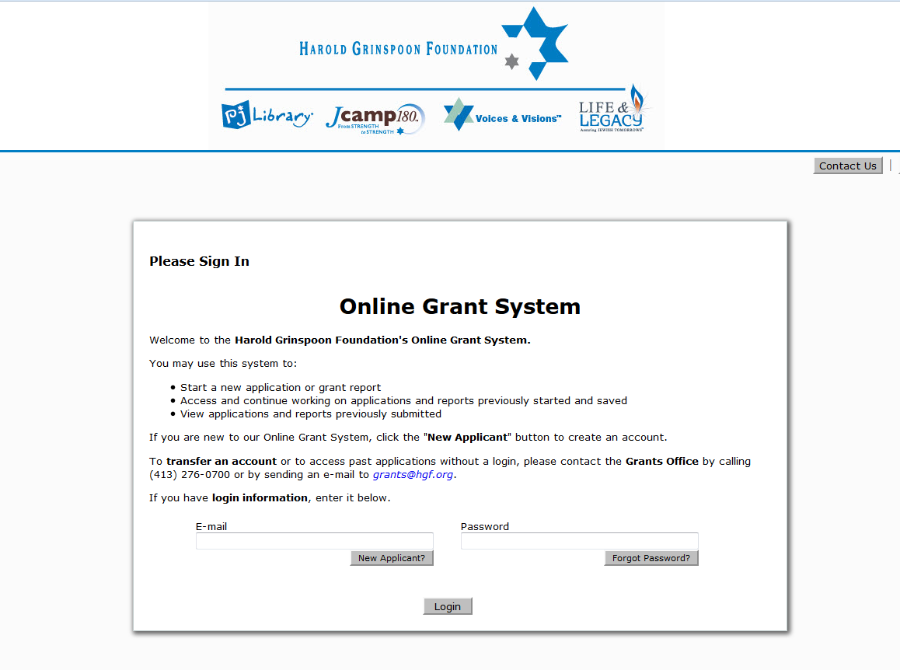
Grant Administration: How to submit pledges/payment support
*Log in using the same email and password used to complete the Build Your Match 1 application

Slide 35
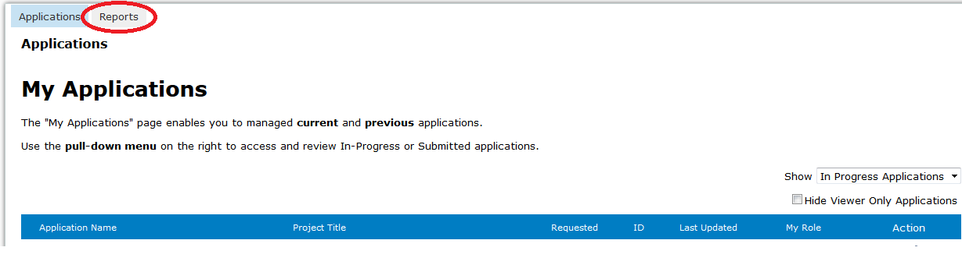
Grant Administration: How to submit pledges/payment support
To submit pledges, select “Reports”

Slide 36
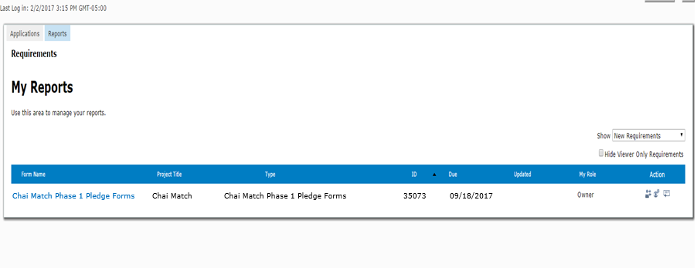
Grant Administration: How to submit pledges/payment support
Click on the Build Your Match 1 link to make a submission
Build Your Match Phase 1 Pledge Forms BYM ! Phase 1 Pledge Forms

Slide 37
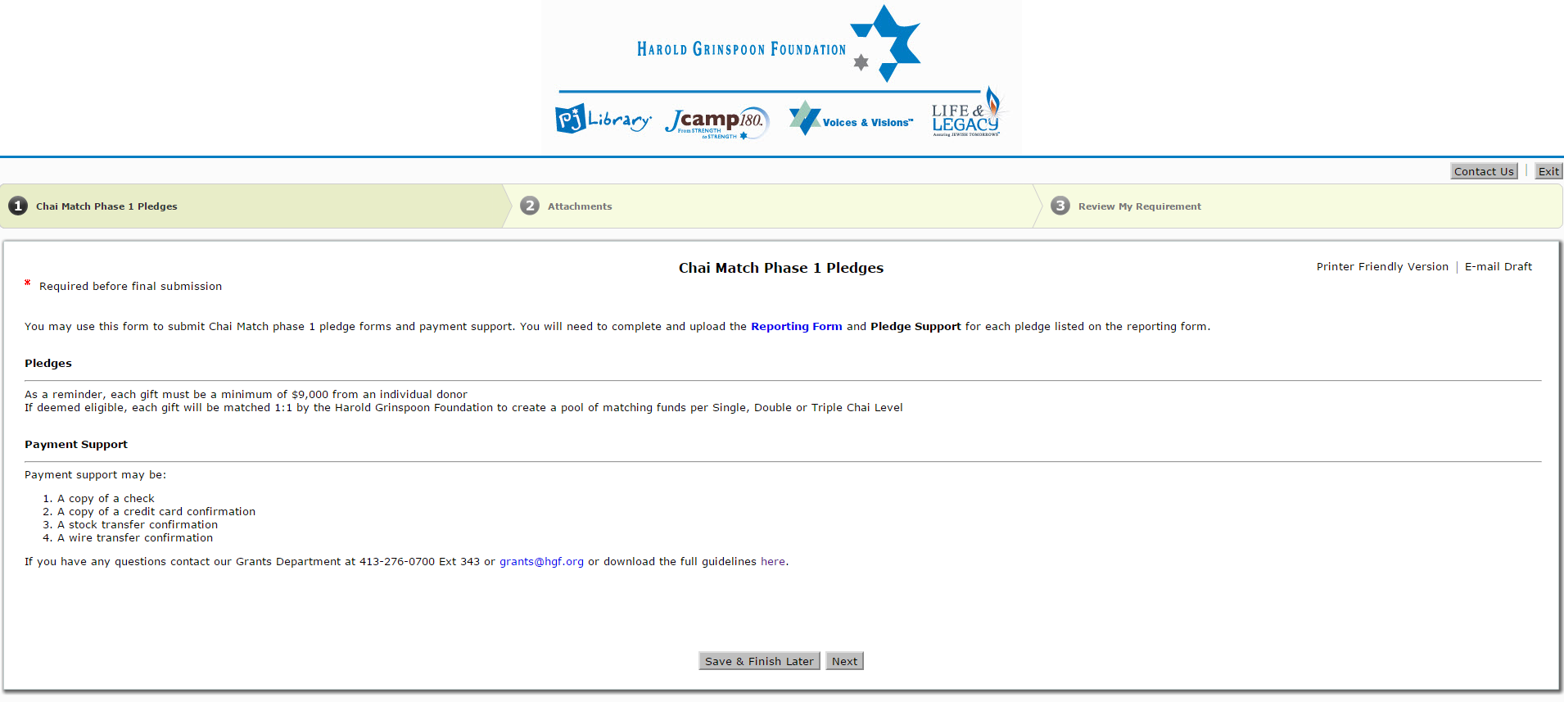
Grant Administration: How to submit pledges/payment support
From there you will be brought to the first of three pages in which you will follow the step by step directions to upload and submit the documentation
Build Your Match 1 Pledges

Slide 38
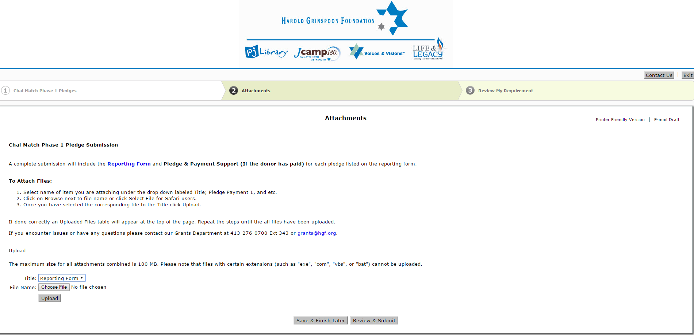
Grant Administration: How to submit pledges/payment support
In Step 2 you upload your attachments
Build Your Match Phase 1 Pledge Submission

Slide 39
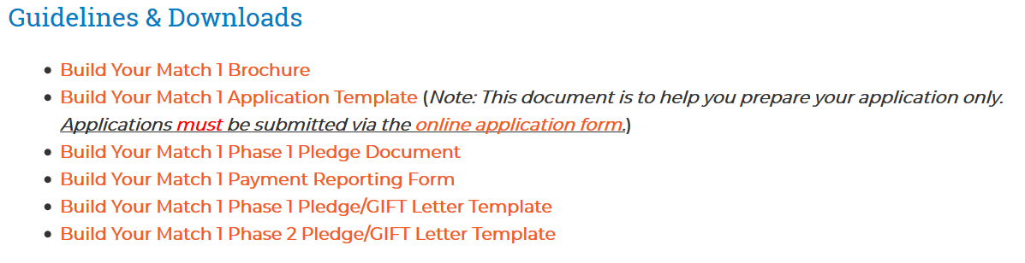
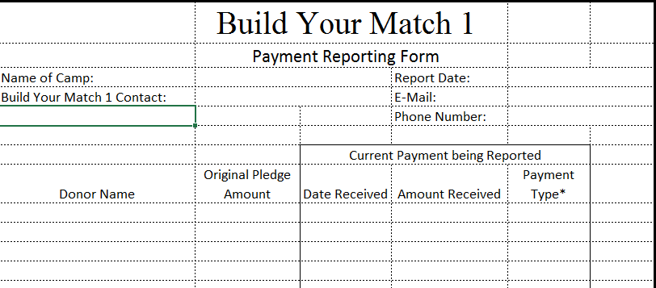
The Reporting Form template can be found on the Build Your Match 1 webpage on the JCamp180 website
Grant Administration: How to submit pledges/payment support

Slide 40
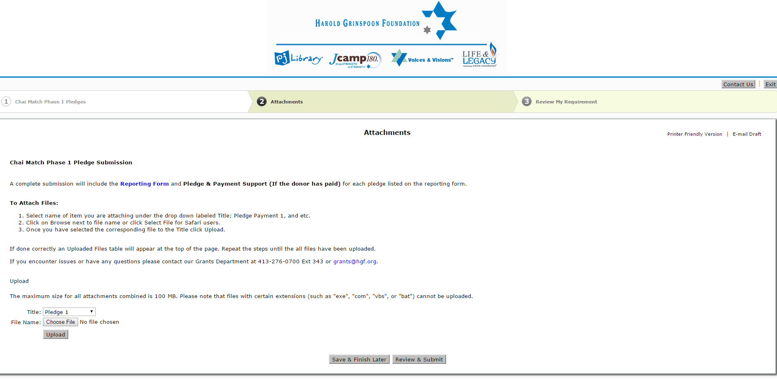
Grant Administration: How to submit pledges/payment support
After the Reporting Form has been uploaded, upload the Pledge form
Build Your Match Phase 1 Pledge Submission

Slide 41
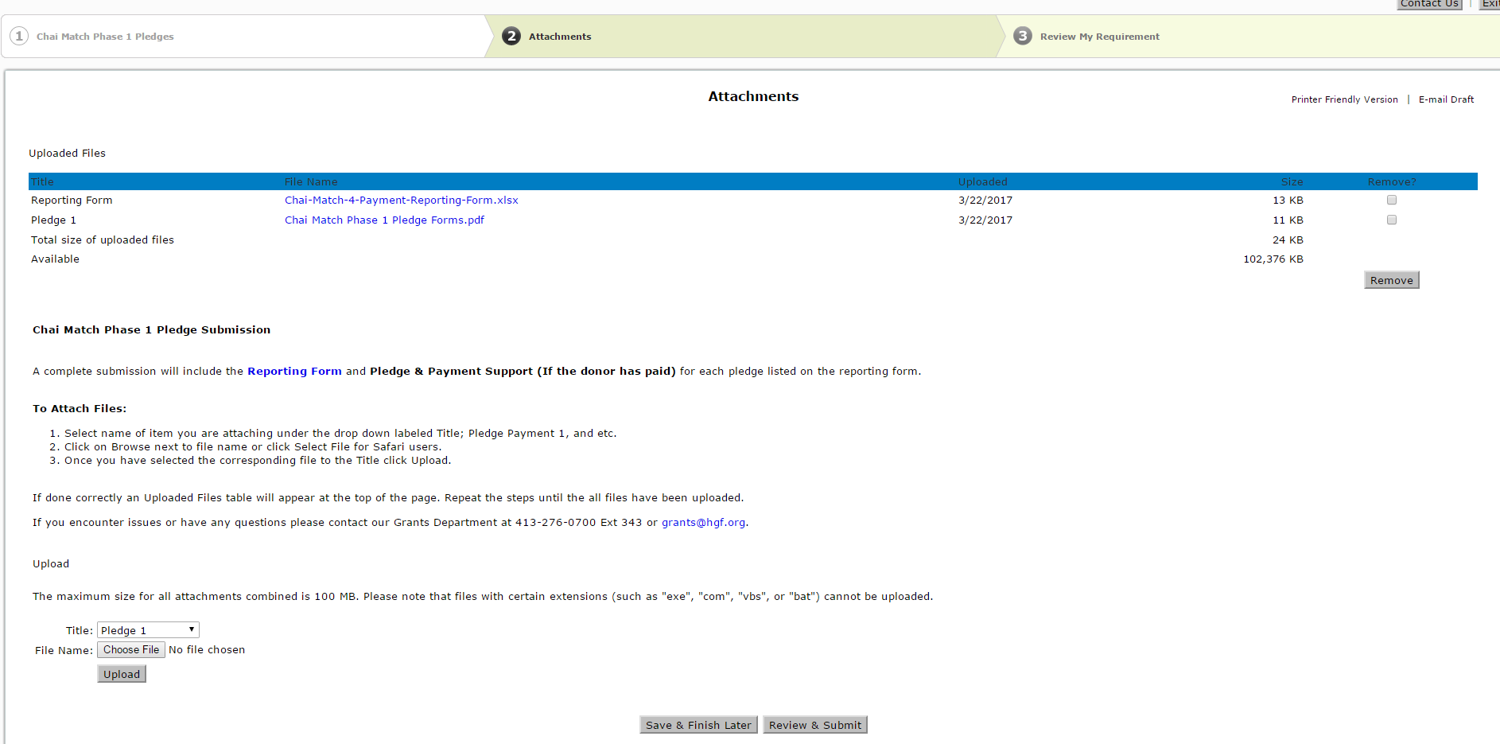
Grant Administration: How to submit pledges/payment support
Once you have uploaded the documents, they will appear on this page
Build Your Match 1 Payment-Reporting-form.xlsx
Build Your Match 1 Pledge Forms.pdf
Build Your Match Phase 1 Pledge Submission
To attach additional payment support, select Choose File, browse for and upload the file

Slide 42
Grant Administration: How to submit pledges/payment support
Build Your Match 1 Payment-Reporting-form.xlsx
Build Your Match 1 Pledge Forms.pdf
Build Your Match Phase 1 Pledge Submission
Once you have uploaded all of the documentation to be submitted, please select “Review and Submit”

Slide 43
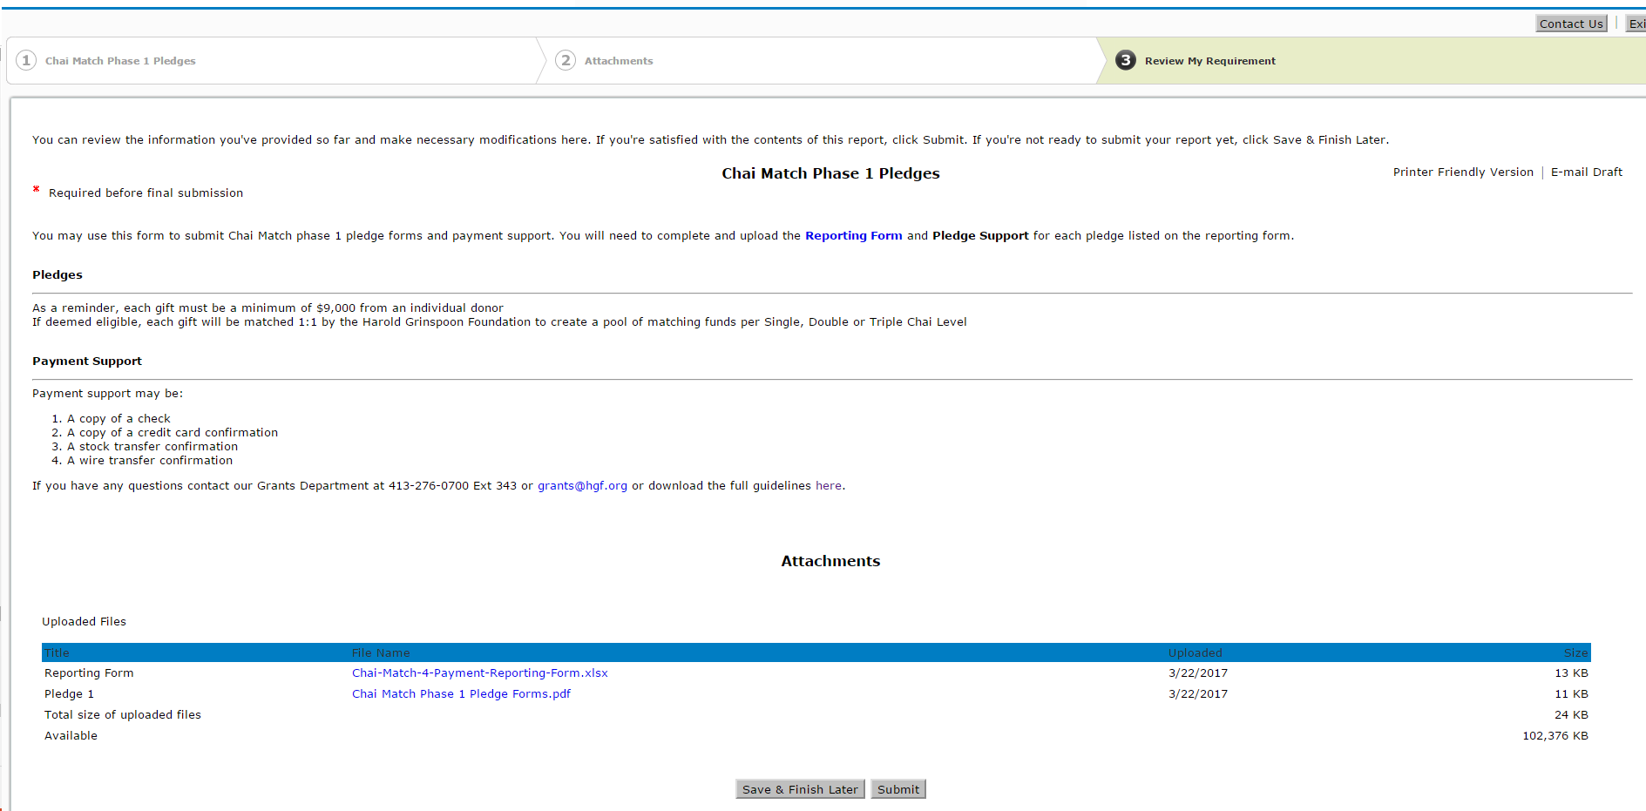
Grant Administration: How to submit pledges/payment support
Build Your Match Phase 1 Pledges
Step 3 ends on the final page, where you will select “Submit” to send the documentation to the grants administration team for review
Build Your Match 1 Payment-Reporting-form.xlsx
Build Your Match 1 Pledge Forms.pdf

Slide 44
Grant Administration:
For any questions regarding the Online Grant System, please email us at Grants@hgf.org

Slide 45
Time Table:
General Timetable
Campaign Announcement | April 9, 2018
Applications Open | April 16, 2018
Pre-application webinar | May 17, 2018
Applications Due | June 1, 2018 5:00 PM PDT
Camps notified of decision | June 15, 2018
Webinar for Accepted Camps | June 21, 2018
First HGF Matching payments released | September 1, 2018

Slide 46
Notifications
We will send notification prior to each important deadline. Notifications will:
  be sent by e-mail
  be sent to two people at each participating camp
  be generic and not specific to your camp
  will include a reminder of the upcoming deadline
There will be only one reminder sent for each deadline
Changes to your contact information can be updated through the online portal
ON-TIME SUBMISSIONS ARE THE RESPONSIBILITY OF THE CAMP, and should not be dependent on a JCamp180 reminder

Slide 47
Questions:
Can a few major donors fulfill phase 1 and
phase 2 and finish the whole campaign quickly?
What do you mean by encouraging participants to plan for unpaid pledges?
No, not with this program. We are requiring camps to use the campaign to reach out to more alumni and camp supporters and increase the base of philanthropic support for camp.
Minimum number of donors:
Phase 1: 3 donors of $25,000+
Phase 2: 18 donors of $25,000+
Maximum number of donors:
Phase 1: 3 donors of $25,000+
Phase 2: 300 donors of $1,500
If you solicit and receive three pledges of $25,000, thereby fulfilling phase 1, and after December 31, 2018 (the end of the phase 1 pledge deadline) one of the pledges is not paid, you are unable to go back and replace that pledge with a new pledge / gift. But, if you solicit FOUR gifts of $25,000 or more before the 12/31/18 phase 1 deadline, we will designate one of these gifts as a Phase 1 alternate gift. This gift will nominally qualify as a phase 2 gift but will be converted to a phase 1 gift if one of the other four phase 1 gifts are not realized to the $25,000 level.

Slide 48
Questions:
What is the exception for releasing matching funds based on the $1,500 minimum payment of a phase 2 pledge?
Donors who agree to fund their pledge through a recurring (monthly) credit card payment will have their donations matched on a quarterly basis before they meet the $1,500 minimum gift level.
For example, a $1,500 donor who agrees to donate $50 per month for 30 months, will have their donations matched after the first three months of donations ($150) rather than wait for the minimum phase 2 gift to be paid. Each quarterly payment will include the JCamp 180 match for that period’s credit card donations. The only requirement is that the recurring credit card payment be of sufficient amount to have the minimum $1,500 phase 2 gift contributed to the camp by the end of the phase 2 pledge payment period (June 30, 2021). From an operational standpoint, this is a $50 per month gift.

Slide 49
Legal Disclaimers
This webinar is considered illustrative only. Although we have intended to fairly and accurately represent the Build Your Match 1 program, the full rules and requirements for the Build Your Match 1 matching grant program are outlined in the Build Your Match 1 matching grant program brochure available at www.jcamp180.org
The Harold Grinspoon Foundation and JCamp180®, a program of the Harold Grinspoon Foundation, reserve the right to change the terms and conditions and/or terminate Build Your Match 1 at any time.
Participating camps are responsible for meeting all requirements for documentation submission as outlined in this presentation and the Build Your Match 1 matching grant program brochure. This responsibility is for both submission dates and materials required to qualify for matching funds.

Slide 50
Your Questions:
QUESTIONS?

Slide 51
Build Your Match 1
Program Overview
June 21, 2018
Mark Gold Kathleen Rodowicz
Director, JCamp 180 Grants Administrator
Mark@hgf.org Kathleen@hgf.org
413-276-0777 grants@hgf.org
413-276-0719

